Slide 1
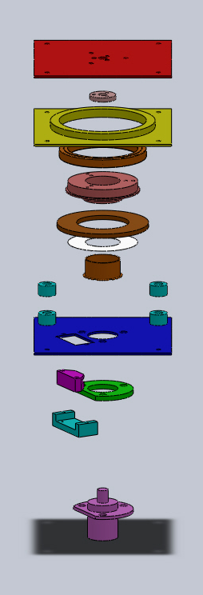
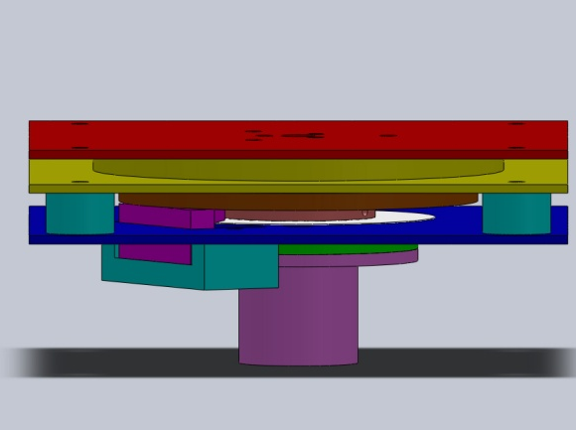
Spinner Assembly: Design Review
Payload Mounting Plate
Flexible Coupling Attachment
Bearing Housing
Multi-Load Bearing
Hollow Shaft
65 Tooth Steel Gear 65mm PD
2500 Tick Encoder Disk
Insert
Spacers
Bus Cover Plate
Optical Encoder
Not Shown:
-Micro DC Motor
-15 Tooth Brass Gear 15mm PD
-Small Gear Mounting Collar
-Flexible Coupling
Slip Ring Spacer
Encoder Mounting Bracket
Slip Ring
Notes:
Type notes here

Slide 2
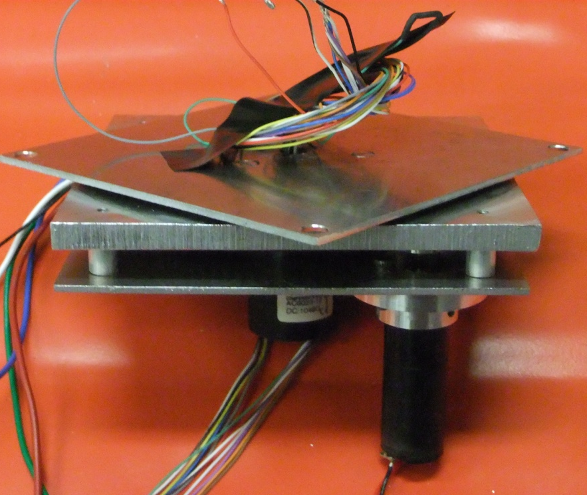
Spinner Assembly: Final Model
Specifications
  Max Angular Velocity: 1.7 Hz
  Motor Controller: Pololu QiK TTL Interface
  Slip Ring Channels: 12
  Dimensions (Interface Space): 100mm x 100mm x 18mm

Slide 3
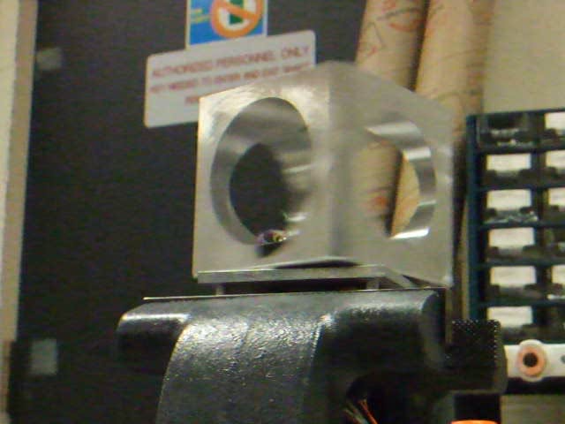
Spinner Assembly: Demonstration

Slide 4
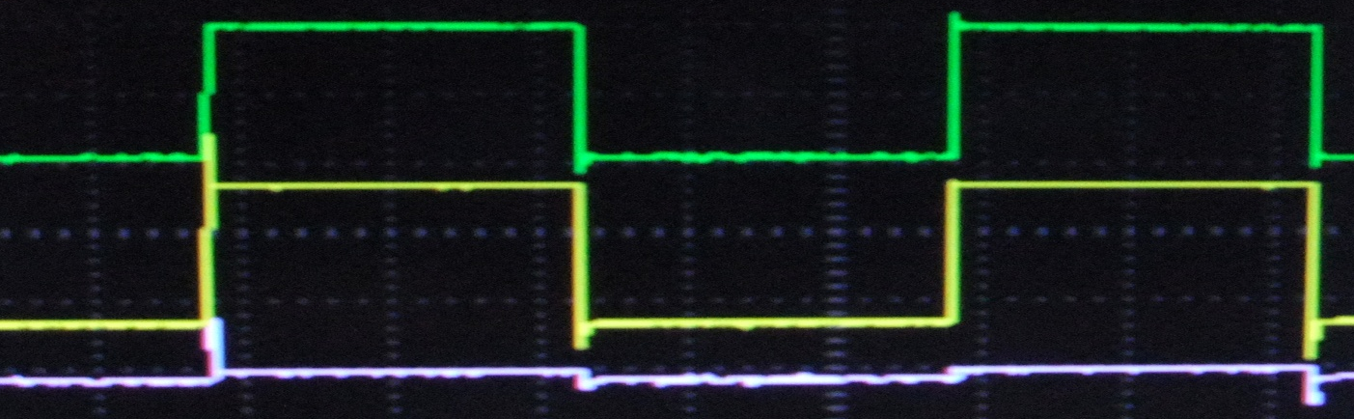
Spinner Assembly: Qualitative Testing
Setup:
Signal Generator
-Sine Wave
-Square Wave
Oscilloscope
Spinner Assembly rotating at 1.7Hz
Sample Square Wave Output (10 Volts/div, 1kHz):
Transmitted Signal
Input
Difference

Slide 5
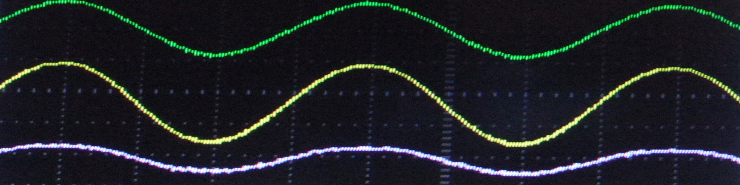
Spinner Assembly: Qualitative Testing
Results:
  Noticeable signal distortion appears at frequencies >1 KHz
  Significant signal distortion appears at signal frequencies >1 MHz
Conclusion:
  LL serial transmission rate: 70 KHz
  Problems due to signal distortion will be minimal
5 MHz Sine Wave
Transmitted Signal
Input
Difference

Slide 6
Spinner Assembly: Quantitative Testing
Setup:
Serial TX
Serial RX
Computer
Spinner Assembly rotating at 1.7 Hz
Results:
  1,000,000 bytes sent; 0 errors
  Error probability <0.0000054 with 99% confidence
Conclusion:
  Slip ring interface is suitable for serial data transfer
Notes:
Type notes here

Slide 7
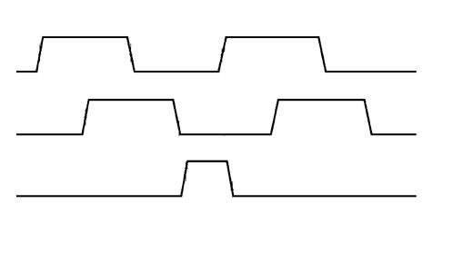
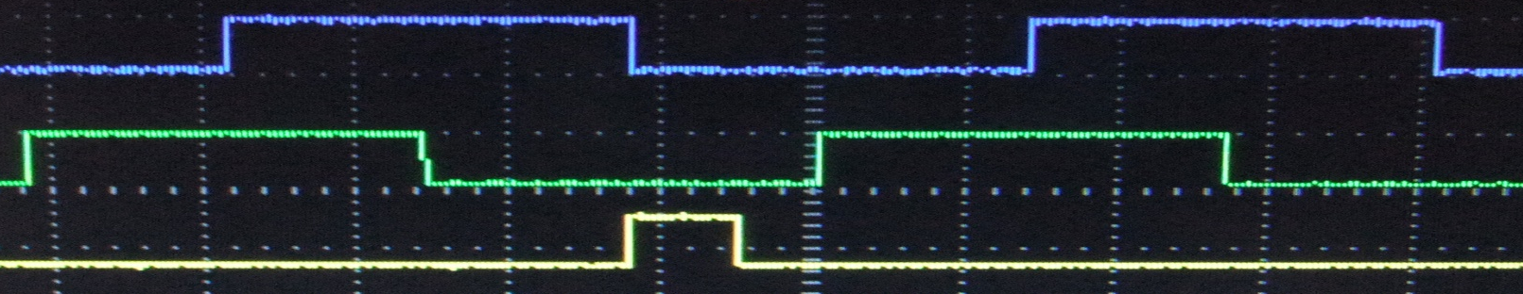
Spinner Assembly: Encoder Testing
Relative roll angle between the bus and payload is given by an optical encoder with 2 arc minute accuracy
US Digital Sample Timing Characteristics
Channel A
Channel B
Index
Observed Timing Characteristics
Channel B
Channel A
Index

Slide 8
Spinner Assembly: Summary
Spinner Assembly redesign was successful
Meets volume, data transmission and pointing knowledge requirements
Next Step: Selection of Space Rated Components

