Slide 1
Ethnic Divisions in Iran
17.523 Ethnic Conflict In World Politics
Matthew Houston

Slide 2

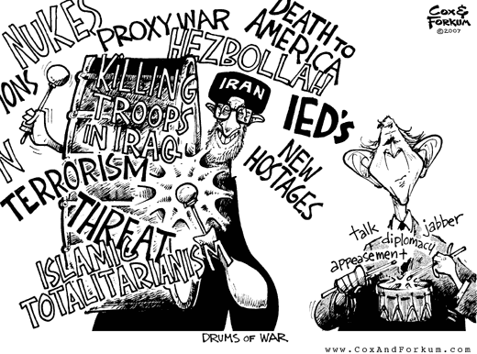
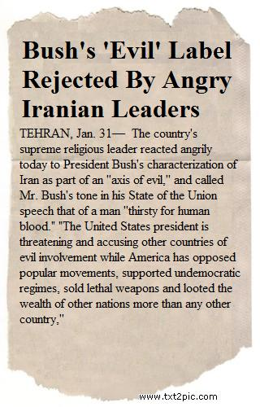
Iranian Ethnic Divisions Matter

Slide 3
The Numbers
The Iranian Census does not collect information regarding ethnicity
United States Government estimates vary significantly
Iran’s Ethnic Groups
Library of Congress Country Profile
CIA World Fact Book

Slide 4
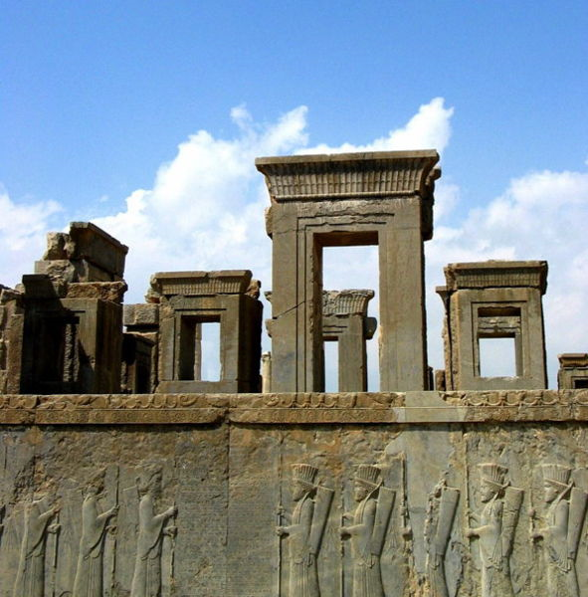
Persians
Persians form a majority in Iran
The official language of Iran is Persian (Farsi) and areas populated predominantly by Persians tend to be more developed.
Preferential government treatment has reinforced a sense of entitlement among Persians.
Photo by Asana Mashouf
An ancient Persian Monument

Slide 5
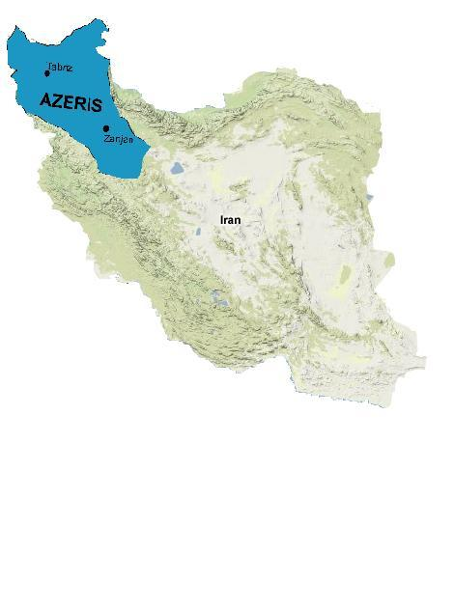
Azeri
Sources agree that the Azeri are Iran’s largest ethnic minority
The Azeri have ties to Azerbaijan and their native language is in the Turkic family
Azeri are not subject to wide spread discrimination, but some feel that the state belittles their cultural heritage.
The Supreme Leader is an Azeri

Slide 6
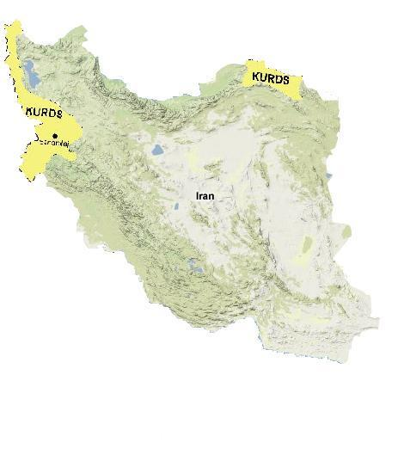
Kurds
Iranian Kurds live mainly in the mountains of Northern Iran
The Kurds are unique because unlike other ethnic groups in Iran they have a separatist movement
The Kurds have traditionally been treated reasonably (given the above), but the situation has become more tense in recent years

Slide 7
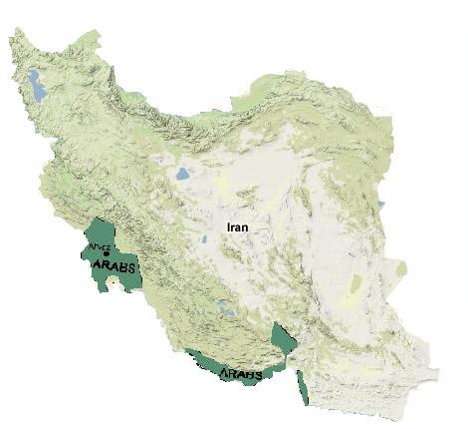
Arabs
Arabs have an extremely strong family based culture based around male patriarchs.
In the past there has been relatively little discrimination against Arabs
Sunni-Shiite Tensions within the Iranian Arab ethnic group have resulted in brief uprisings

Slide 8
Notes on Religion
The official Iranian religion is Islam
The Iranian constitution offers religious protection to Christians and Jews, but not members of the Baha’i faith.
Religious discrimination is a factor in most human rights complaints with discrimination against the Baha’i being extremely common
Tension between Iran’s government and Israel has created a tense situation for Iranian Jews despite constitution protections.

Slide 9
A Brief History of Modern Iran
1975-1985
1979 - Protests force the Shah to leave Iran, despite US support and Ayatollah Khomeini comes to power. A new constitution which significantly restricts the rights of women and religious minorities is ratified.
Summer 1979 – Ethnic groups violently protest the lack of autonomy under the Islamic State
1980 – The Iran-Iraq war begins.
1980-1981 – The Iranian hostage crisis.
1983 – The right to assemble is revoked for members of the Baha’i faith.
1975
Present

Slide 10
A Brief History of Modern Iran
1985-1995
1988 – The Iran-Iraq war ends
1993-1998 – 5 Jews are accused of spying for Israel and executed
The political climate remains relatively constant
1975
Present

Slide 11
A Brief History of Modern Iran
1995-2005
1995 – President Clinton imposes sanctions on Iran
1999 – Turkey’s arrest of Abdullah Ocalan sparks separatist violence among Iran’s Kurdish population
2002- President Bush labels Iran, Iraq, and North Korea, “The Axis of Evil”
2005- A Kurdish boy is shot leading to clashes between Kurds and Iranian security forces.
1975
Present

Slide 12
A Brief History of Modern Iran
2005-Present
2006 - A political cartoon comparing Azeris to cockroaches causes violent protests.
2006 – Iranian Arabs clash with the police over demands for independence.
2007- Iranian security forces arrest Azeri activists.
1975
Present

Slide 13
Questions?

