Slide 1
Potential Ethnic Conflicts In Iran
17.523 Ethnic Conflict In World Politics
Matthew Houston

Slide 2
Possible Conflicts
Focusing on the Persian/Azeri alliance, the Kurds, the Arabs, and the Baloch, there are 7 potential conflicts.
Persians/Azeris
Kurds
Arabs
Balochs

Slide 3
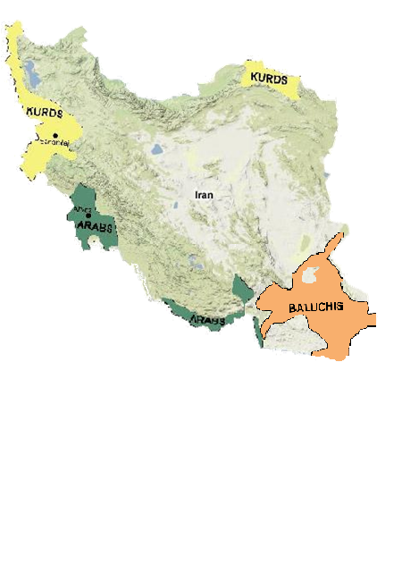
Conflict Between Minority Groups
Conflict between minority groups (Kurds, Arabs, and Balochs) is unlikely.
These groups are geographically isolated, electorally insignificant, and don’t compete for resources.
Persians/Azeris
Kurds
Arabs
Balochs

Slide 4
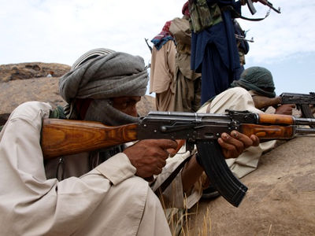
Persian/Azeri-Baloch Conflict
Balochistan is one of the least developed regions in Iran—Unemployment is rampant.
A strong nationalist movement has participated in almost constant violence against the Iranian state including attacks against the Revolutionary Guard.
Persians/Azeris
Kurds
Arabs
Balochs
Baloch extremists (www.balochwarna.com)

Slide 5
Persian/Azeri-Baloch Conflict
Pakistan supports Iran’s repression of the Baloch and has participated in military crackdowns.
In 2007 Iran built a military base in Balochistan emphasizing the violent character of the Baloch-Persian/Azeri conflict.
Potential for Violent Conflict: High
Low
Medium
High

Slide 6
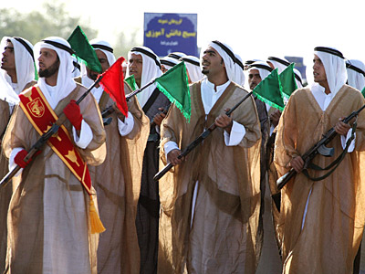
Persian/Azeri-Arab Conflict
Although Arab nations tend to distrust Iran, Iranian Arabs enjoy good relations with the Persians and Azeris.
Cultural similarities including a shared religion and strong family loyalties, further strengthen ties between the two groups.
Persians/Azeris
Kurds
Arabs
Balochs
Iranian Arab members of Iran’s military
(www.skynews.com Iran’s Military Might Photo Gallery)

Slide 7
Persian/Azeri-Arab Conflict
External pressures, especially from Arabs in Iraq, have increased tensions since Operation Iraqi Freedom.
Iranian Arabs occupy oil rich territories, which has caused tension in the past and will likely continue to do so in the future.
Potential for Violent Conflict: Medium-Low
Low
Medium
High

Slide 8

Persian/Azeri-Kurdish Conflict
Iran’s Kurds are active participants in the political process and are often associated with the reform movement.
Differential modernization exists with the Kurds living primarily in rural areas.
Culturally the Kurds are at odds with the Persian/Azeri block due to religious differences (Kurds practice Sunni Islam; The government religion is Shiite Islam)
Persians/Azeris
Kurds
Arabs
Balochs
Democratic Party of Iranian Kurdistan’s Logo (www.pdki.org)

Slide 9
Persian/Azeri-Kurdish Conflict
Historically the Kurds have become violent when the central government is weak or threatened.
International pressures are mixed. The United States desires regional stability and is unlikely to support a Kurdish rebellion. Israel is rumored to have programs designed to exploit ethnic fissures between the Kurds and Iran’s government.
Potential for Violent Conflict: Medium-High
Low
Medium
High

Slide 10
Persian-Azeri Conflict
The Persian Azeri alliance has been stressed, by cultural differences between the two groups (language and history).
This stress has been evidenced by several riots.
However, strong Azeri integration into Iran’s government makes violent conflict unlikely.
Potential for Violent Conflict: Medium-Low
Low
Medium
High

Slide 11
Religious Considerations
Within Iran religious affiliation is highly correlated with ethnic conflict.
Both groups with a high potential for violence (The Kurds and The Balochs) practice Sunni Islam; while, the predominantly Shiite Arabs enjoy a relatively peaceful relationship with the Persian/Azeri block.
As such it is likely that reducing ethnic violence in Iran will involve a significant religious discussion.

Slide 12
Questions?

