Slide 1
Measuring the Balmer Lines and the Proton-Deuterium Nuclear Mass Ratio via Optical Spectroscopy
Matthew Houston
Junior Lab

Slide 2
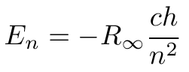
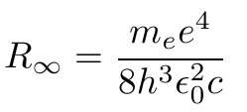

Theory: A Model of the Atom
Solving the 3D Schrödinger equation for a Coulomb potential yields energy eigenvalues:
Assuming transitions between energy states occur due to emission of photons:
Transitions with m=2 are known as the Balmer Lines

Slide 3



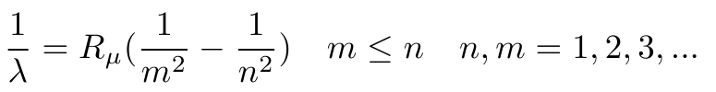

Theory: The Effects of Finite Mass
The assumption of an infinitely massive nucleus is reasonable:
Borrowing a more exact result from astrophysics:
Which when applied hydrogen and deuterium:

Slide 4
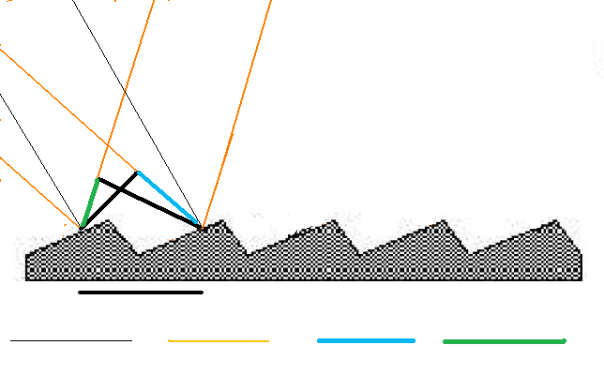


Theory: Spectrometry
By creating differences in path length, it is possible to isolate various wavelengths
Grating Normal
Light

Slide 5
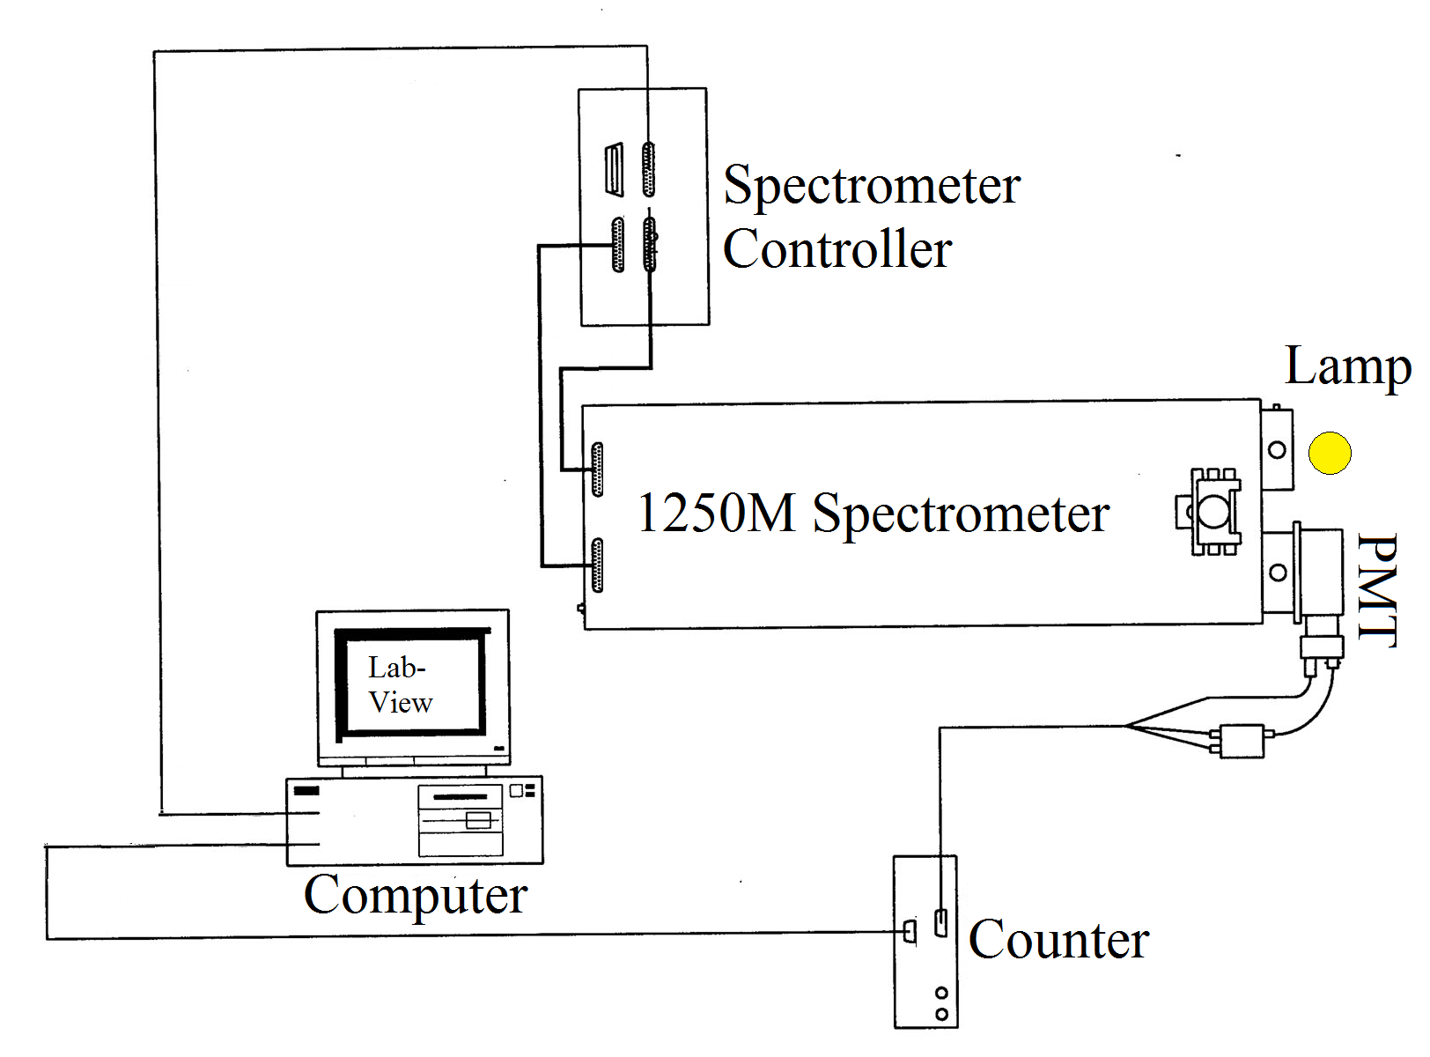
Experiment Setup: Overview
Modified from MIT Junior Lab Lab Guide http://web.mit.edu/8.13/www/JLExperiments/JLExp17.pdf

Slide 6
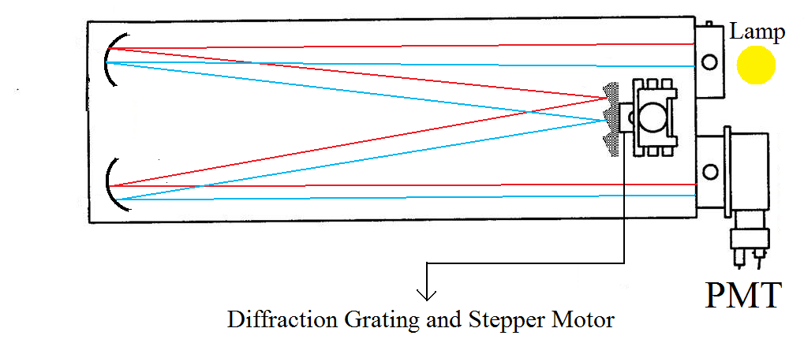
Experimental Set Up: Spectrometer
Not to Scale
Line colors do NOT indicate wavelength
Modified from MIT Junior Lab Lab Guide http://web.mit.edu/8.13/www/JLExperiments/JLExp17.pdf

Slide 7
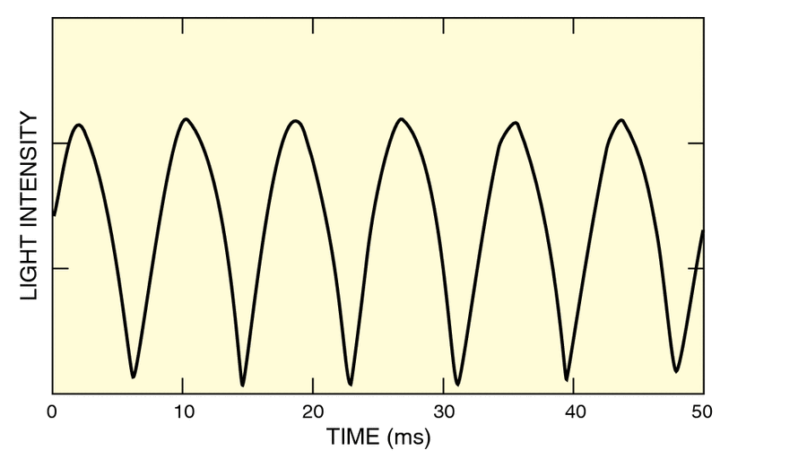
Analysis: Sources of Error
Experience from previous experiments and dark count data → Poisson counting
Time-dependent output from lamps is another source of error
Short term temporal behavior of 65010 Cesium Lamp*
*http://www.newport.com/High-Power-Spectral-Calibration-Lamps/378229/1033/catalog.aspx

Slide 8
Analysis: Overview
Spectral lines appear as peaks
These peaks can be fit to Gaussians giving a wavelength
Wavelengths from the spectrometer are in error, necessitating calibration

Slide 9
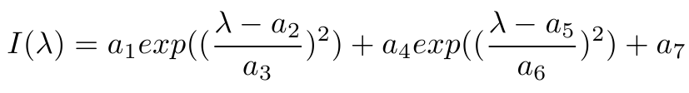
Analysis: Fitting to the Peaks
Hg, H, and D peaks are fit to a sum of Gaussians:
Chi-squared values range from 0.5-3
In the mercury spectrum, the second Gaussian accounts for doublet splitting.
In deuterium, the first Gaussian fits the hydrogen peak and the second fits the deuterium peak.

Slide 10
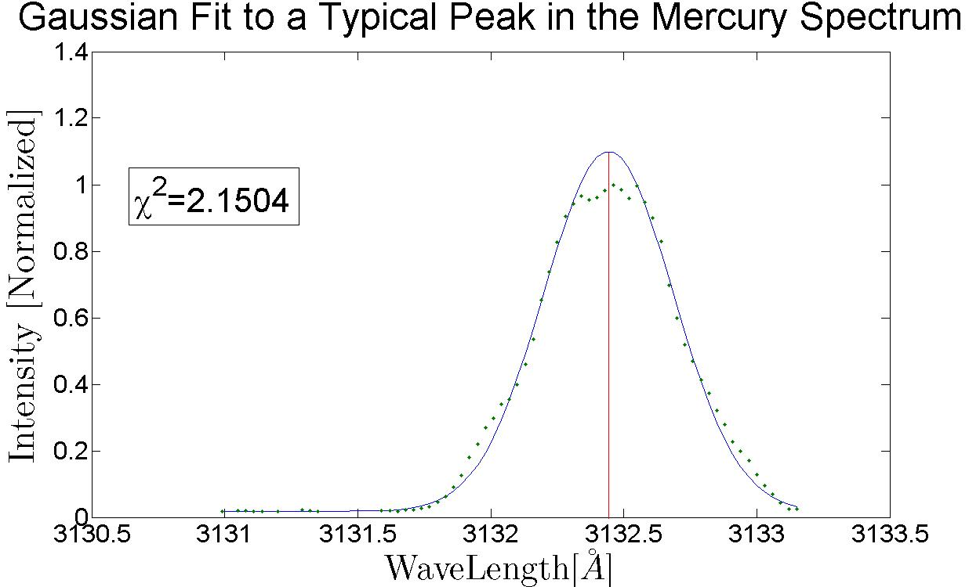
Analysis: Fitting to the Peaks

Slide 11
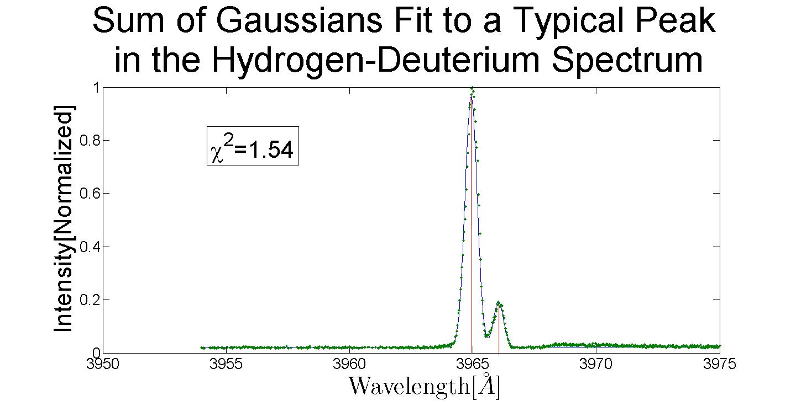
Analysis: Fitting to the Peaks

Slide 12
Analysis: The Calibration Curve
Comparing known mercury lines to observed values gives a calibration function:
This function has residuals ≈0.2 Angstroms
Quadratic term indicates a linear approximation in the spectrometer

Slide 13
Analysis: Final Steps
Once peaks are identified and fit to the calibration function gives true wavelengths
Deuterium peaks are plugged into:
First order error propagation.

Slide 14
Conclusion: The Balmer Lines
Actual [Å] | Measured [Å] | Error/σ | Rydberg‘s Result [Å]
6562.85 | 6562.66±0.18 | 1.02 | 6564.67
4861.33 | 4861.26±0.19 | 0.36 | 4862.72
4340.47 | 4340.48±0.19 | 0.04 | 4341.71
4101.74 | 4101.91±0.17 | 1.04 | 4102.92
3970.07 | 3970.29±0.21 | 1.09 | 3971.22
3889.05 | 3888.73±0.23 | 1.39 | 3890.17
Strongly supports the Quantum model of the atom
Lends credibility to the Rydberg formula

Slide 15

Conclusion: The Hydrogen Deuterium Mass Ratio
The Hydrogen Deuterium Mass Ratio was measured to be:
The actual value is 0.49996 which differs from our value by 0.207 standard deviations.
Assuming knowledge of protons and neutrons, our results suggest a 1-proton 1-neutron nucleus.

Slide 16
Conclusion: Wave Particle Duality
The spectrometer operates via destructive interference suggesting that light is a wave.
The photomultiplier tube observes distinct counts suggesting light is a particle.

Slide 17
Questions?

