Slide 1


Playing in the Sandbox
David Benjamin
Process Isolation in Google Chrome
Notes:
Hello everyone. Thank you for coming. My name is David Benjamin. Today I’d like to tell you about process isolation in Google Chrome. This is a technique used by the Chrome browser to make it more stable and lets you use the Internet more safely. So, first, what does process isolation do?

Slide 2
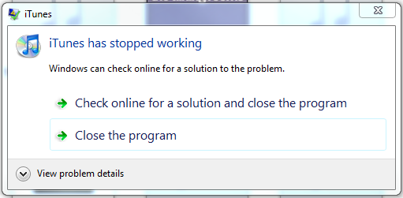
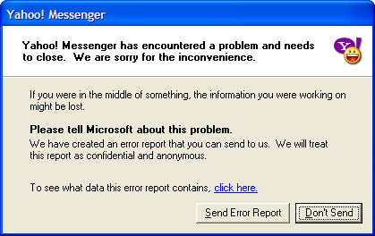
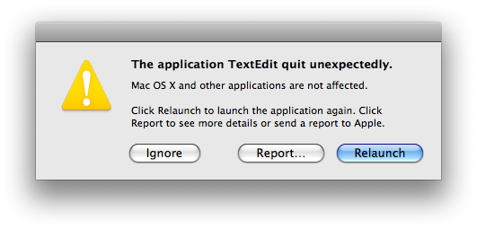
Notes:
Well, you’ve all probably seen these plenty of times. Some program crashed and you lose what you were working on. Pretty annoying. But there’s something remarkable in this picture that we take for granted today: it could have been much worse. It could have been this.

Slide 3
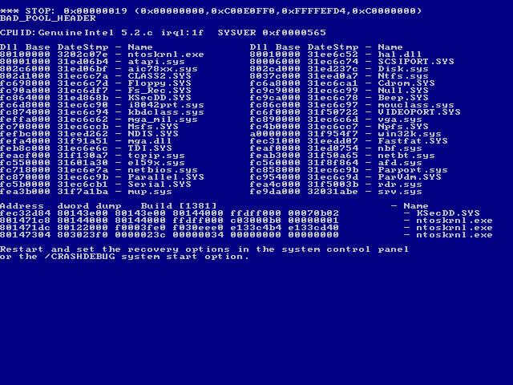
Notes:
You could have lost everything you had open. That English paper. Your music. Those chats with your friend. Instead you only lost one program. Much better than the alternative.

Slide 4
Notes:
This happens because your operating system /isolates/ all your applications from each other. A crash in one does not affect your system and other applications.

Slide 5

What if a webpage crashes?
Notes:
Now, let’s see what happened on the web before Chrome. You’ve got your mail open, maybe facebook, some video. And, uh-oh.

Slide 6
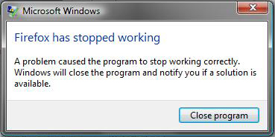
What if a webpage crashes?
Notes:
Everything’s gone. Everything you had open in your browser is lost, just because one tab broke. The desktop has solved this problem, but webpages are still fragile.

Slide 7
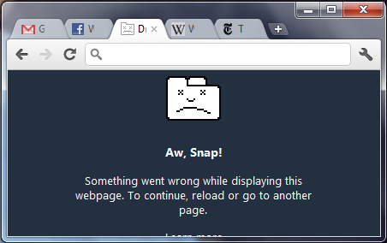
Tab isolation
Chrome brings the same isolation to webpages
One crashed tab doesn’t kill the browser
Notes:
So, Chrome brings this same isolation to the web. If one tab crashes, it is the only one affected. And yes, it really looks like that.

Slide 8
Why bother?
Crashes mean browser bugs
Why not just write correct code?
5,000,000
Notes:
So, you might ask, “why bother?”. Webpages shouldn’t crash your browser. That’s a bug. Why can’t we just write correct code?
The problem is your browser is complicated. Browsers these days have over [next] five million lines of code in them. If you printed that out, you’d use 90,000 sheets of paper, a stack 30 feet tall. You can’t write that much code and get it right. You really have to build these expecting to have bugs.

Slide 9

Playing in the sandbox
How tab isolation works
Sandboxing
Principle of least privilege
Notes:
And this is what Chrome does. I’m going to tell you about how Chrome’s tab isolation works, an additional security measure it takes called sandboxing, and the related principle of least privilege. First, how this all works.

Slide 10

Processes
Tasks organized into processes
Typically one process per application
Each process has private memory, state, etc.
Independently scheduled and killed
itunes.exe
notepad.exe
winword.exe
mspaint.exe
Operating System
Notes:
Your operating system organizes tasks into processes, typically one per application. Processes, for the most part, run independently of each other. If one process misbehaves [slide], the operating system can kill it without touching the others.

Slide 11
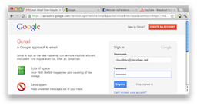
Single-process browsing
Chrome browser process
Notes:
Now, traditionally, a browser is just a single process, like any other application. So if it misbehaves, the operating system kills everything. Chrome, however, uses multiple processes.

Slide 12
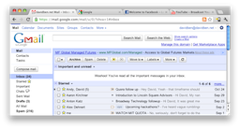


Multi-process browsing
Chrome browser process
Mouse click
Update me
Renderer
mail.google.com
Renderer
youtube.com
Renderer
facebook.com
Renderer
wikipedia.org
Notes:
In addition to the browser process which opens windows and everything, Chrome has a renderer process per page that actually figures out what the page does. It communicates with the browser by sending messages. Say you click on a page. The browser process gets the click and [next] sends a message to the renderer. The renderer may react by, say, [next] changing the picture. It then [next] asks the browser to update [next]. All your interactions with pages work this way. The browser sends messages when you do something, and the renderer sends messages when it wants to show the user something.

Slide 13
Multi-process browsing
Chrome browser process
Renderer
mail.google.com
Renderer
youtube.com
Renderer
facebook.com
Renderer
wikipedia.org
Notes:
Now, with this design, if youtube’s renderer dies, everything else still runs and the browser can keep the other tabs working, draw a sad tab, etc.

Slide 14
Multi-process browsing
Chrome browser process
Renderer
mail.google.com
Renderer
facebook.com
Renderer
wikipedia.org
Notes:
What if, however, the browser process dies? Well, then you’ve lost everything like before. But the difference is, because much of the complexity and the code that directly runs the page is in the renderer, hopefully more bugs are in the renderer, and not the browser.

Slide 15
Multi-process browsing
Each tab in a separate renderer process
Renderers coordinated by browser process
Communicate by sending messages
Renderer bugs are recoverable
  Browser process crashes are still fatal
Notes:
So, Chrome achieves tab isolation by splitting each one into a separate process with a single browser process to coordinate them. Communication is done by sending messages with the browser process in total control. Because of this separation, renderer bugs (but not browser bugs) are recoverable, and you get a more stable browser.

Slide 16
Playing in the sandbox
How tab isolation works
Sandboxing
Principle of least privilege
Notes:
So, that’s tab isolation. Now I’m going to talk about sandboxing, which lets us extend this to also be more secure.

Slide 17
Browser security
Webpages are very restricted
  Cannot read your English paper
  Cannot write a virus
  Cannot delete your files
Visiting evil.example.com should be safe
Browser enforces these restrictions
What if there is a bug?
Notes:
Pages in a browser are very restricted in what they do. They can’t read your files, install a virus, or delete things. Ideally, visiting an evil website should never be harmful to your data, because it’s not allowed to touch it. The browser enforces these restrictions. But what if there’s a bug in this code? [nod to earlier buffer overflow talk?] Then the evil site can try to exploit it and delete all your files. One bug, and you’ve lost. We should do better than that.

Slide 18
Enforcing security
Sandbox each renderer
  Can’t access files
  Internet
  Other processes
Only communicate with browser
  Performs privileged actions on behalf of renderer
  Including network access
Notes:
To improve this, Chrome sandboxes each renderer. That is, the renders don’t have access to file, other process, the network, etc. It takes away every privilege it doesn’t need. All renderers can do is ask to the browser to do things for them.

Slide 19

Enforcing security
Chrome browser process
Renderer
mail.google.com
Renderer
facebook.com
Compromised renderer
Notes:
So now, even if a renderer gets compromised, it still has to break out of the jail before it can do anything.

Slide 20
Enforcing security
Chrome browser process
?
Renderer
mail.google.com
Renderer
facebook.com
Compromised renderer
Notes:
Again though, this is limited to renderer failures, but we have this process separation and sandbox acting as a layer between the page and the browser.

Slide 21
Playing in the sandbox
How tab isolation works
Sandboxing
Principle of least privilege
Notes:
And that’s how Chrome uses tab isolation to provide better security. This is actually an instance of a more general principle in security, the principle of least privilege.

Slide 22
Principle of least privilege
Each component of your system should have only the rights it needs and no more
Limit damage when things go wrong
Fewest privileges to parts most likely to fail
Notes:
The principle of least privilege states that each component of your system should have only the rights it needs and no more. The point here is to limit damage when things go wrong. Ideally you set things up so that the parts more likely to fail, like a renderer, are also the parts with the fewest privileges.

Slide 23
Playing in the sandbox
All complex software is buggy, so design for bugs
Separate renderer process per tab
  Improved stability
  Security
Restrict renderer rights to bare minimum
Principle of least privilege
Questions?
Notes:
We’ve seen that because complex software is inherently buggy, you should design assuming things will go wrong. Chrome does this by splitting each tab into a separate renderer, which improves both stability and security. It follows the principle of least privilege to restrict renderer rights. And that’s Chrome’s multi-process sandboxing architecture. Does anyone have any questions?

