Slide 1
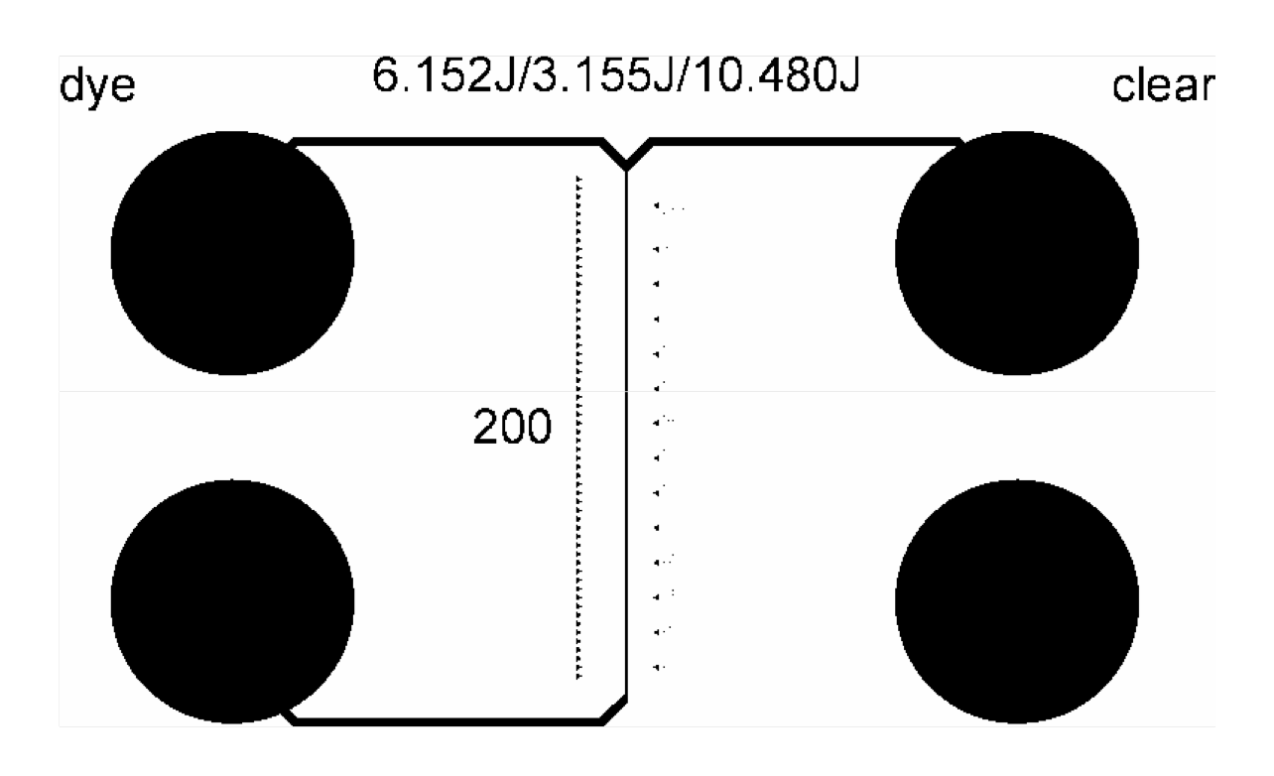
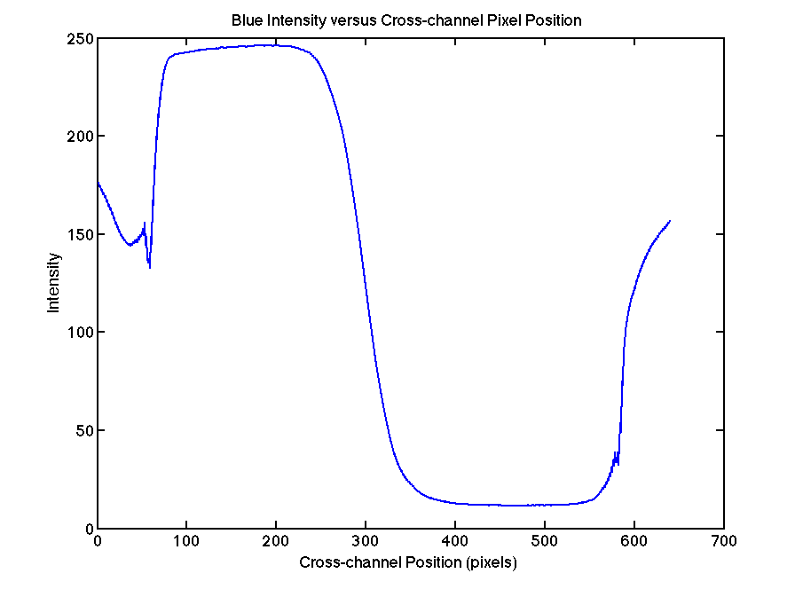
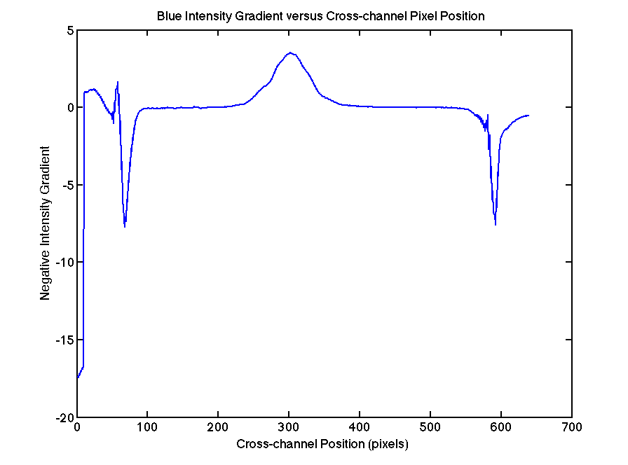
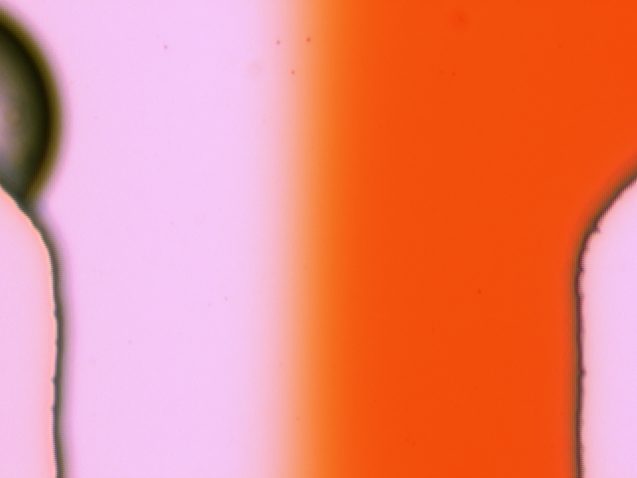
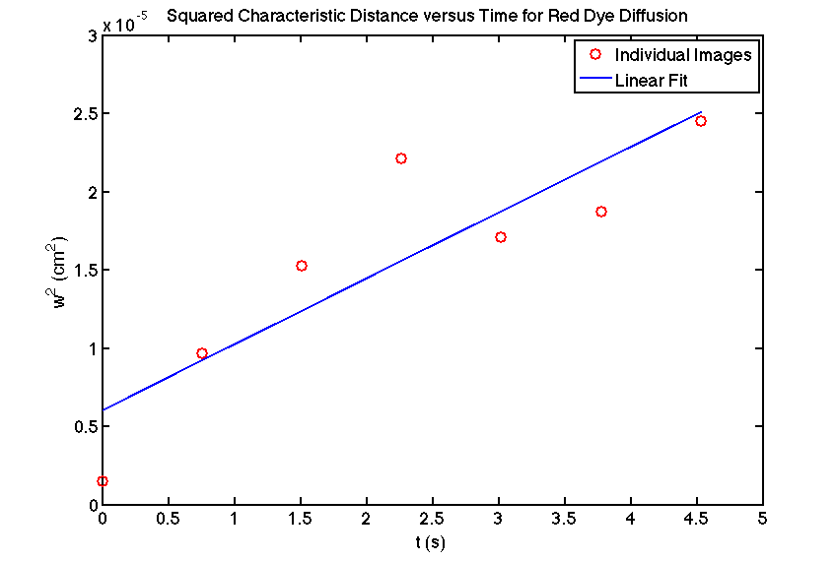
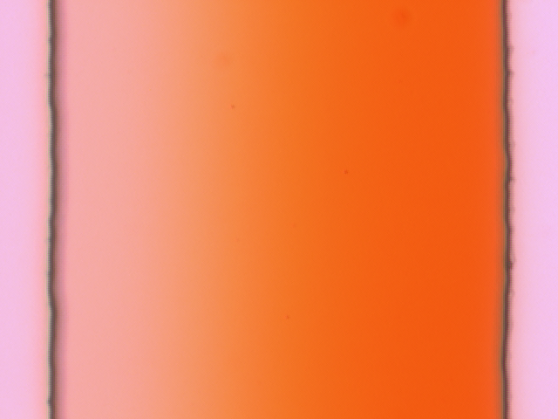
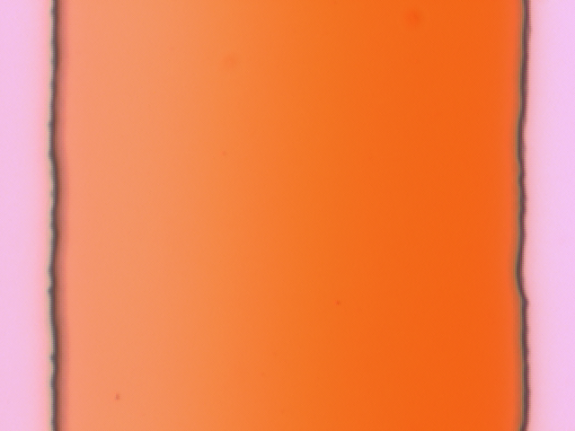

FABRICATION AND CHARACTERIZATION OF A FLUID MICROMIXER
Vikas Kumar, Chris Post
6.152 - Massachusetts Institute of Technology
To fabricate a microfluidic channel in PDMS (a polymer) with two inlets and one outlet
To experimentally determine the diffusivity of red dye in water by mixing red-colored water and colorless water as they flow through the channel
OBJECTIVES
DEVICE LAYOUT
ANALYSIS
Region of interest
FABRICATON
Artifact from channel edge
Artifact from channel edge
Si
Spin on SU-8 to approximately 40 µm
SU-8:
A photo-definable, epoxy-based, negative resist. It allows high aspect-ratio features (up to 25:1).
(a) – Intensity for 0mm image
(b) – Intensity gradient for 0mm image
RESULTS
Blue intensity in the horizontal dimension was averaged over all vertical lines in the image, and a moving average of size 10 was used to smooth the curve (example graph (a) above).
The gradient of the intensity curve was produced (example graph (b) above).
The artifacts from the channel edges were eliminated by constraining the further analysis to the “region of interest” that only contained data from within the channel.
The region of interest was normalized, and the characteristic width (w) is the width where the intensity gradient is greater than half its peak value.
UV light
Mask
Pictures were taken at 2mm intervals along the channel. The image data was used to quantitatively determine diffusivity by analyzing the intensities of the blue image component.
Si
Photolithography
0mm
Distinct clear/dyed boundary where the two inlets merge
Conclusion
Si
Develop
Experimental diffusivity is close to the theoretical diffusivity (experimental is 75.86% of theoretical).
Time t is inversely related to the flow velocity, and t is inversely related to the diffusivity D, so D is directly related to the estimated flow velocity.
Flow velocity is estimated by observing microspheres in the liquid, which may not be travelling at the full speed of the liquid, accounting for the slightly low experimental diffusivity.
Overall, the liquid flowed and mixed cleanly, and the diffusivity was close to the expected value.
Fabrication and characterization were both successful.
“Master” Mold
PDMS
4mm
Si
Pour PDMS on mold
PDMS: Poly-Di-Methyl Siloxane
A polymer; well-suited for microfluidics because of stability, bio-compatability, and ease of fabrication.
Boundary becomes less distinct and more spread out as fluids progress down the channel
PDMS
Remove PDMS after curing
8mm
(c) – Combining characteristic width data from all images
Experimental Diffusivity:
1.517 * 10⁻⁶ cm²/s
Theoretical Diffusivity:
2 * 10⁻⁶ cm²/s
Fluid Velocity:
Fluid velocity was approximated using microspheres in the flow. The fastest microspheres observed gave an estimate for the fluid velocity of 0.2648 cm/s.
D = w² / (4 ln(2) t)
slope of the linear fit in graph (c) = (4 ln(2) D)
D = slope / (4 ln(2))
tubing
Press PDMS against glass plate after plasma ashing both pieces to bond,
Insert plastic tubing
12mm
glass

