Slide 1
Risk Management Strategies
for Cave Conservancies
(Part 1)
Mitchell Berger
Risk Management Committee Chair
Northeastern Cave Conservancy, Inc.
m.berger@necaveconservancy.org

Slide 2
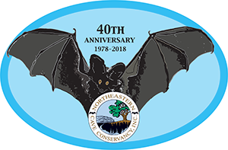
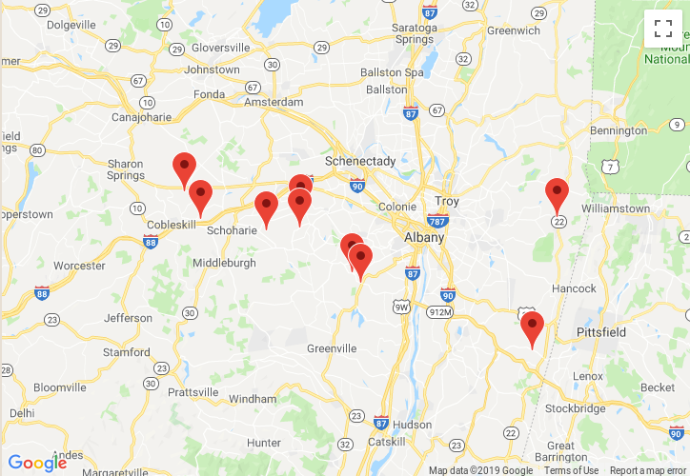
The NCC – then and now
Formed in 1978 to accept the donation of Knox Cave
Spent its first 20 years with just that one cave preserve, run by 3 people
In 1999, became a membership organization, run by a Board of Directors
Today
9 cave preserves
16 caves
90+ acres
175 members

Slide 3
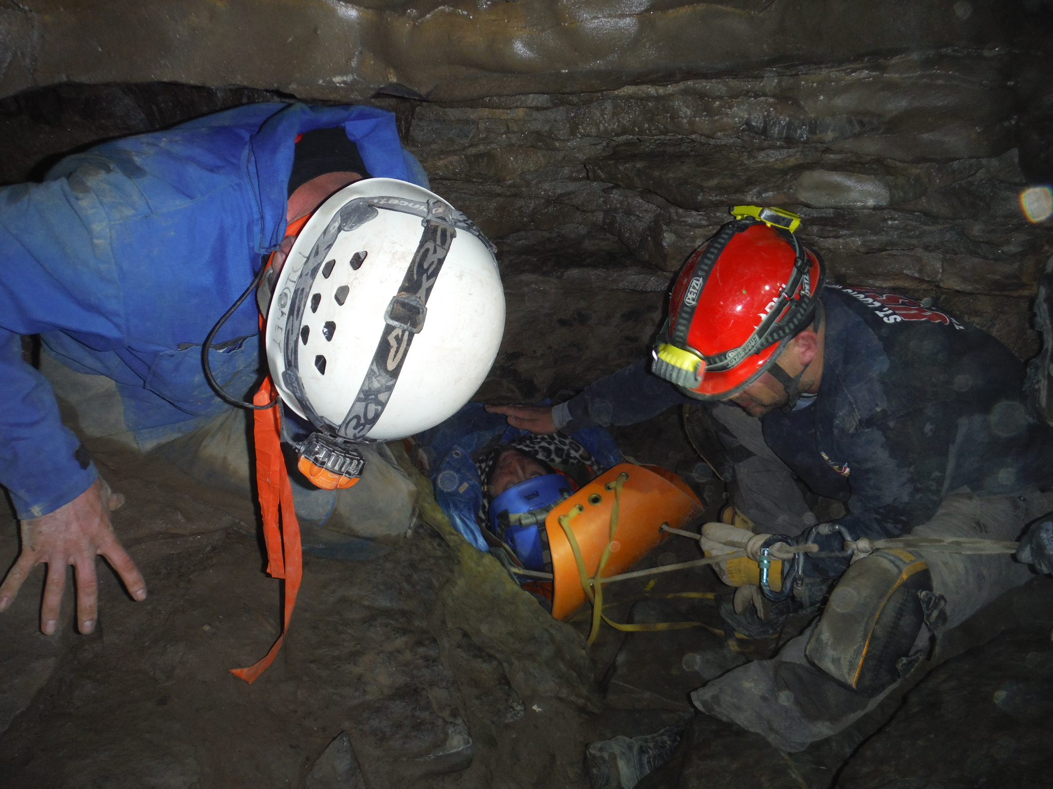
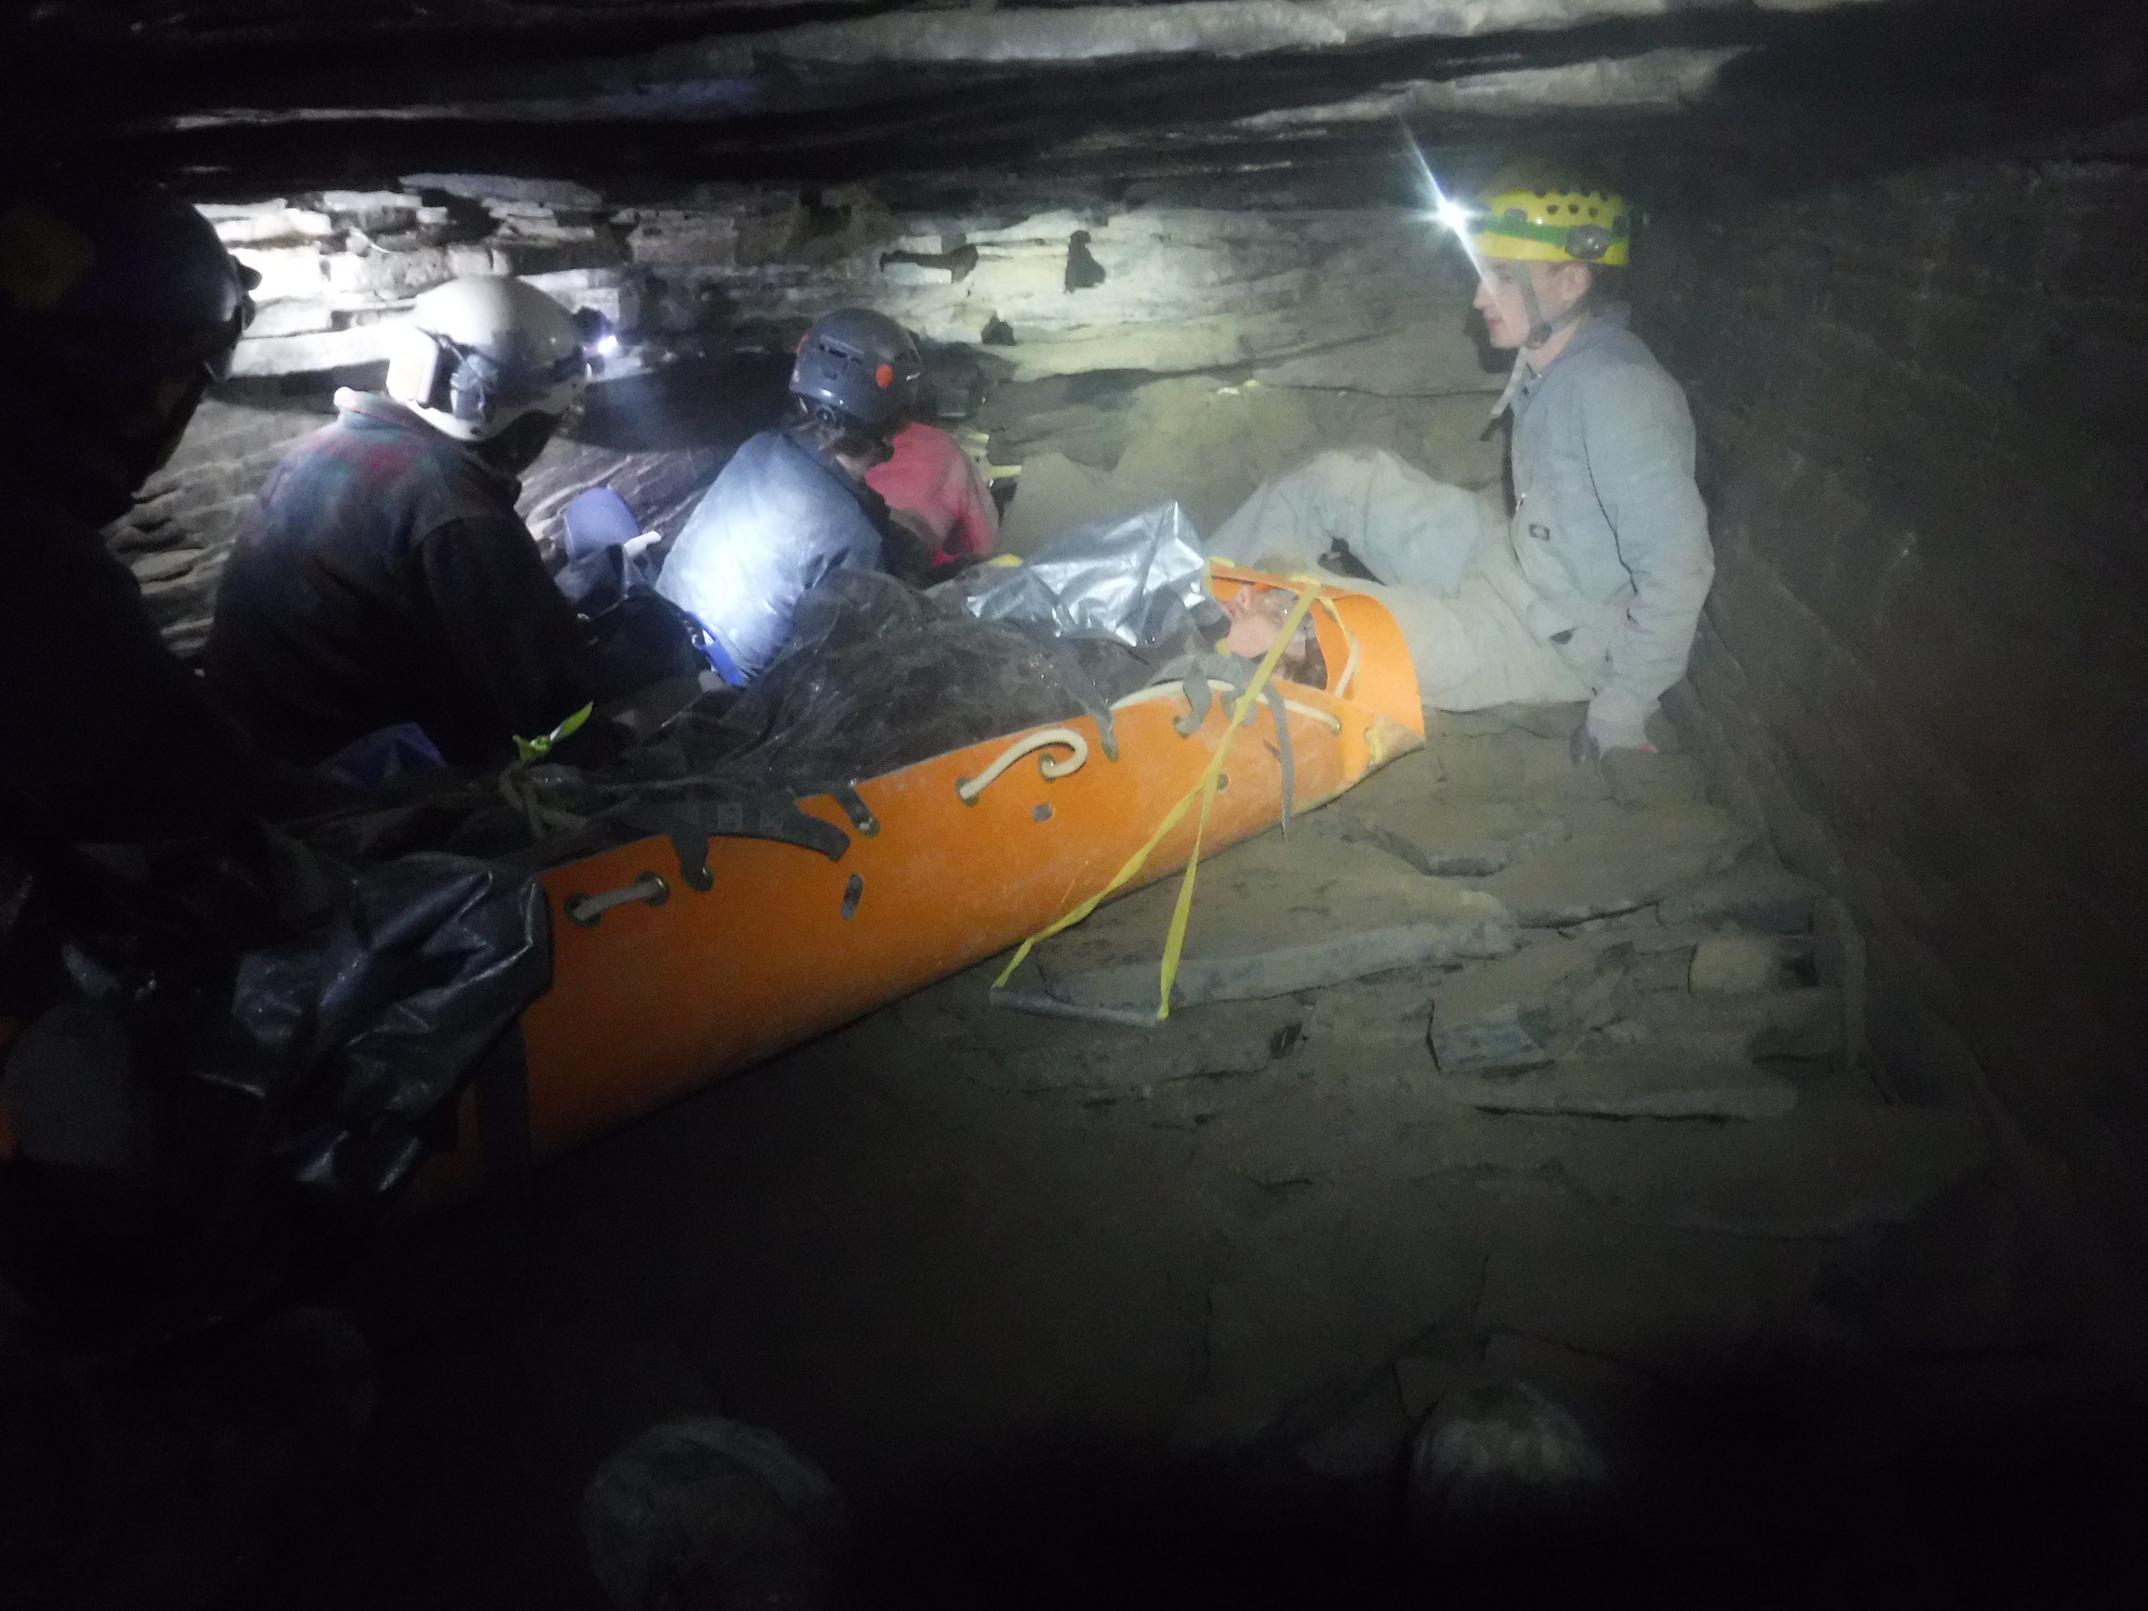
Risks of owning caves and karst
The obvious one – someone gets hurt or worse
Photo credit: Mark Dickey
... and you get sued

Slide 4
Liability – what it is
Premises liability
What duty you have to someone on your land
Laws vary by jurisdiction
May depend on what type of person was visiting
Trespasser? Licensee? Invited party?
Likely depends on what services you do or have provided
Safety training, guided trips, etc.
Almost certainly depends on whether you charge a fee
Assumption of risk
Adjusts how much of the liability is yours

Slide 5
Liability – ways to protect against it
“Sportsman's laws”
Generally free landowners of some or most of the duty they would otherwise have to a visitor, if they allow recreational use of their land
Typically only apply if no money is collected
Vary state-to-state as to which recreational activities are included
New York: “speleological activity”
Vermont: “caving”
West Virginia: “spelunking” (also Cave Protection Law)
Virginia: “for any other recreational use” (also Cave Protection Law)
your state: ???

Slide 6
Liability – ways to protect against it
Insurance
General Liability (G/L)
Insurance company provides and pays for legal representation if you get sued for something covered by the policy
Pays for damages awarded if you lose a case
You can always be sued, even if you're not liable
This costs money even if the outcome is known

Slide 7
Liability – ways to protect against it
Waivers
Visitors sign an agreement to give up some rights (typically including the right to sue you)
Assumption of risk by the visitors
Challenges to enforcing a waiver in court
How old is it?
Did the visitor truly understand what they were getting themselves into?
How much choice did they really have in signing it?

Slide 8
Liability – ways to protect against it
Conservation easements
Landowner gives up a subset of their rights to a different conservation organization
Structured such that neither the owner nor the easement holder can damage the land (or caves)
Decreases the value of the land to most other entities by eliminating its development potential (makes your organization a less attractive litigation target)
Managing the easement costs real money
Easement holder does inspections, recordkeeping, etc.
Landowner often pays for this up-front or by encumbering the land at sale time

Slide 9
End of Part 1
Please turn the deck
over to Side B
(Friday morning)
Coming up in Part 2:
Some less obvious types of risk
and ways to deal with them
What the NCC does to manage risk
and how we learned what was right for us
Resources you can use to put together a plan for your conservancy

