Slide 1
Risk Management Strategies
for Cave Conservancies
Mitchell Berger
Risk Management Committee Chair
Northeastern Cave Conservancy, Inc.
m.berger@necaveconservancy.org

Slide 2
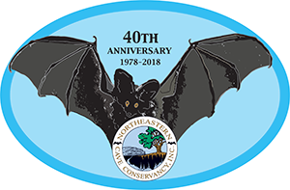
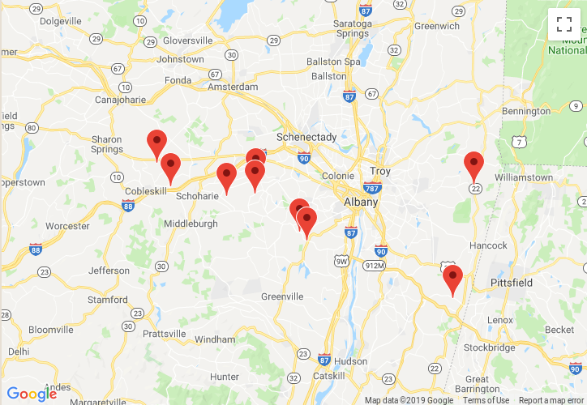
The NCC – then and now
Formed in 1978 to accept the donation of Knox Cave
Spent its first 20 years with just that one cave preserve, run by 3 people
In 1999, became a membership organization, run by a Board of Directors
Today
9 cave preserves
16 caves
90+ acres
175 members

Slide 3
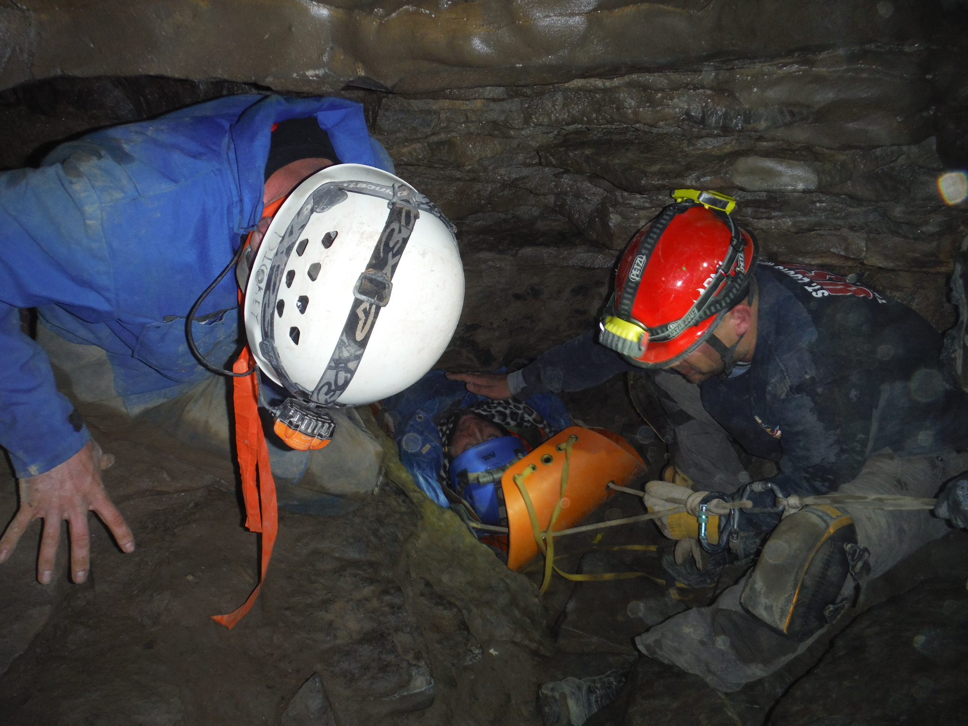
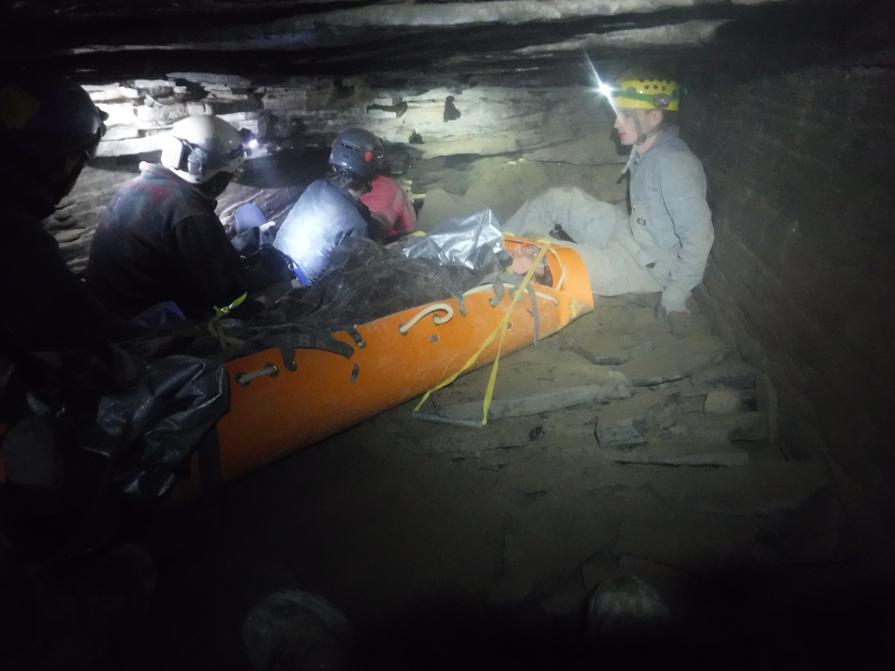
Risks of owning caves and karst
The obvious one – someone gets hurt or worse
Photo credit: Mark Dickey
... and you get sued

Slide 4
Liability – what it is
Premises liability
What duty you have to someone on your land
Laws vary by jurisdiction
May depend on what type of person was visiting
Trespasser? Licensee? Invited party?
Likely depends on what services you do or have provided
Safety training, guided trips, etc.
Almost certainly depends on whether you charge a fee
Assumption of risk
Adjusts how much of the liability is yours

Slide 5
Liability – ways to protect against it
“Sportsman's laws”
Generally free landowners of some or most of the duty they would otherwise have to a visitor, if they allow recreational use of their land
Typically only apply if no money is collected
Vary state-to-state as to which recreational activities are included
New York: “speleological activity”
Vermont: “caving”
West Virginia: “spelunking”
your state: ???

Slide 6
Liability – ways to protect against it
Insurance
General Liability (G/L)
Insurance company provides and pays for legal representation if you get sued for something covered by the policy
Pays for damages awarded if you lose a case
You can always be sued, even if you're not liable
This costs money even if the outcome is known

Slide 7
Liability – ways to protect against it
Waivers
Visitors sign an agreement to give up some rights (typically including the right to sue you)
Assumption of risk by the visitors
Challenges to enforcing a waiver in court
How old is it?
Did the visitor truly understand what they were getting themselves into?
How much choice did they really have in signing it?

Slide 8
Liability – ways to protect against it
Conservation easements
Landowner gives up a subset of their rights to a different conservation organization
Structured such that neither the owner nor the easement holder can damage the land (or caves)
Decreases the value of the land to most other entities by eliminating its development potential (makes your organization a less attractive litigation target)
Managing the easement costs real money
Easement holder does inspections, recordkeeping, etc.
Landowner often pays for this up-front or by encumbering the land at sale time

Slide 9
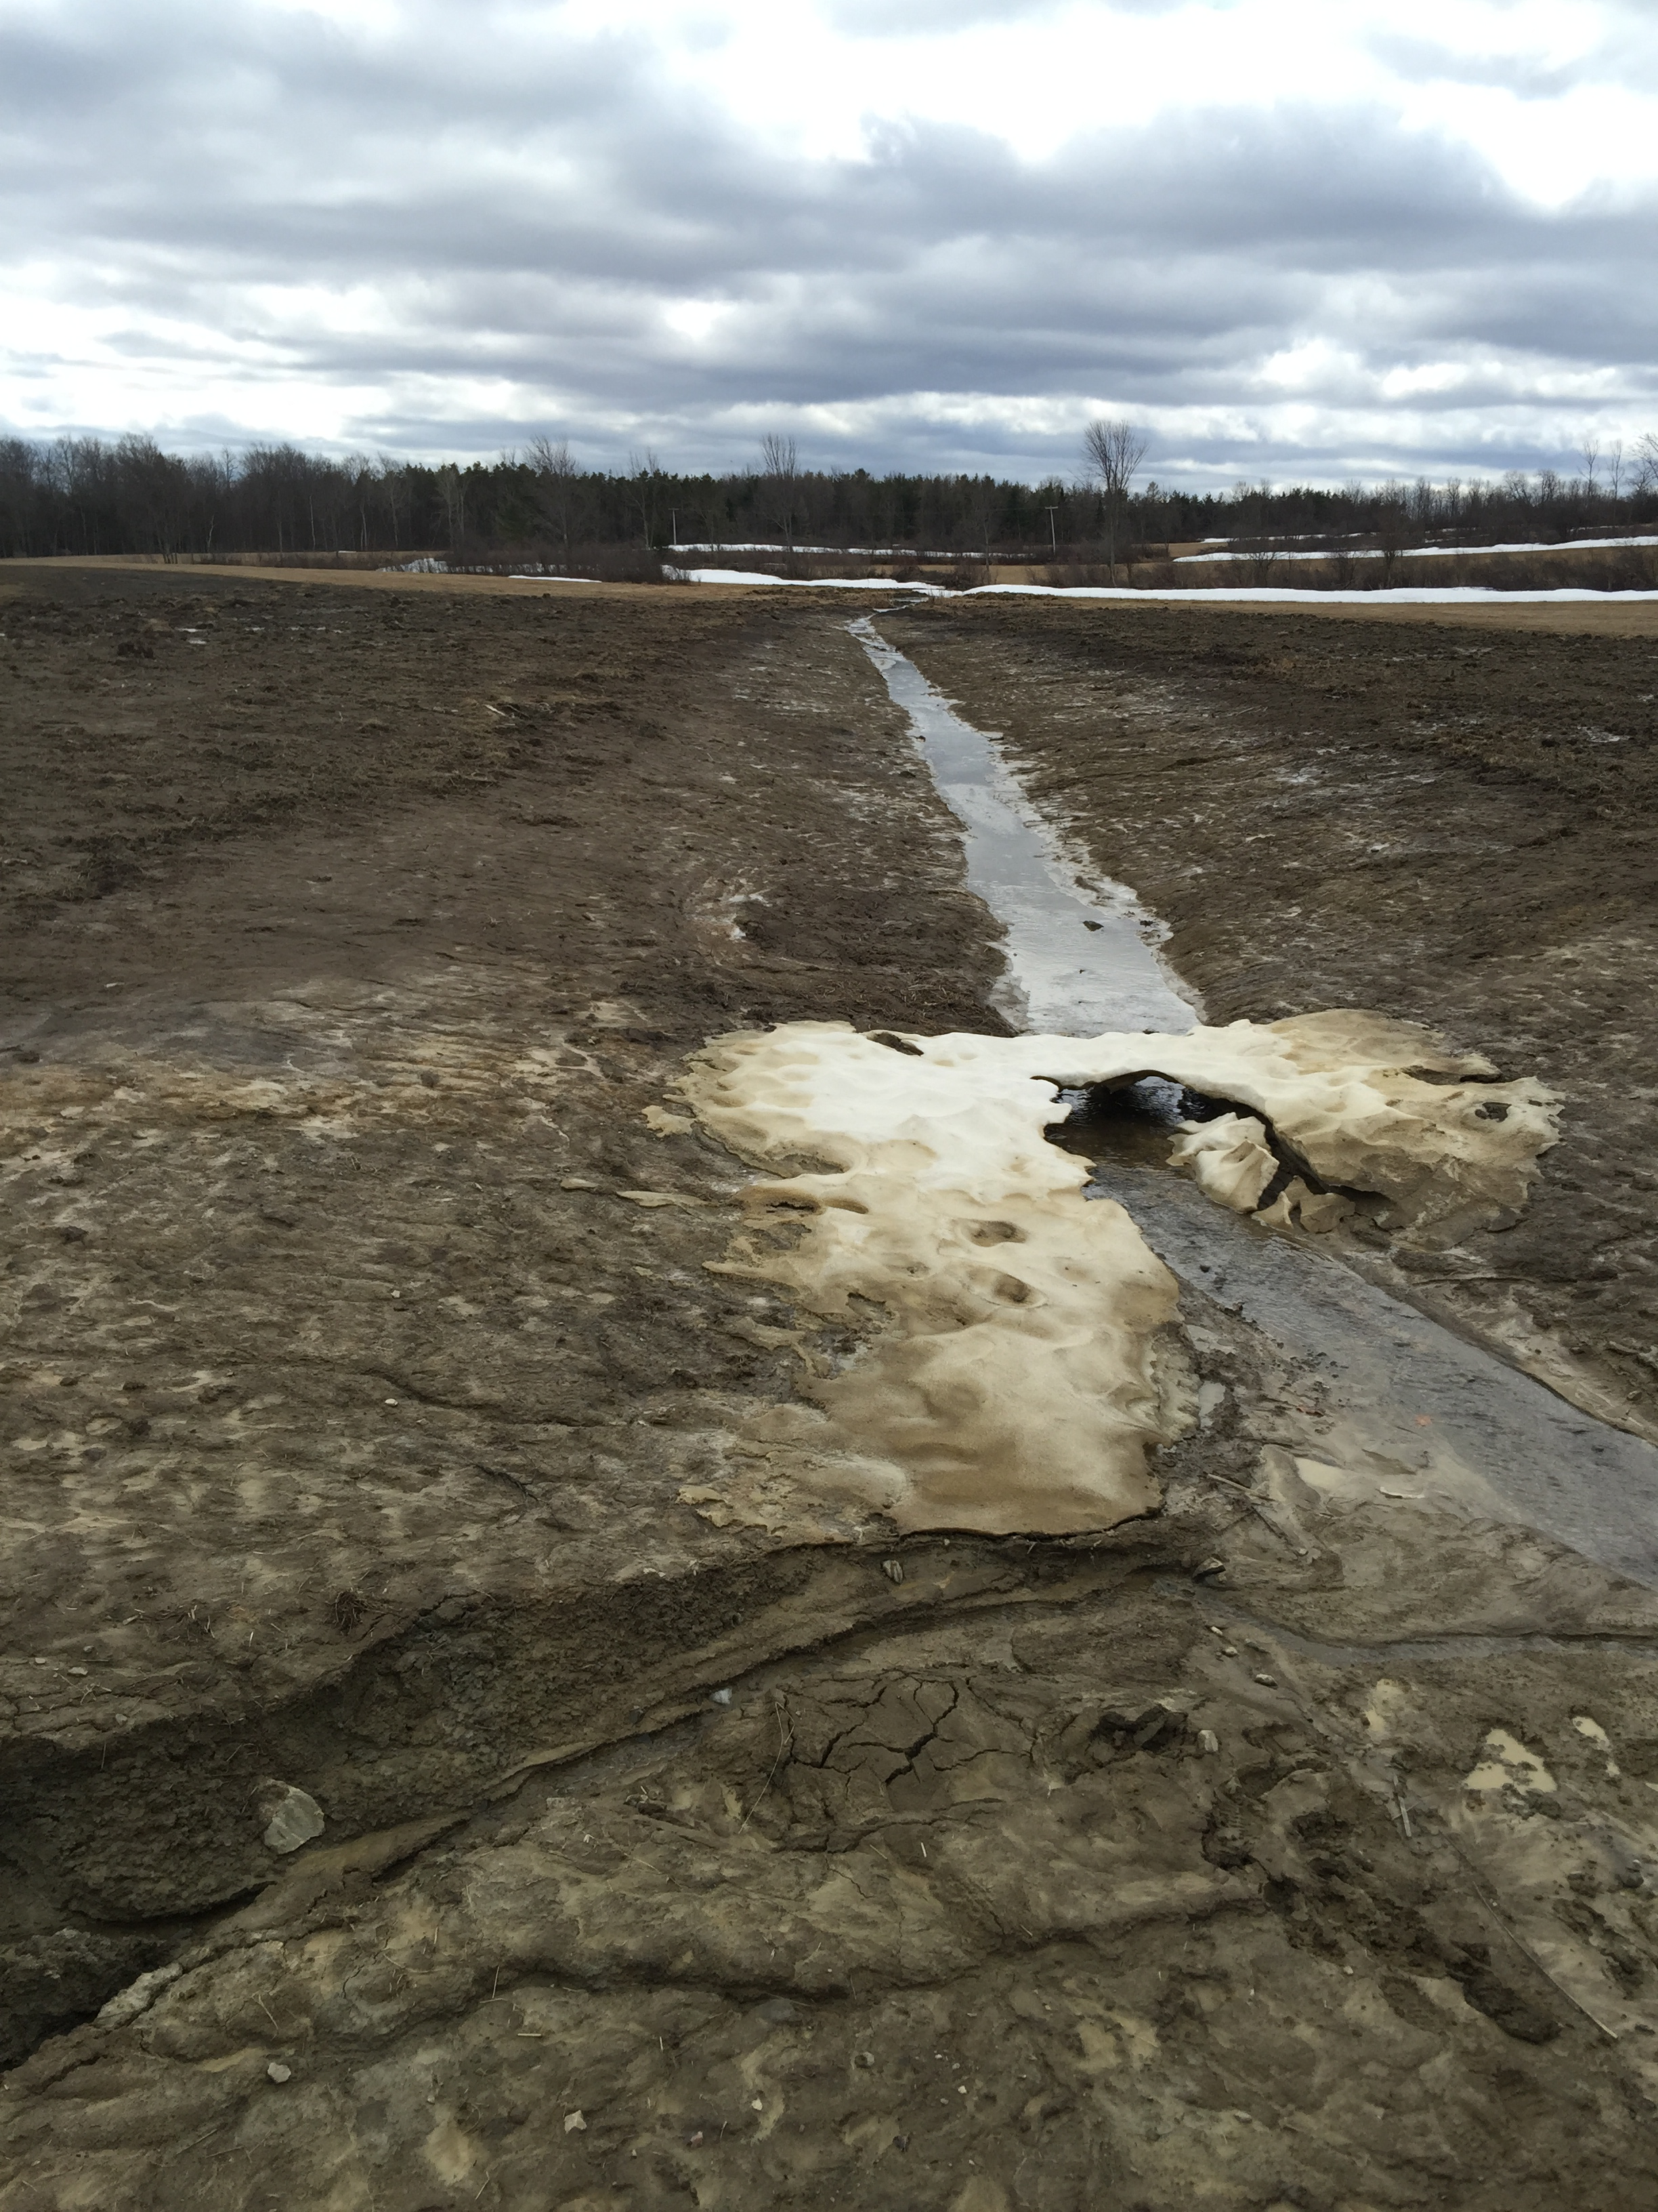
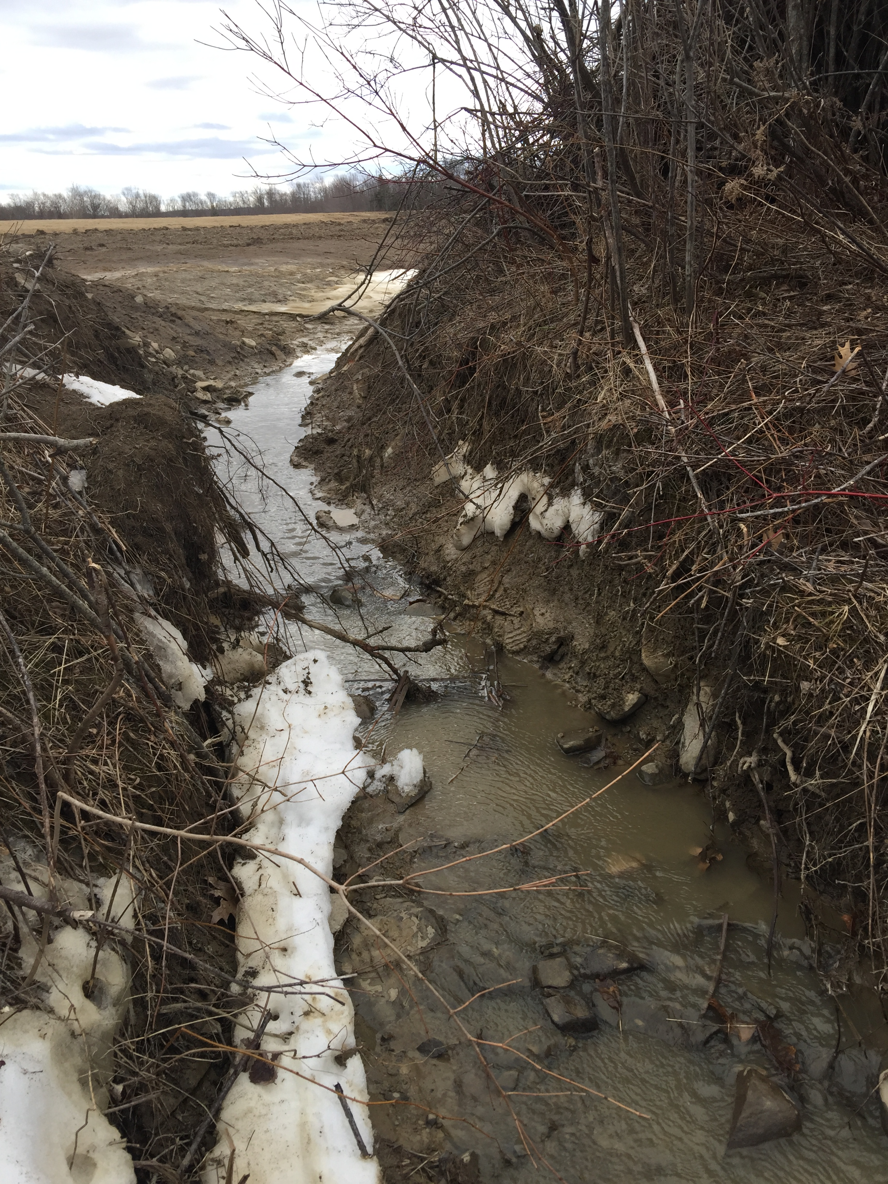
Risks of owning caves and karst
Serious damage to your land and/or your caves
Photo credits: Lance Dickey

Slide 10
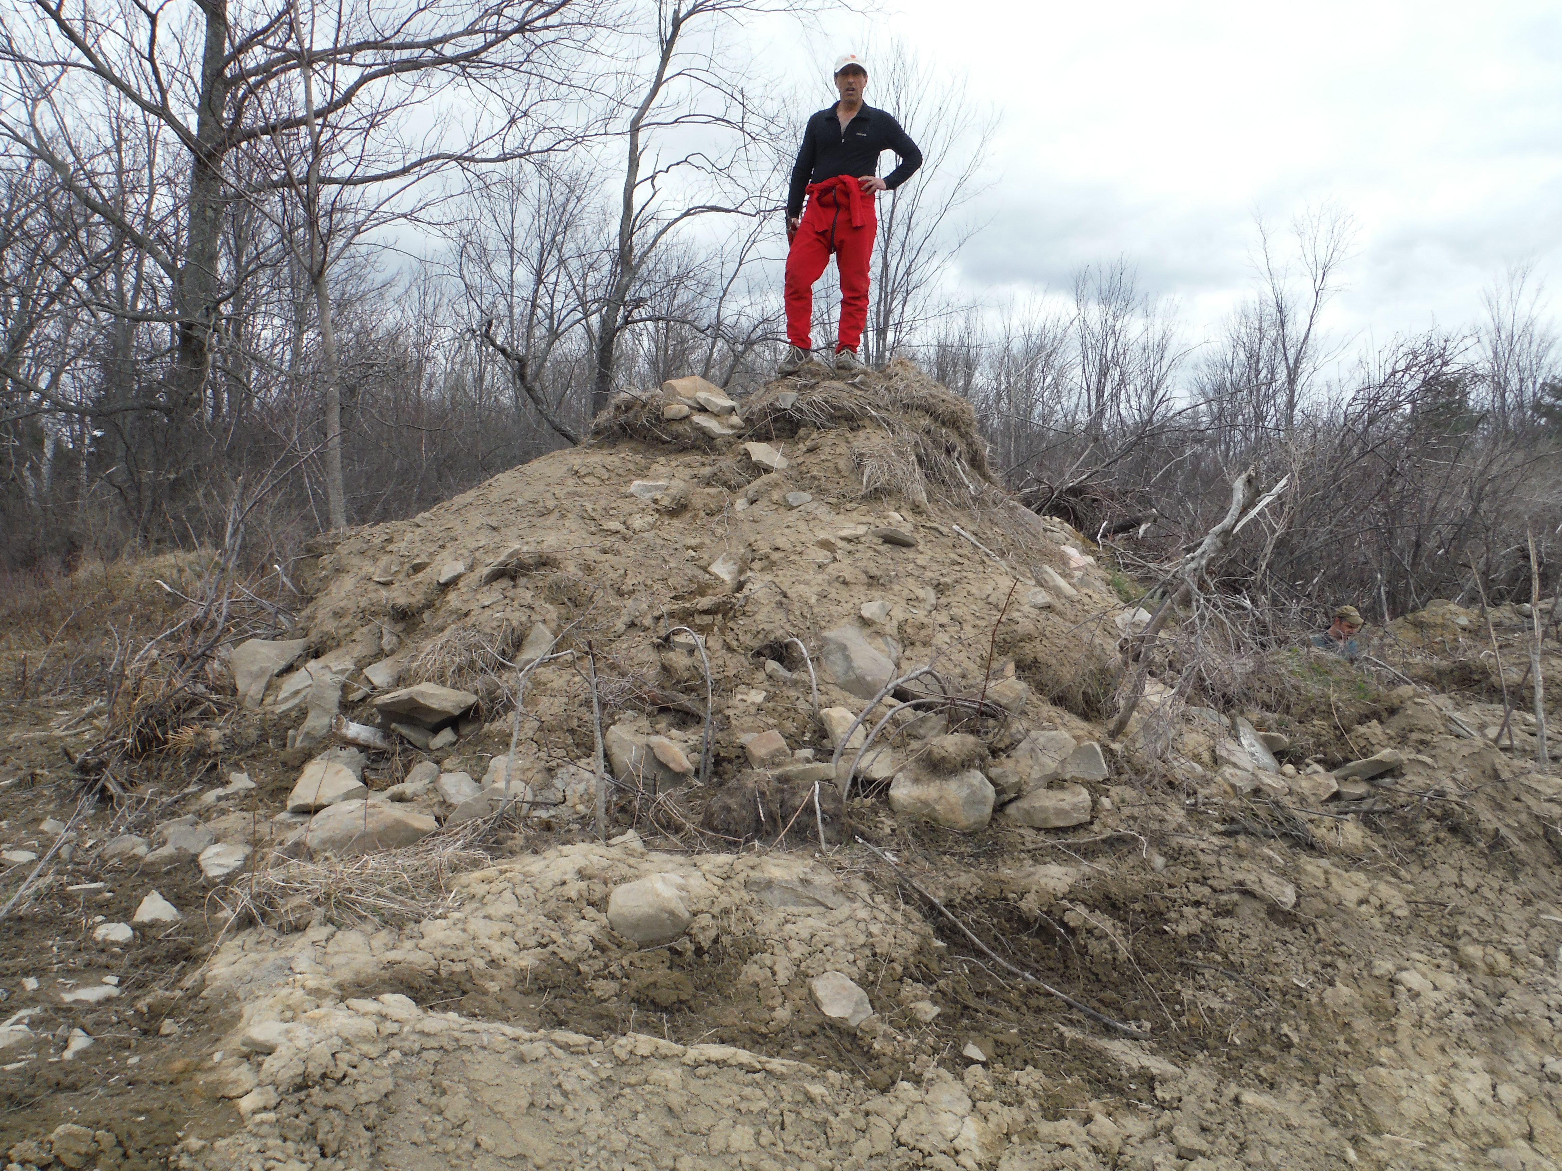
Risks of owning caves and karst
Serious damage to your land and/or your caves

Slide 11
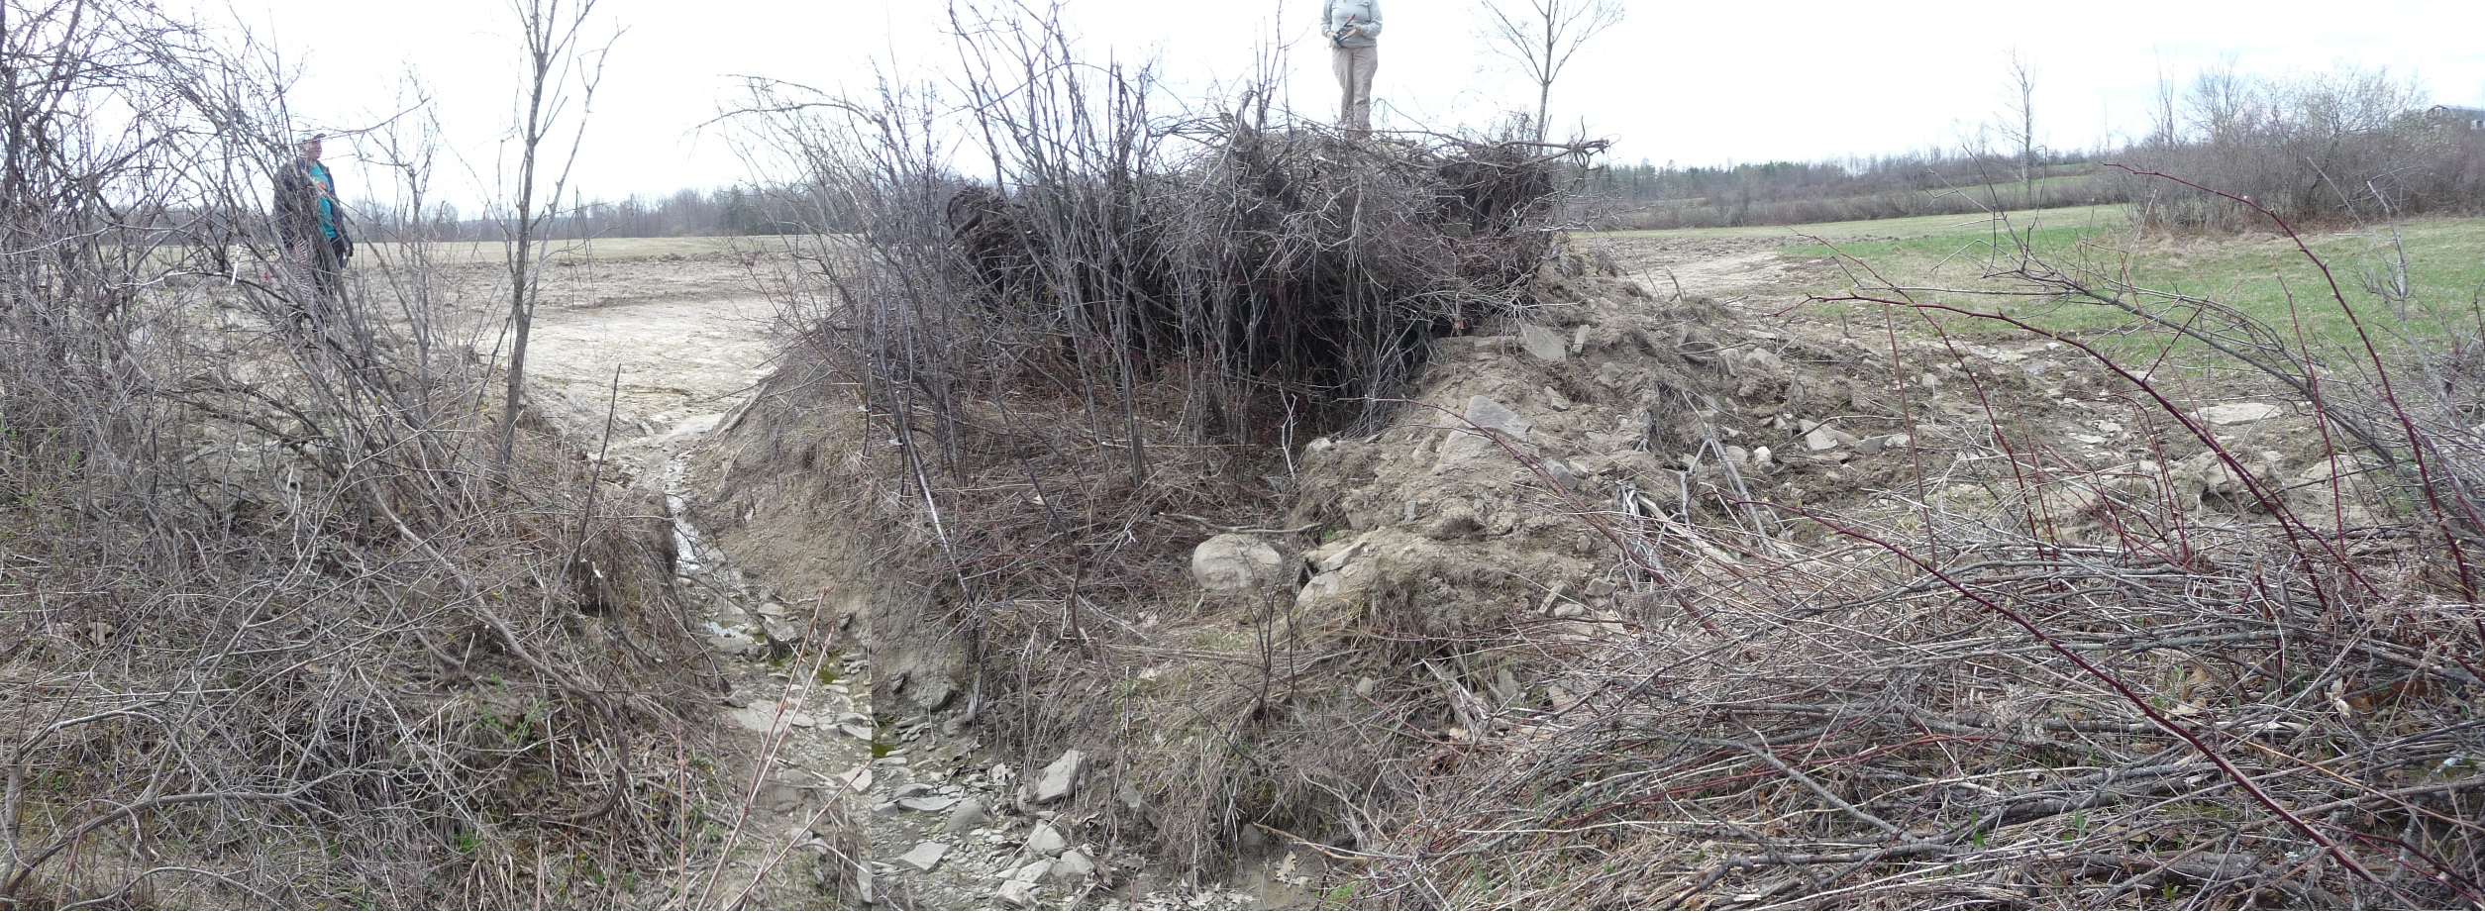
Risks of owning caves and karst
Serious damage to your land and/or your caves
Photo credit: Thom Engel

Slide 12
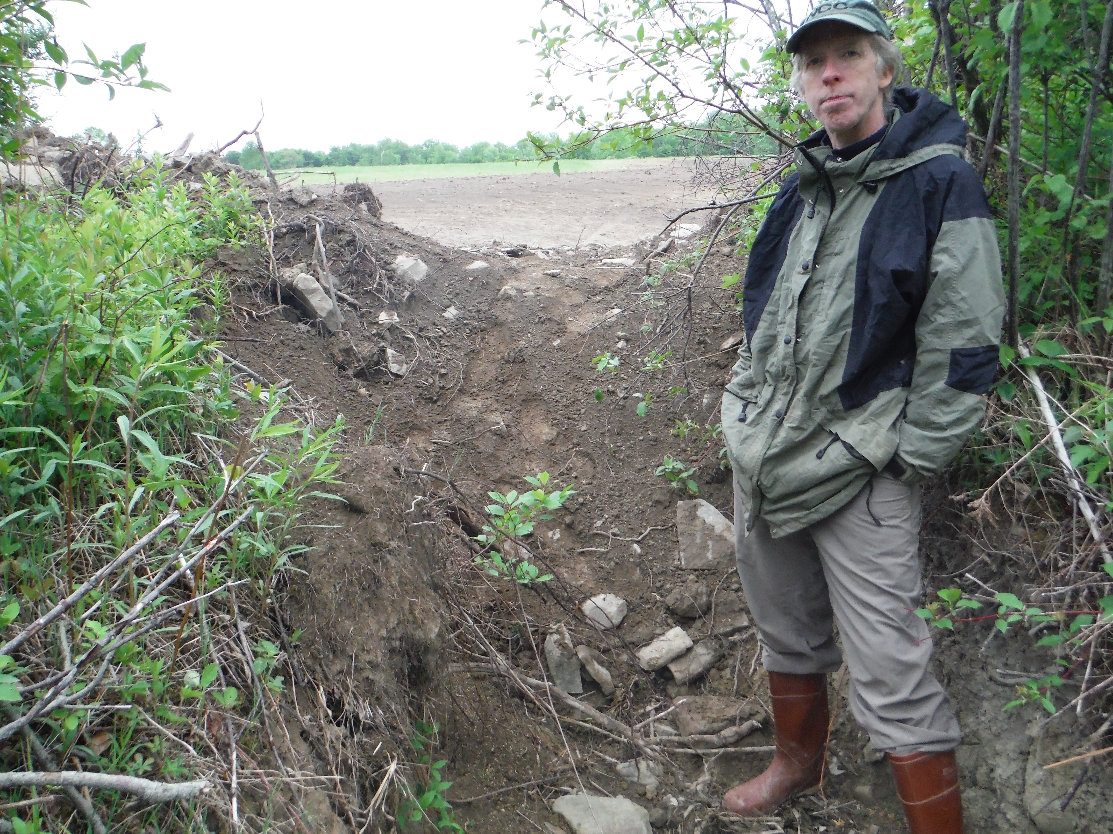
Risks of owning caves and karst
Serious damage to your land and/or your caves

Slide 13
Defending conservation
Terrafirma Risk Retention Group, LLC
Unique insurance program protecting its members from the legal costs of conservation defense
Owned and managed by its insured member land trusts
Has fixed premiums
Trains and educates on risk management
Members must also be members of the Land Trust Alliance and carry general liability insurance

Slide 14
Risks of owning caves and karst
Business-related problems
Accusations of mismanaging funds
Accusations of discrimination
Accusations of harassment
Directors & Officers insurance
Not just for directors and officers: good “association-style” policies also protect your volunteers and committee members
Not just for organizations with employees

Slide 15
How the NCC used to manage risk
Up until 1997, we only had one property to worry about
We knew of the “sportsman's law” in New York
We collected waivers
By 2011, we had 7 preserves, all potentially at risk if an accident at any of them resulted in losing a lawsuit
A search for liability insurance coverage revealed:
Many insurers think caves are too dangerous
Many don't see the difference between us and commercial caves or amusement parks
Many are way too expensive for a small volunteer organization to afford
We purchased a policy we were able to afford
One property had a conservation easement on it, and we were in negotiations for easements on two other properties

Slide 16
Learning about liability exposures
Ask a lawyer for advice!
The NCC applied for and reveiced a grant that awarded pro-bono legal services
Used those services to conduct a study of statutes and case law history about liability exposures to cave owners in New York and Vermont
Asked questions about several topics (mostly the ones discussed in this presentation)
End product was a pair of memos explaining risks and protections specific to our organization and the jurisdictions we owned or expected to own land in, along with recommendations about what to do.

Slide 17
How the NCC manages risk today
These choices may not be the right ones
for your organization's current needs!
We carry insurance (Gen. Liability and Directors&Officers)
We're a proud member of Terrafirma RRG, LLC
We no longer collect waivers
We post an “Assumption of Risk” statement at the kiosk at all our preserves, and on paperwork for “Special Use” groups
We've discontinued looking to place additional preserves under conservation easements
We participate in LTA risk management training, and attend conferences like this one to share with and learn from our karst management colleagues across the country

Slide 18
Resources to learn more
Land Trust Alliance
Vast amounts of information useful to all aspects of running a land trust http://www.landtrustalliance.org/
Terrafirma Risk Retention Group, LLC
Insurance for conservation defense http://terrafirma.org/
Conserve-A-Nation insurance program
Insurance for conservation organizations
http://www.alliant.com/
NSS Cave Conservancies Roundtable
Each year at NSS Convention http://caves.org/
NCKMS
You're already here! http://nckms.org/

