Slide 1
The Photoelectric Effect
Matthew Houston
10/1/2010

Slide 2


Explanations-Classical and Quantum
In 1887 Hertz observes a new phenomena
No classical explanation exists
In 1905 Albert Einstein proposes a quantum explanation

Slide 3
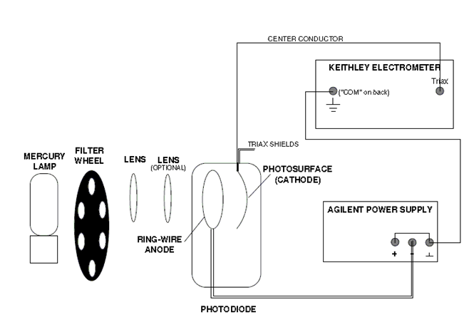
Experimental Setup

Slide 4
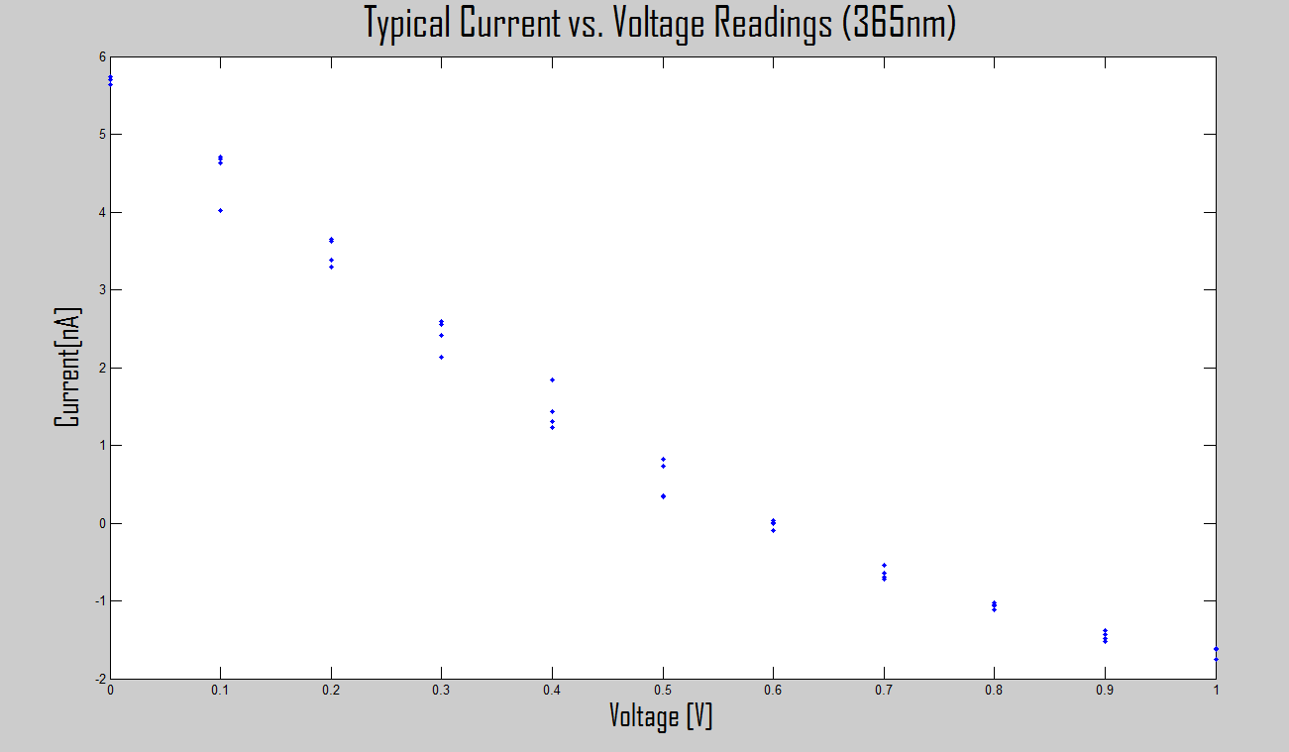
Raw Data-Voltage vs. Current
275 Current, Voltage pairs collected over 5 different wavelengths

Slide 5
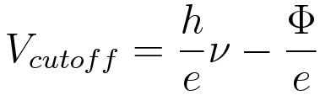
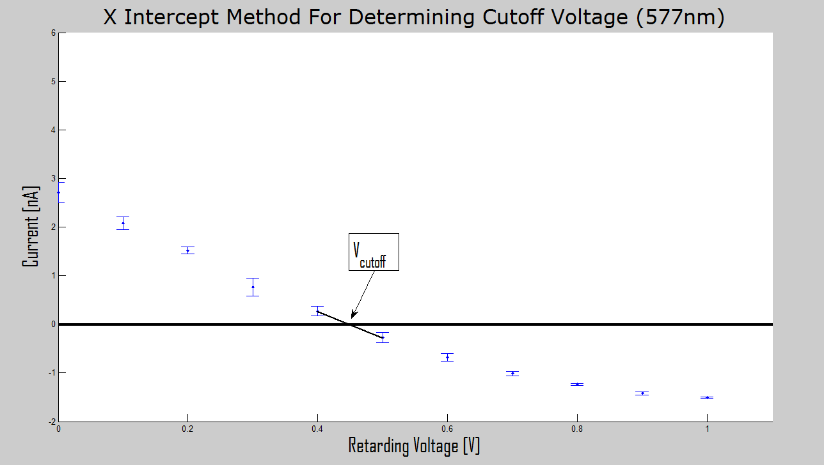
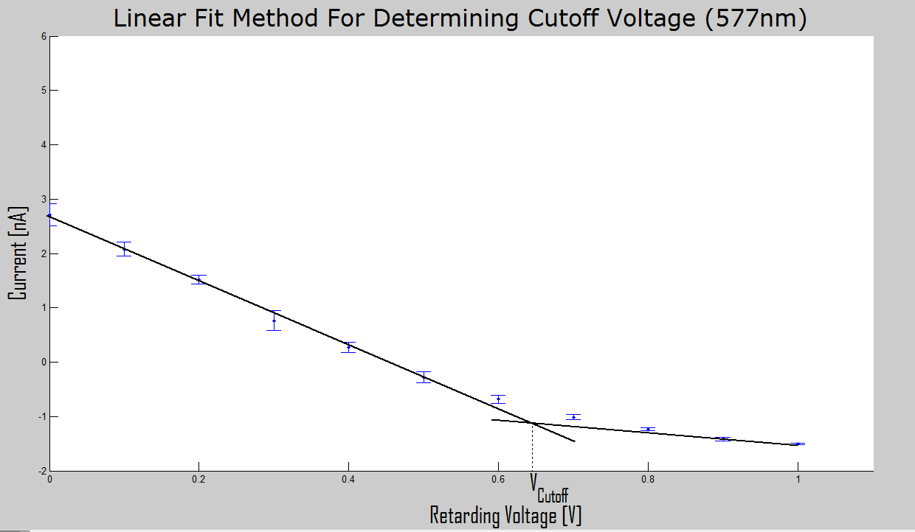
Finding the Cutoff Voltage
Two Methods to determine

Slide 6
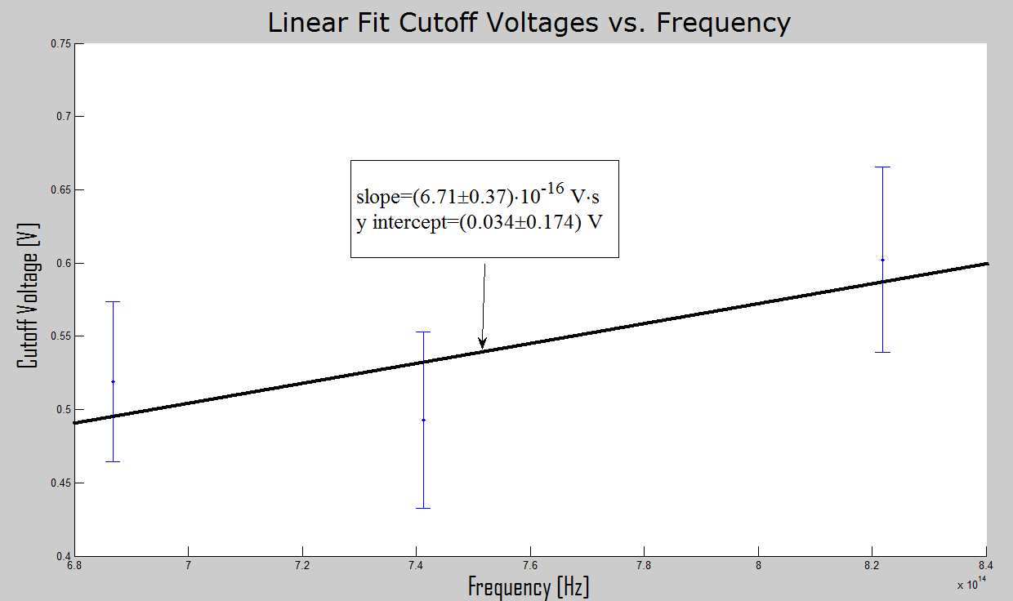
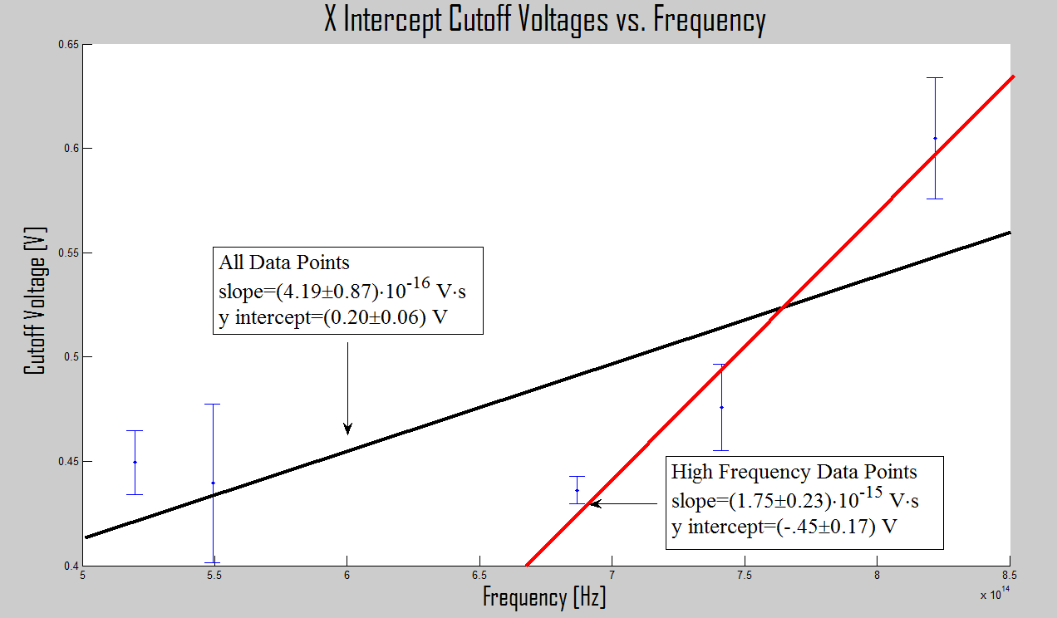
Graphical Results

Slide 7
Numerical Results
Method | Plank’s Constant (Js) | Work Function (eV)
Linear Fit High Freq. | (1.07±0.37)·10⁻³⁴ | 0.03±0.175
X-Intercept High Freq. | (2.04±0.37)·10⁻³⁴ | -0.45±0.175
X-Intercept All Data | (6.72±1.40)·10⁻³⁵ | 0.20±0.06
Actual | 6.63·10⁻³⁴ | 2.3
Experimental results differ from known values by at least an order of magnitude (several standard deviations)

Slide 8
Systematic Error
Potassium build up on the anode causes reverse photoelectric currents
Insufficient Higher Voltage Data

Slide 9
Questions?

