Slide 1
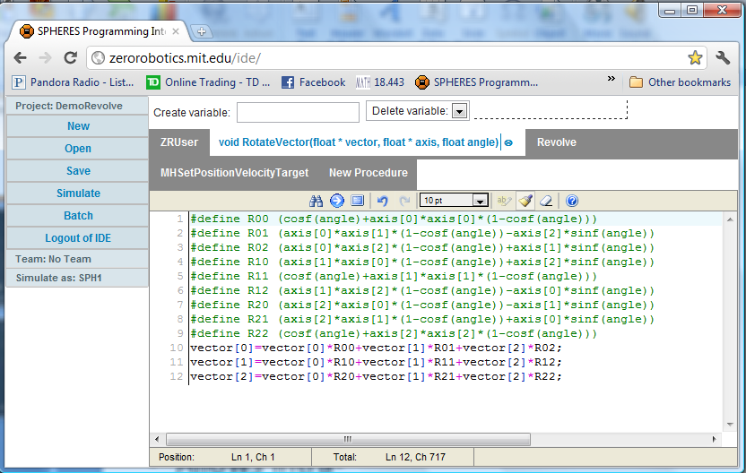
The SPHERES IDE
Simulate flight aboard the ISS
Automatic Version Control
Compete with other teams
Web-based
Write and compile C-code

Slide 2
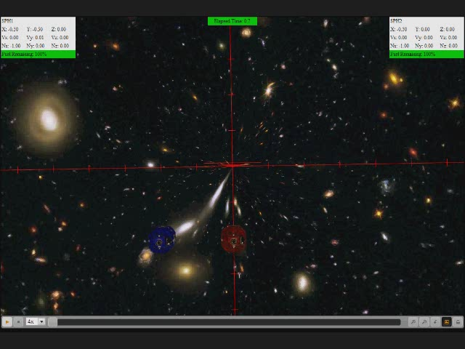

Slide 3
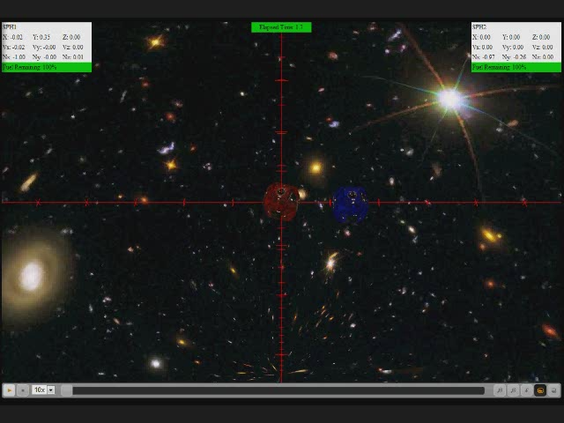

Slide 4
The SPHERES Process
Login
Write C code
Simulated Competition
Compile and Simulate
Debug and Refine
ISS Competition

