Slide 1

Innovative Educational Practices
Enabled by the Cloud
Let's Talk Digital!
ISB Hyderabad, August 2014
M.S. Vijay Kumar
Senior Strategic Advisor, Digital Learning , MIT
Unless otherwise specified this work is licensed under a Creative Commons Attribution 3.0 United States License.
Notes:
Unless otherwise specified this work is licensed under a Creative Commons Attribution 3.0 United States License.
1

Slide 2
Cloud-ed
Students at the UK’s King Solomon Academy are using Chromebooks, inexpensive laptops that rely on ubiquitous connectivity and cloud-based software and storage, for experiments with blended learning in a seventh grade math classroom.
The city of Zhuji in Zhejiang has installed over 6,000 3Tcloud computing terminal devices in 118 schools in a project to replace all obsolete PCs in the city’s school system with over 30,000 cloud terminal devices by 2015.
Lansing Studies in the Cloud : At Lansing Central School, a social studies teacher held online reviews for mid-term exams in the cloud using Google Hangouts and Google Docs to provide a private forum where students could study with each other. go.nmc.org/lans*.
* Johnson, L., Adams Becker, S., Estrada, V., and Freeman, A. (2014). NMC Horizon Report: 2014 K-12 Edition Austin, Texas: The New Media Consortium.

Slide 3
Technology/Cloud
Open
Networks, Devices, Software , Architecture, Processes
Cloud Computing
The Internet of Things
Mobile Computing
Data Visualization & Analytics
Simple Augmented Reality
The Semantic Web
Game-Based Learning
Location-Based Services
Machine Learning
Makerspaces
Content
Tools/Applications
  Finding; Getting; Using
  Knowledge
Enabling Resources
  Legal
  Policy
  Community
Educational Innovation and Transformation
Notes:
The symposium is built on 2 significant influences on education
Open ……… and Technology) and is directed toward their implications for advancing STEM Education. Te
The evidence of these significant influences is clear and I will certainly give you a few substantiating indicators
expandable, on-demand services and tools that are served to the user via the Internet from a specialized data center and do not live on a user’s device. Cloud computing resources support collaboration, file storage, virtualization,
Right at the outset I would ask you to adopt a generous definition of these terms Open,
Open frinstance - to include Content, Tools, legal enablers…
Similary – Technolgy as a proxy for – networks
Gathering Storm of Openess is eveident - So much so that the there is an international discorse onn the opportunities and challenges - Toru and I are in the thick of it -- Book --
Some time ago --e Verything Now we talk about O evrything -

Slide 4
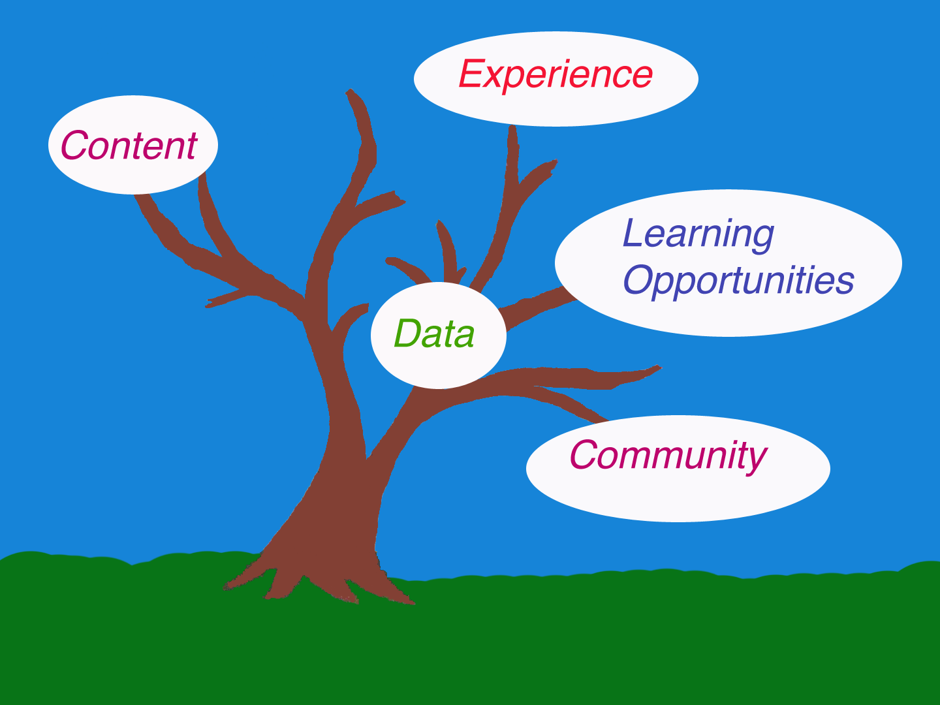
N
O
I
T
A
V
O
N
N
N
O
I
I
T
A
V
O
N
N
I
Notes:
Cloud Connotes – Computational Resources; Content; Context; Crowd
Many of these Dimensions are enabled by the Open Dimension ---

Slide 5

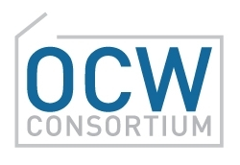
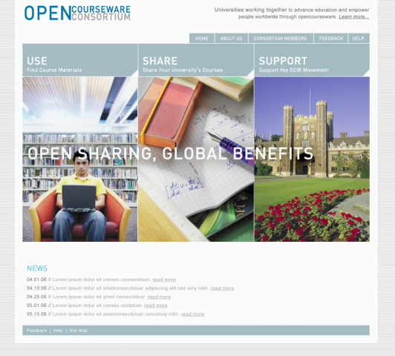
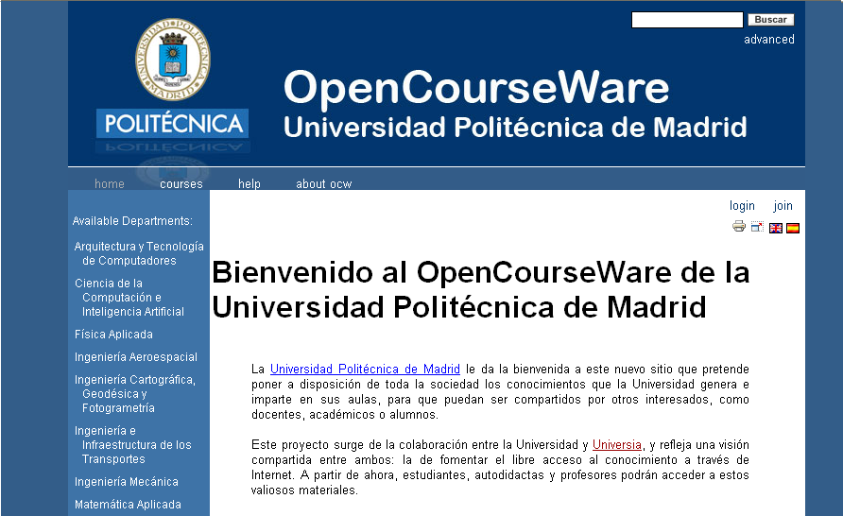
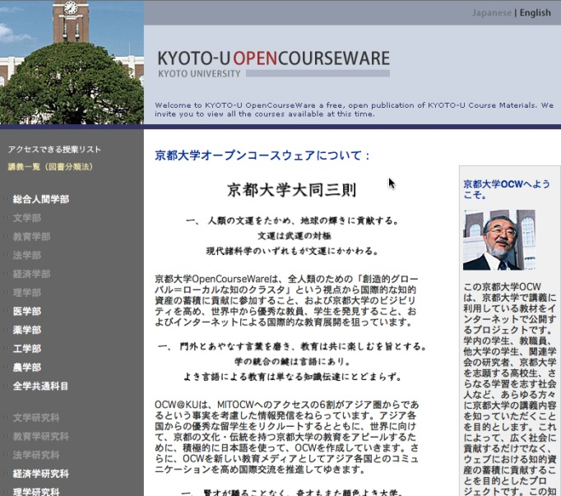
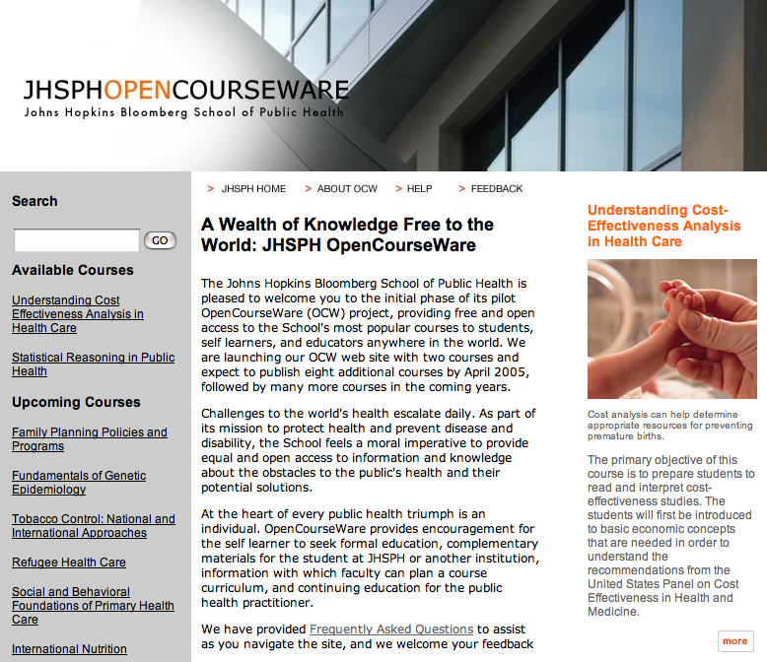



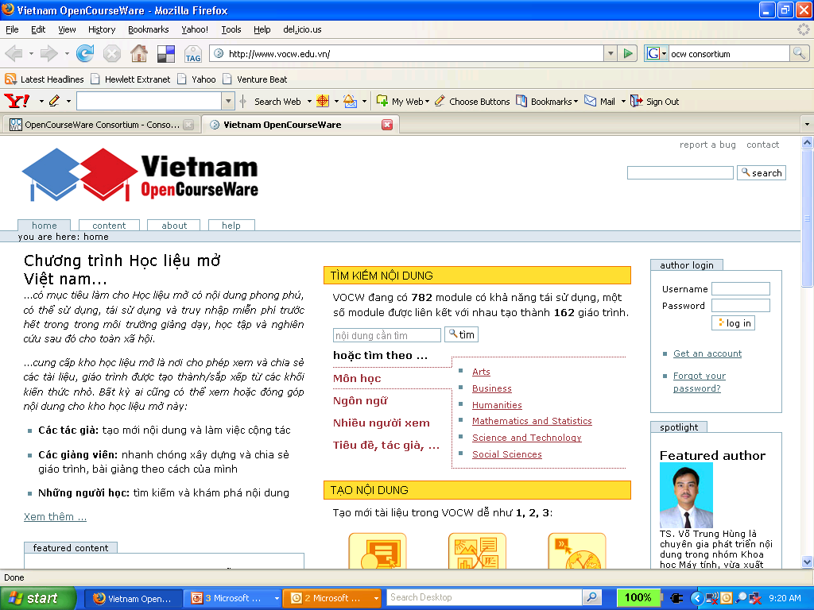

Unlocking Knowledge
Inspiring a Movement
Notes:
It’s hard for us to communicate just how big OCW is. 2,051 courses, means of course 2,051 syllabi and reading lists, but also notes from 17,531 lectures, 9,460 assignments, 980 exams. About 50% of the exams include solutions, so you check your answers. And beyond the core teaching materials, we’ve included other kinds of enhanced materials, including video content in about 60 courses—21 of which have their entire lectures recorded—complete text books, animations and simulations. The materials cover all 33 of MITs academic disciplines at both the undergraduate and graduate level.
to publishing MIT’s content, you’ll remember that our dual mission included a charge to extend the reach and impact of the OCW concept, to inspire a broad movement. In this respect, we could never have imagined how successful we would turn out to be.
Almost as soon as we launched the 500 courses, we began to get inquiries from other schools interested in creating their own OpenCourseWares leading schools in the US like Johns Hopkins and Notre Dame, top schools in Japan, China and Europe. There are now more than 250 schools with projects in the works, and about 13,000 courses total already published. We’re 2,000 of those, so only about a third, and we’re thrilled to be losing market share every day.

Slide 6
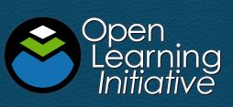




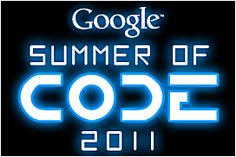


The Open Explosion: Internet for
“Non-Traditional” Education
Notes:
Computer-based courses with intelligent tutoring, virtual laboratories, simulations, assessment, and ongoing feedback. Mentors and stipends for students who complete free or open-source coding projects. Collectively aggregated, edited, and organized knowledge base; 150,000 visitors a month. 100 hubble pictures by 250,000 “citizen scientistsillion classifications of H” in 3 years. Over 39 million views of short instructional videos made by one MIT alumnus

Slide 7


Making a Difference – Student Use
Kunle Adejumo, Engineering student at Ahmadu Bello University in Zaria, Nigeria
“Last semester, I had a course in metallurgical engineering. I didn’t have notes, so I went to OCW. I downloaded a course outline on this, and also some review questions, and these helped me gain a deeper understanding of the material.”

Slide 8
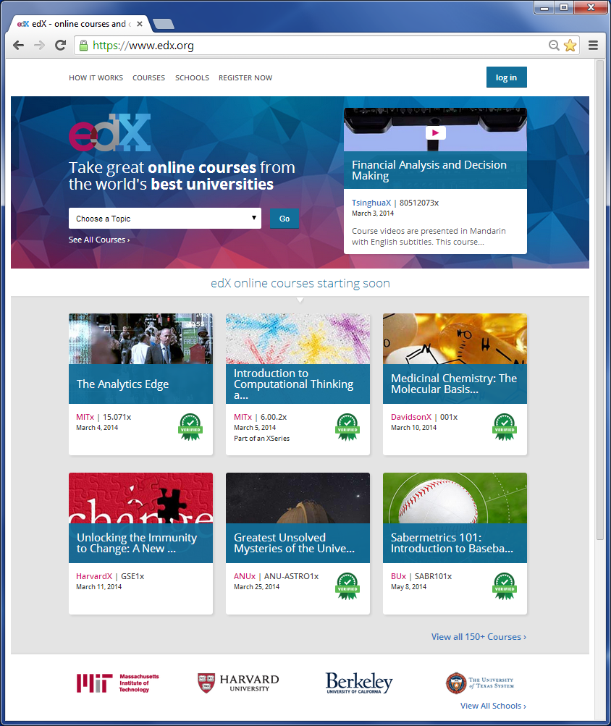
Non-profit venture founded by MIT & Harvard
Expand access to quality education
Improve
on campus education
Advance research

Slide 9
What’s unique?
Scale
  Thousands – Tens of Thousands – Hundreds of Thousands of simultaneous participants
  Communities
Content (mostly video) and (formative) assessments are tightly coupled
Many innovative activities
  Assessments
  Tight Loop
  Automatically evaluated

Slide 10
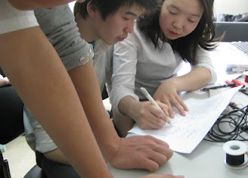
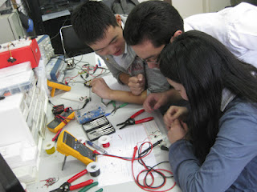
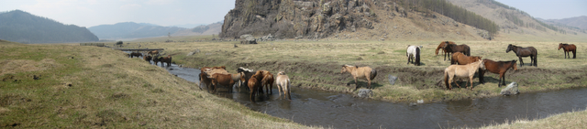
6002x.blogspot.com – the new classroom
Where is this…..?

Slide 11
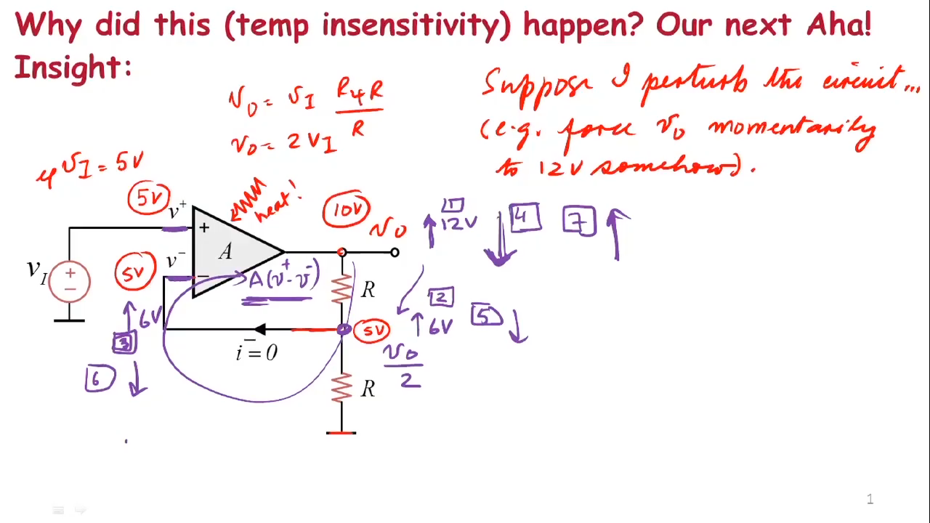
Video Vignettes
Personalization effect - Mayer 2003
Notes:
It is simplisti/ view of MOOCs – as jst a tranfer of what happens in a traditional lecture to the net OR that tradition DE classroom
Video Vignettes like these reprent
Video Vignettes, wwhich are not just talking heads bur represent a degree of persona interaction with the learner – a la Khan

Slide 12
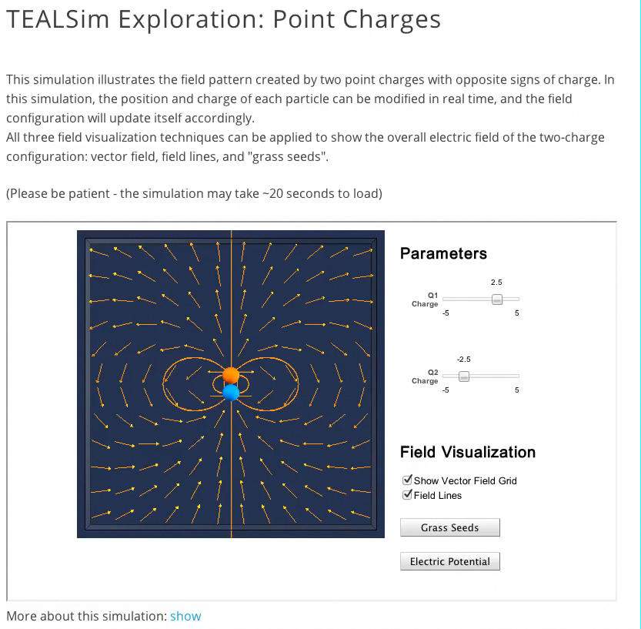
Interactive Simulations: Physics
Notes:
Simultions such as rese for an Electromagnetism Course – which help elaborae a oiur for greater explanation - ..undestanding of conceps.. Tese are interspersed

Slide 13
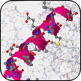
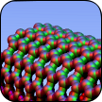

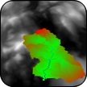
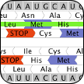


STAR: Software Tools for Academics & Research: star.mit.edu
Innovative tools to bring the practice of research to the process of learning
StarBiochem
StarMolSim
protein visualization
materials modeling
StarGenetics
StarHydro
genetic cross simulator
hydrology visualization
StarOrf
StarHPC
gene finder
parallel programming
Expose students to the discovery aspect of research and to
the processes of doing research using interactive technology
Notes:
Whst these represent are resources that nmake the online experience to be a rich interactive engaging educationa experience

Slide 14
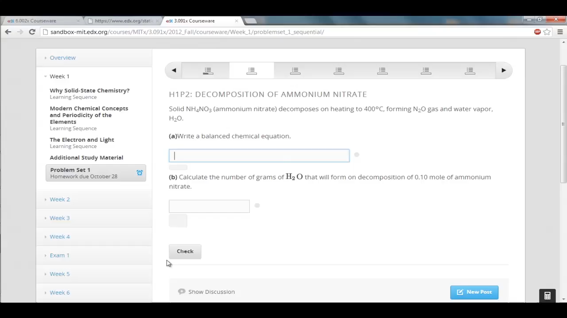
Rich Set of Autograded Exercises
Chemical Equations
Notes:
Through Interactive Exercises t that are embedded along with the lectures we can quickly/timely fashio get a sense of how learning is proressing – test the understanding and give feedback, take corrective action
Mind you tese are auto graded – one of the aspects of MOOCS is tat several of these standard functions are automated – scale and immediacy 9Just-in-tme ness)
These are for subjects ranging from Chemistry -- Programmin

Slide 15
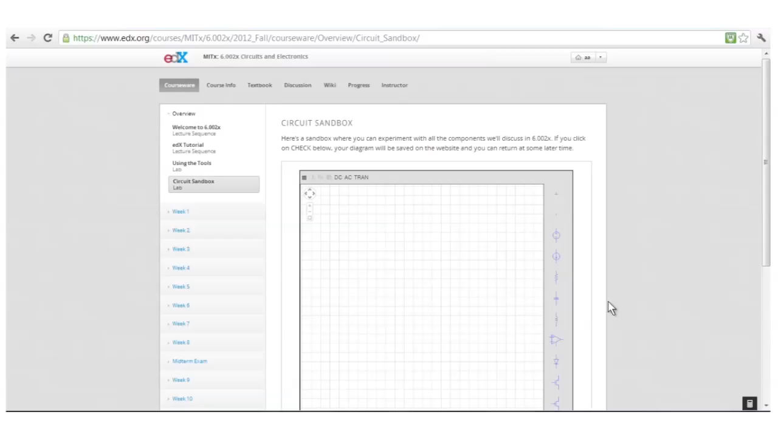
Virtual Game-Like Laboratory
Notes:
The other aspect is that you can include Lab-like exrecises – sanbox - folearners to apply aconcepts – that they have learny…in virtual gme like labs – such as this one for a circuits coutrse or

Slide 16
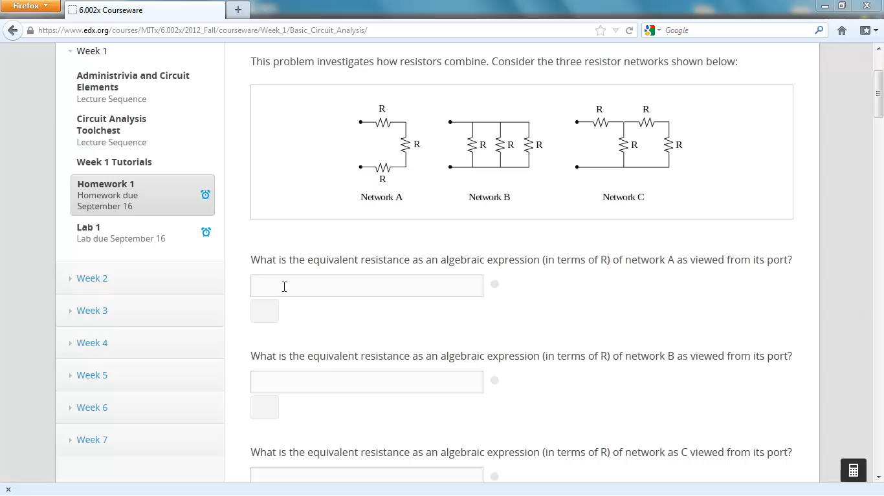
Instant Feedback
Notes:
Interacti=ve Exercises for Circuits courss
Bottoe Line is that
Rapid feedbac has a significant positive effect on performance …engagment
Bottom LineRapid feedback has a significant and positive effect on student performance when compared to no rapid feedback.
– Chen, Whittinghill, Kadlowec

Slide 17
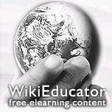


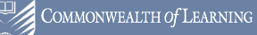


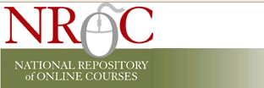

K-12
Notes:
17
European schoolnet – 19 countries
Col – virutal university of the small states
Wgbh – teachers domain
Teacher ed in sub saharan africa – portal literacy, numeracy, life skills

Slide 18
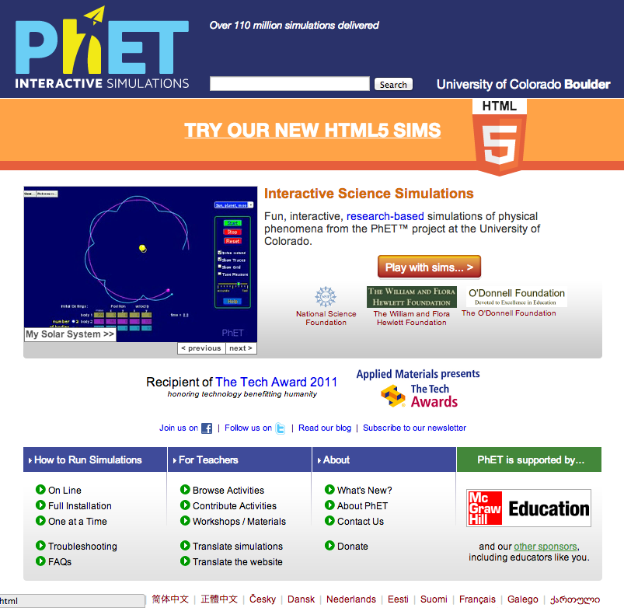
PhET: phet.ucolorado.edu

Slide 19
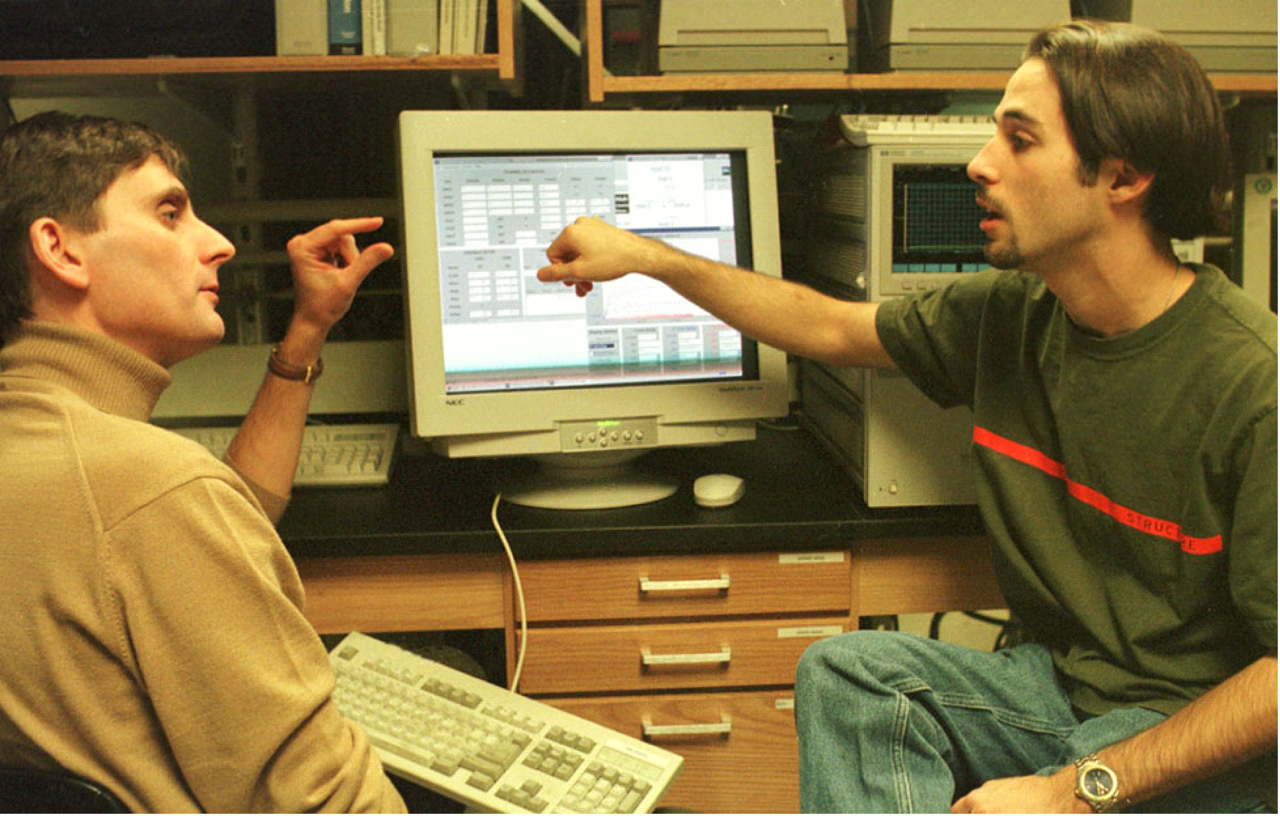
iLab: If you can’t come to the lab… the lab will come to you!
Notes:
19
Real laboratory accessed through the Internet
From anywhere at any time
Not a “virtual laboratory” (simulations)

Slide 20

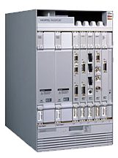



The iLab Vision
Order of magnitude more lab experiences
More lab time to users/researchers
More sophisticated labs available
Communities of scholars created around iLabs sharing educational & research content
Campus network
Internet
Client
Service Broker
University Databases
Lab Server
Notes:
Students will perform a broad range of educationally meaningful experiments online in real time.
Online laboratories will be embedded inside rich educational platforms that include visualization tools, simulations, data processing, collaboration, etc.
Online laboratories and their educational content will be broadly shared across many institutions all over the world.

Slide 21
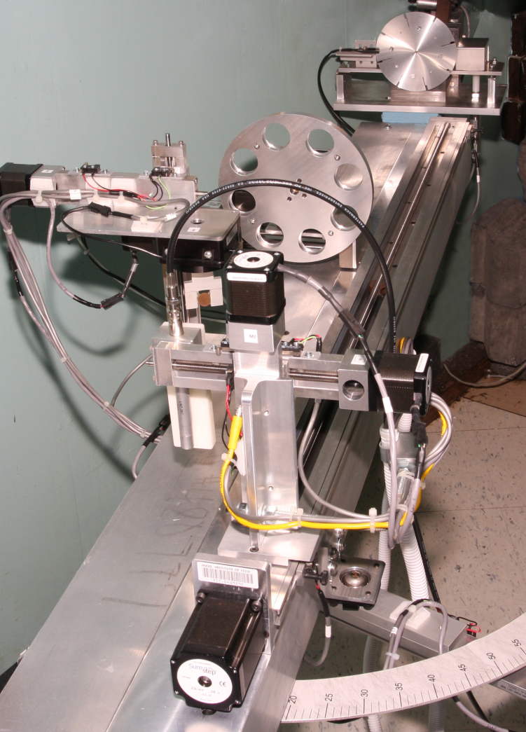
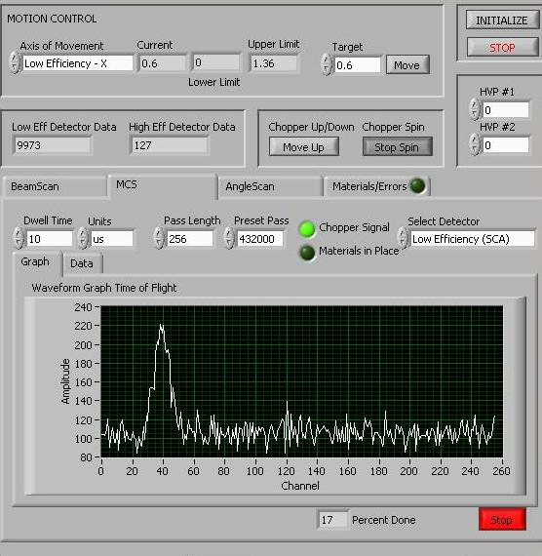
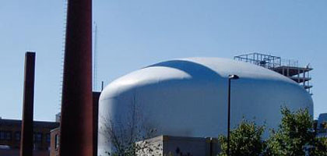
iLab Partnerships for K-12
(with Northwestern University)
NSF-funded project focused on integrating iLabs into secondary schools
iLabs are used to demonstrate science relating to topics of interest
  Makes STEM programs more engaging
Presently focused on physics, though new iLabs in biology and chemistry are forthcoming
Notes:
NSF-funded project (CI-TEAM) just started with Northwestern University to explore use of iLabs in Chicago public secondary schools, other leadership schools (e.g., IMSA, QAMST/Au), and museum settings
Real laboratory accessed through the Internet
From anywhere at any time
Not a “virtual laboratory” (simulations)

Slide 22


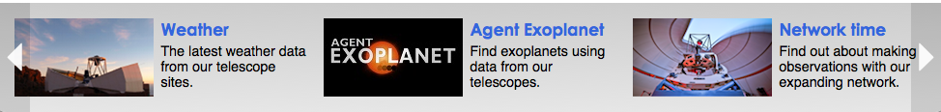
  E-Science Initiatives
  Faulkes Telescope Project (Las Cumbres Observatory) Global Telescope Network)
    Access to telescopes in Hawaii, Australia
    Access to experts and collaborative projects

Slide 23

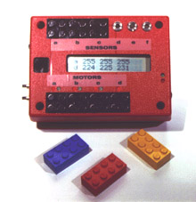
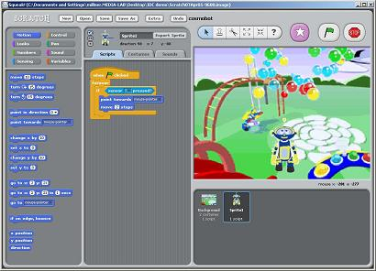
Constructionism v.2.0
Mitchel Resnick
Programmable
Bricks, LEGO
Scratch, programming for all!

Slide 24
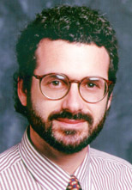

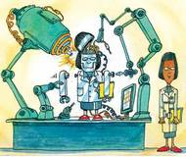
Constructionism 3.0
Neil Gershenfeld
Digital Fabrication,
Fabrication for all!
Fab Labs
digital bits <=> physical atoms

Slide 25
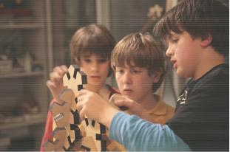
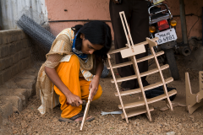
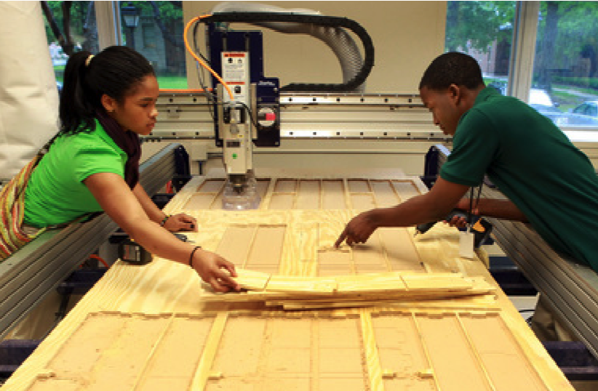
A Fab Education
Fab Academy
Fab Lab Barcelona
MC2STEM
High School
Fab Lab

Slide 26
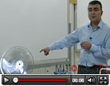
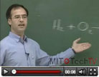
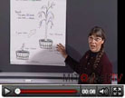
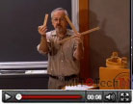
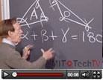
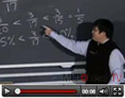
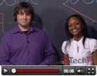
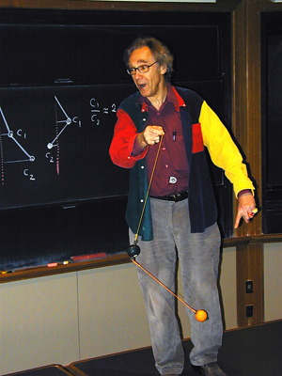
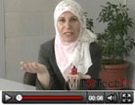
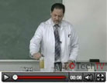
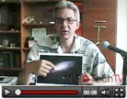















MIT BLOSSOMS?
    A free online repository of “interactive” video lessons for high school math and science classes. created by gifted volunteer educators from around the world
Notes:
http://www.myoops.org/twocw/mit/NR/rdonlyres/Physics/8-03Fall-2004/911B954A-1B85-45B0-9C2A-B1B3CB68A576/0/lewin_pendulum.jpg
A free online repository of “interactive” video lessons for high school math and science classes.

Slide 27



Real Problems Do Not Self-Organize by Academic Discipline
Notes:
http://www.vivid.ro/images/88/congestion.jpg
http://water1st.org/waterlog/wp-content/uploads/photos/bangladesh_4.jpg
http://www.buzzybloggers.com/wp-content/uploads/2010/01/haiti-earthquake-2.jpg

Slide 28







Electric
Vehicles
Molecular Simulations
Active Learning
Eco-System
Virtual
Game-like
Laboratory
Maker Spaces
Access to
telescopes,
experts
iLabs
Las Cumbres
Observatory

Slide 29

Notes:
Peter's Crosslinks 2.0: https://oki-dev.mit.edu/crosslinks-demo/
Students read and discuss articles. All of the discussion is in context and comments have scope.
Threaded discussions like a forum in document margin
Standard web site
Faculty initiates
uploads PDFs
Students discuss
Highlight text, enter comment
Reply to existing comment

Slide 30


Caesar: Divide & Conquer
programs chopped into chunks and sent to many reviewers
Courtesy, Eric Klopfer,MIT
Notes:
Rob Miller was working on a problem for 6.005, one of our heavily enrolled CS courses. How do you get feedback to students for detailed feedbac
Foundation-level course (250-300 students)
Students write lots of code
Solution chop up the code into chunks and farm it out to students

Slide 31

Social Reviewing
seeded by automatic style checker
go beyond the chunk, if needed
upvote & downvote
write new comments
reply & discuss
Courtesy, Eric Klopfer,MIT
Notes:
These are the kinds of feedback. Contextual discussions – share some similarities with Nb

Slide 32



MITCET Modularity Experiments
Chemistry
John Essigmann
Bridge challenging concepts between courses with similar concepts
MechE
Ken Kamrin &
Pedro Reis
Modularize mechanics and materials into discrete learning experiences
Aero-Astro
Wilcox, Darmofal, Radovitzky, Wang
Transform 16.20 & 16.90 to modular, active learning experiences, and enable self-paced
completion of the courses
Notes:
Concept based approaches – Modularity - central theme in our online ed efforts- MITCET Experiments – Educationa Motivation and Vision
Aero/Astro: Shift from lecture-based mode to active learning mode with a focus on self-paced independent study through modularity coupled with online tools and resource. This experiment is running in spring semester AY2012 and being assessed.
Chemistry Bridges: provide multiple paths (multi-media explanatory “bridges”) toward understanding a set of concepts that have traditionally been challenges for students in first year chemistry. This experiment is under development currently and will be in pilot form for the Fall.
Mechanical Eng. Provide flexibility through modularizing mechanics and materials into discrete topics. This experiment is running in spring semester AY2012 and being assessed.
Distributed Assessment: The ability to embed a formative assessment in any webpage or Content
Current quiz and test tools require the user to use a tool as distinct from content, lessons, etc. The development of distributed assessment systems is a unique contribution of the MITCET work; there are no systems that currently support this feature. This work could form the basis of a core infrastructure service.
Chemistry Bridge Content Delivery Platform: The ability to present chunks of content (text, video, etc.), selected by faculty and student teams in defined pathways through the materials to support learning key concepts.
Prototyping a limited content delivery system for the Chemistry Bridge project. to support a portion of potential core infrastructure content management and delivery services.
Faculty Support/Development:
Working with MIT faculty to support new pedagogies and identify & implement new learning technologies to support blended and asynchronous distance learning opportunities for students.

Slide 33



Concept-Based Learning & Modularity
Crosslinks
Video Concept Browser
i2.002 Online Course
Notes:
At MIT, an Increasing traction on Concept Based approaches
Pros:Promotes reusability, and perhaps learner choice
Aligns with learning sciences: Many short activities
Aligns with competency-based learning: Focus on specific skills
Flexibility in delivery (time and place)
Cons:Modularity for modularity’s sake, same problem with learning objects; May lead to desire to over-structure courses and activities
Focus on learning outcomes…
…or describing content / activities by concepts or topics
MIT is developing tools and infrastructure
Video Concept Browser
Concept map authoring, linking concepts and content (not showing today)
Essentially to look at Core Concepts – tie leaning outco st, build assessment arpiound
Also devekop and present linkages between Concepts and others ans Content.
A couple of examples…
Crosslink – Flashback..
Mech E – i2002
Video Concpt Browser – Spen Media bRowser

Slide 34









The MC3 Service
Other
Go to MAPS “Momentum and Impulse” Page
“Momentum” at Wikipedia
MIT 8.03 Vibrations &Waves, Lecture 23, Fall 2004 at 2824
MIT 8.01t, Fall 2004, Conservation of Momentum (pdf)
The Physics Classroom, mentum and Impulse
YouTube, Julius Miller, Energy and Momentum Part 1
YouTube, Julius Miller, Energy and Momentum Part 2
The Physics Zone, Lessons in Momentum
Notes:
This idea is being developed into an infrastructure – MC3 – that can provide underlying data representations for these linkages and can apply across tools/courses.
The MIT Core Concept Catalog (MC3) project is designed to explore and enhance re-use of Open Educational Resources, like OCW and other on-line educational content or activities, from the perspective of core curricular concepts and learning objectives/outcomes. In addition to supporting deeper learning, this project helps us to answer the question “How can OERs be more effectively used by MIT faculty and students for instruction and learning?”

Slide 35

“Treasure chest” of problems (412)
277 videos
164-page e-text
No home-works, no exams
All proctored weekly quizzes
3.091x
Introduction
to Solid State Chemistry

Slide 36


Slide 37
Changing the Ecology and Economics of Education
Abundance
  A
    Actionable Access to Resources, Learning Experiences; Communities
    Alternate ways to learn: Models; Pathways
  B
    Blended Learning; Boundary-less Education
  C
    Customization and Continuous Improvement ;
      Learner feedback/Analytics /Open Design
    Continuous Education
Notes:
edX has 860 learning vommunities
Meet Ups
Dwell on the Value proposition
Pedagogy of Abundance – 4 RS Accessible Resources and Learning Experiences
Open high quality digitized educational content, tools and communities; Available anytime, anywhere (for free/at cost?)
Teaching → Learning I al its modalirties – self learning, just-i-time, peer…
Alternate way to learn: Accelerate/deepen learning
Allows Different Pathways to learn; Localizable and re-mixable
Allows for collective improvement and feedback – visible ocw. Community agency,
Support Innovative Practice (Teaching as Research)
New pedagogy; improvement
Grand Opportunity to scale excellenceAlternate way to learn: Accelerate/deepen learning
Localizable and re-mixable
Allows for collective improvement and feedback
Support Innovative Practice (Teaching as Research)
New pedagogy; improvement
Illunminate with some examples
Proximity: Content-Learner, Teacher-Student, Research-Teaching
Visibility
Adaptability: Common infrastructure to deliver quality digital content in different sectors.
Flexibility: Learners structure the reality of their educational experience.)
Interactivity: Virtual learning environments facilitate peer interaction, which is invaluable.

Slide 38



Research in Learning on an Unprecedented Scale via “Big Data”
Online
textbook
Videos
Assessments
All learners
Those who passed
Learner activity and performance
Courtesy Seaton, Pritchard Aug 2012

Slide 39
The Open Difference
  Generative
    4Rs: Reuse; Remix, Revise, Redistribute
      Permitted by Technology Policy and Legally
  Boundary-less
    Access, Development and Use not limited by domain/ community/technology/Policy
      Bidirectional
      Distributed locus of control;
      Outcome and Process are shareable/transparent
  New Structural Relationships
    Access – Cost - Quality
    Individual – Institution – Knowledge
      Agency of the Community (Crwd)
      Learning Opportunities
      Disaggregation of educational services
Notes:
These properties and illuminate with examplesThe two factors relate to the OCW Consortium iLAbHighlights-- generative properties; SChallenges well established relationships...Cost-access-qaulity; Value India, ..Boundariless; - Bidirectional Teaching and Collaborative Research Activity..Data drive/Anaytics -- Open Outside; Open Insie - Design.iLAbindividual-insitution-knowledge --Greater Engagement of the Cmmunity; Self-Learning Opportunities..Both Present Opportunities and Challenges:
Overcome the Iron Triangle of AQC (Sir John Daniel) The nature of the challenge is clear when you create a triangle of vectors. With traditional methods of face-to-face teaching this is an iron triangle. You want to stretch the triangle like this to give greater access, higher quality and lower costs. But you can’t!
Try extending access by packing more students into each classroom and you will be accused of damaging quality.
Try improving quality with better learning resources and the cost will go up.
Try cutting costs and you will endanger both access and quality.
This iron triangle has hindered the expansion of education throughout history. It has created in the public mind – and probably in your own thinking – an insidious link between quality and exclusivity. This link still drives the admission policies of many universities, which define their quality by the people they exclude.

Slide 40






MIT’s exertions to reestablish hands-on
Rogers:
Learning by Doing
Massively Flipped
Classrooms using
edX Platform
6.01,
2.007
ESG
Concourse
TEAL

Slide 41

Feedback
“I absolutely love the new way of doing problem sets. It lets me know that I am on the right track and helps me understand the problems better.”
“One of the most rewarding things about the first 8.02 problem set was solving a problem on paper, then immediately checking the answer online to receive a confirmation (small dopamine rush, confidence, motivation to continue, and reinforcement of concepts) or an error (immediate feedback, prompt to go look over solution and fix careless mistakes or more importantly, correct fundamental misunderstandings of the material).”

Slide 42
Reasons 3~n
More modularity
“Choose your own adventure” courses
More research apprenticeship
More field experiences
More internships/travel
More Magic Time

Slide 43
The Future of MIT Education
Taskforces
  MIT Education and Facilities for the Future
  Future Global Implications of edX and the Opportunities It Creates
  New Financial Models for Education

Slide 44
Key Trends Accelerating Higher Education Technology Adoption
Growing Ubiquity of Social Media
Integration of Online, Hybrid, and Collaborative Learning
Rise of Data-Driven Learning and Assessment
Shift from Students as Consumers to Students as Creators

Slide 45
Implications
Rethinking the Roles of Teachers
Shift to Deeper Learning Approaches
Increasing Focus on Open Educational Resources
Increasing Use of Hybrid Learning Designs
Rapid Acceleration of Intuitive Technology
Rethinking How Schools Works

Slide 46
Visible | Usable;
Situated | Anywhere; Virtual; Blended
Receiving/Knowing | Affecting
Limited Term | Varying; Lifelong
Enrolled Student | Registered; Life-long Member
Dropouts | 100% completion
DE as 2nd Class | Net-Enabled, Open as Central Modality
University | Metaversity
Where could we be going

Slide 47

We are seeing the early emergence of a meta-university
Notes:
In fact the vision [ainted by CMV - Ex Pres + champion of OCW points to a model
of educational access fueled by open educational rersources that hold promise
for opening the gates
I believe that Op Ed Movement so far charectrerizes the first stage if the Metversity vision. Let us a look at a couple of th einitoatoves tha, Firs

Slide 48
Photo credits
waterdrop_1 http://www.flickr.com/people/rifqidahlgren/ Peter Dahlgren
waterdrop_2 http://www.flickr.com/photos/victoriawhite/ Victoria White
ripples_pond http://www.flickr.com/photos/jedlangdon/ Jed Langdon
stream http://www.flickr.com/people/kikocat/ kittylitter
endless http://www.flickr.com/photos/waltstoneburner/ walt stoneburner
seashore http://www.flickr.com/photos/joegratz/ Joe Gratz
ocean http://www.flickr.com/people/repoort/ Adam Hally

Slide 49
A Harvest Too Large?
Toward an Ecosystem of Open Experiential Learning
Vijay Kumar
With (more than) a little help from my friends

