Slide 1

Risk Management Strategies
for Cave Conservancies
(Part 2)
Mitchell Berger
Risk Management Committee Chair
Northeastern Cave Conservancy, Inc.
m.berger@necaveconservancy.org

Slide 2

Part 2
You are now on Side B
Last time in Part 1:
  How the NCC came into existence
    How its risk profile changed as it grew
  Obvious risks
    Premises liability
      What it is
      Ways to protect against it

Slide 3
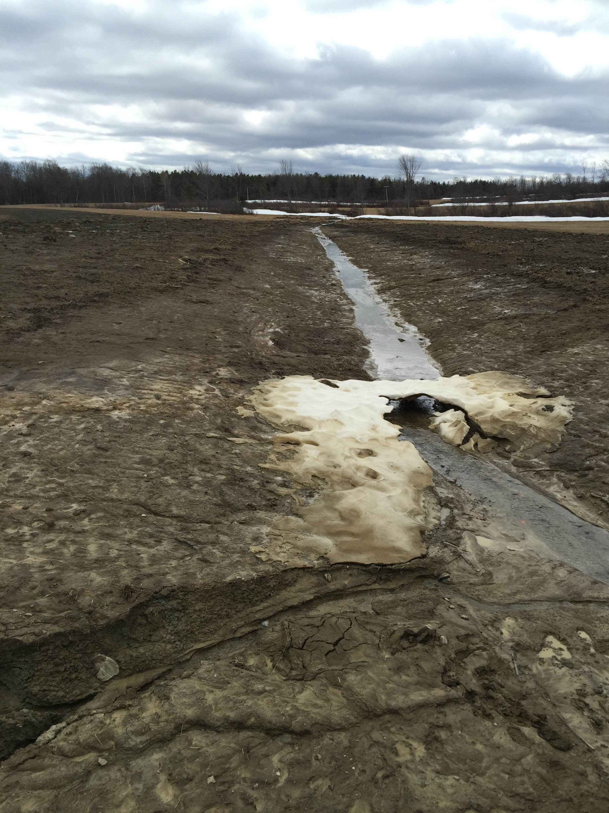
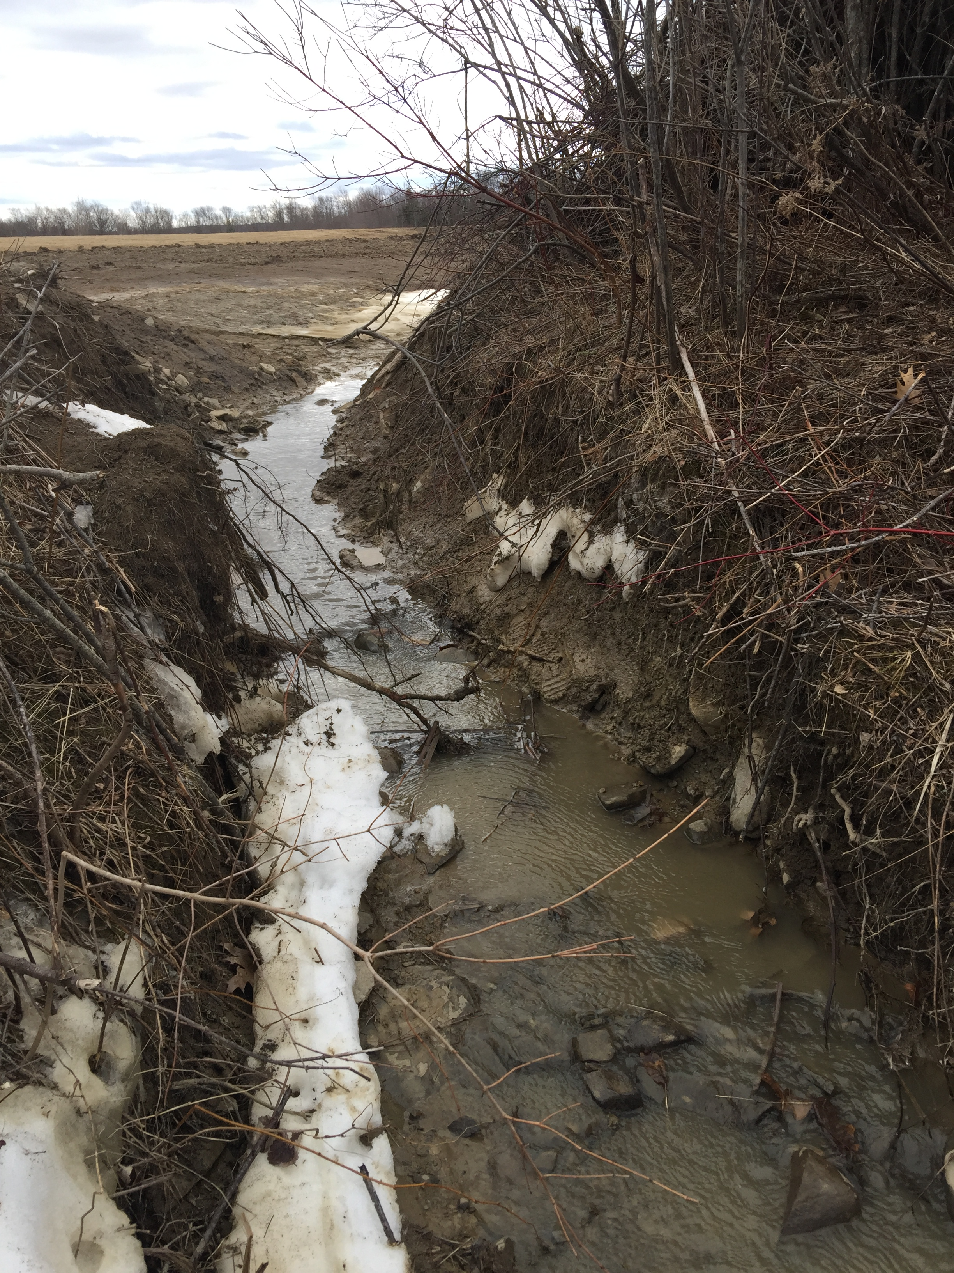
Risks of owning caves and karst
Serious damage to your land and/or your caves
Photo credits: Lance Dickey

Slide 4
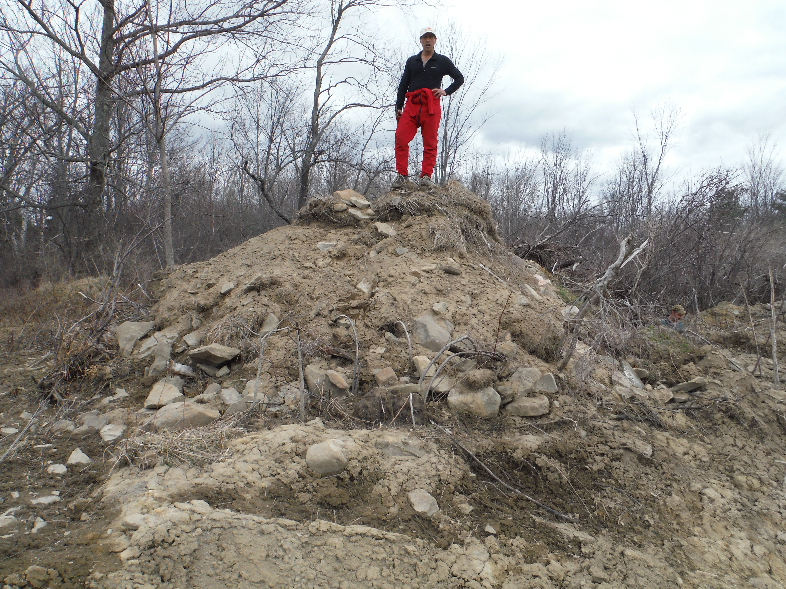
Risks of owning caves and karst
Serious damage to your land and/or your caves

Slide 5
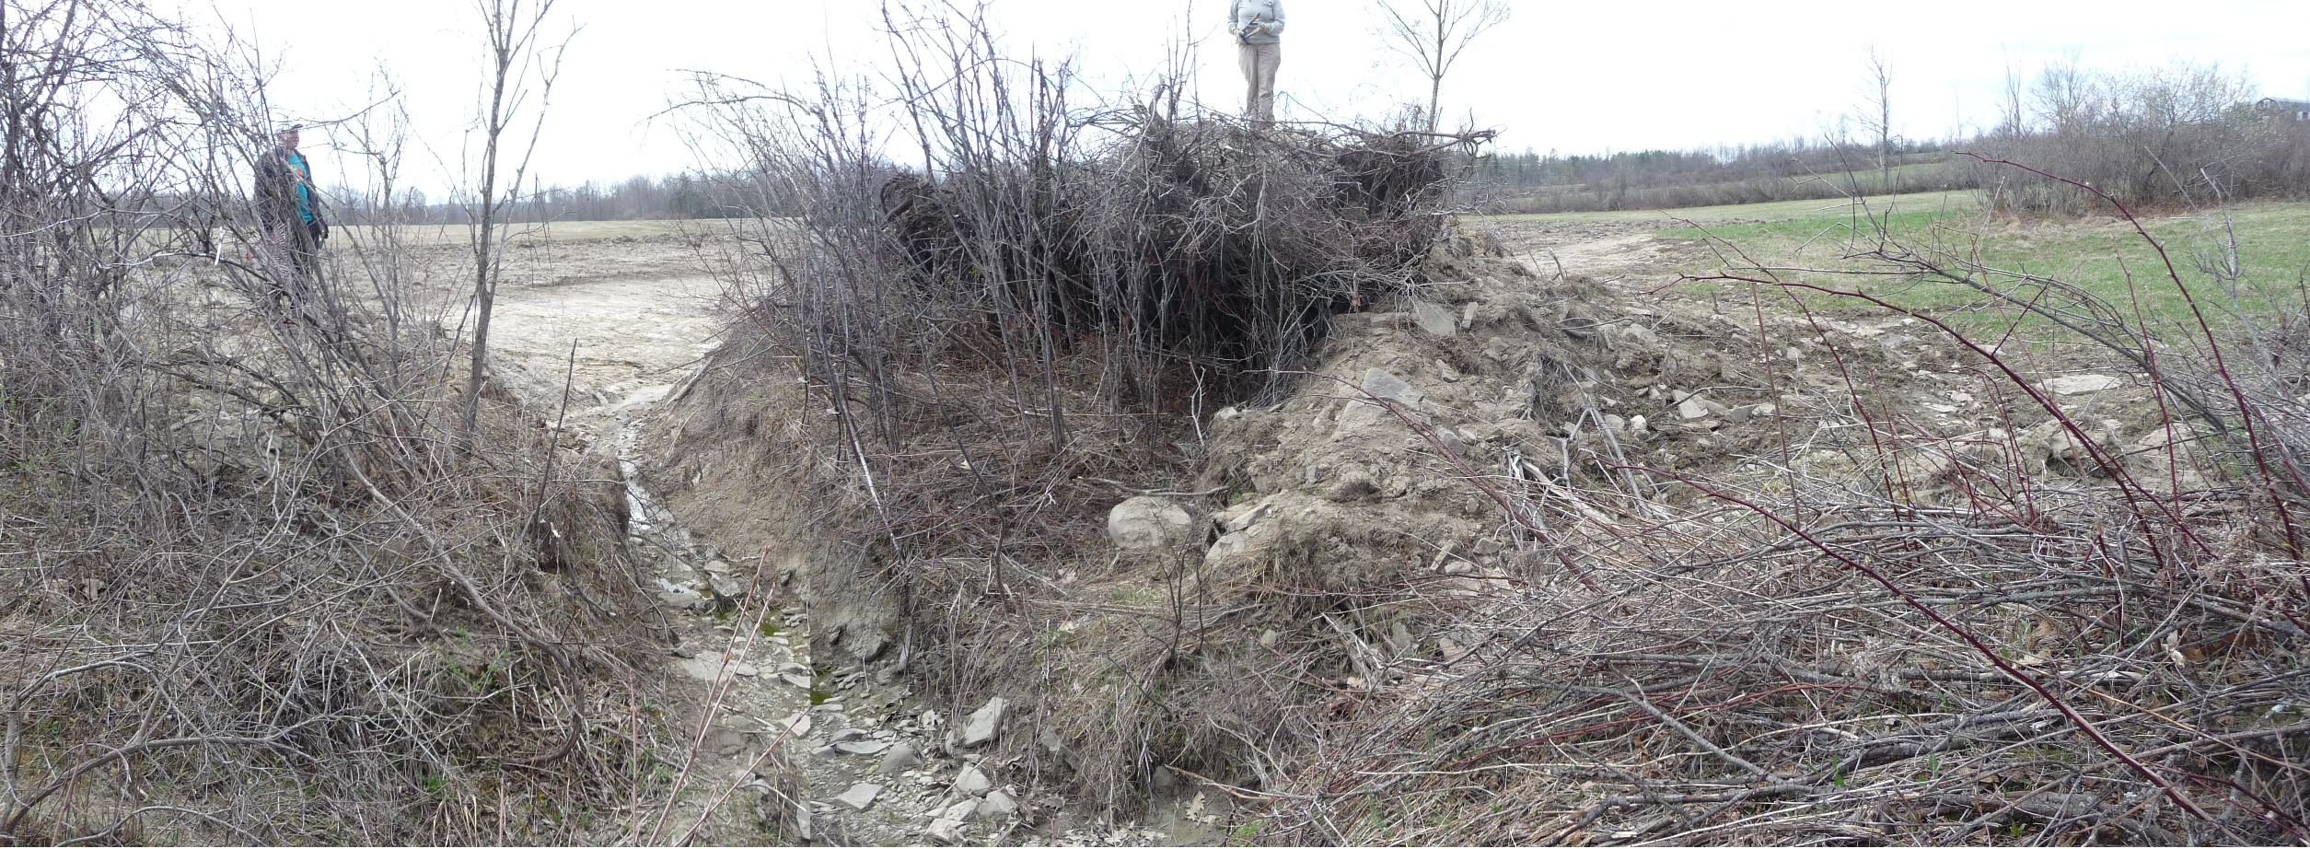
Risks of owning caves and karst
Serious damage to your land and/or your caves
Photo credit: Thom Engel

Slide 6
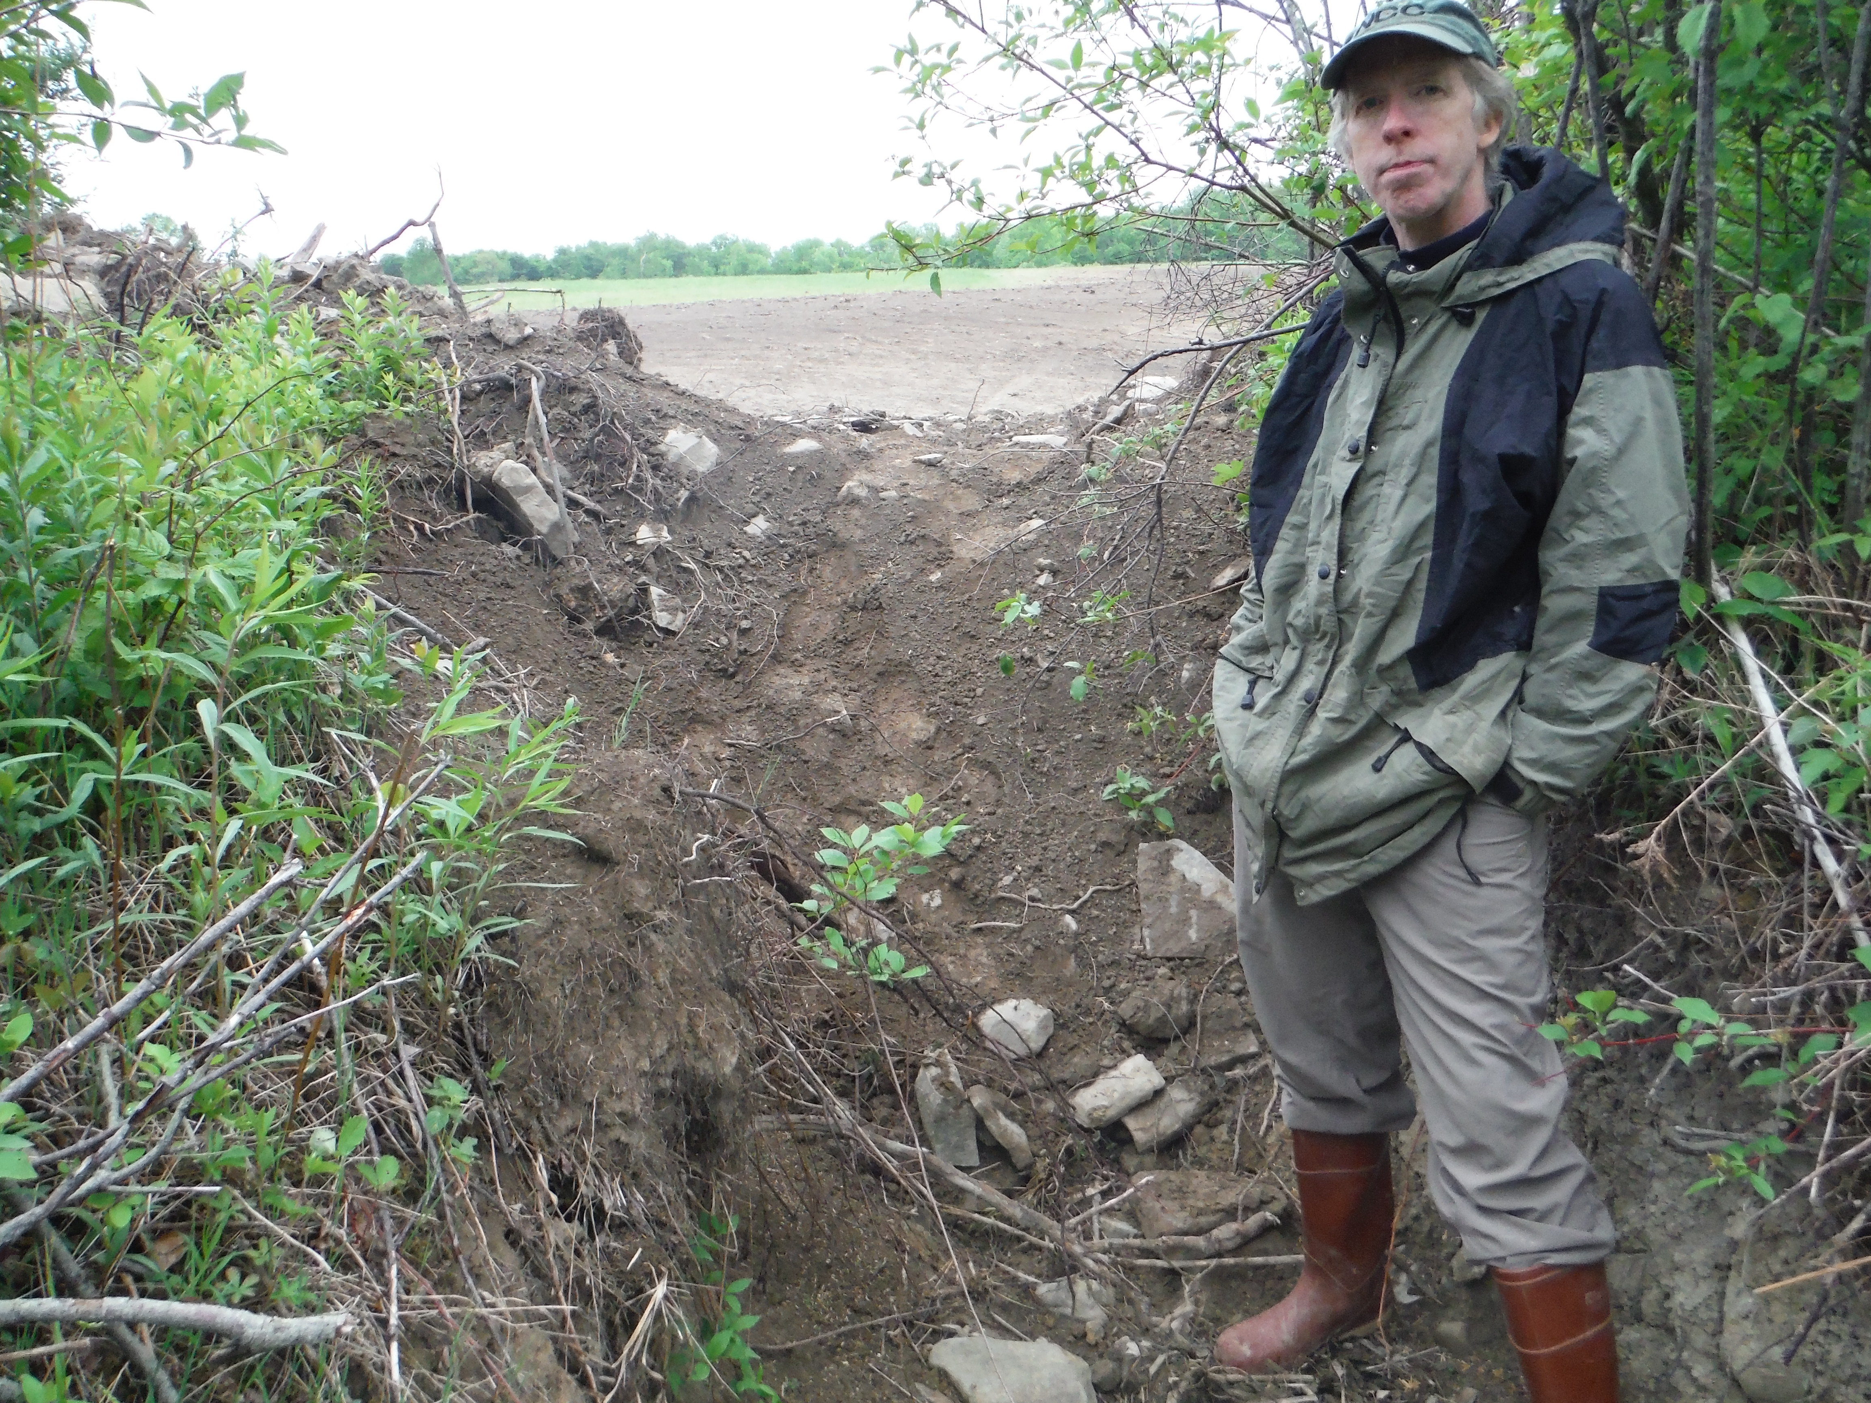
Risks of owning caves and karst
Serious damage to your land and/or your caves

Slide 7


Defending conservation
Terrafirma Risk Retention Group, LLC
  Unique insurance program protecting its members from the legal costs of conservation defense
  Owned and managed by its insured member land trusts
  Has fixed premiums
  Trains and educates on risk management
  Members must also be members of the Land Trust Alliance and carry general liability insurance

Slide 8
Risks of owning caves and karst
Business-related problems
  Accusations of mismanaging funds
  Accusations of discrimination
  Accusations of harassment
Directors & Officers insurance
  Not just for directors and officers: good “association-style” policies also protect your volunteers and committee members
  Not just for organizations with employees

Slide 9
How the NCC used to manage risk
Up until 1997, we only had one property to worry about
  We knew of the “sportsman's law” in New York
  We collected waivers
By 2011, we had 7 preserves, all potentially at risk if an accident at any of them resulted in losing a lawsuit
  A search for liability insurance coverage revealed:
    Many insurers think caves are too dangerous
    Many don't see the difference between us and commercial caves or amusement parks
    Many are way too expensive for a small volunteer organization to afford
  We purchased a policy we were able to afford
  One property had a conservation easement on it, and we were in negotiations for easements on two other properties

Slide 10
Learning about liability exposures
Ask a lawyer for advice!
  The NCC applied for and reveiced a grant that awarded pro-bono legal services
  Used those services to conduct a study of statutes and case law history about liability exposures to cave owners in New York and Vermont
  Asked questions about several topics (mostly the ones discussed in this presentation)
  End product was a pair of memos explaining risks and protections specific to our organization and the jurisdictions we owned or expected to own land in, along with recommendations about what to do.

Slide 11
How the NCC manages risk today
These choices may not be the right ones
for your organization's current needs!
We carry insurance (Gen. Liability and Directors&Officers)
We're a proud member of Terrafirma RRG, LLC
We no longer collect waivers
We post an “Assumption of Risk” statement at the kiosk at all our preserves, and on paperwork for “Special Use” groups
We've discontinued looking to place additional preserves under conservation easements
We participate in LTA risk management training, and attend conferences like this one to share with and learn from our karst management colleagues across the country

Slide 12
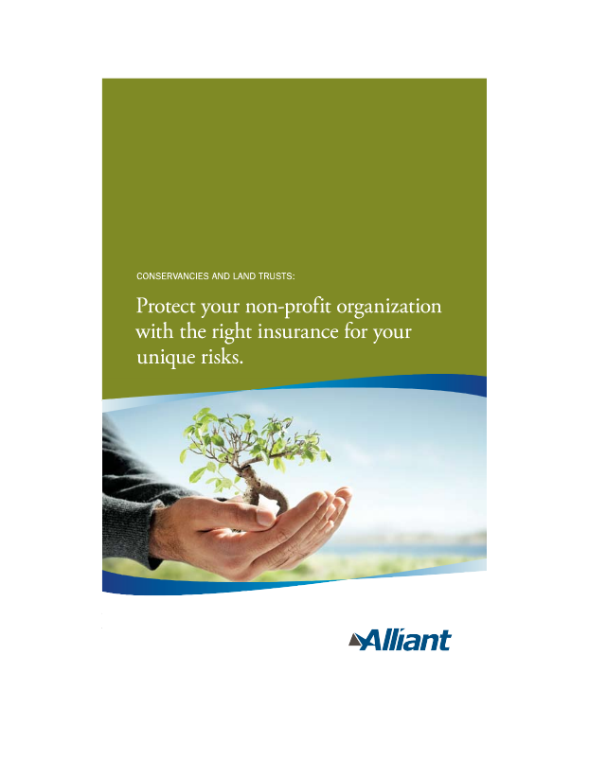

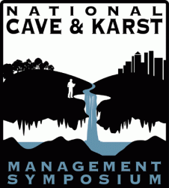
Resources to learn more
Land Trust Alliance
  Vast amounts of information useful to all aspects of running a land trust http://www.landtrustalliance.org/
Terrafirma Risk Retention Group, LLC
  Insurance for conservation defense http://terrafirma.org/
Conserve-A-Nation insurance program
  Insurance for conservation organizations
  http://www.alliant.com/
NSS Cave Conservancies Roundtable
  Each year at NSS Convention http://caves.org/
NCKMS
  You're already here! http://nckms.org/

