Slide 1

Risk Management Strategies
for Cave Conservancies
Mitchell Berger
Risk Management Committee Chair
Northeastern Cave Conservancy, Inc.
m.berger@necaveconservancy.org

Slide 2
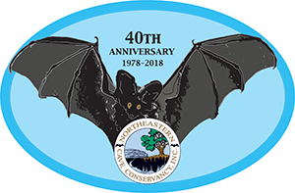
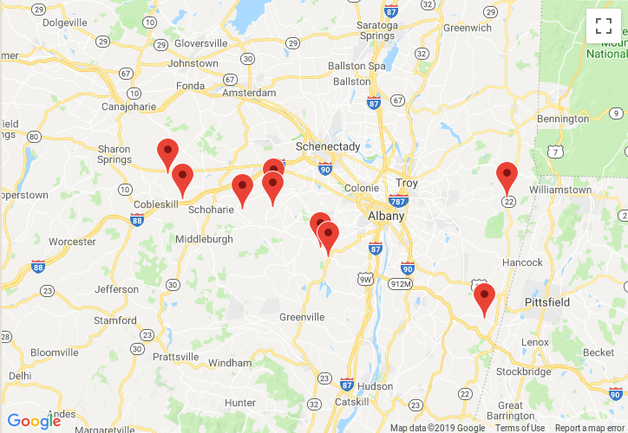
The NCC – then and now
Formed in 1978 to accept the donation of Knox Cave
Spent its first 20 years with just that one cave preserve, run by 3 people
In 1999, became a membership organization, run by a Board of Directors
Today
9 cave preserves
16 caves
90+ acres
175 members

Slide 3
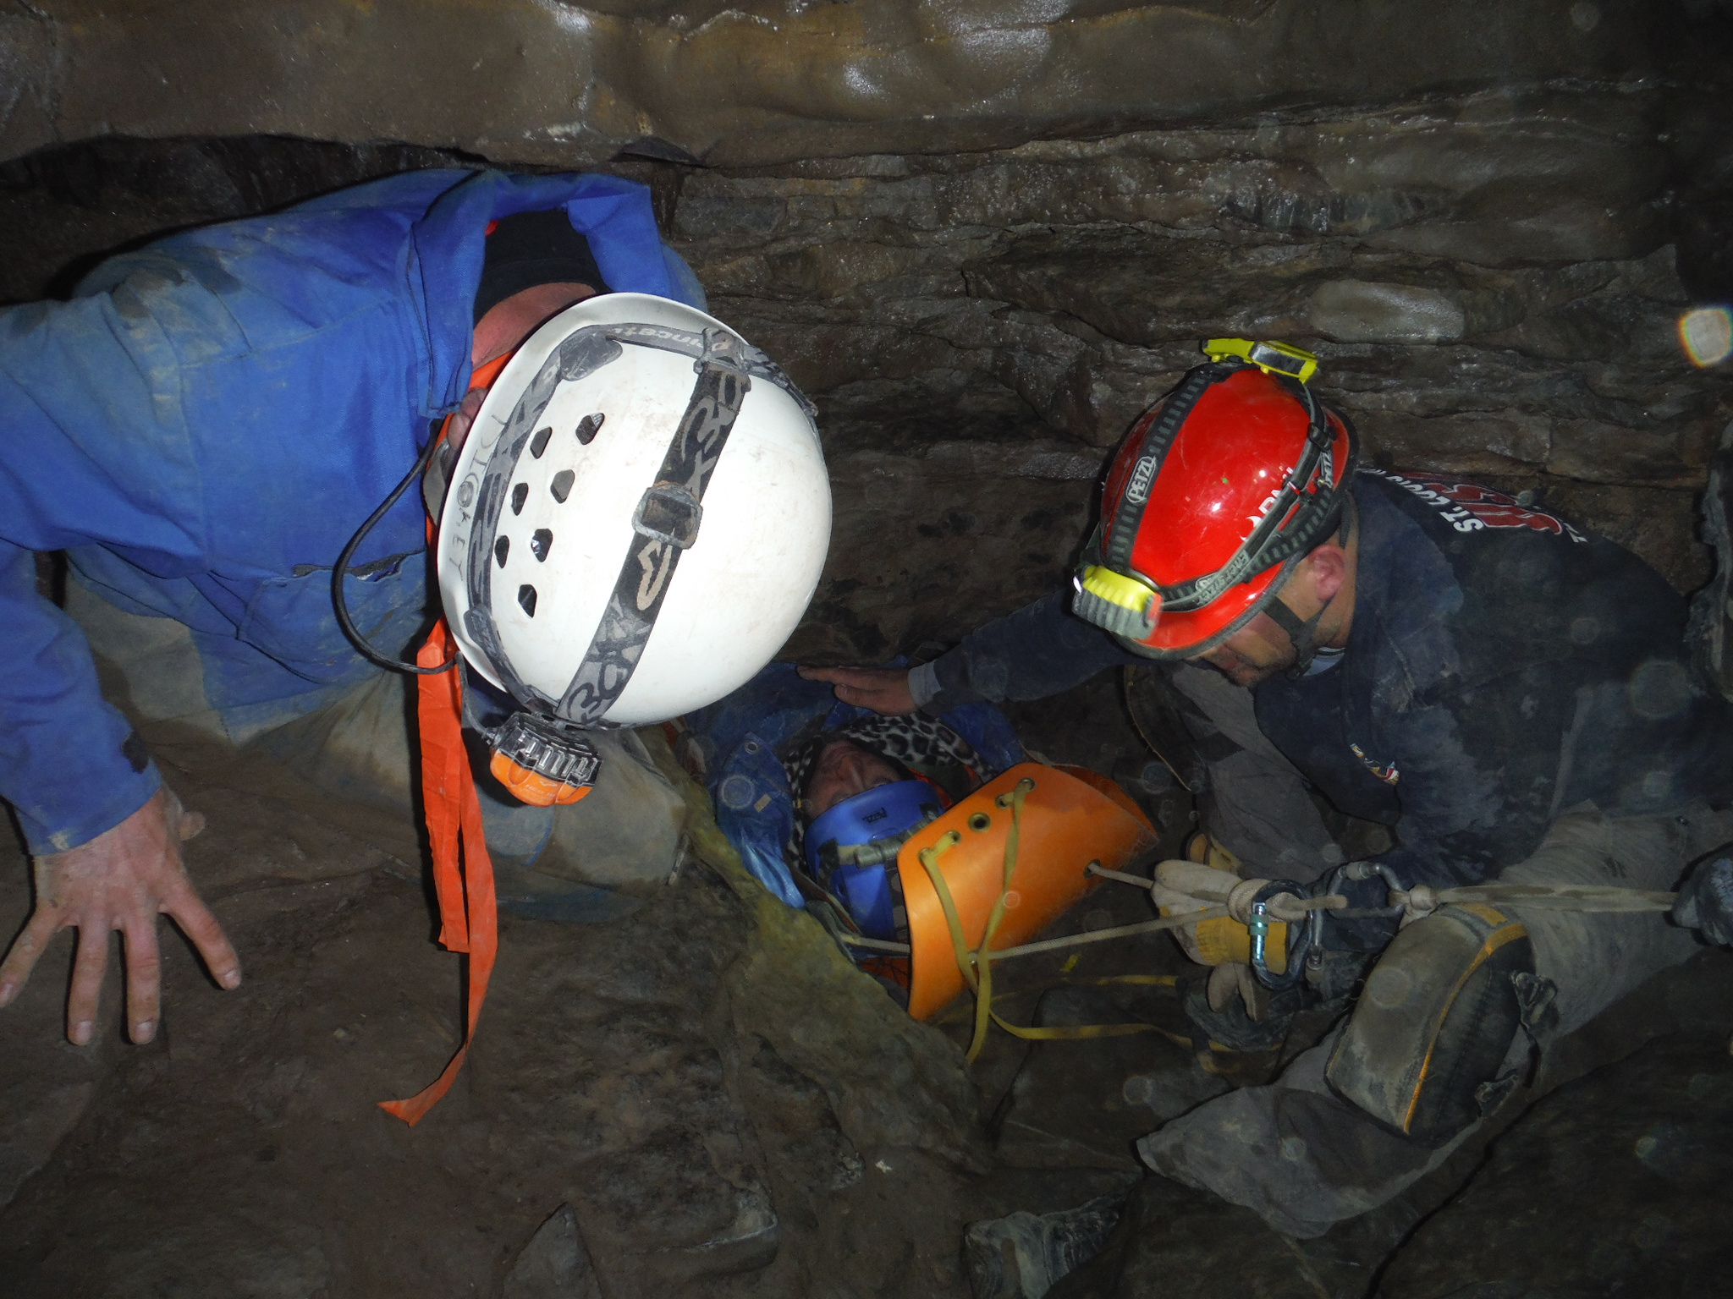
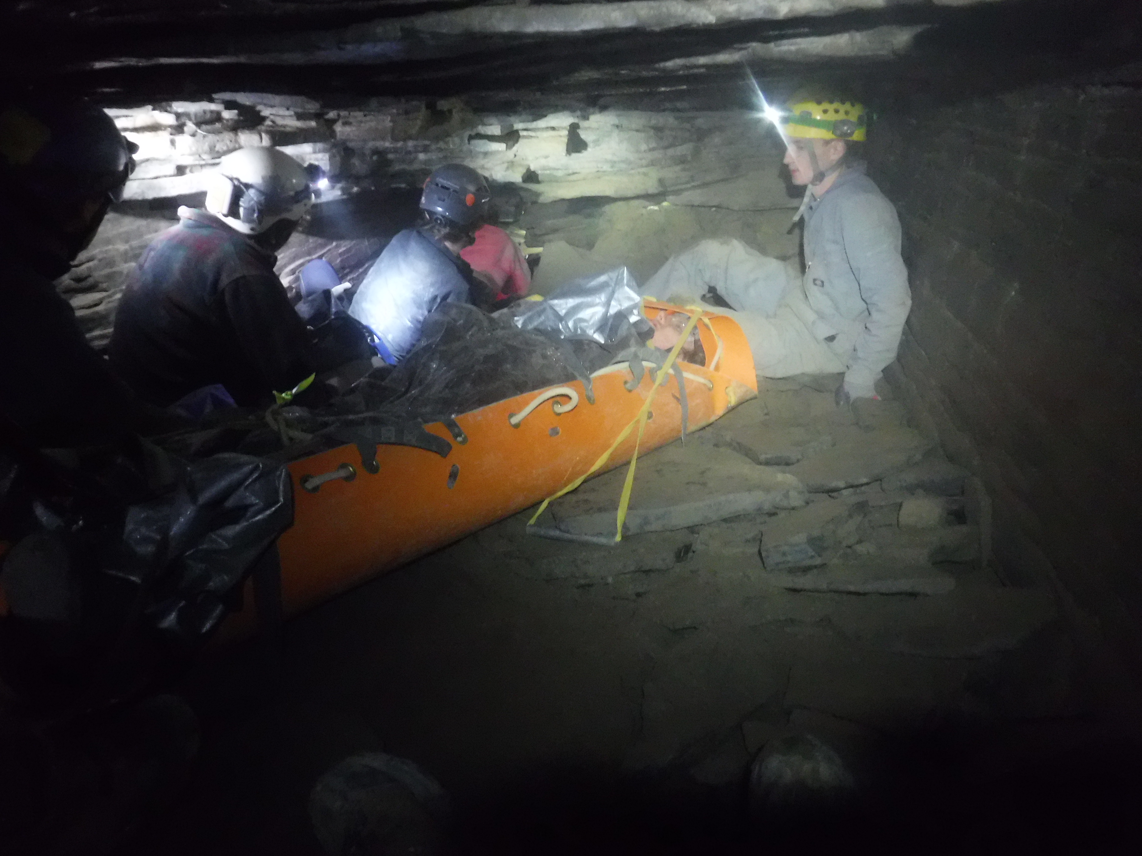
Risks of owning caves and karst
The obvious one – someone gets hurt or worse
Photo credit: Mark Dickey
... and you get sued

Slide 4
Liability – what it is
Premises liability
  What duty you have to someone on your land
  Laws vary by jurisdiction
  May depend on what type of person was visiting
    Trespasser? Licensee? Invited party?
  Likely depends on what services you do or have provided
    Safety training, guided trips, etc.
  Almost certainly depends on whether you charge a fee
Assumption of risk
  Adjusts how much of the liability is yours

Slide 5
Liability – ways to protect against it
“Sportsman's laws”
  Generally free landowners of some or most of the duty they would otherwise have to a visitor, if they allow recreational use of their land
  Typically only apply if no money is collected
  Vary state-to-state as to which recreational activities are included
    New York: “speleological activity”
    Vermont: “caving”
    West Virginia: “spelunking”
    your state: ???

Slide 6
Liability – ways to protect against it
Insurance
  General Liability (G/L)
    Insurance company provides and pays for legal representation if you get sued for something covered by the policy
    Pays for damages awarded if you lose a case
  You can always be sued, even if you're not liable
    This costs money even if the outcome is known

Slide 7

Liability – ways to protect against it
Waivers
  Visitors sign an agreement to give up some rights (typically including the right to sue you)
  Assumption of risk by the visitors
  Challenges to enforcing a waiver in court
    How old is it?
    Did the visitor truly understand what they were getting themselves into?
    How much choice did they really have in signing it?

Slide 8
Liability – ways to protect against it
Conservation easements
  Landowner gives up a subset of their rights to a different conservation organization
  Structured such that neither the owner nor the easement holder can damage the land (or caves)
  Decreases the value of the land to most other entities by eliminating its development potential (makes your organization a less attractive litigation target)
  Managing the easement costs real money
    Easement holder does inspections, recordkeeping, etc.
    Landowner often pays for this up-front or by encumbering the land at sale time

Slide 9
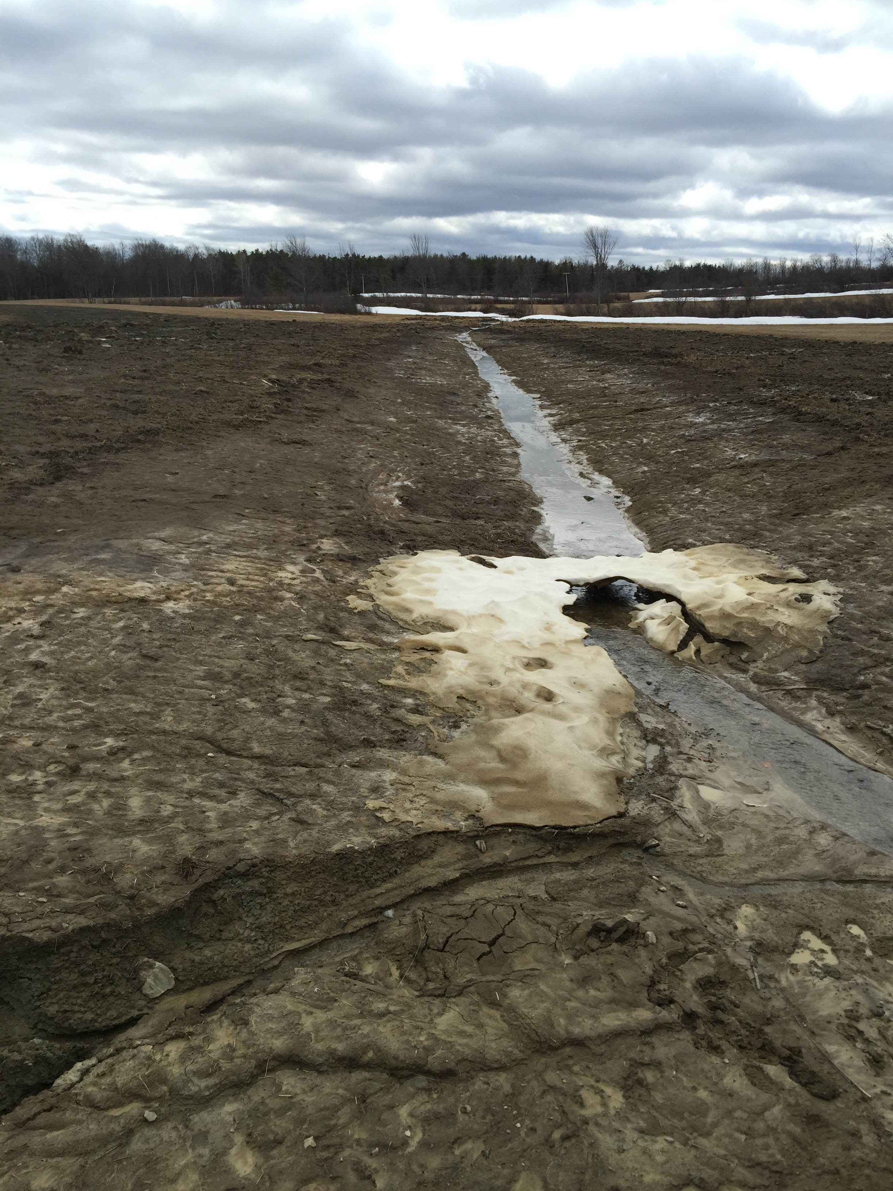
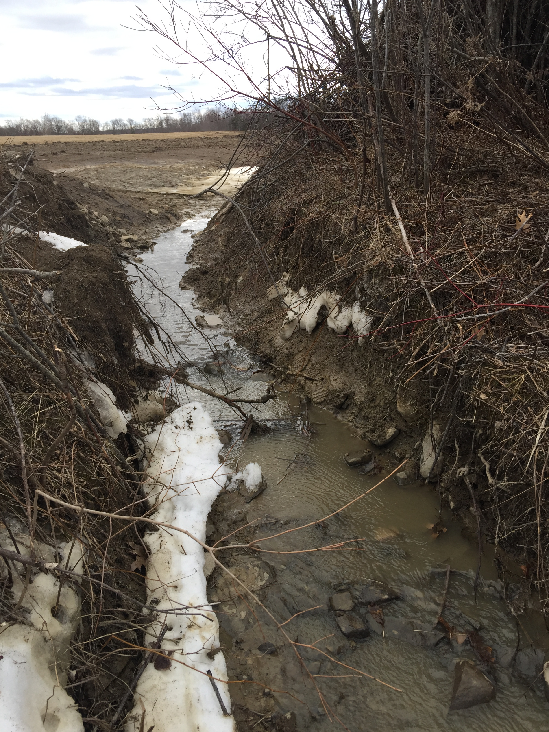
Risks of owning caves and karst
Serious damage to your land and/or your caves
Photo credits: Lance Dickey

Slide 10
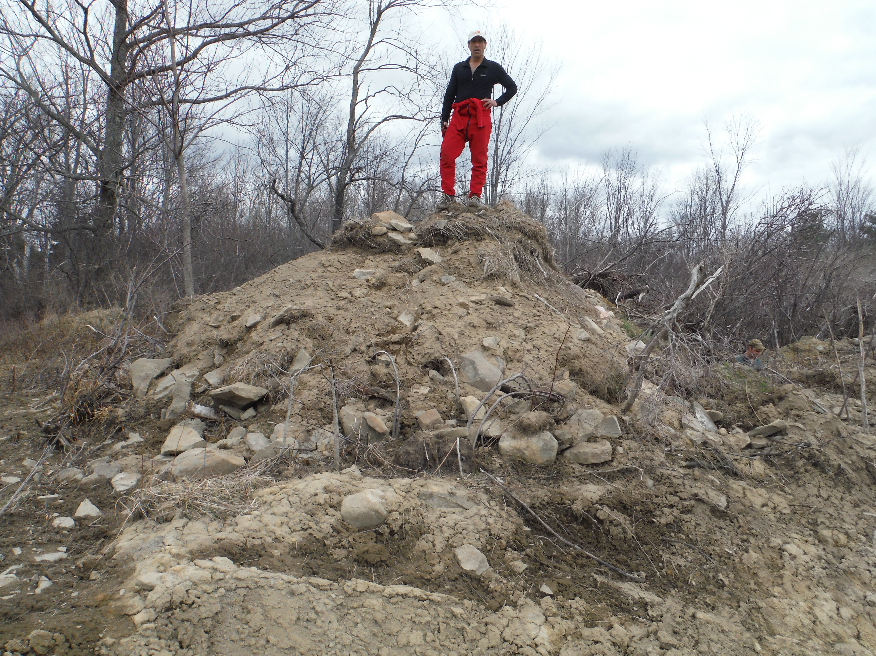
Risks of owning caves and karst
Serious damage to your land and/or your caves

Slide 11
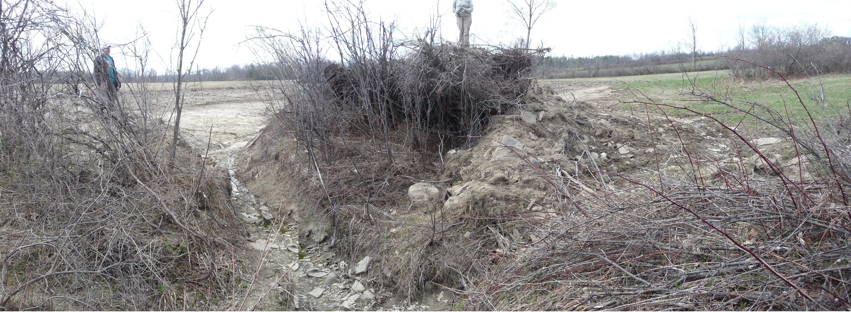
Risks of owning caves and karst
Serious damage to your land and/or your caves
Photo credit: Thom Engel

Slide 12
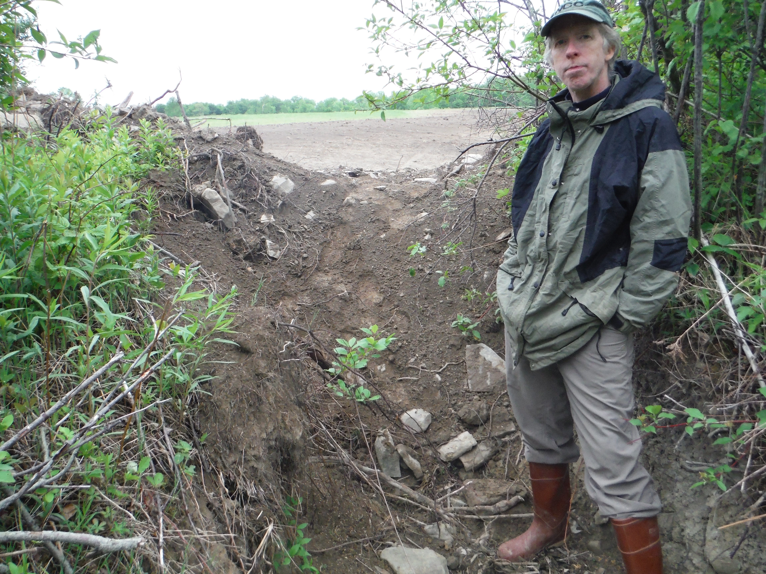
Risks of owning caves and karst
Serious damage to your land and/or your caves

Slide 13


Defending conservation
Terrafirma Risk Retention Group, LLC
  Unique insurance program protecting its members from the legal costs of conservation defense
  Owned and managed by its insured member land trusts
  Has fixed premiums
  Trains and educates on risk management
  Members must also be members of the Land Trust Alliance and carry general liability insurance

Slide 14
Risks of owning caves and karst
Business-related problems
  Accusations of mismanaging funds
  Accusations of discrimination
  Accusations of harassment
Directors & Officers insurance
  Not just for directors and officers: good “association-style” policies also protect your volunteers and committee members
  Not just for organizations with employees

Slide 15
How the NCC used to manage risk
Up until 1997, we only had one property to worry about
  We knew of the “sportsman's law” in New York
  We collected waivers
By 2011, we had 7 preserves, all potentially at risk if an accident at any of them resulted in losing a lawsuit
  A search for liability insurance coverage revealed:
    Many insurers think caves are too dangerous
    Many don't see the difference between us and commercial caves or amusement parks
    Many are way too expensive for a small volunteer organization to afford
  We purchased a policy we were able to afford
  One property had a conservation easement on it, and we were in negotiations for easements on two other properties

Slide 16
Learning about liability exposures
Ask a lawyer for advice!
  The NCC applied for and reveiced a grant that awarded pro-bono legal services
  Used those services to conduct a study of statutes and case law history about liability exposures to cave owners in New York and Vermont
  Asked questions about several topics (mostly the ones discussed in this presentation)
  End product was a pair of memos explaining risks and protections specific to our organization and the jurisdictions we owned or expected to own land in, along with recommendations about what to do.

Slide 17
How the NCC manages risk today
These choices may not be the right ones
for your organization's current needs!
We carry insurance (Gen. Liability and Directors&Officers)
We're a proud member of Terrafirma RRG, LLC
We no longer collect waivers
We post an “Assumption of Risk” statement at the kiosk at all our preserves, and on paperwork for “Special Use” groups
We've discontinued looking to place additional preserves under conservation easements
We participate in LTA risk management training, and attend conferences like this one to share with and learn from our karst management colleagues across the country

Slide 18
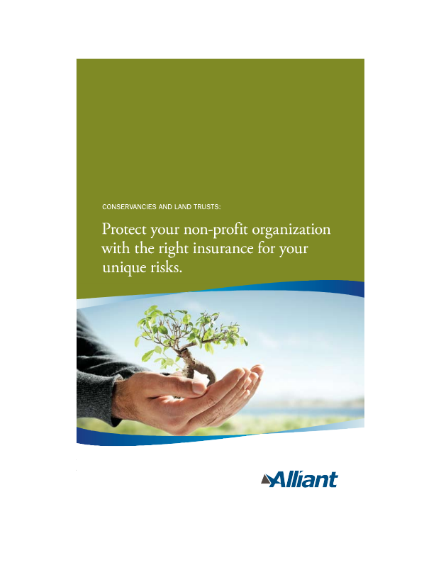

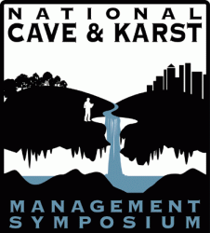
Resources to learn more
Land Trust Alliance
  Vast amounts of information useful to all aspects of running a land trust http://www.landtrustalliance.org/
Terrafirma Risk Retention Group, LLC
  Insurance for conservation defense http://terrafirma.org/
Conserve-A-Nation insurance program
  Insurance for conservation organizations
  http://www.alliant.com/
NSS Cave Conservancies Roundtable
  Each year at NSS Convention http://caves.org/
NCKMS
  You're already here! http://nckms.org/

