Slide 1
MIT 3.071
Amorphous Materials
10: Metallic Glass
Juejun (JJ) Hu
hujuejun@mit.edu

Slide 2
After-class reading list
Structure of metallic glass
  D. Miracle, “A structural model for metallic glasses”
Mechanical properties
  C. Schuh et al., “Mechanical behavior of amorphous alloys”
Topical review
  M. Chen, “A brief overview of bulk metallic glasses”

Slide 3
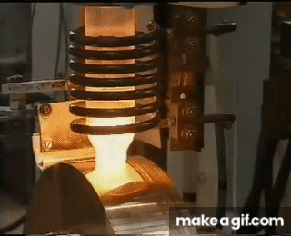
Metallic glass: the timeline
1960: First report of a metallic glass in binary Au-Si via rapid solidification (RS)
1970’s: Study of RS ribbons; commercialization in magnetic applications
1980’s: First observation of ‘bulk’ metallic glass (BMG) formers > 1 mm in size
1990’s: Development of ‘cheap’ bulk glasses (Vitreloy) based on Zr
2000’s: First limited commercialization of BMG, rapid increase in number of glass forming alloys, discovery of bulk binary glasses
2010’s: Gradual increase in understanding toughness and plasticity

Slide 4
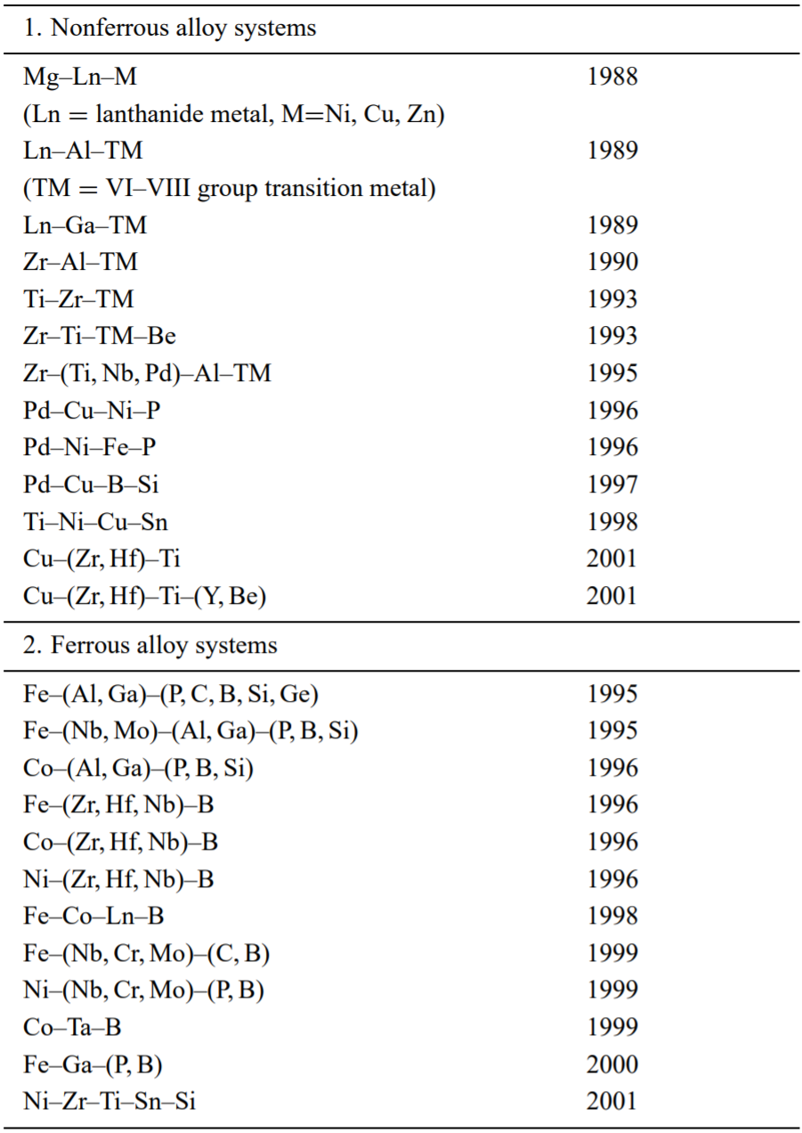
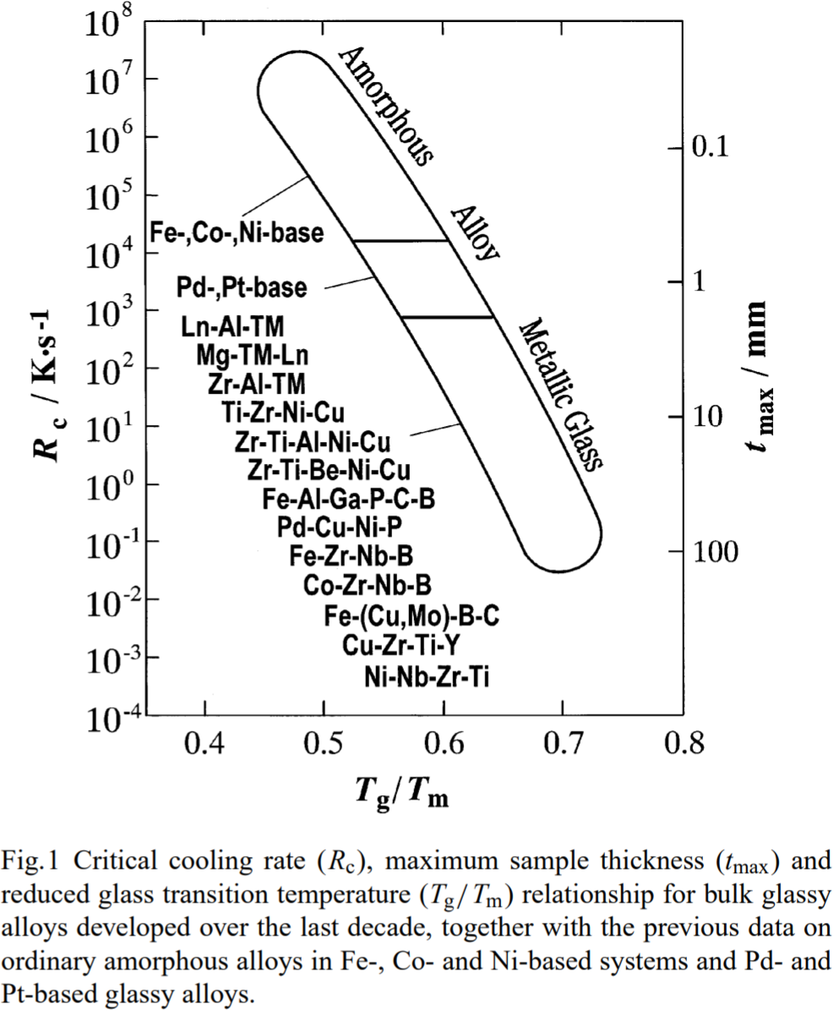
Metallic glass: the timeline
Mater. Trans. 43, 1892 (2002)

Slide 5
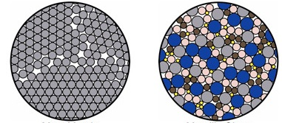
Metallic glass: structure
Polycrystalline metal
Amorphous metal
Metallic bonding, largely non-directional, is mostly about achieving dense packing
Notes:
It is frequently presumed that free volume (similar to Fictive temperature in network glasses) is an adequate state variable to describe the structure of a metallic glass, although it is important to remember that other effects such as chemical ordering may be involved.

Slide 6
Metallic glass: structure
Polycrystalline metal
Amorphous metal
Inoue’s empirical rules for bulk metallic glass (BMG) formation
  Multicomponent systems consisting of three or more elements
  Significant difference in atomic size ratios (frustration)
  Negative enthalpy of mixing

Slide 7
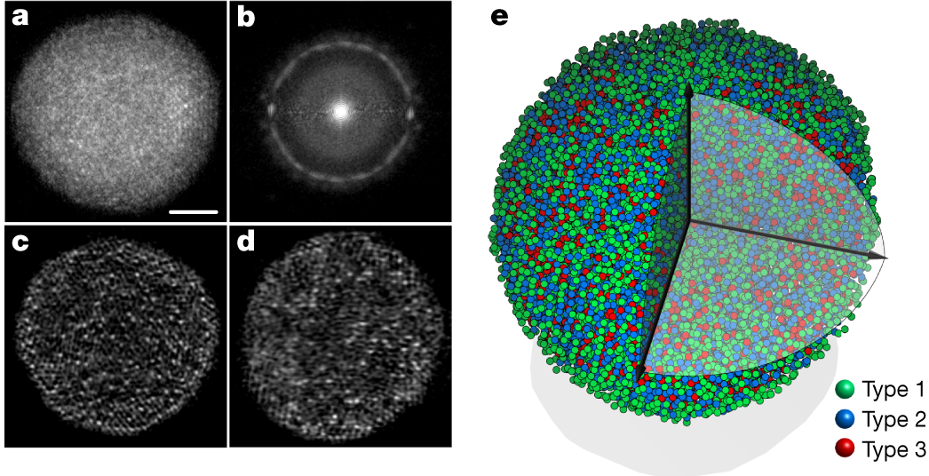
3D atomic structure of a multi-component metallic glass nanoparticle
Close-packed structure imaged using atomic electron tomography
Nature 592, 60-64 (2021)

Slide 8
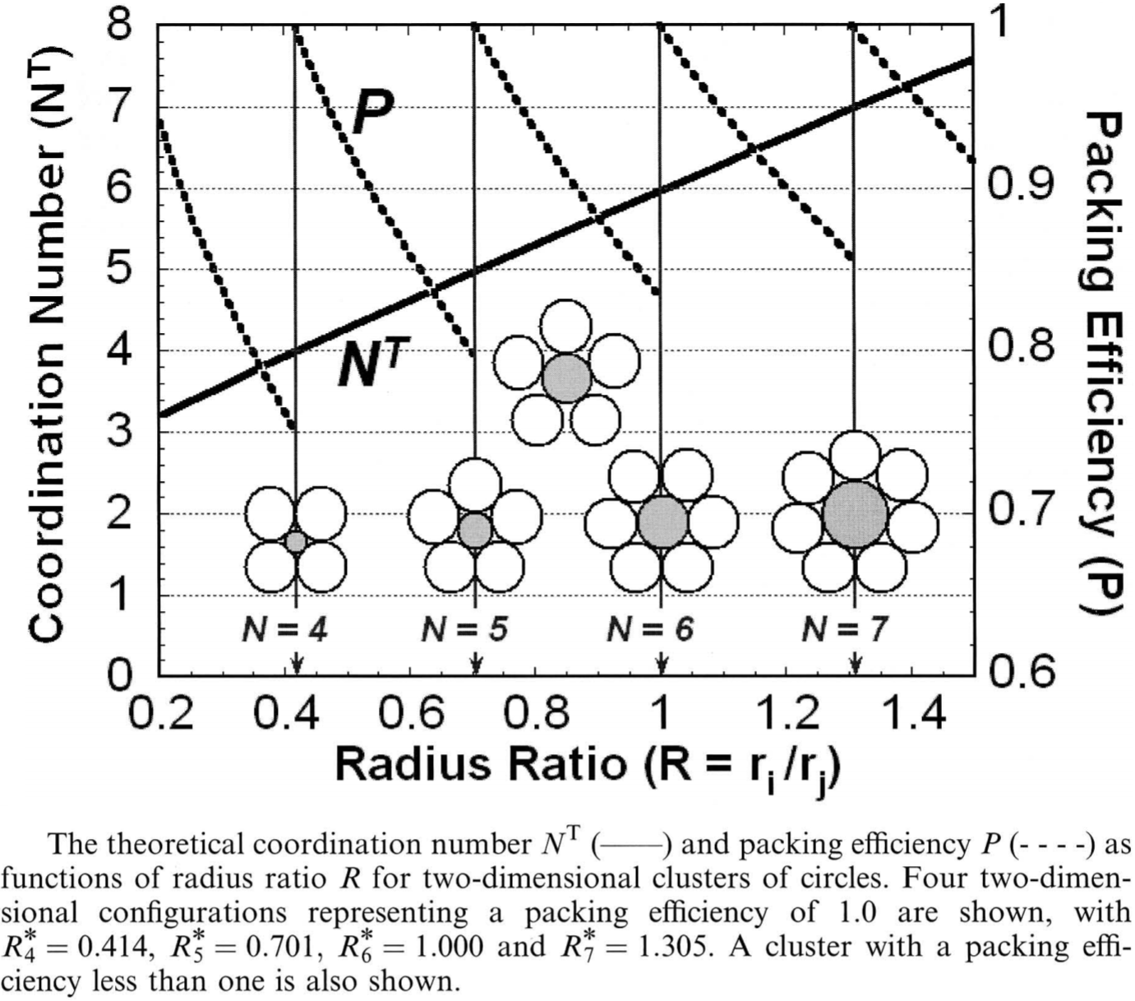
Hard sphere packing in 2-D
Dense packing is only achieved at certain critical radius ratios
Philos. Mag. 83, 2409 (2003)

Slide 9
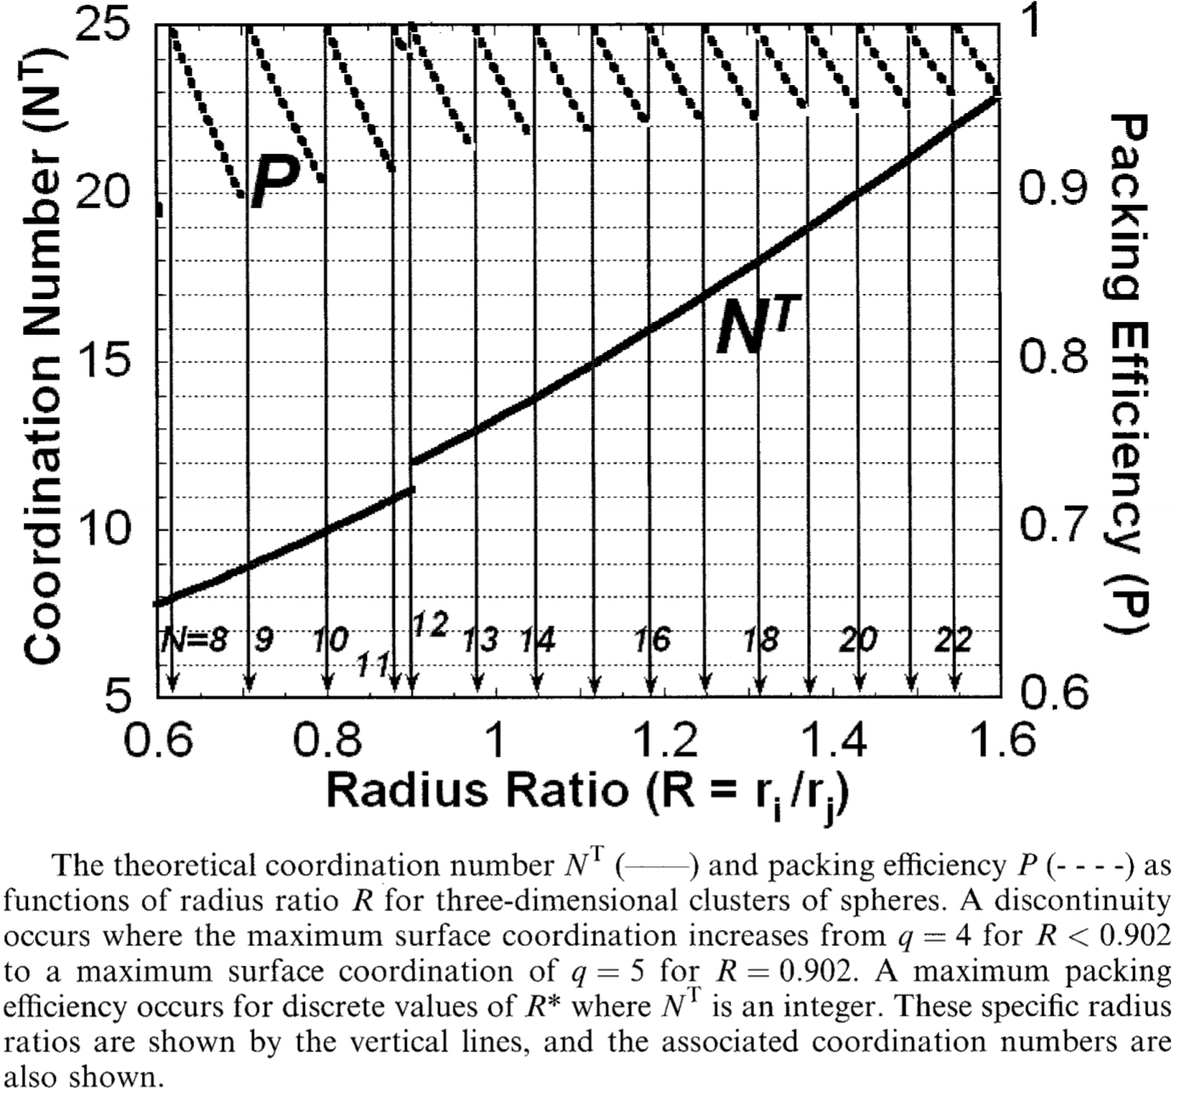
Hard sphere packing in 3-D
Local structures of metallic glasses are efficiently packed in systems with critical atomic radius ratios
Philos. Mag. 83, 2409 (2003)
Notes:
The discontinuity results from a transition from substitutional to interstitial structure

Slide 10
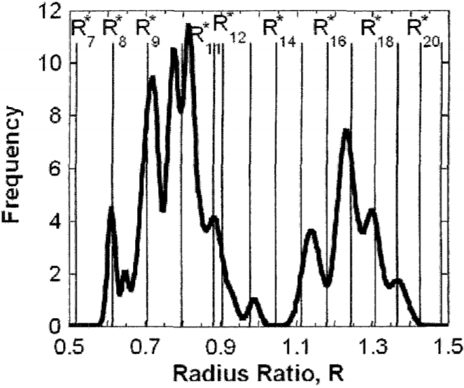
Dense packing favors metallic glass formation
Stable binary metallic glasses tend to form at atomic size ratios corresponding to dense packing
Philos. Mag. 83, 2409 (2003)
Notes:
Histogram of atomic radius ratios in known stable binary metallic glasses
Coordination number 12 corresponds to regular close packed structures and has minimal probability

Slide 11
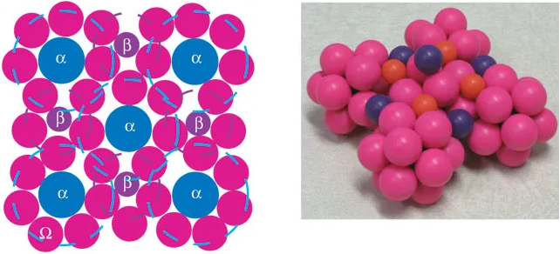
Beyond nearest neighbors: cluster packing
Nat. Mater. 3, 697 (2004)
Close-packed clusters sharing faces or edges
Atoms of different critical sizes fulfill different topological roles
α: center atom of polyhedral; β / γ: filling in interstitials
Notes:
Αλτηουγη μεταλλιχ γλασσεσ χαν ηαϖε ανψ νυμβερ οφ χηεμιχαλλψ διστινχτ σολυτε σπεχιεσ, τηισ μοδελ σηοωσ τηατ τηεψ χονταιν νο μορε τηαν τηρεε τοπολογιχαλλψ διστινχτ σολυτεσ ανδ τηατ τηεσε σολυτεσ ηαϖε σπεχιφιχ ανδ πρεδιχταβλε σιζεσ ρελατιϖε το τηε σολϖεντ ατομσ.
αλπηα: cluster forming solute; beta/gamma: secondary/tertiary solutes filling in octahedral/tetrahedral interstices

Slide 12
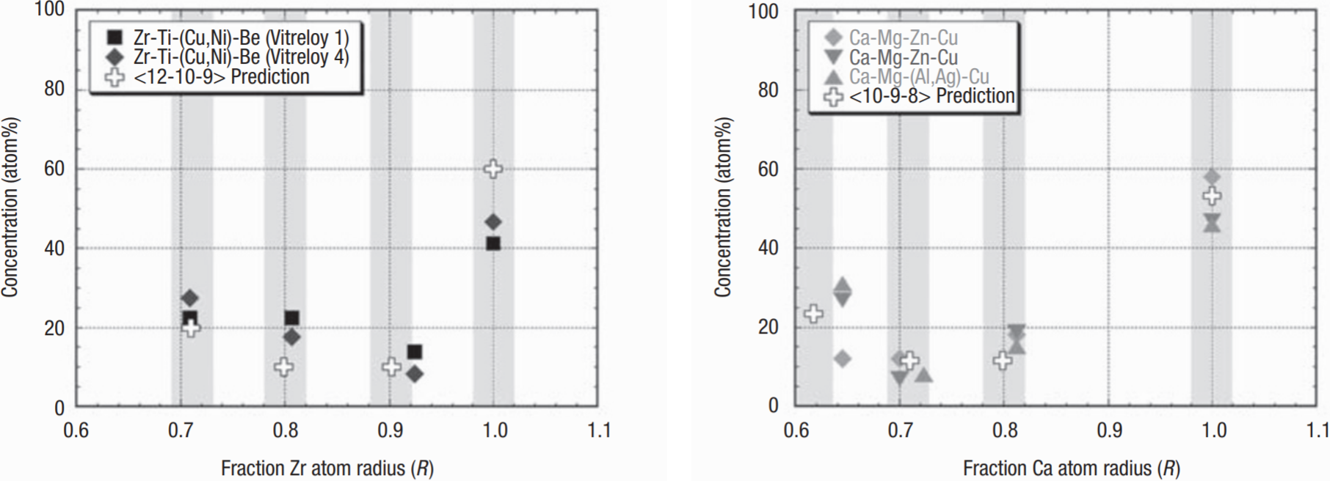
Beyond nearest neighbors: cluster packing
The cluster packing model correctly predicts the atomic size and concentration of stable metallic glasses
D. Miracle, Nat. Mater. 3, 697 (2004)
Notes:
Elements enclosed in parentheses in the legends have nearly identical atomic radii and thus represent topologically identical solutes

Slide 13
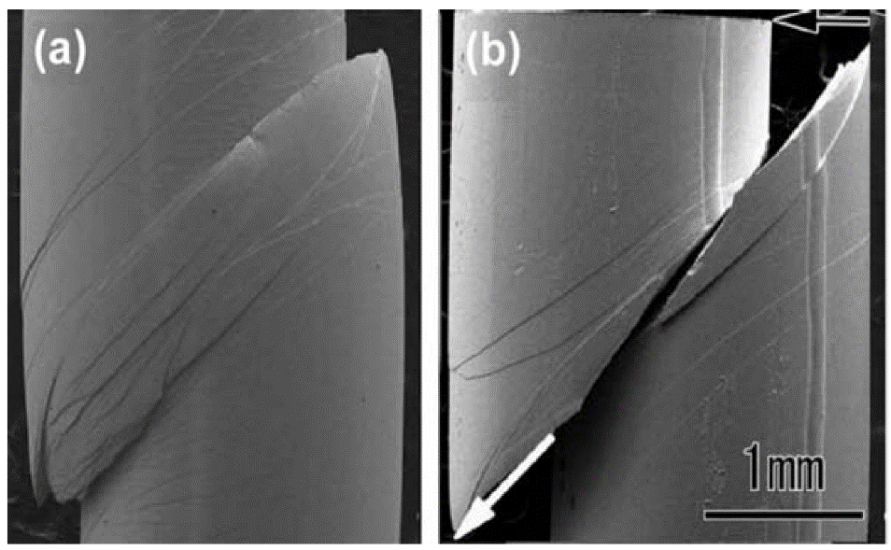
Mechanical properties of metallic glasses
Polycrystalline metal
Amorphous metal
Grain boundaries
Crystal planes
Metals 3, 1 (2013)
Absence of dislocations and slip planes/directions in BMG
  Large elastic limit and high yield strength (2% and 2 GPa in Zr-based BMGs)
  Poor global plasticity: absence of strain hardening, strong tendency towards shear localization

Slide 14
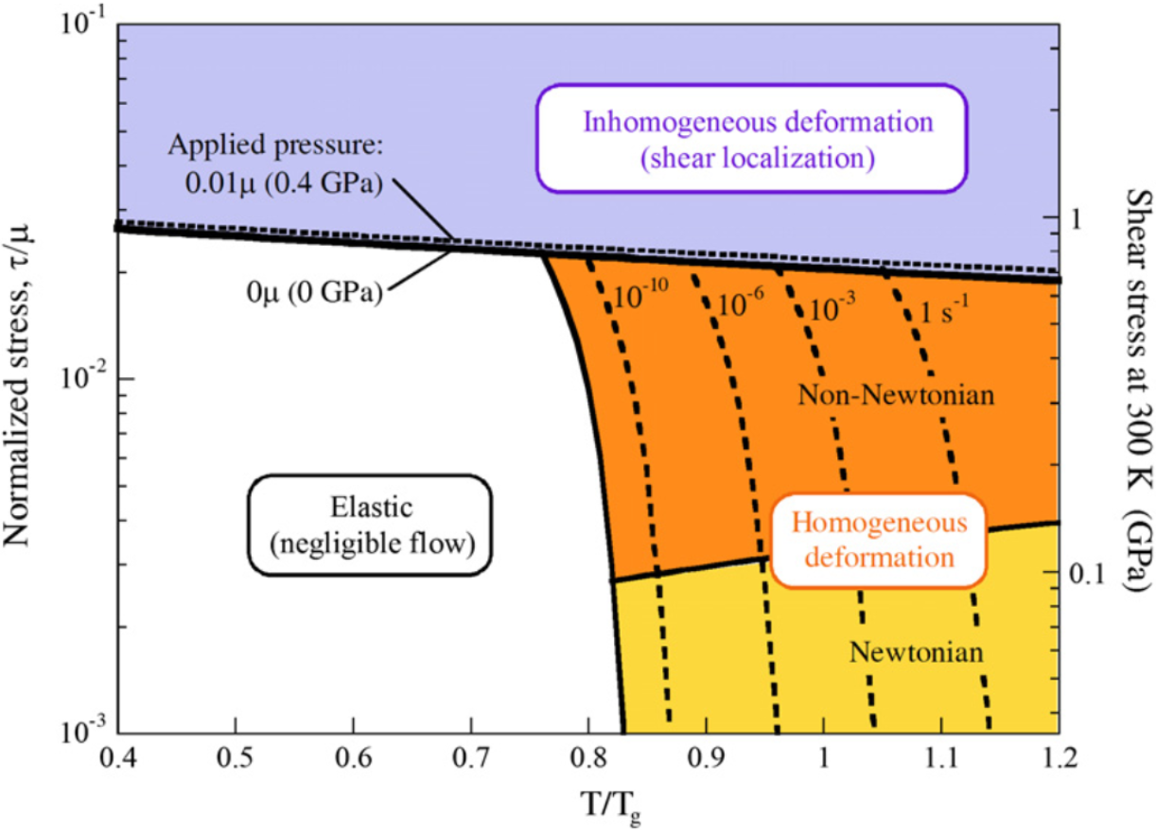
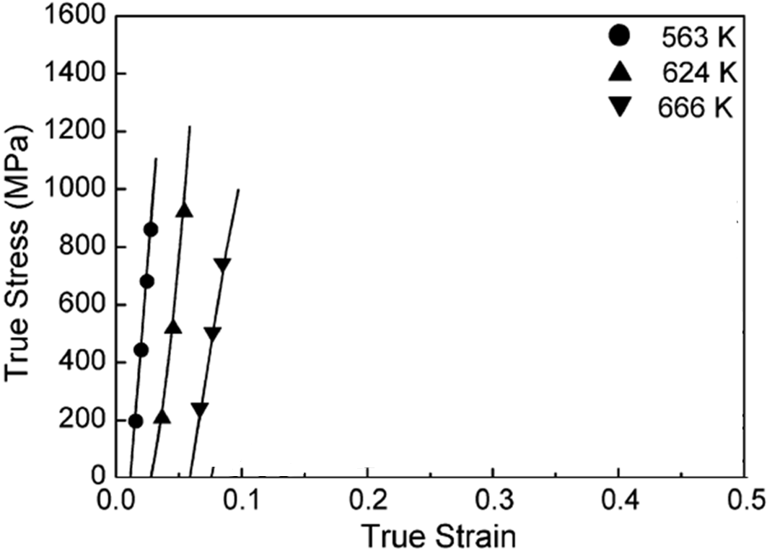
A deformation map of metallic glasses
Schuh et al., Acta Mater. 55, 4067 (2007)
Shear localization at high stresses

Slide 15
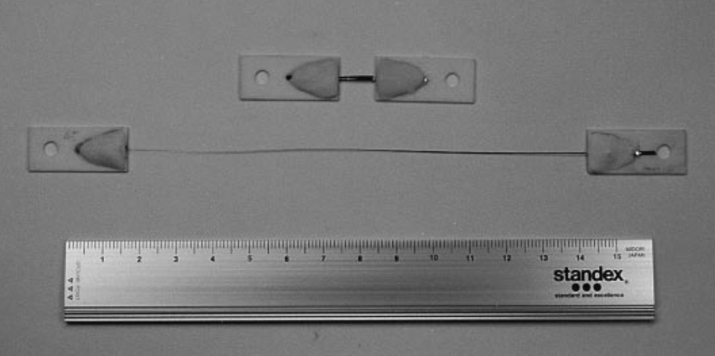
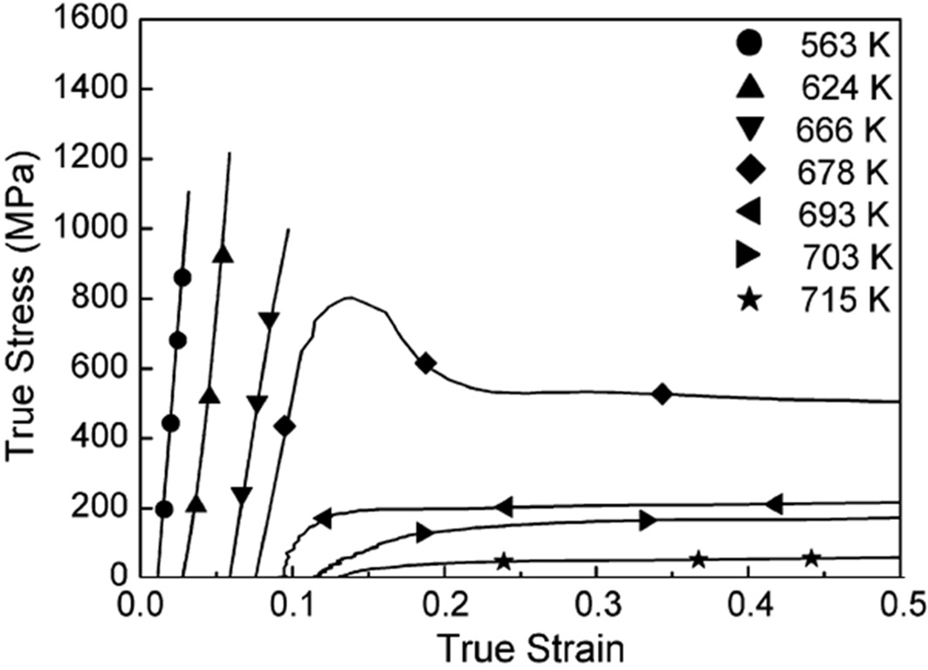
A deformation map of metallic glasses
Scr. Mater. 39, 301 (1998)
Schuh et al., Acta Mater. 55, 4067 (2007)
Homogeneous flow at high temperatures
Notes:
Photograph of Pd₄₀Ni₄₀P₂₀ metallic glass before and after the deformation to 1260% at an initial strain rate of 1.7 × 10⁻¹ s⁻¹ and at 620 K

Slide 16
Elastic and anelastic deformation
Isotropic media
Bulk modulus: typically ~ 6% smaller than that of the crystalline counterpart
  Can be accounted for by the less dense packing (presence of free volume) in metallic glasses
Shear/Young’s modulus: ~ 30% smaller than that of the crystalline counterpart
  In a crystal, all atoms undergo similar displacement defined by the macroscopic strain
  In metallic glass, non-uniform local displacement takes place, e.g. through STZ

Slide 17
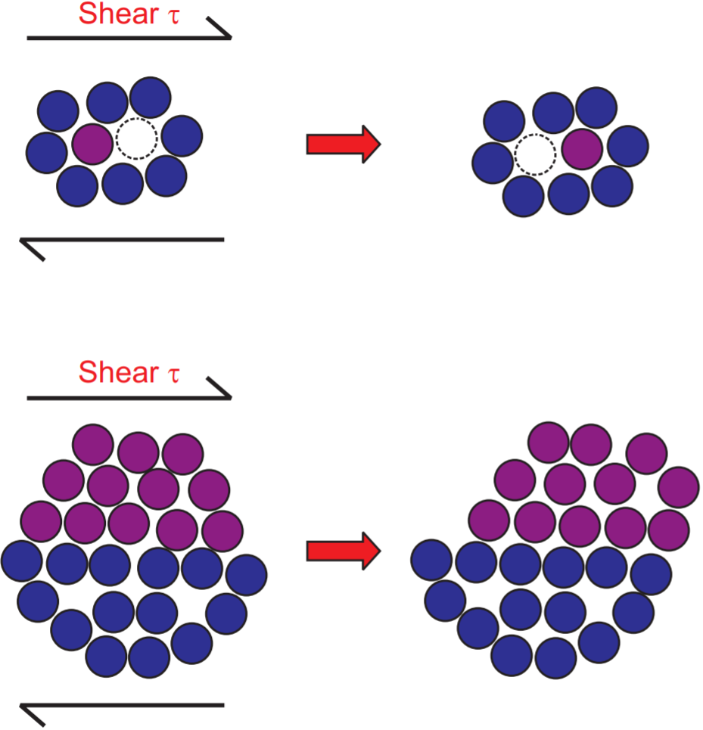
Atomistic mechanisms of deformation
Diffusive atomic jump
Shear transformation zone (STZ)
Acta Mater. 55, 4067 (2007)
Notes:
Both mechanisms strongly correlate with local distributions of free volume.
STZs comprise a few to perhaps 100 atoms. An STZ is not a structural defect in an amorphous metal in the way that a lattice dislocation is a crystal defect. Rather, an STZ is an event defined in a local volume, not a feature of the glass structure.

Slide 18
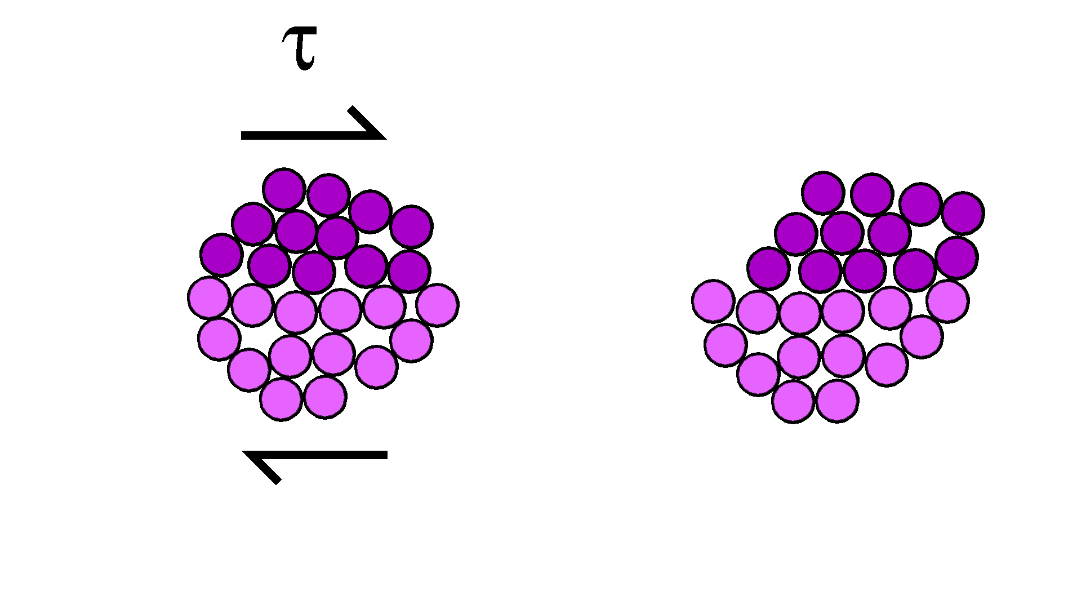
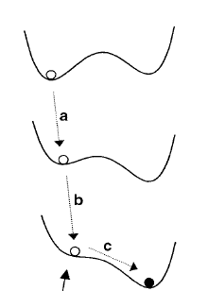
Atomistic origin of plastic deformation
τ
“The plastic deformation of metallic glasses on the macroscopic scale is essentially a biased accumulation of local strains incurred through the operation of STZs and the redistribution of free volume.”
Schuh et al., Acta Mater. 55, 4067 (2007)
Image courtesy of C. Schuh

Slide 19
Atomistic origin of plastic deformation
Once a local deformation occurs in a STZ, its surrounding regions are placed under strain
The strain catalyzes plastic deformation in surrounding STZs
STZs “talk” with each other through strain
Phys. Rev. B 81, 064204 (2010)
τ
Image courtesy of C. Schuh

Slide 20
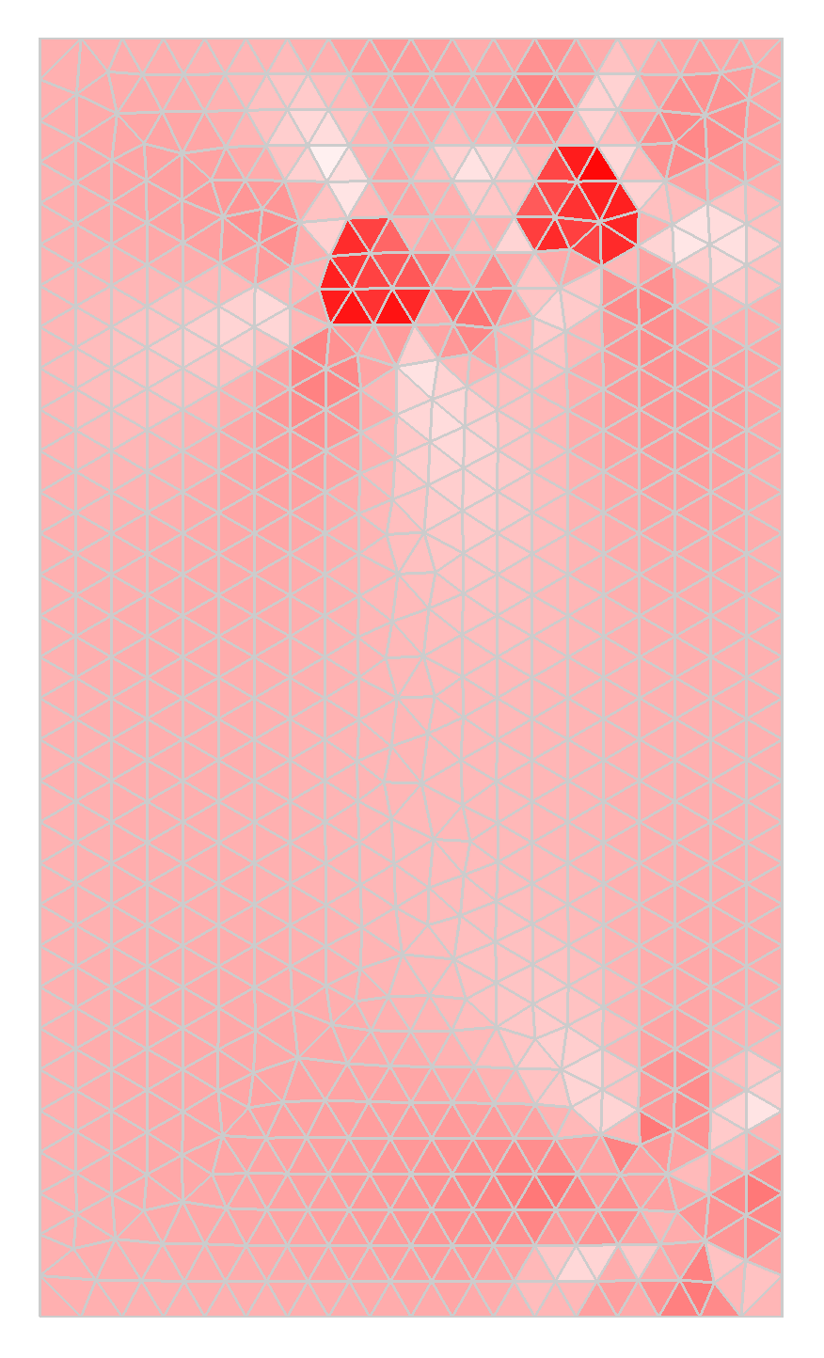
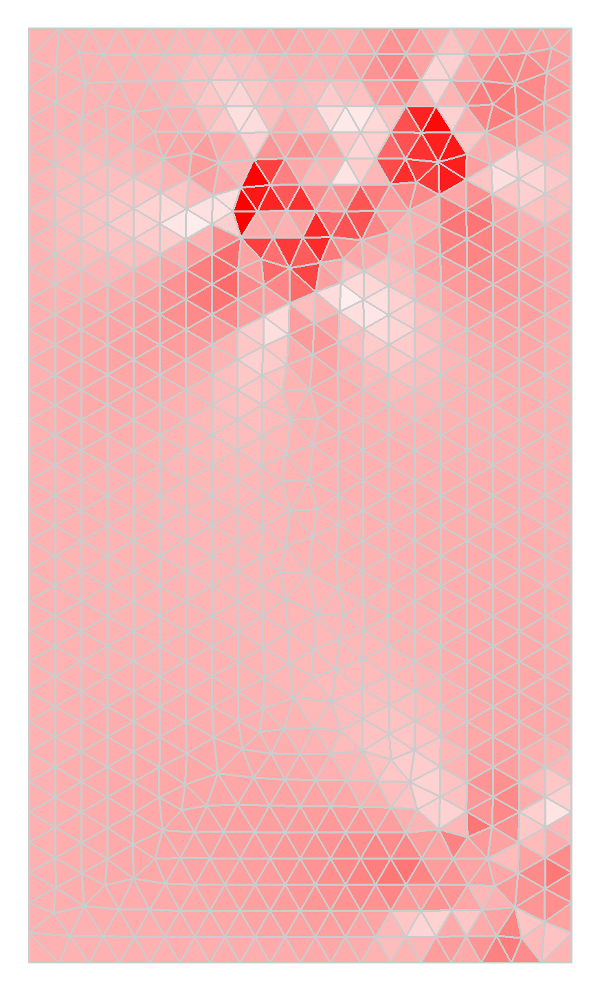
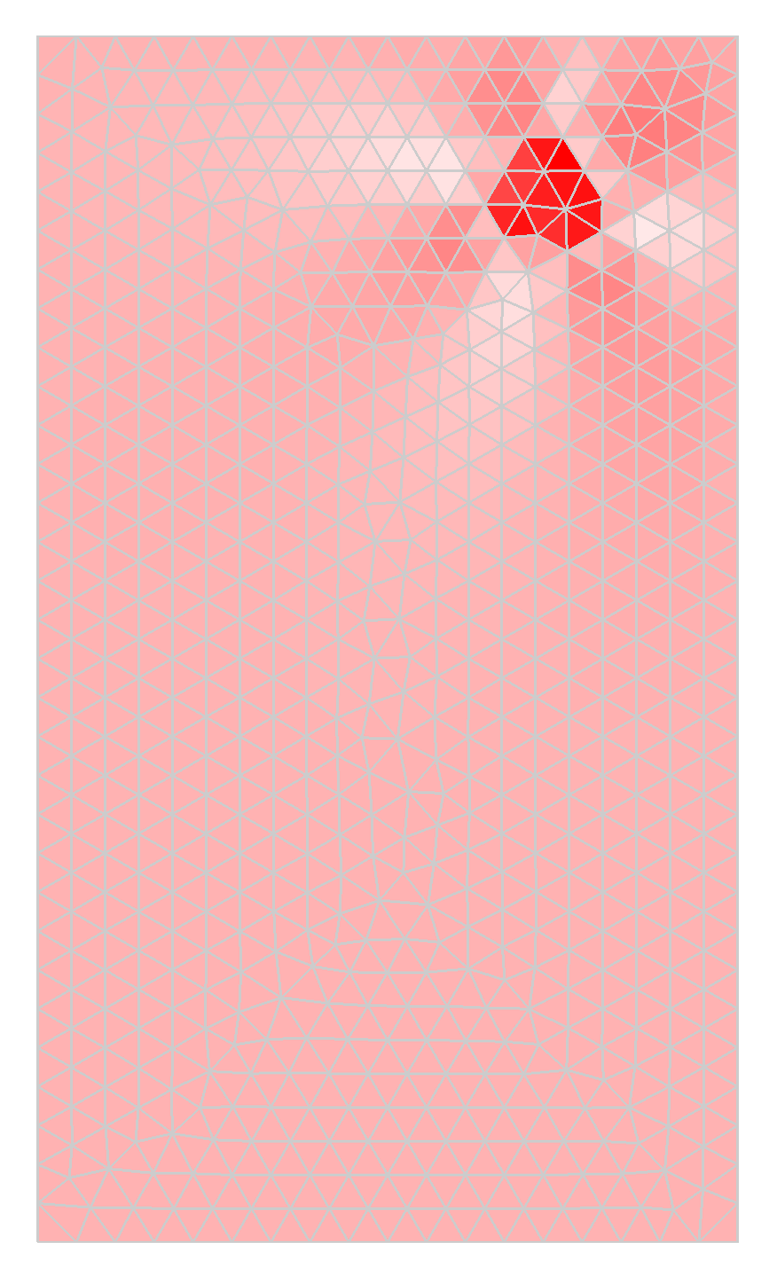
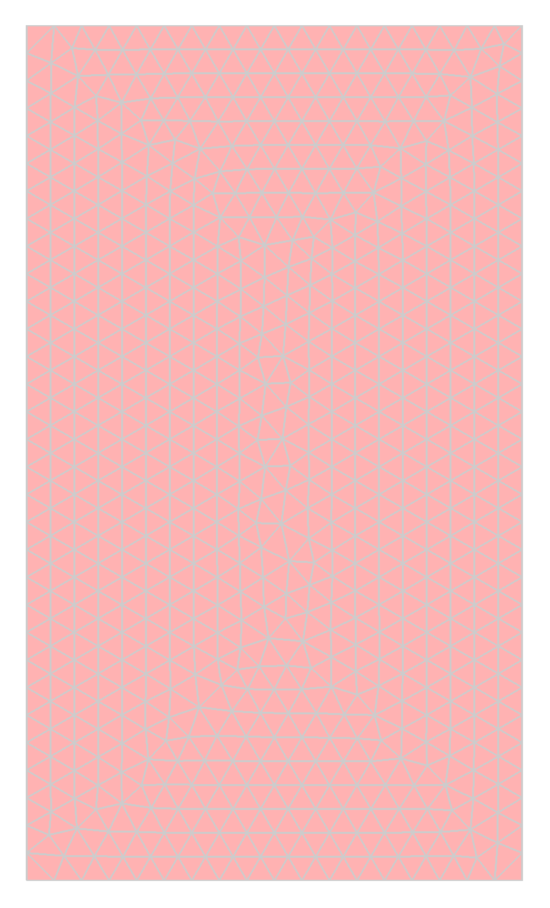
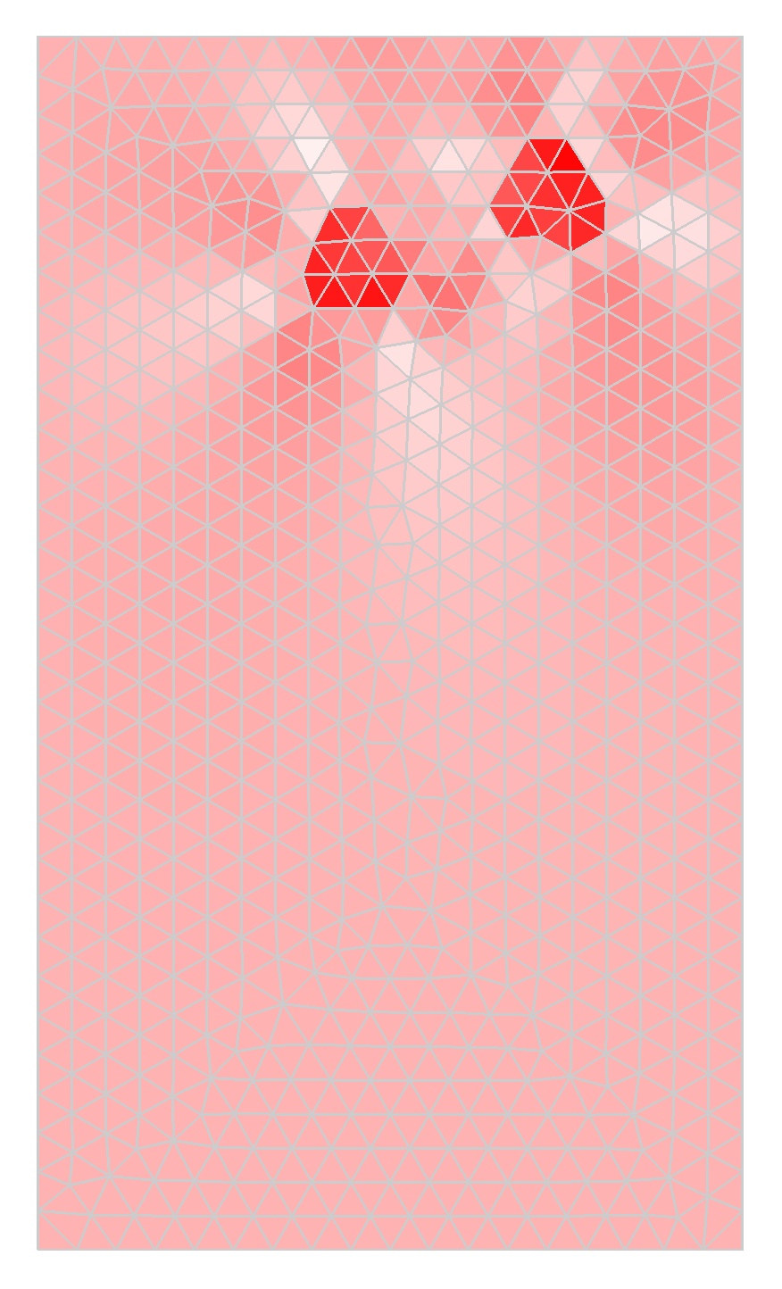
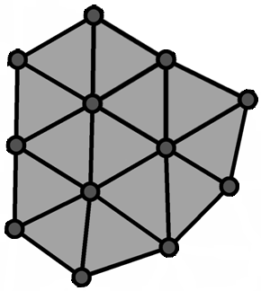
The origin of shear localization
Strain softening
Homogeneous deformation: at high temperatures, all zones readily deform
Shear localization: STZs adjacent to the one that has already deformed preferentially deforms due to strain coupling; this effect is most pronounced at high stress levels and reduced temperatures
Kinetic Monte Carlo modeling of STZs
Acta Mater. 57, 2823-2833 (2009)

Slide 21
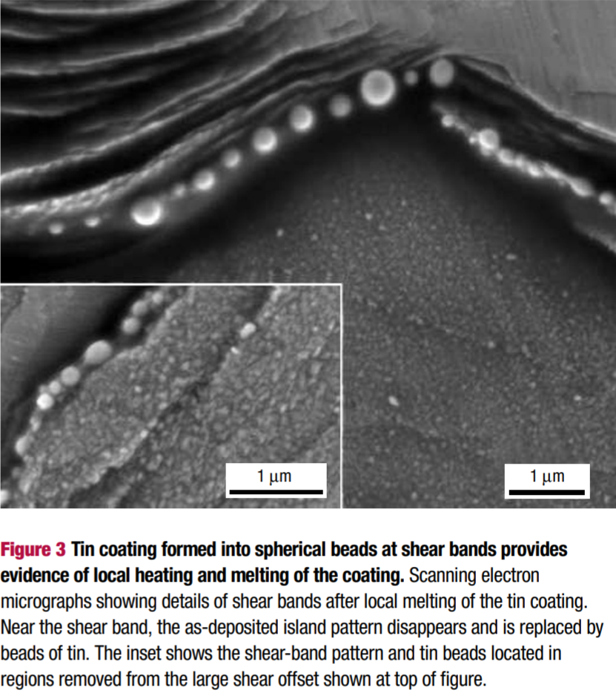
Shear localization and shear band formation
Plastic strain concentrated in narrow shear bands in both compressive and tensile regions
J. Appl. Phys. 94, 904 (2003); Nat. Mater. 5, 15 (2006)

Slide 22

Shear deformation in metallic glass is dilatational
Free-volume creation: strain softening
Shear deformation is a pressure-dependent, frictional process

Slide 23
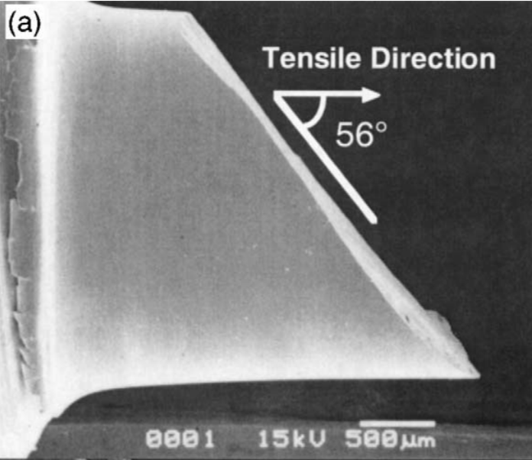
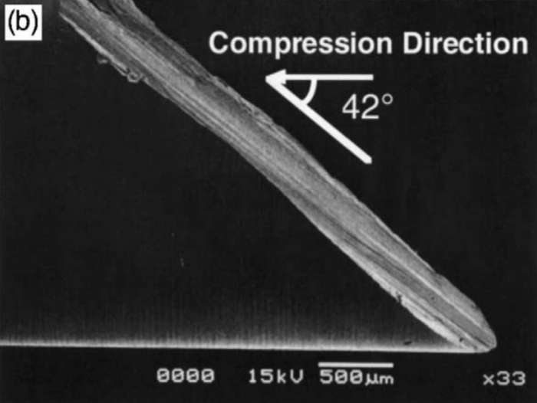
Shear angles in uniaxial loading tests
Fractured surface in tensile test
Fractured surface in compressive test
Intermetallics 10, 1071-1077 (2002)

Slide 24
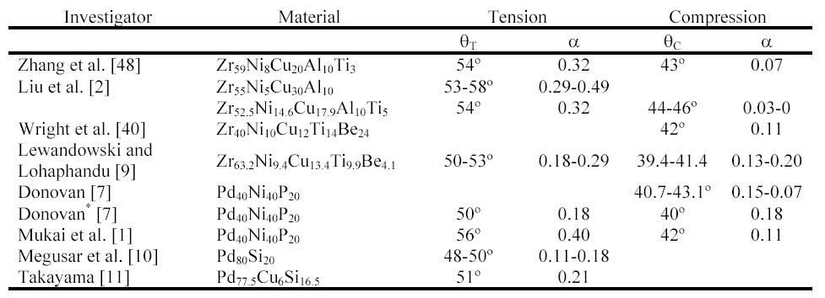
Shear angles in uniaxial loading tests
Shear angles are larger than 45° in tension and smaller than 45° in compression
Acta Mater. 51, 5399-5411 (2003)

Slide 25
Tensile/compression asymmetry due to friction
20% strength difference
Metallic glass is stronger in compression than in tension
CuCr metallic glass simulation
Acta Mater. 51, 5399 (2003)
Notes:
Vertical axis is normal stress normalized by Young’s modulus

Slide 26
Summary
Metallic glass structure is dictated by close packing requirements
Large elastic limit, lower elastic moduli compared to crystalline metals
Plastic deformation
  Homogeneous flow (important for thermoplastic forming): high temperature
  Inhomogeneous deformation (strain softening): high stress
Atomistic mechanisms of plastic deformation
  Shear transformation zone and STZ coupling
  Pressure-dependent, frictional shear deformation

