Slide 1
MIT 3.071 Amorphous Materials 13a: Candy Fiber Drawing
Juejun (JJ) Hu
hujuejun@mit.edu

Slide 2
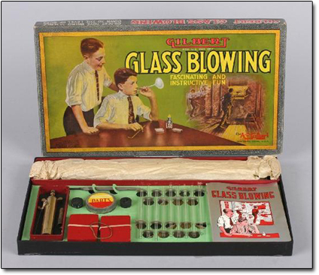
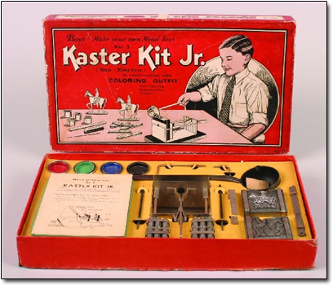
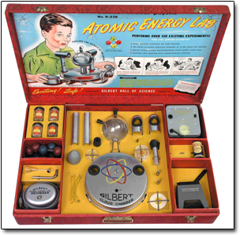
Glass blowing in the classroom? Hmm… probably not a good idea
Gilbert Glass Blowing Manual

Slide 3
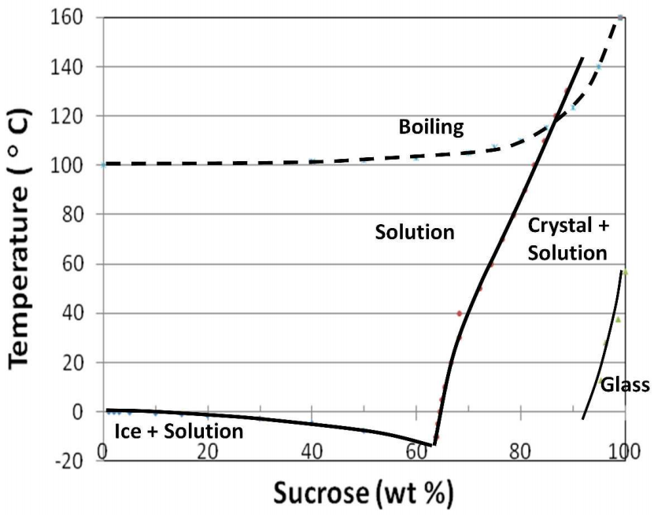
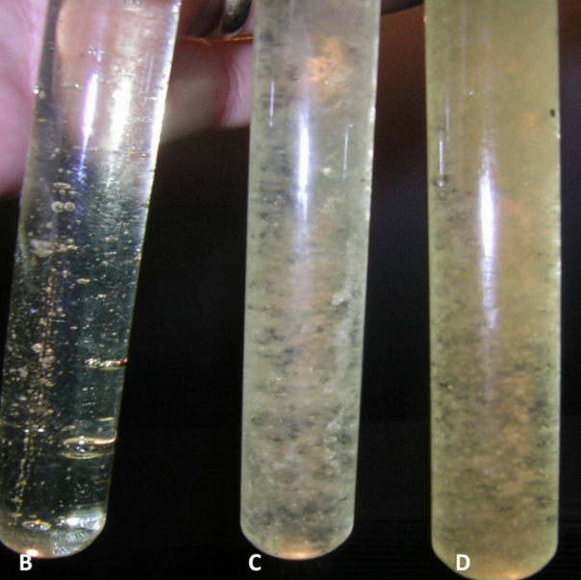
Candy glass
Clear candy glass
Crystallized candy glass
Mater. Res. Soc. Symp. Proc. 1233, 1233-PP03-06 (2010)

Slide 4
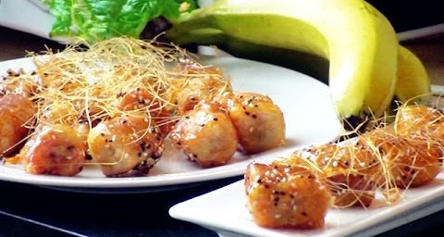
Deep fried toffee (candy fiber!) banana
Cuisine Journal of Yangzhou University 19, 35 (2002)

Slide 5
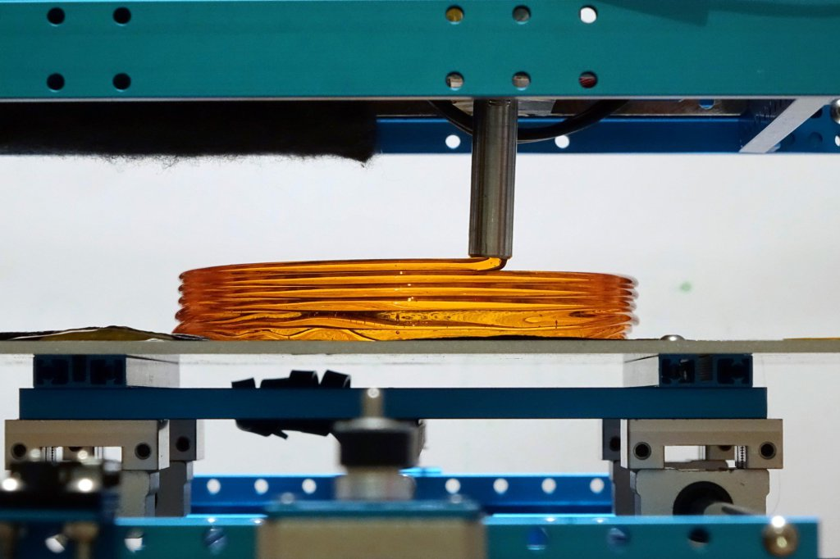
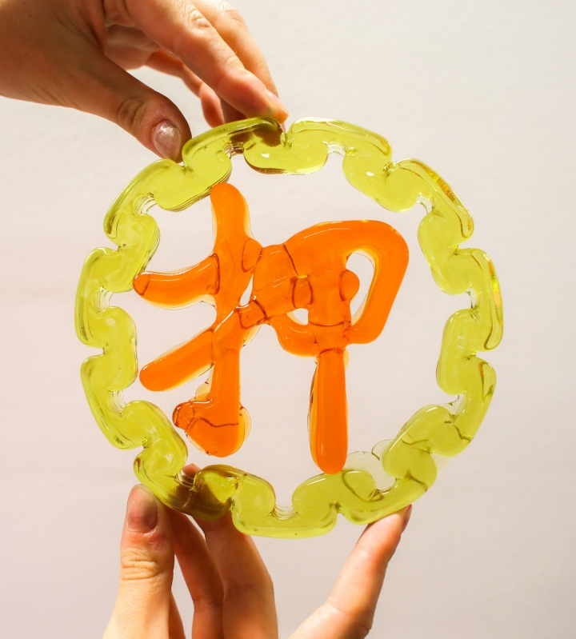
Sweet: 3-D printed sugar glass
http://www.victorleung.info/post/aavs-2016-sweetest-cnc-machine/

Slide 6
Acknowledgement
International Materials Institute for New Functionality in Glass, Lehigh University
Glass Education for Students, Teachers & General Public
Yifei Zhang for design and assembly of the candy fiber drawing tower

