Slide 1
MIT 3.071 Amorphous Materials 16: Biomineralization of Amorphous Materials
Juejun (JJ) Hu
hujuejun@mit.edu

Slide 2
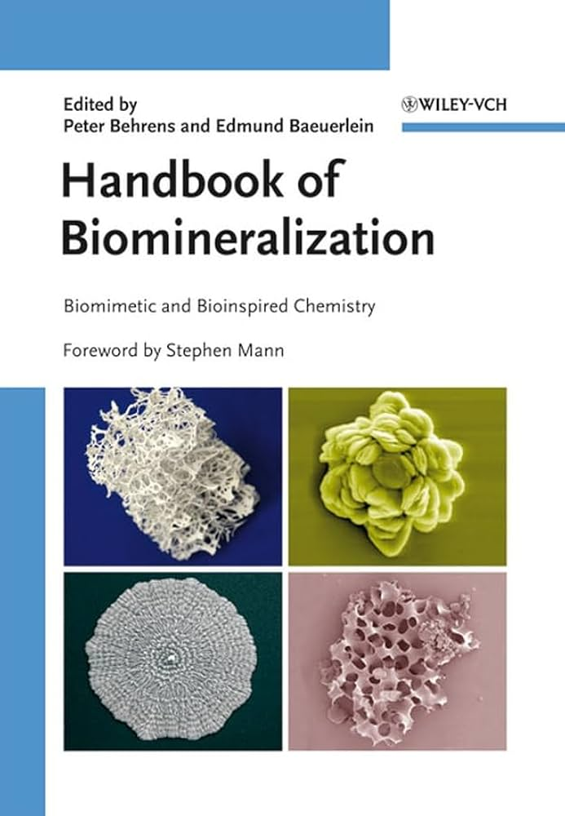
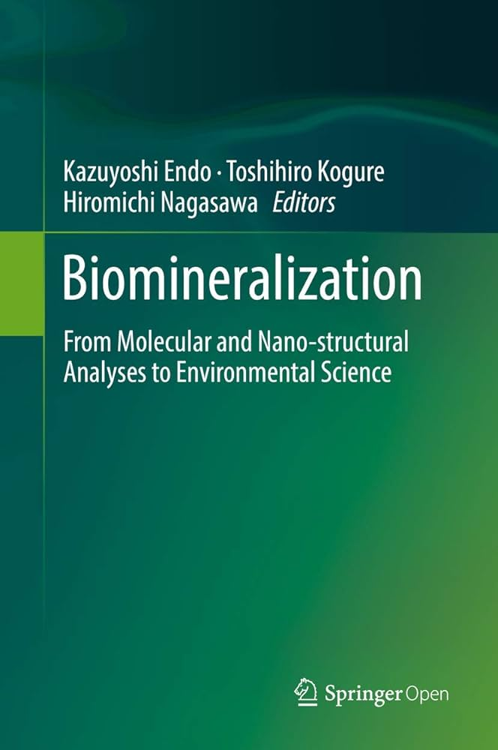
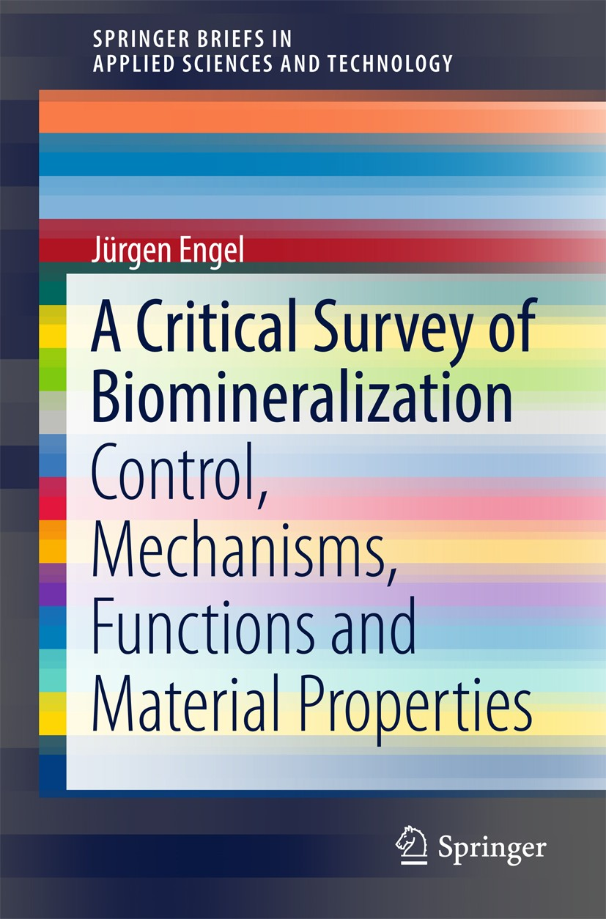
References

Slide 3
Outline
Introduction to biomineralization
Examples: mollusk shells, crustacean exoskeleton, bone and teeth, biosilica
Microstructural evolution and kinetics of biomineralization
Hierarchical microstructures
Transient amorphous precursors
Applications inspired by biomineralization
Bioinspired structural materials
Diatom-based sensing and drug delivery
Biomineralization processes in chemical synthesis and dental therapies

Slide 4
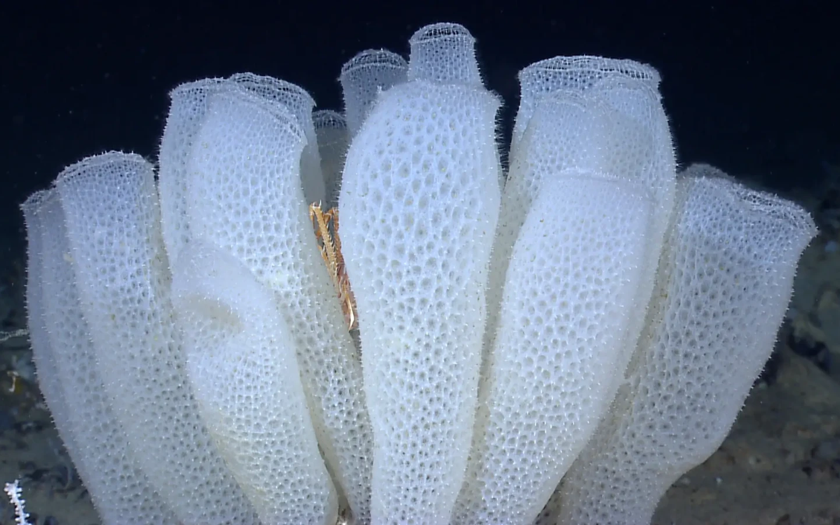
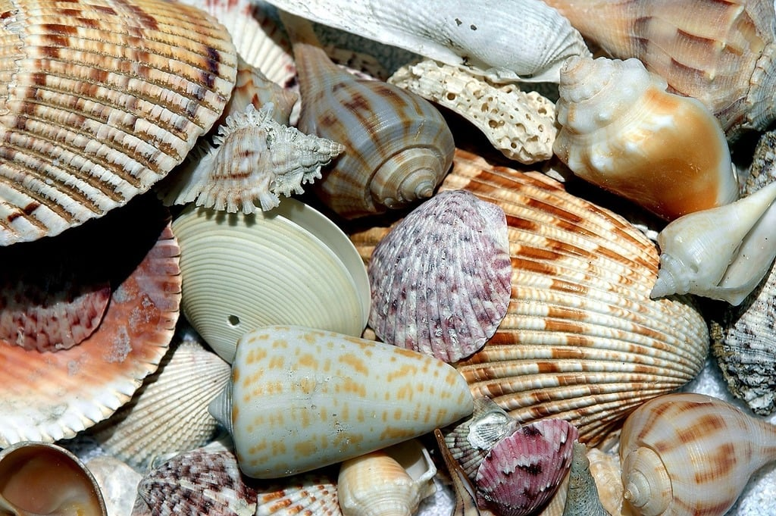
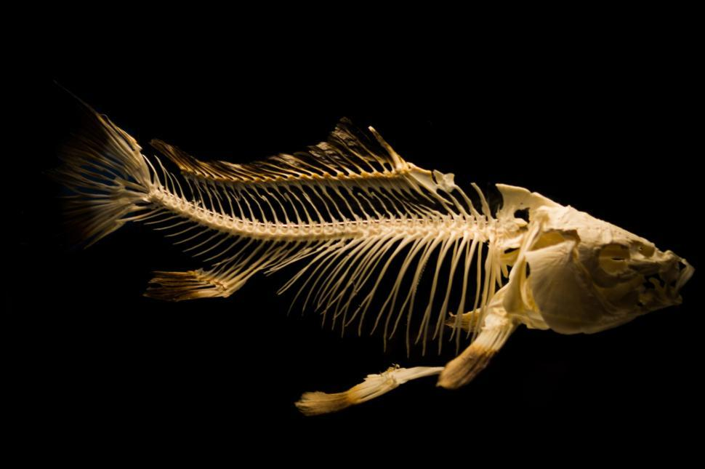
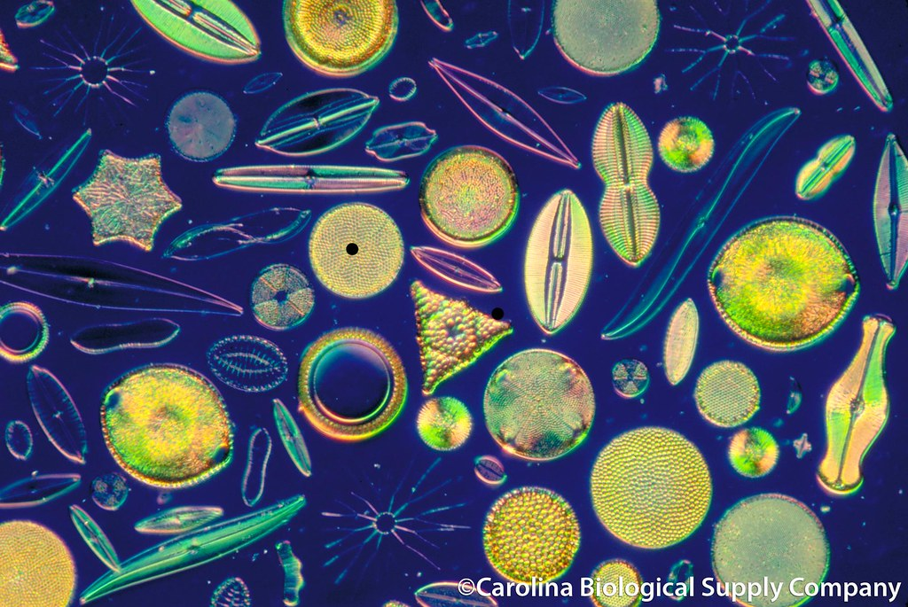
Biologically controlled mineralization
Formation of inorganic solids by living organisms
Hierarchical structure: organic matrix + inorganic phase
Hexactinellid (glass sponge)
Mollusk shells
Bones in vertebrates
Diatom frustules

Slide 5
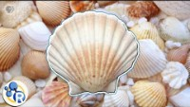
Mollusk Shells

Slide 6
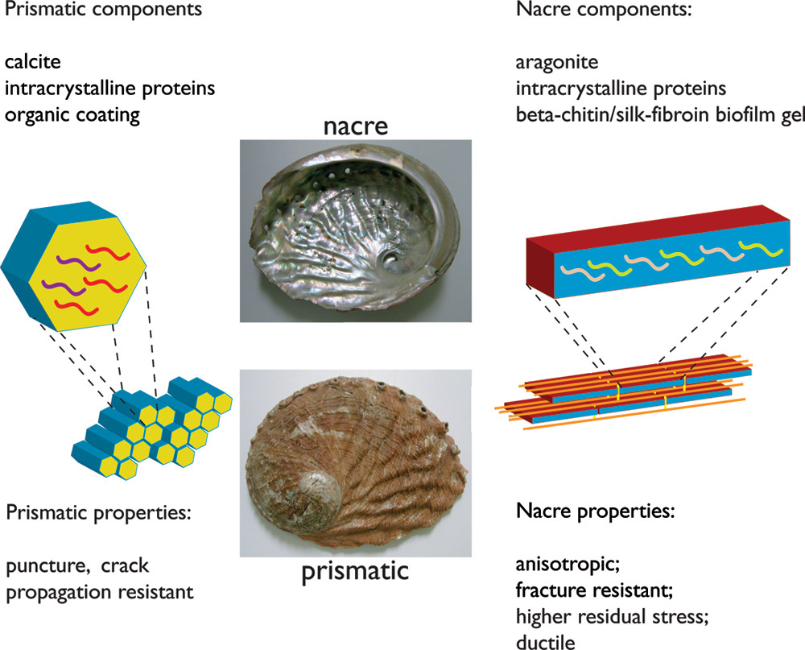
Mollusk Shells
Calcite or aragonite crystals (> 95% by weight) with an organic matrix (~ 5%)
Calcite​: prismatic layer
Aragonite: nacre layer
Amorphous calcium carbonate (ACC): a transient precursor in shell formation
Reduces interfacial energy barriers, allowing rapid formation of uniform mineral layers
Crystal phase controlled by matrix proteins
Chem. Rev. 108, 4455 (2008)
Notes:
Mollusks secrete an organic matrix composed mainly of proteins, polysaccharides, and lipids.
Specific matrix proteins (such as nacrein, perlucin, and acidic glycoproteins) can:
Stabilize amorphous precursors like amorphous calcium carbonate (ACC).
Selectively promote the crystallization into either aragonite (common in nacre/mother-of-pearl) or calcite (common in outer shell layers).
Control crystal orientation, size, and polymorph by binding selectively to certain crystal faces or influencing ion supersaturation.

Slide 7
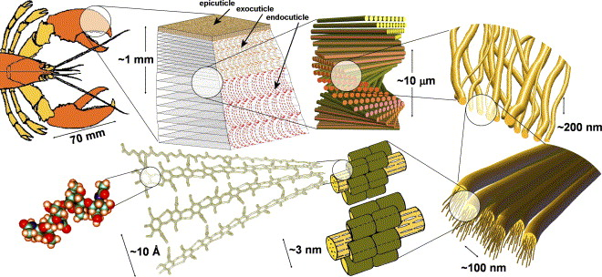
Crustacean exoskeleton
Composition: chitin, proteins, and minerals (most commonly ACC and calcite)
Hierarchical architecture
Millimeter scale: layered mineralized composite
Micron scale: helicoidal Bouligand stacking
Nanometer scale: chitin fibrils wrapped in protein
Mechanical properties
Crack resistance
Enhanced toughness
Near-isotropic strength
Flexibility
Acta Mater. 53, 4281 (2005)
Notes:
Crack deflection
When a crack tries to propagate through the layers, it meets interfaces between differently oriented fibril layers. This forces the crack to twist, turn, or split, making it much harder to move straight through the material.
Enhanced toughness
As the crack path twists, the material absorbs more energy through: microcracking, fibril pull-out, and friction at the interfaces. This increases the material’s overall toughness, even though the material itself is partly brittle.
Isotropic-like strength
The rotating layers make the exoskeleton strong and tough in multiple directions. This helps resist complex loads — tension, compression, bending, or shear — that the animal experiences during walking, burrowing, fighting, or predator attacks.
Flexibility plus stiffness balance
The combination of stiff mineral layers and flexible organic helicoidal architecture allows: hardness where needed and flexibility at joints or impact points.

Slide 8
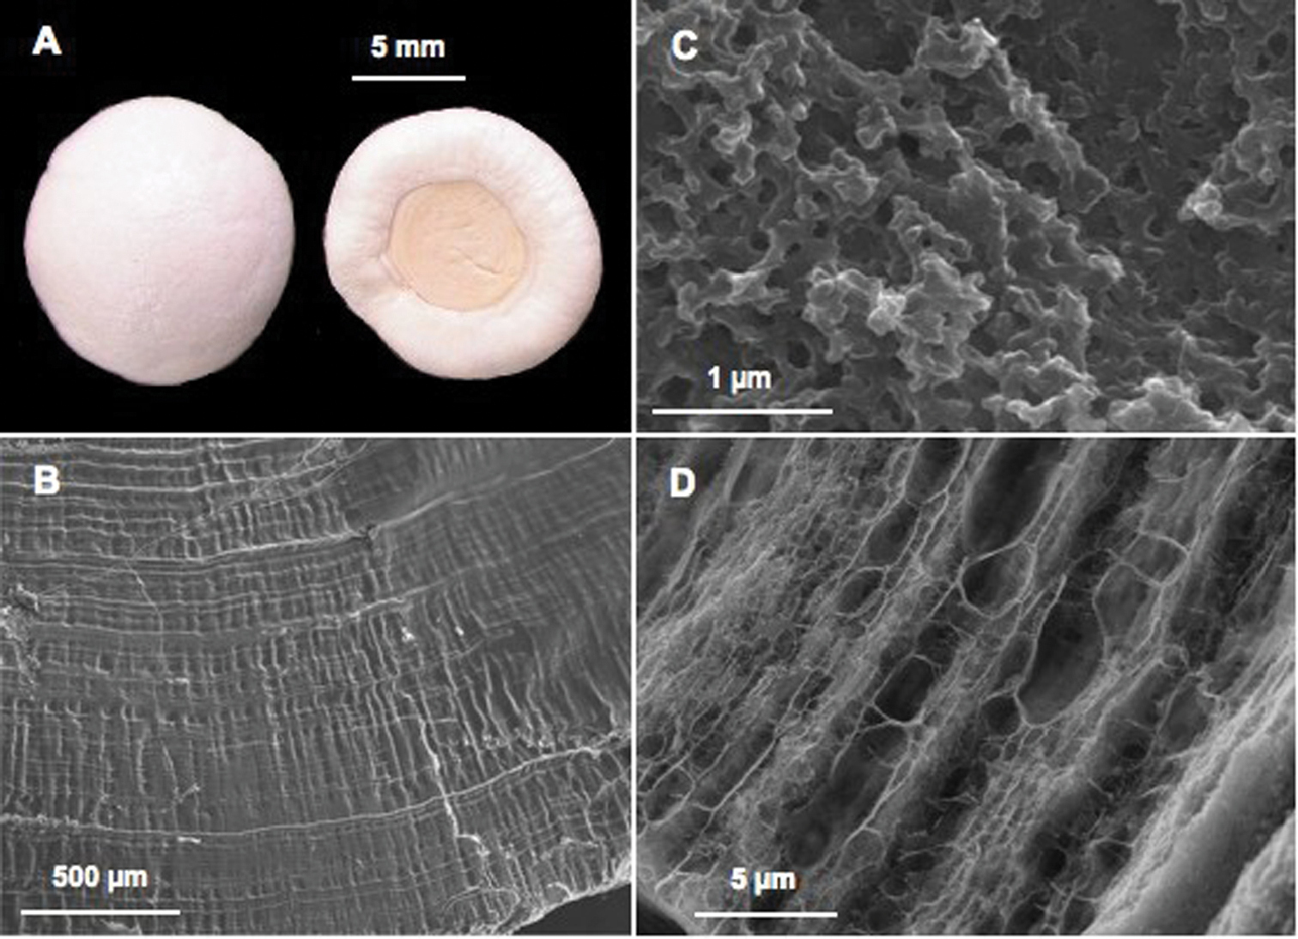
Crustacean exoskeleton
Molting: a process of shedding hard exoskeletons to facilitate growth
Calcium balance
Terrestrial and freshwater crustaceans store large amounts of calcium to minimize calcium loss due to molting
Gastrolith: ACC and amorphous calcium phosphate in an organic matrix
Zookeys 176, 103 (2012)
A Pair of gastroliths from the crayfish Cherax quadricarinatus; B Internal striated structure visible on natural fracture after slight acetic acid decalcification; C Ultrastructure well visible after natural fracture and high magnification: the mineral is precipitated as nanospheres; D Organic matrix network revealed after acetic acid decalcification.
Notes:
After shedding the old shell, this ACC rapidly dissolves and is transported to mineralize the new exoskeleton as calcite. Thus, ACC acts as a kinetically stabilized reservoir of CaCO₃ that can be quickly mobilized.

Slide 9
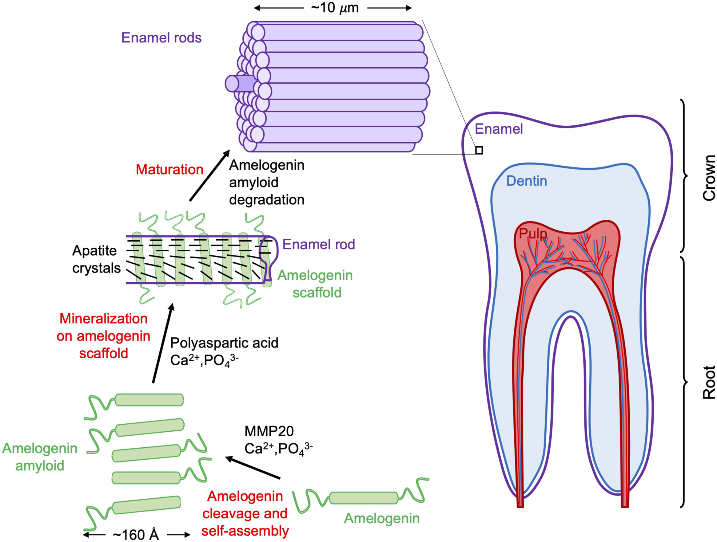
Bone and teeth of vertebrates
Composition
Mineral phase: calcium phosphate primarily as hydroxyapatite [Ca₁₀(PO₄)₆(OH)₂]
Organic matrix: mainly collagen type I (in bone & dentin) or non-collagenous proteins (in enamel)
Water phase: providing hydration
PNAS 117, 21847-21848 (2020)
Notes:
These tissues have different mineral/organic ratios:
Bone: ~50–60% mineral, ~20–30% organic matrix
Dentin (tooth core): ~70% mineral, ~20% organic matrix
Enamel (tooth outer layer): ~95% mineral, ~<5% organic

Slide 10
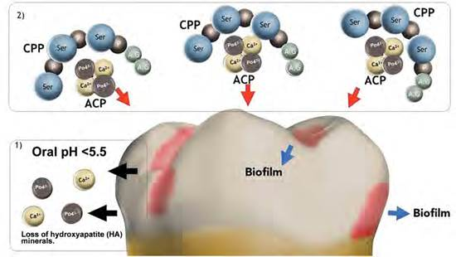
Bone and teeth of vertebrates
Amorphous calcium phosphate (ACP)
Act as precursors for crystalline hydroxyapatite
Provide shape flexibility: fill small gaps and coat collagen fibrils evenly before crystallization
Allow controlled transformation and support nucleation
Casein phosphopeptide-amorphous calcium phosphate nanocomplex (CPP-ACP) in dentistry: state of the art, Rev. Fac. Odontol. Univ. Antioq 30, (2019)

Slide 11

Silica mineralization: diatoms and glass sponges
Skeletons made of hydrated amorphous silica (SiO₂·nH₂O)
Use organic molecules to guide silica formation, shape, and patterning
Silaffins in diatoms: induce silica precipitation and interact with other molecules to create self-organized silica nanostructures
Silicateins in sponges: protein catalysts and scaffolds that assemble silica into long, layered spicules
Notes:
Silafin is a protein that acts as a matrix for the precipitation of silica in the cell walls of diatoms.
Silicateins are enzymes which catalyse the formation of biosilica from monomeric silicon compounds (such as silicic acid) extracted from the natural environment.

Slide 12
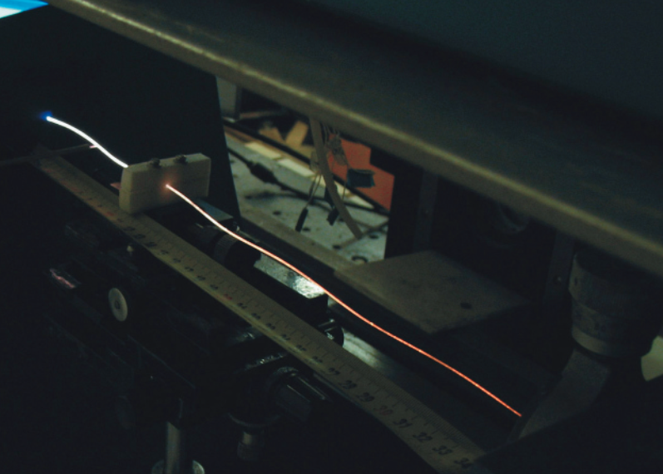
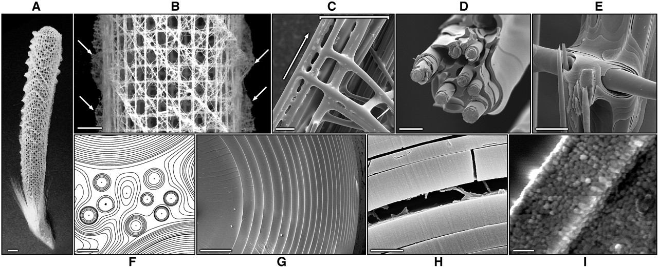
Hierarchical structure of glass sponge spicule
Core-shell architecture
Protein-rich central core surrounded by concentric layered amorphous silica shells with thin organic interlayers
© Biosilica in Evolution, Morphogenesis, and Nanobiotechnology
5 mm
100 μm
20 μm
25 μm
1 cm
5 μm
1 μm
500 nm
Science 309, 275 (2005)

Slide 13
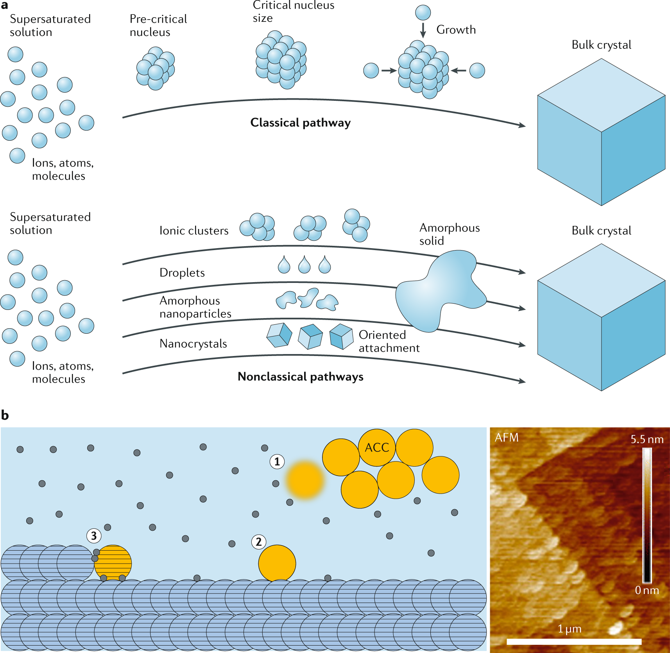
Transient amorphous phases: amorphous first, crystalline later
Lowering nucleation barrier
Ostwald step rule
Reduced interfacial energy
Providing preferential nucleation sites via organic matrices
Solution phase infiltration and deposition
Crystallization by particle attachment
Nat. Rev. Chem. 5, 93 (2021)
Notes:
Rapid Precipitation, Slow Crystallization: A common kinetic pattern is that organisms precipitate the amorphous mineral rapidly, then slow down the crystallization step. Fast initial precipitation is achieved by quickly mixing reagents in a confined space – for example, specialized cells can pump Ca²⁺ and CO₃²⁻ into an isolated vesicle or extracellular compartment, causing ACC to rain out in seconds. This amorphous deposit is then held in a metastable state. The slow crystallization that follows (minutes to hours) is controlled by inhibitory biomolecules. This two-stage timing is beneficial: it allows organisms to form the bulk of the mineral matter quickly (useful for responding to environmental needs, like a crab molting its shell overnight) while still achieving an ordered crystal microstructure eventually. In coral, initial mineralization of each skeletal fiber is via amorphous nanoparticles that attach in minutes, but the lateral growth and crystallographic alignment take days – giving the organism time to orchestrate the material properties.

Slide 14
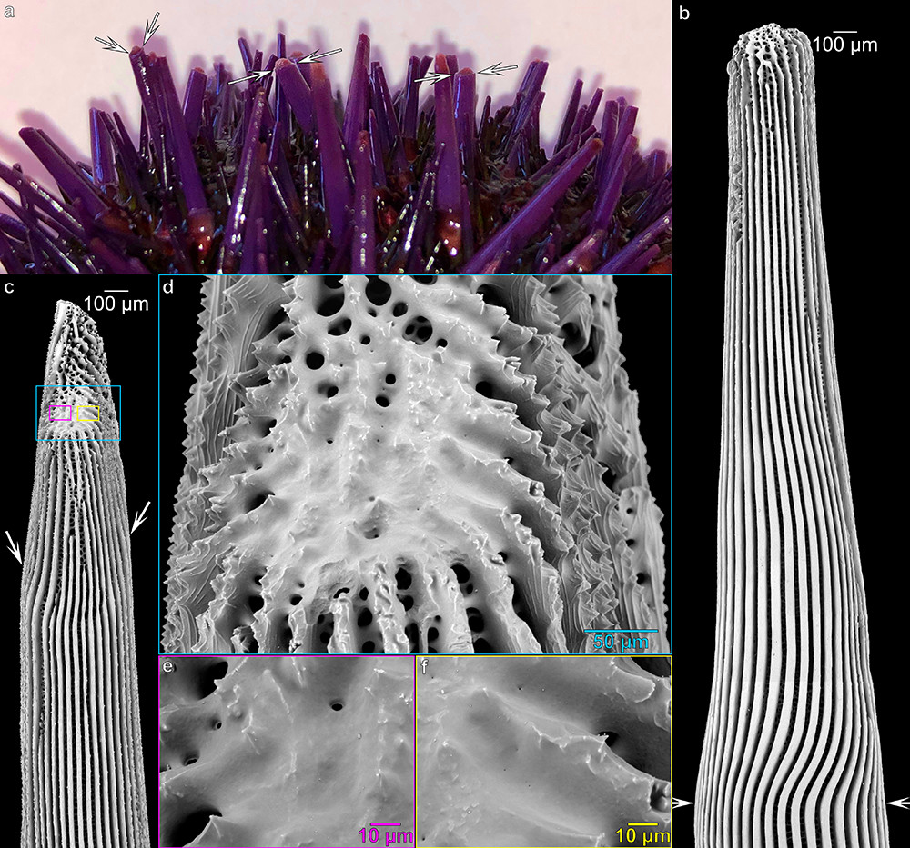
Transient amorphous phase stabilization
Organic macromolecules (proteins, polysaccharides)
Small ions: Mg²⁺ in ACC
Water and hydration shells
Confinement by organic templates
Example: Mg²⁺-rich, hydrated ACC stabilized by SM50 protein in sea urchin spicules before transforming into single-crystalline calcite
Cryst. Growth Des. 21, 6635 (2021)
Notes:
Organic macromolecules adsorb onto the mineral surface, lowering interfacial energy and blocking crystal growth sites.
Mg²⁺ works by distorting the local coordination environment, making crystal nucleation more difficult.
Bound water molecules create a more dynamic, fluid-like structure and act as a “kinetic barrier” to reorganization. Dehydration or water removal often triggers crystallization.
The physical confinement inside organic scaffolds (like collagen fibrils in bone) restricts the ability of mineral phases to form large, ordered crystals. This spatial control slows down or prevents spontaneous crystallization.

Slide 15
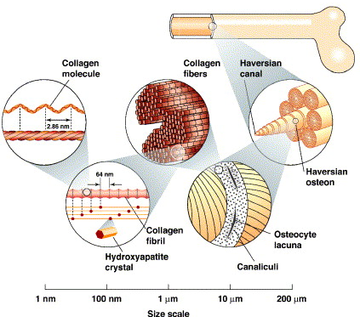
Hierarchical microstructural evolution
Formation of amorphous precursor phase
Assembly into mesoscale scaffolds
The amorphous precursor is transported and deposited into organic scaffolds
Controlled local transformation into nanocrystals
Nanocrystal alignment along the organic matrix
Nanocrystals assemble into macroscopic structures
Hierarchical structure of human cortical/compact bone
Mater. Sci. Eng. C 26, 1251 (2006)
Notes:
1. Macroscale (~cm)
Cylindrical bone shafts (diaphysis) with thick cortical walls.
Bears body weight, resists bending and torsion.
2. Millimeter scale (~0.1–1 mm)
Osteons (Haversian systems): Cylindrical units (~200–300 μm diameter) aligned with the long axis.
Central Haversian canal contains blood vessels and nerves.
Surrounded by concentric lamellae.
3. Sub-millimeter scale (~10–100 μm)
Lamellae: Thin (~3–7 μm) concentric layers of mineralized collagen.
Contain alternating collagen fiber orientation (~30°–60° shift between lamellae), which improves crack deflection.
4. Micrometer scale (~1–10 μm)
Lacuno-canalicular system: Lacunae (~10 μm) house osteocytes (bone cells).
Canaliculi (~0.1–1 μm channels) connect lacunae and allow communication.
Provides mechanosensing and nutrient transport.
5. Nanoscale (~10–100 nm)
Mineralized collagen fibrils: Type I collagen triple helices self-assemble into fibrils (~100 nm diameter).
Fibrils are mineralized with nanocrystalline hydroxyapatite (~2–5 nm thick, ~50 nm long).
Collagen provides toughness; mineral provides stiffness.
6. Molecular scale (~1–10 nm)
Hydroxyapatite nanocrystals [Ca₁₀(PO₄)₆(OH)₂]: Highly oriented along the collagen fibril axis.
Non-collagenous proteins: e.g., osteocalcin, osteopontin, which regulate mineralization and crystal growth.

Slide 16
Amorphous materials in hierarchical microstructural evolution
Shape molding flexibility
Can fill irregular or nanoconfined spaces
Avoidance of brittle failure
Premature crystal nucleation would create internal stresses and cracks
Kinetic control
Organisms can “freeze” the amorphous phase at desired times or locations
Hierarchical integration
Once the amorphous phase transforms, it connects nanoscale, microscale, and macroscale order seamlessly

Slide 17
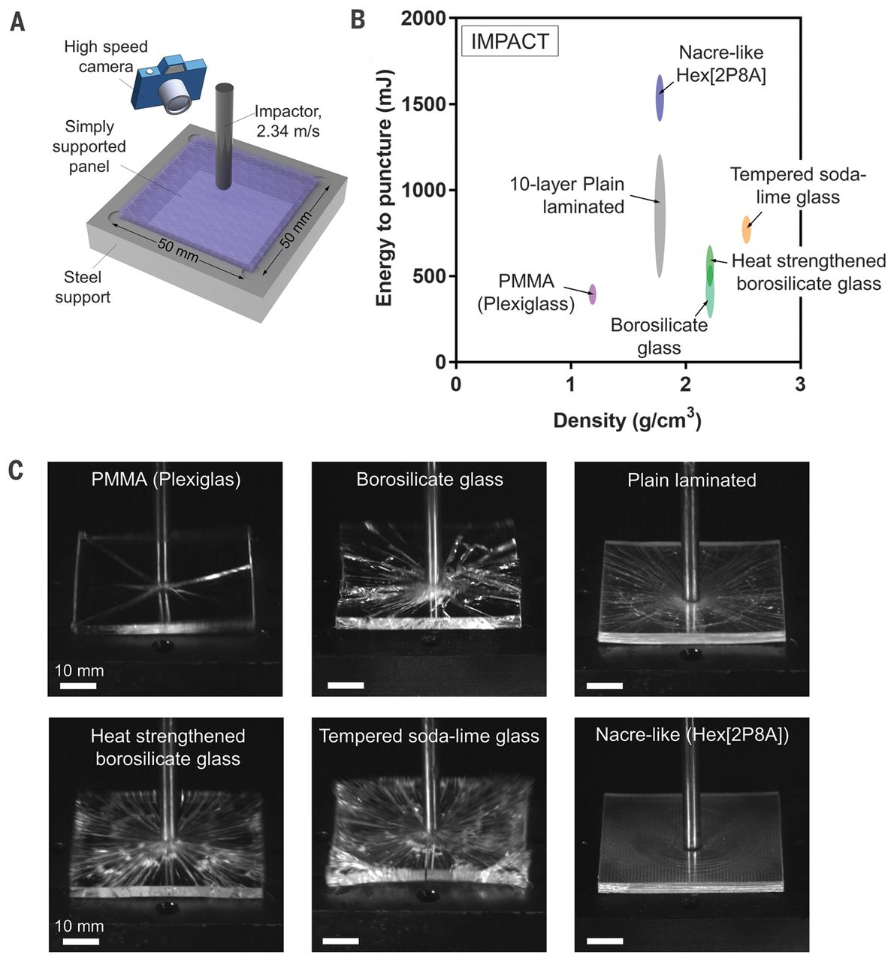
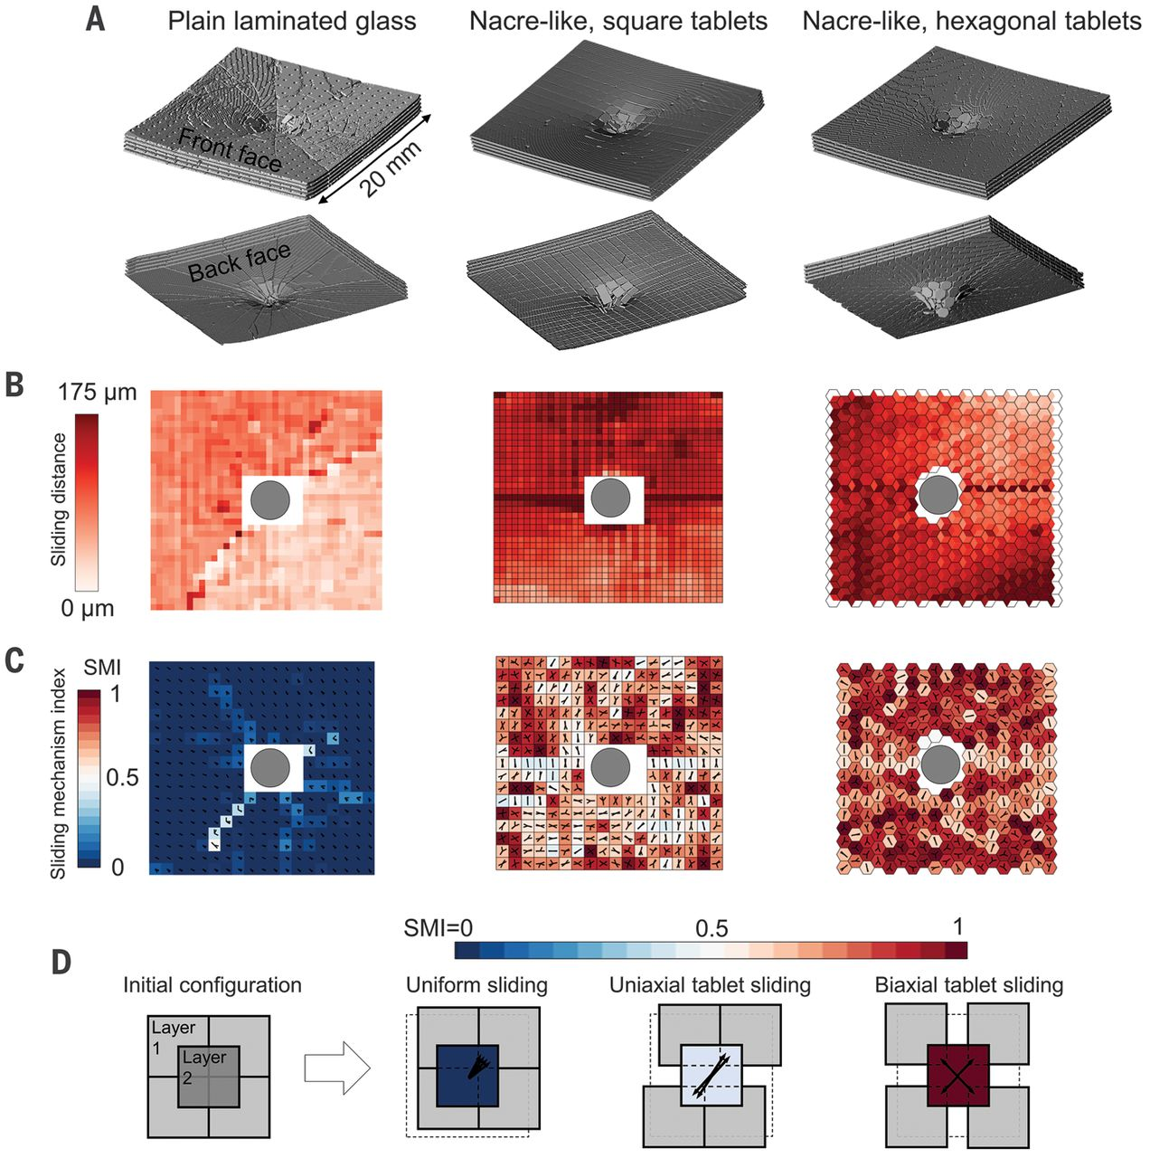
Bioinspired composites: nacre-inspired glass
Science 364, 1260 (2019)

Slide 18
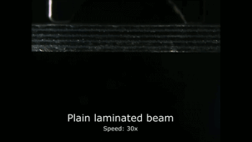
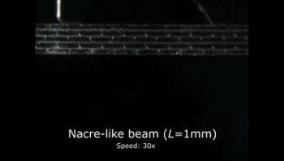
Bioinspired composites: nacre-inspired glass
Science 364, 1260 (2019)

Slide 19
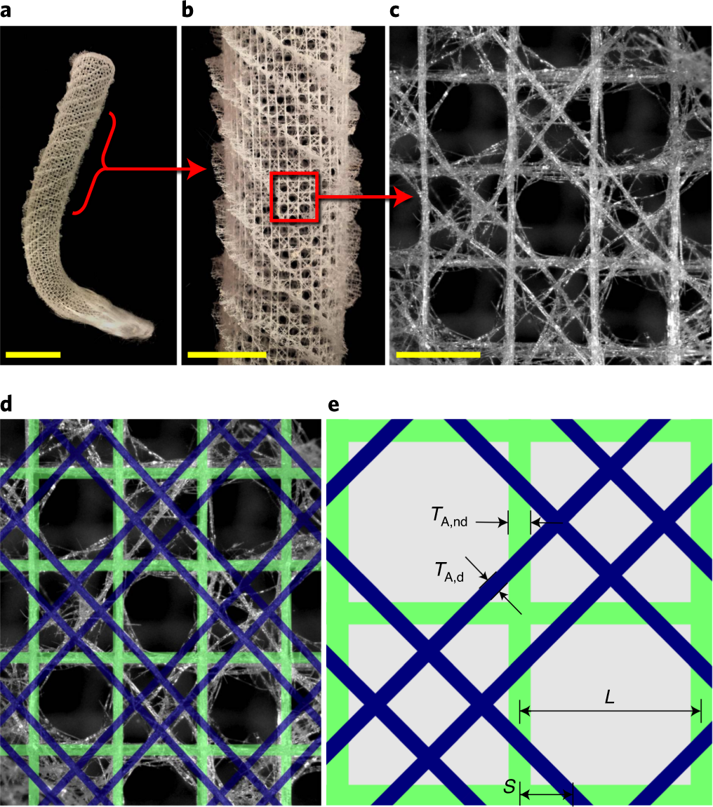
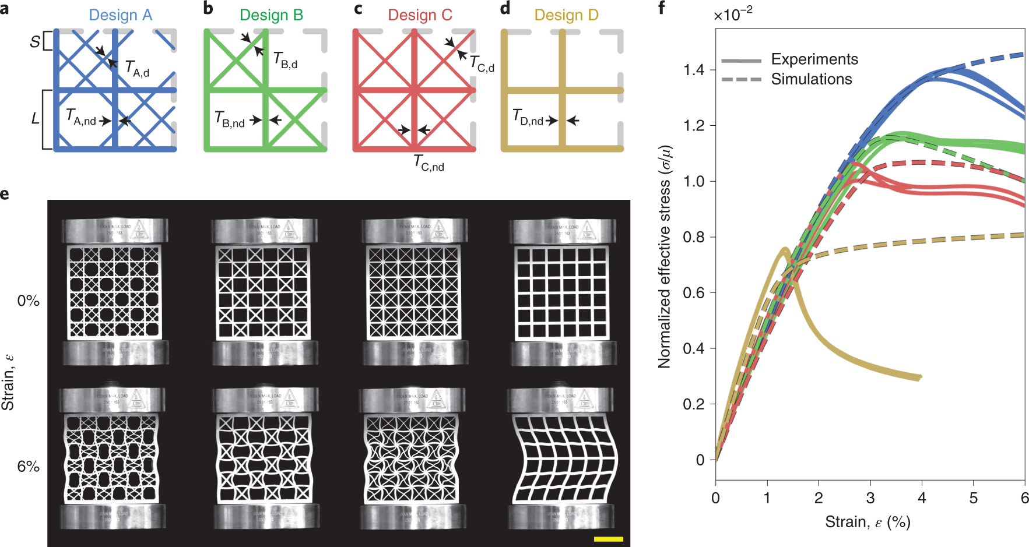
Sponge-inspired buckling-resistant lattices
Silica skeleton of Euplectella aspergillum consists of a square grid overlaid with a double set of diagonal bracings
The diagonal reinforcement strategy achieves the highest buckling resistance for a given amount of material
Nat. Mater. 20, 237 (2021)

Slide 20
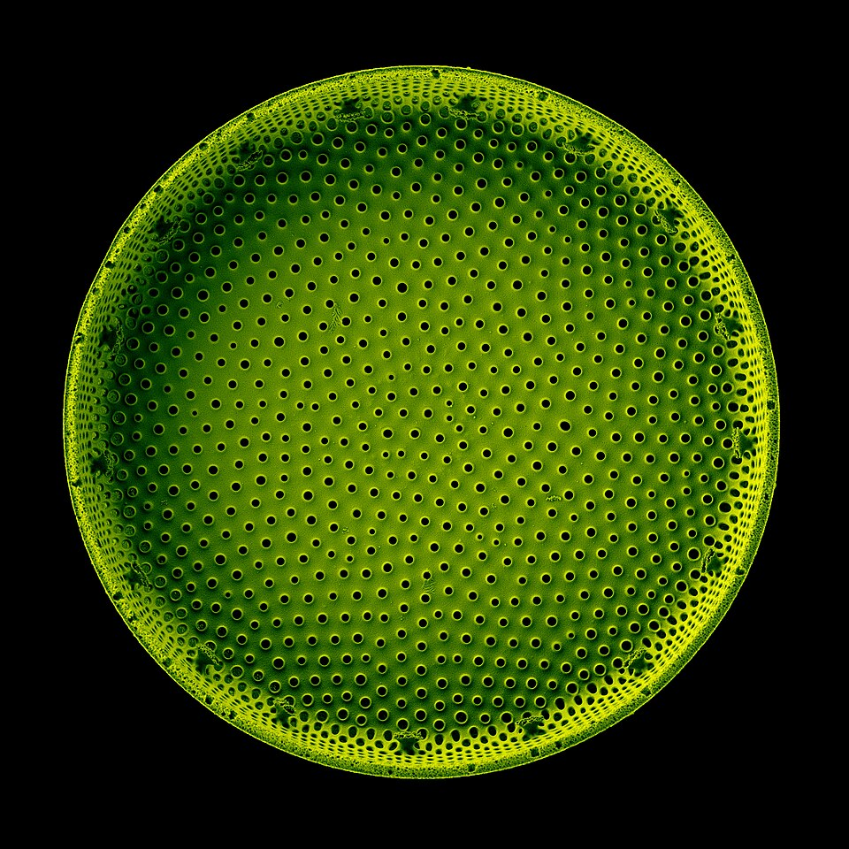
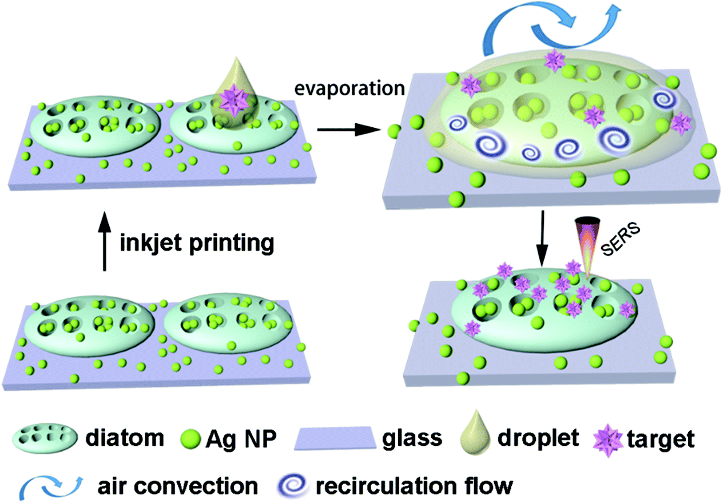
Diatom-based single-molecule sensors
Dual enhancement by diatom biosilica
Hydrophilic surface pulls droplets inward during drying
Porous structure amplifies SERS hot-spot intensity
© Wikimedia
Nanoscale 8, 17285 (2016)

Slide 21
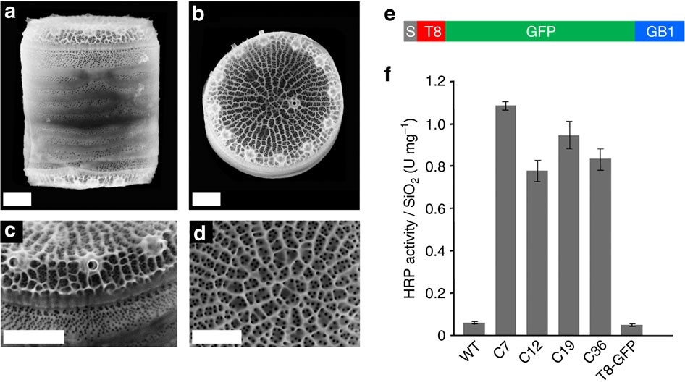
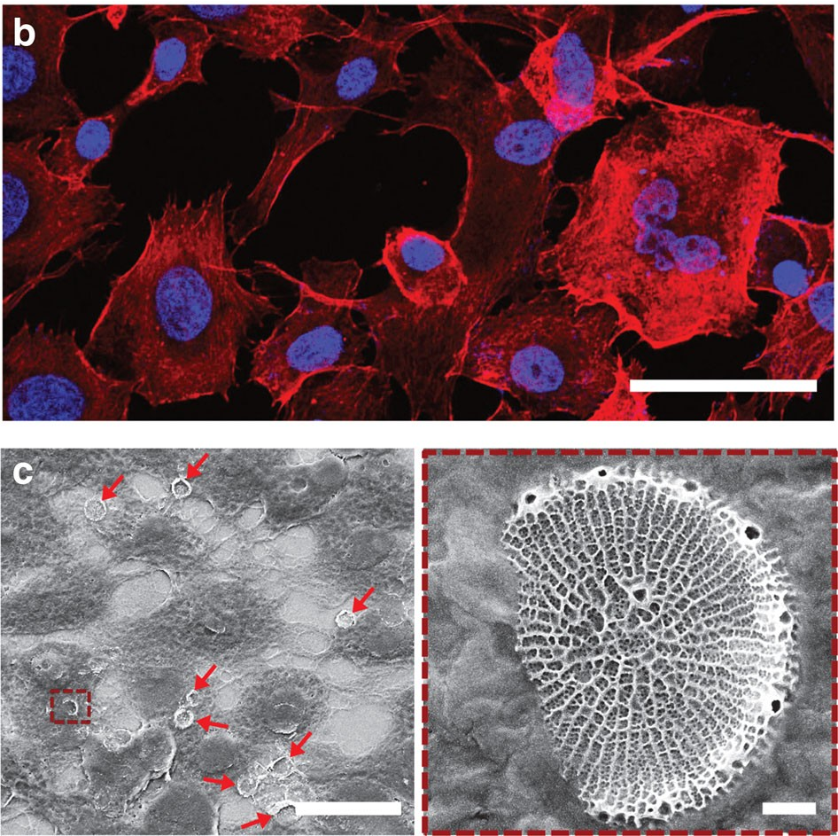
Diatom-based drug delivery
Targeted drug delivery using genetically engineered diatom
Genetically engineered diatoms display GB1 protein domain on their silica shells, enabling the binding of IgG antibodies
Hydrophobic drugs loaded into cationic liposomes, which electrostatically adsorbed onto negatively charged biosilica
Nat. Commun. 6, 8791 (2015)
Notes:
Panel f: IgG binding was determined by HRP activity measurements of diatom biosilica after incubation with IgG–HRP and removal of unbound IgG–HRP. IgG–HRP binding to biosilica from wild type (WT), from four GFP-fluorescent transformant clones that express the T8–GFP–GB1 fusion protein (C7, C12, C19 and C36) and from a previously described transformant clone that strongly expresses the T8–GFP fusion protein.

Slide 22
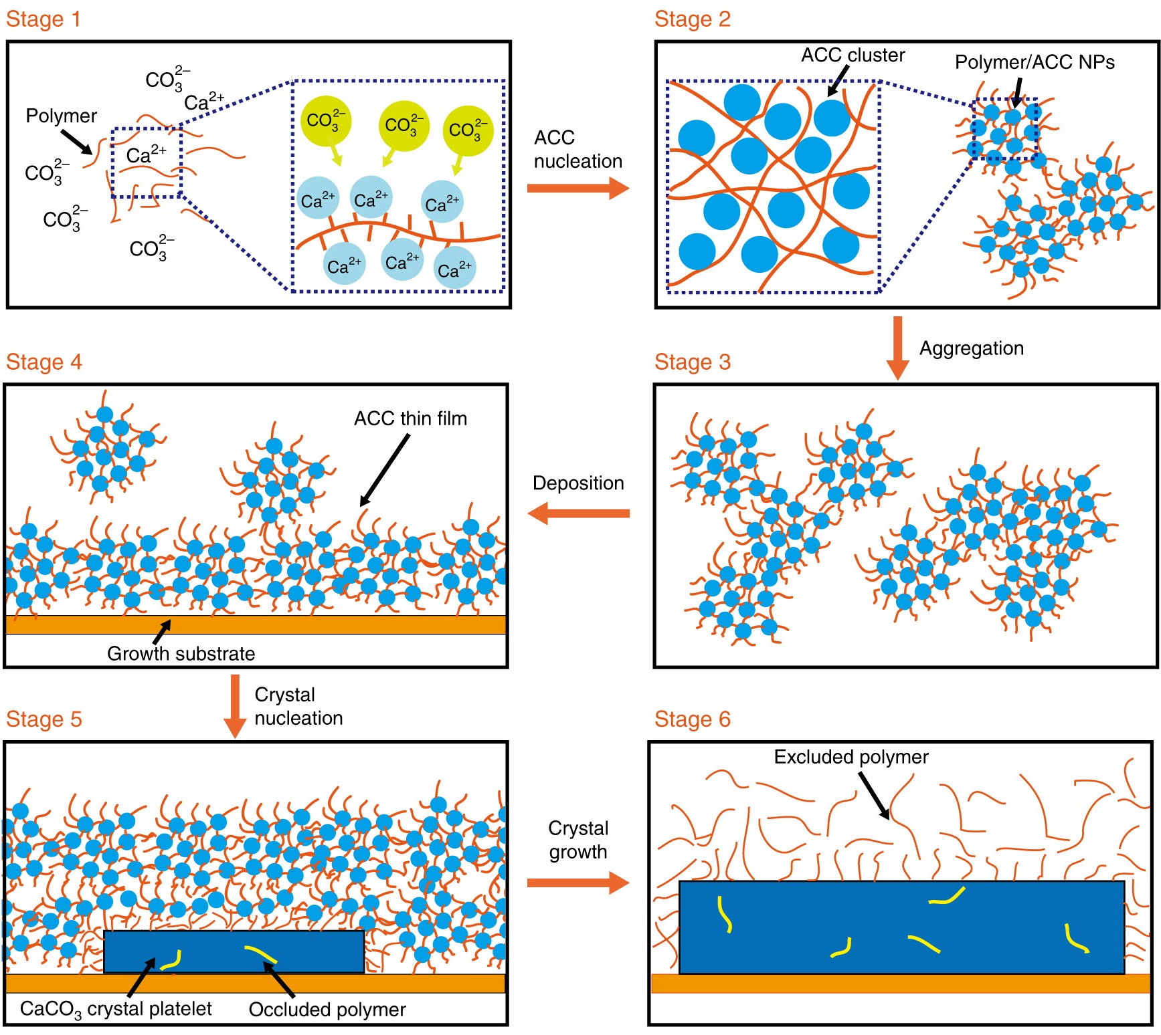
Polymer-induced liquid precursor (PILP)
Adding polyionic polymers to a solution supersaturated with mineral ions
Polymers interact with the mineral ions, stabilizing them in liquid-like amorphous clusters
Infiltration into organic or porous matrices
The precursor dehydrates and solidifies
The matrix guides the alignment and orientation of the crystals formed
Nat. Commun. 9, 2582 (2018)
Notes:
Key benefits of PILP
Enables controlled mineralization in confined or complex geometries,
Mimics natural processes (like bone and shell formation),
Produces materials with superior toughness and biological integration.

Slide 23
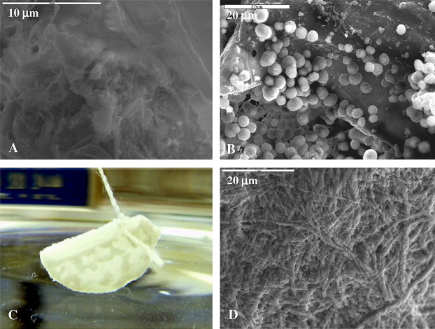
Mineralization of collagen sponges mimicking bone structures
Develop bone-like collagen-hydroxyapatite (HA) composites using the PILP process to mimic natural bone nanostructure
PILP achieved intrafibrillar infiltration of HA via capillary action within collagen fibrils
Nanocrystals aligned along the collagen fibril long axis ([001] direction) matching native bone
Acta Biomater. 6, 3676 (2010)
Notes:
SEM images and a photograph of a collagen sponge from Collagen Matrix, Inc., before and after mineralization via the conventional solution crystallization process vs. the PILP process using 32 kDa polyAsp. (A) SEM micrograph of untreated collagen sponge, showing very little fibrillar structure on the surface of the original scaffold. (B) Collagen sponge mineralized by the conventional crystallization process for 4 days, showing HA clusters nucleated on the surface of the collagen sponge. (C) Photograph of a collagen sponge (2 cm in diameter) suspended in the PILP mineralization solution, which appears clear throughout the reaction while the sponge whitens due to uptake of mineral. This photograph was taken at 6 days of mineralization, which shows heterogeneous infiltration, with highly mineralized areas appearing white, and less mineralized areas appearing grey and more translucent. (D) SEM micrograph of collagen fibrils mineralized via the PILP process for 3 days; contrary to the conventional mineralization process, no HA clusters are seen on the surface of the collagen sponge mineralized via the PILP process.

Slide 24
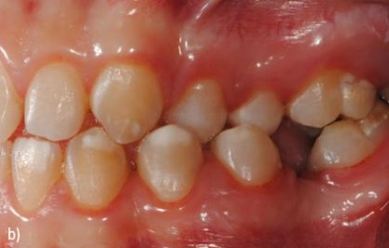
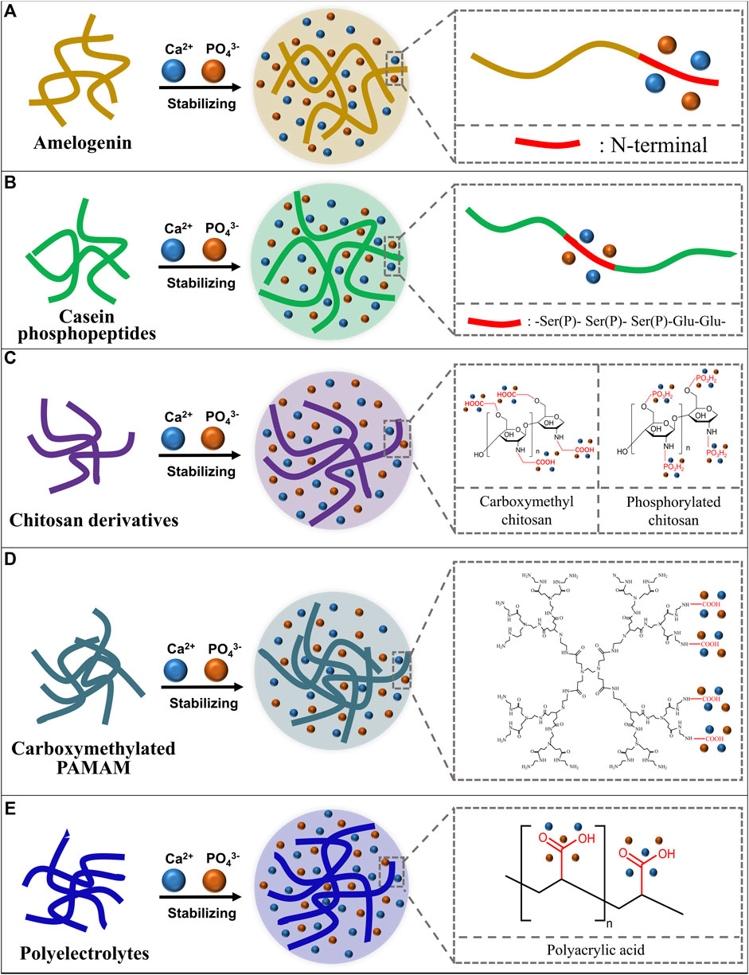
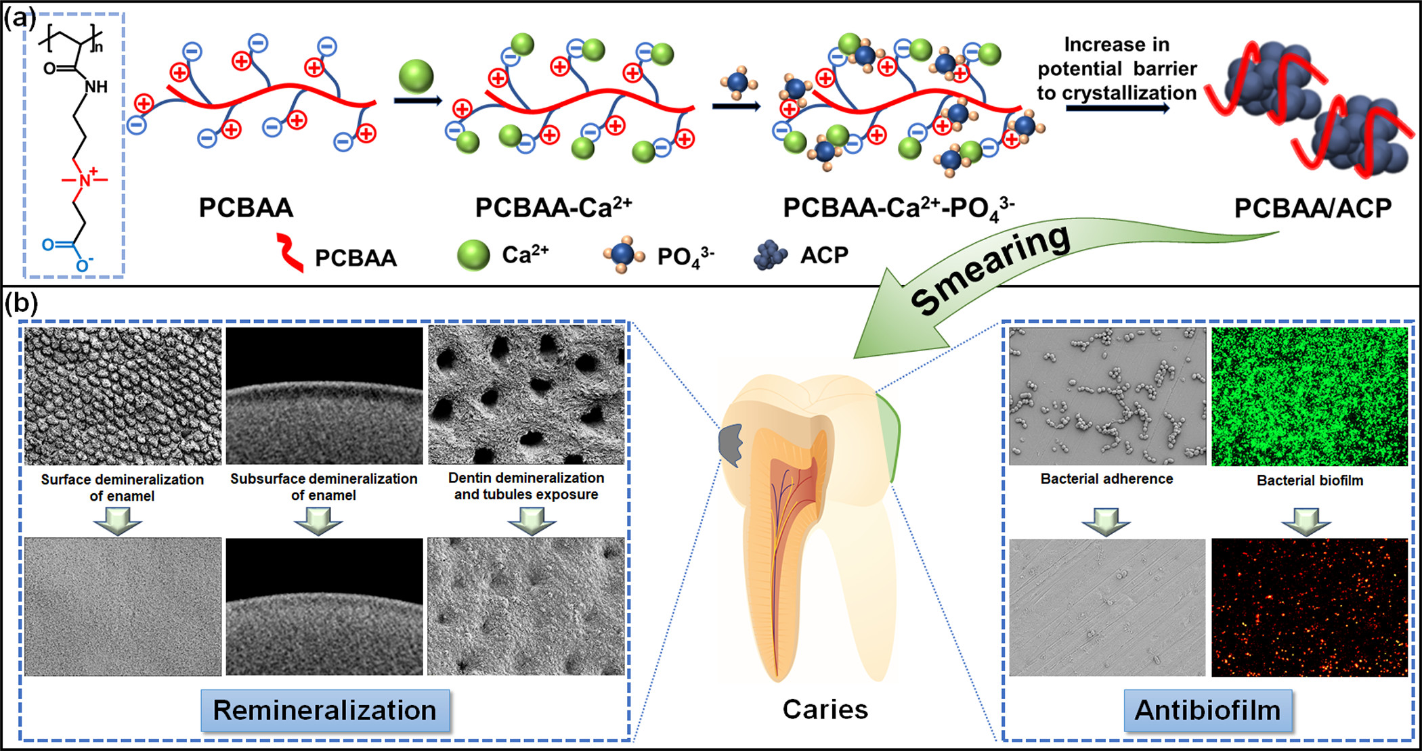
ACP-based enamel remineralization
ACP deposition, infiltration, and phase transformation into hydroxyapatite crystals
Stabilization of ACP
White spot lesion
Dent. Res. Oral Health 2, 62 (2019)
Front. Bioeng. Biotechnol. 10, 853436 (2022); ACS Nano 16, 3119 (2022)
Notes:
The main active sequence of casein phosphopeptide (CPP), the phosphoserine - glutamate cluster (-Ser(P)- Ser(P)- Ser(P)-Glu-Glu-), could stabilize calcium and phosphate ions and form the CPP stabilized ACP complex (CPP-ACP) to avoid the spontaneously crystallizing, phase conversing and precipitating of calcium and phosphorus ion.
Under continuous bacterial challenge in the oral cavity, the currently developed ACP-based remineralization system lacks the ability to inhibit bacterial adhesion and biofilm formation. A dual-functional nanocomposite with antibiofilm and remineralization properties was designed by combining zwitterionic poly(carboxybetaine acrylamide) (PCBAA) and ACP [ACS Nano 16, 3119 (2022)].

Slide 25
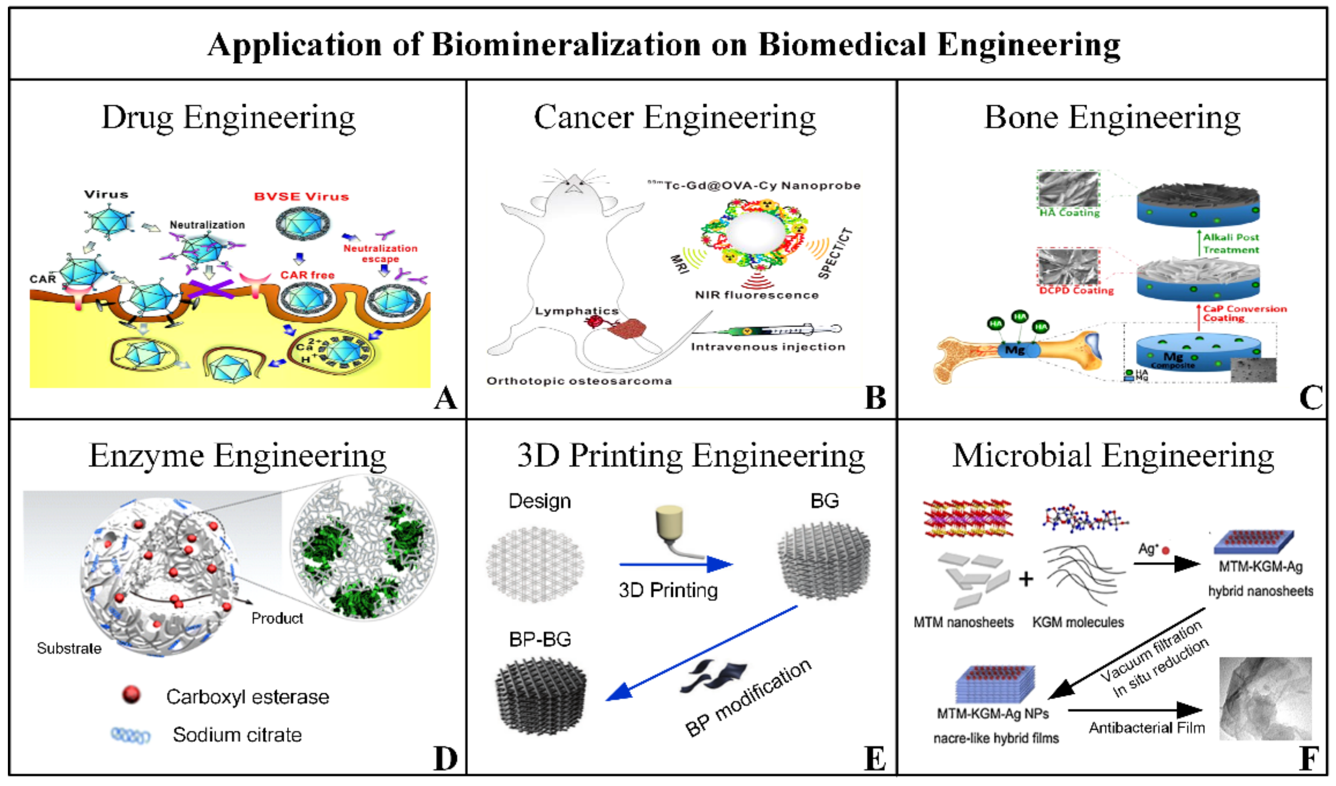
Minerals 9, 68 (2019)

