Slide 1
MIT 3.156/3.46
Photonic Materials and Devices
15: Flat Optics
Juejun (JJ) Hu
hujuejun@mit.edu

Slide 2
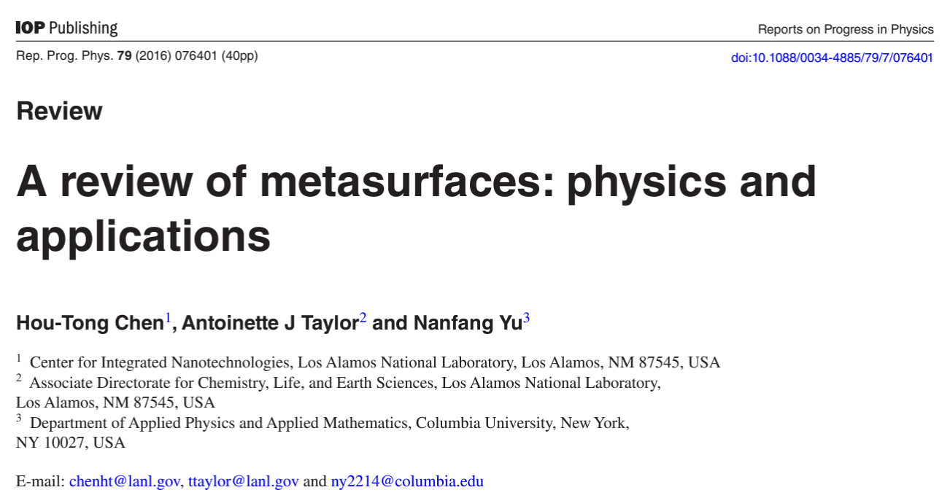
References
“A review of metasurfaces: physics and applications,” Rep. Prog. Phys. 79, 076401 (2016).
“Advances in optical metalenses,” Nat. Photonics 17, 16 (2023).

Slide 3
Flat optics: how it works
Wavefront
Micro-structures
Focal spot
Phase delay
Phase delay
x
x

Slide 4
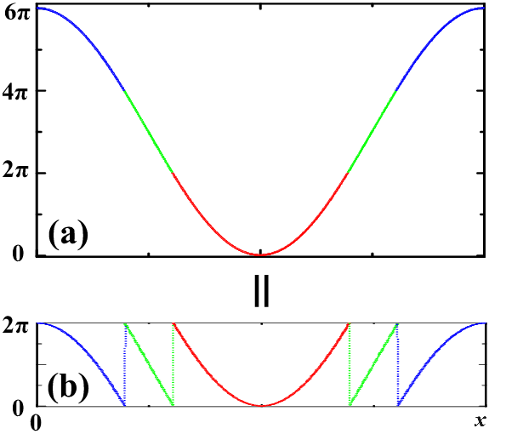
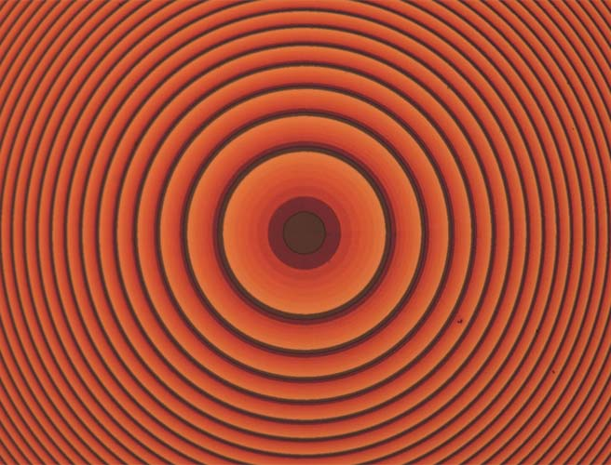
Phase wrapping
Represent the optical phase profile as modulo 2π
The positions of the Fresnel zone boundaries are wavelength-dependent
Unwrapped phase
Fresnel zone
Optical micrograph of a flat lens showing the Fresnel zones
Wrapped phase

Slide 5
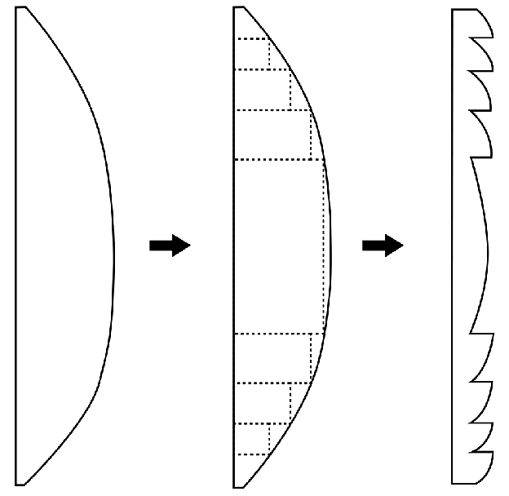
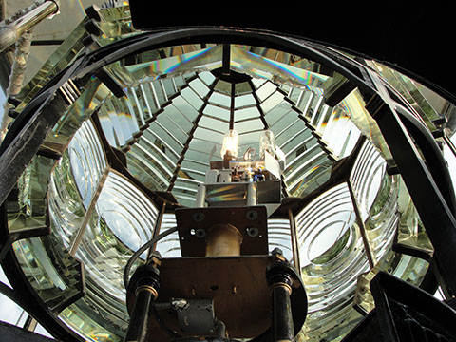
Fresnel lens
Removes non-refractive parts of a traditional lens
Thin profile for weight reduction
Fresnel lens at Boston Light
https://www.insidescience.org/news/remarkable-lens-americas-oldest-lighthouse-station

Slide 6
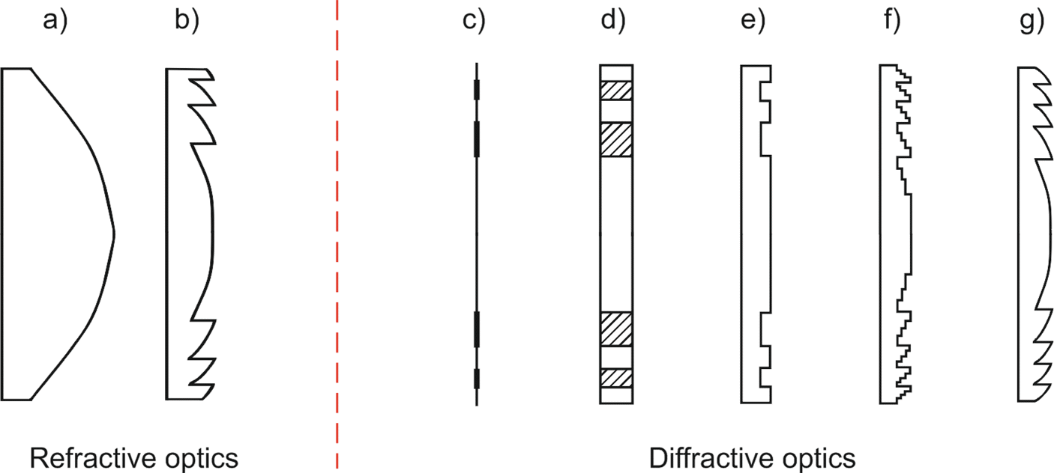
Diffractive optical element (DOE)
Generating optical phase delay by varying height
Multi-level DOE
J. Infrared, Millimeter, Terahertz Waves 40, 477 (2019)

Slide 7
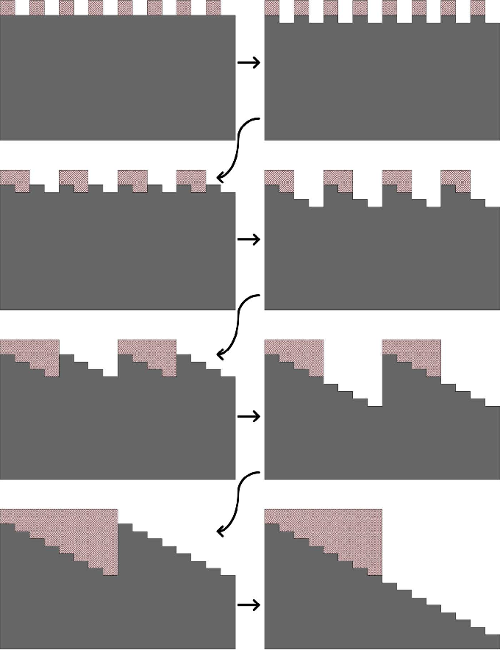

Binary multi-level DOEs
IEEE Trans. THz Sci. Technol. 3, 479-485 (2013)
n binary masks needed to produce 2^{n} different levels
Optical efficiency depends on the phase accuracy
Diffraction efficiencies of DOEs
  2^{n} = 2: up to 41%
  2^{n} = 4: up to 81%
  2^{n} = 8: up to 95%
$$η={\left[\frac{\sin\left(2Δφ\right)}{2Δφ}\right]}^{2}$$

Slide 8
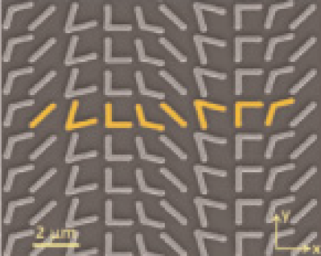
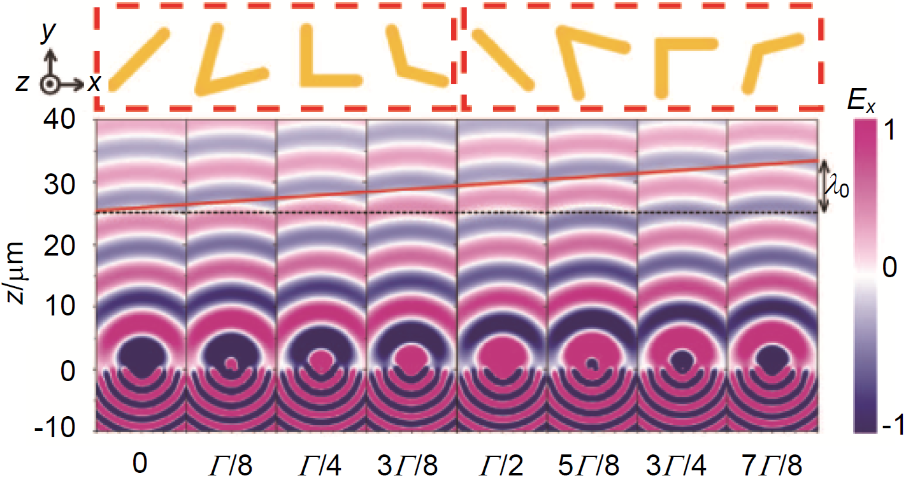
Optical metasurfaces
Eliminating spurious diffraction orders
Plasmonic metal antennas
Δx < λ
Meta-atoms
Science, 334, 333 (2011)
Phase delay
x

Slide 9
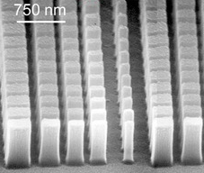
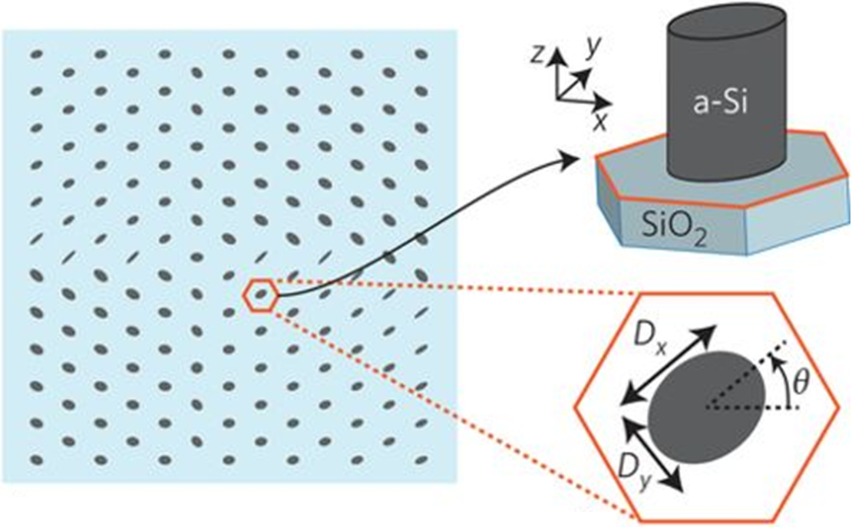
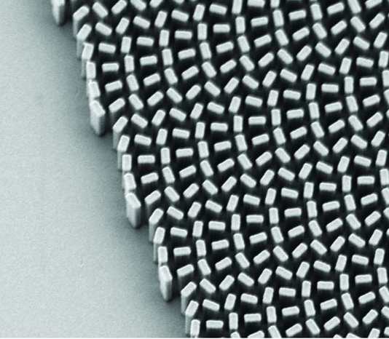
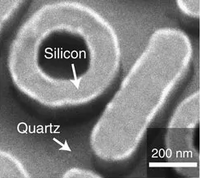
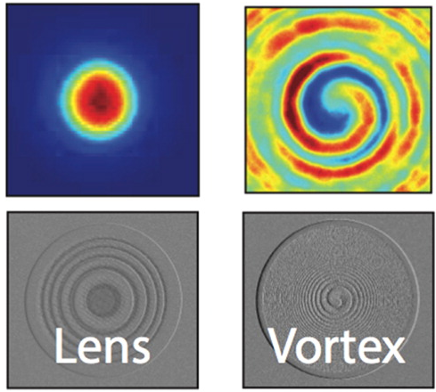
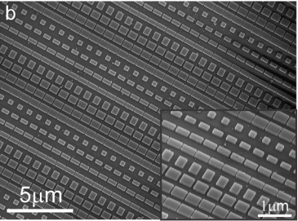
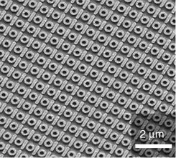
Optical metasurfaces
Opt. Lett. 23, 1081 (1998)
Nat. Nanotechnol. 10, 937 (2015)
Science 352, 1190 (2016)
and many others
…
Nat. Commun. 5, 5753 (2014)
ACS Photonics 3, 209 (2016)
Nano Lett. 15, 6261 (2015)

Slide 10
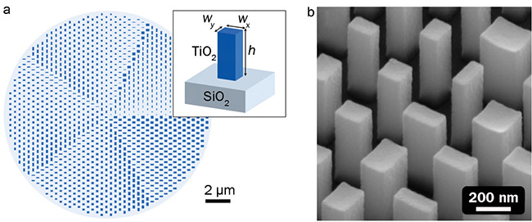
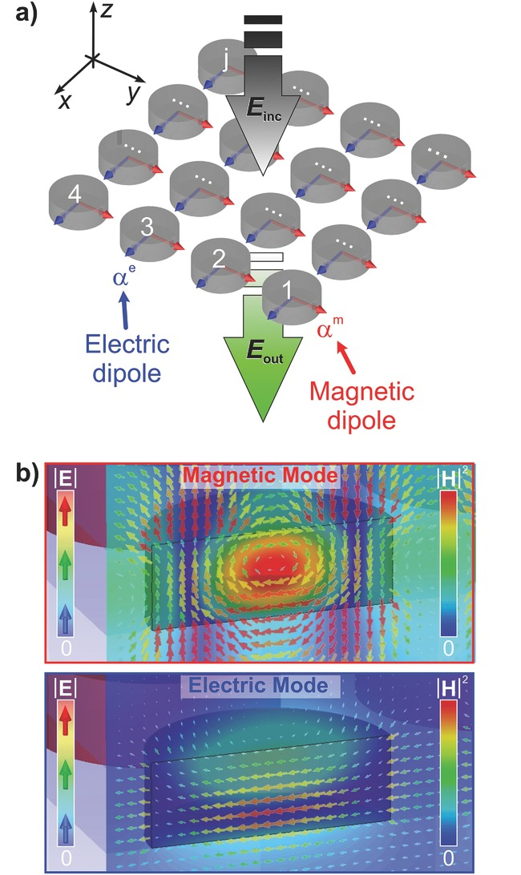
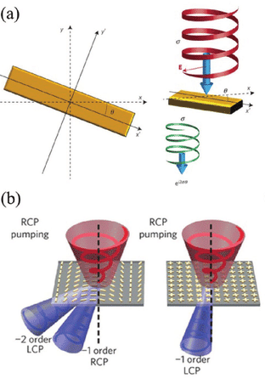
Optical phase modulation mechanisms
Nat. Photonics 14, 498 (2020)
Adv. Opt. Mater. 3, 813 (2015)
Adv. Opt. Mater. 5, 1700040 (2017)
Waveguide
Resonator
Pancharatnam-Berry phase

Slide 11
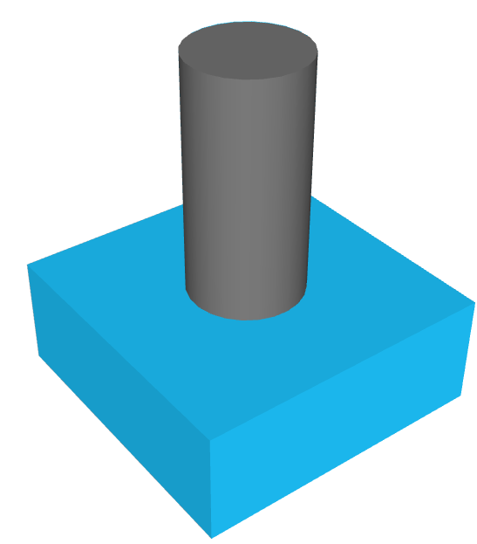
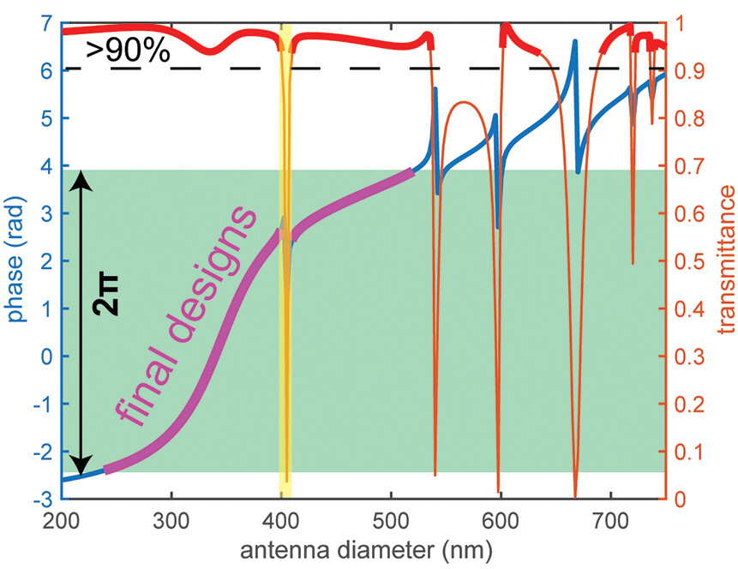
Waveguide-type meta-atoms
Nano Lett. 23, 51 (2023)
a-Si
SiO₂
Guided mode resonances
Solving the meta-atom optical response assuming periodic boundary condition
Each meta-atom acts as a truncated waveguide to impart optical phase delay to the incident lightwave

Slide 12
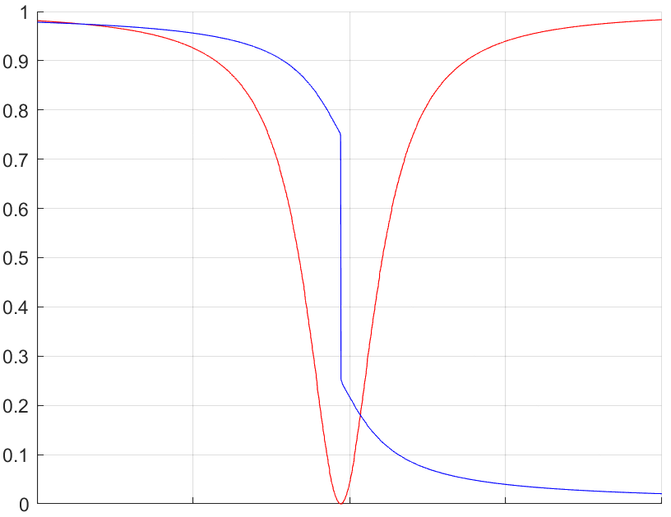
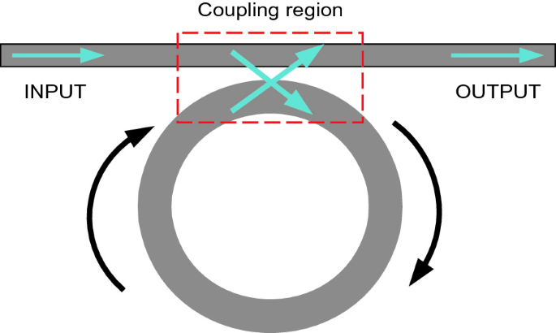
Resonance and phase delay
Transmittance / Phase (2π)
Critically coupled resonator
Wavelength

Slide 13
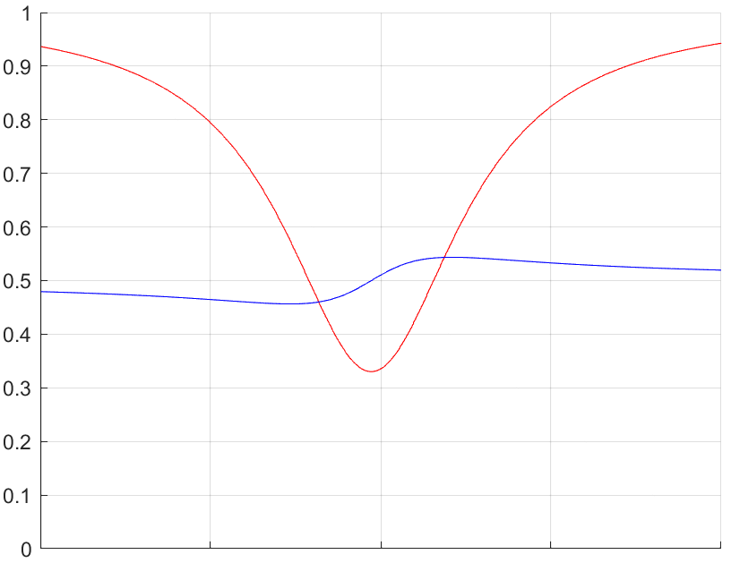
Resonance and phase delay
Transmittance / Phase (2π)
Under coupled resonator
Wavelength

Slide 14
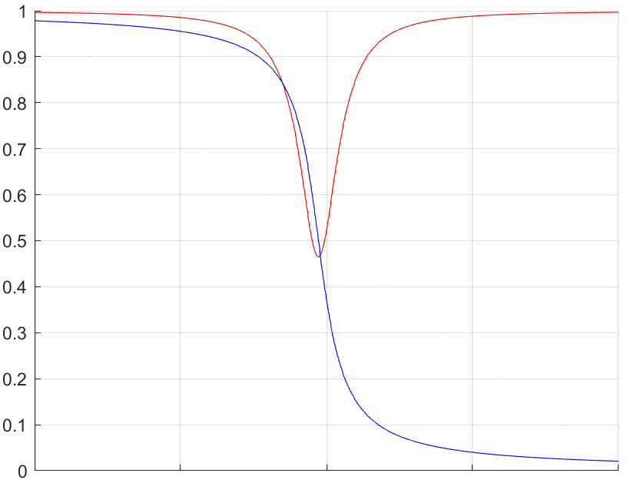
Resonance and phase delay
Transmittance / Phase (2π)
Over coupled resonator
Wavelength

Slide 15
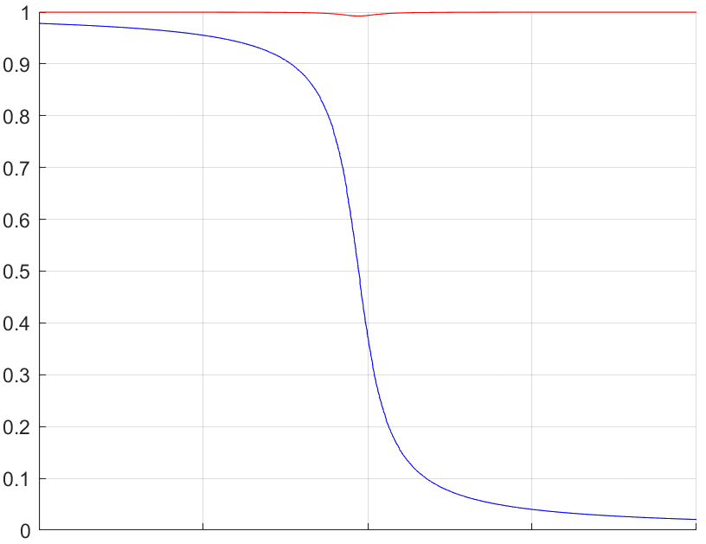
Resonance and phase delay
Transmittance / Phase (2π)
Heavily over coupled resonator
Wavelength

Slide 16
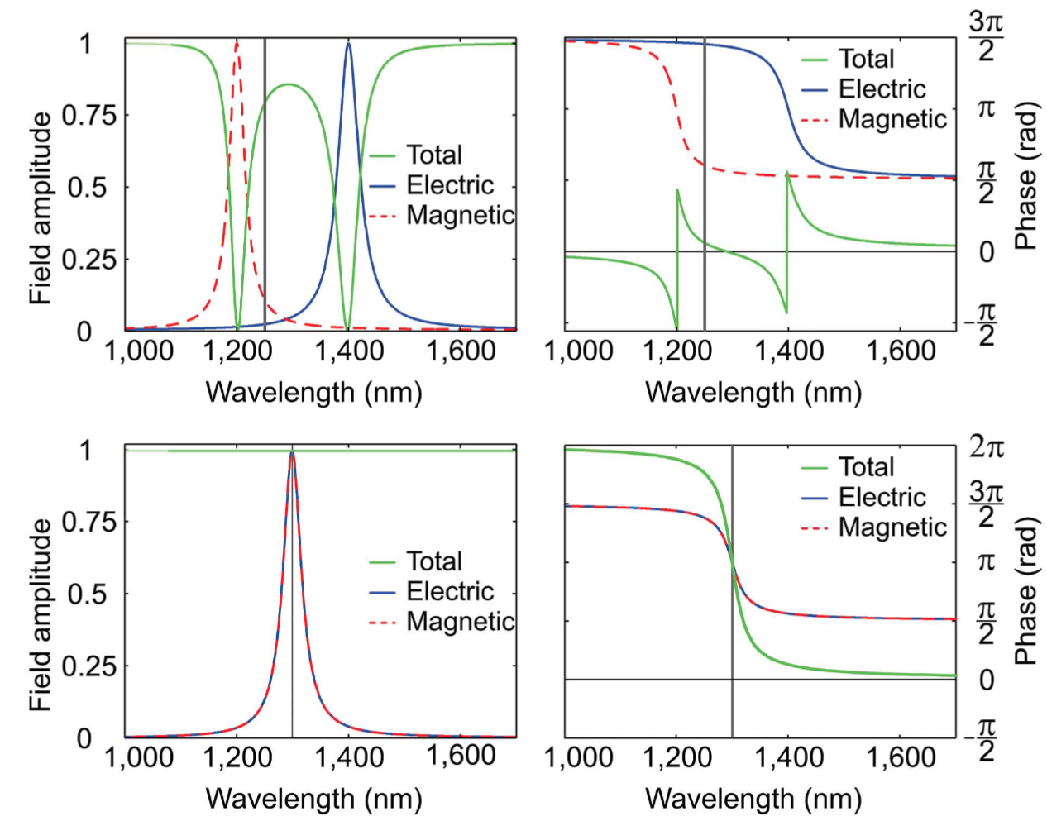
Dielectric Huygens metasurface
Kerker condition: suppression of back scattering
Adv. Opt. Mater. 3, 813 (2015)

Slide 17
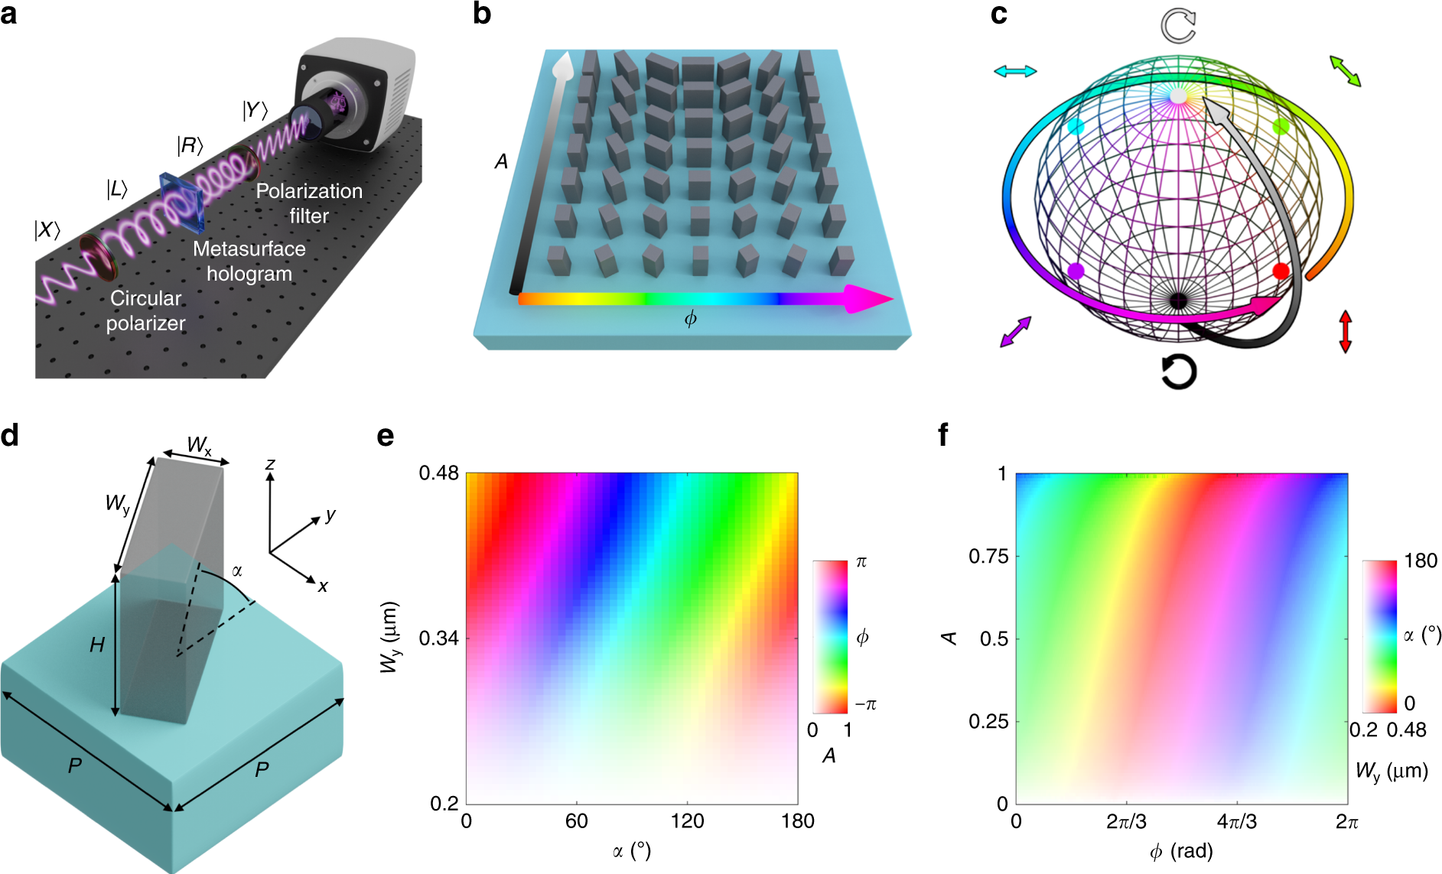
Pancharatnam-Berry (geometric) phase
Extra phase delay acquired by light due to change of its polarization state
Operates with circularly polarized light
Phase-gradient metasurface implemented with anisotropic meta-atoms with spatially varying orientations
Light Sci. Appl. 8, 92 (2019)

Slide 18
Multi-level DOEs vs. metasurfaces
Low lithographic resolution requirement
Ease of achieving high efficiency at small angles
Multiple patterning steps involved
Efficiency limitations due to shadowing and spurious diffraction orders
Polarization insensitivity
Fine-line patterning methods required
Extensive optimization needed to achieve high efficiency
Single mask level lithography
Capable of large light bending angles
Polarization manipulation capability
Nat. Commun. 11, 1991 (2020)

Slide 19
Advantages and limitations of flat optics
System-level Size, Weight and Power (SWaP) benefits
Simplified packaging
Wafer-level integration compatibility
Low monochromatic aberration
Low fabrication cost at high volume
Polarization discrimination capacity
Chromatic aberration
Moderate efficiency

Slide 20
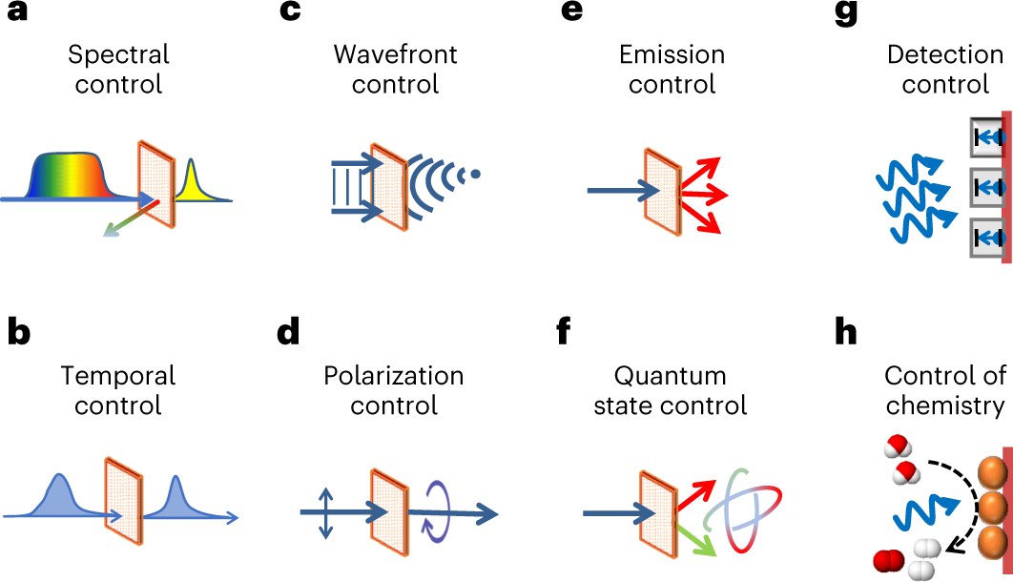
Flat optics functions
Nat. Photonics 17, 26 (2023)

Slide 21

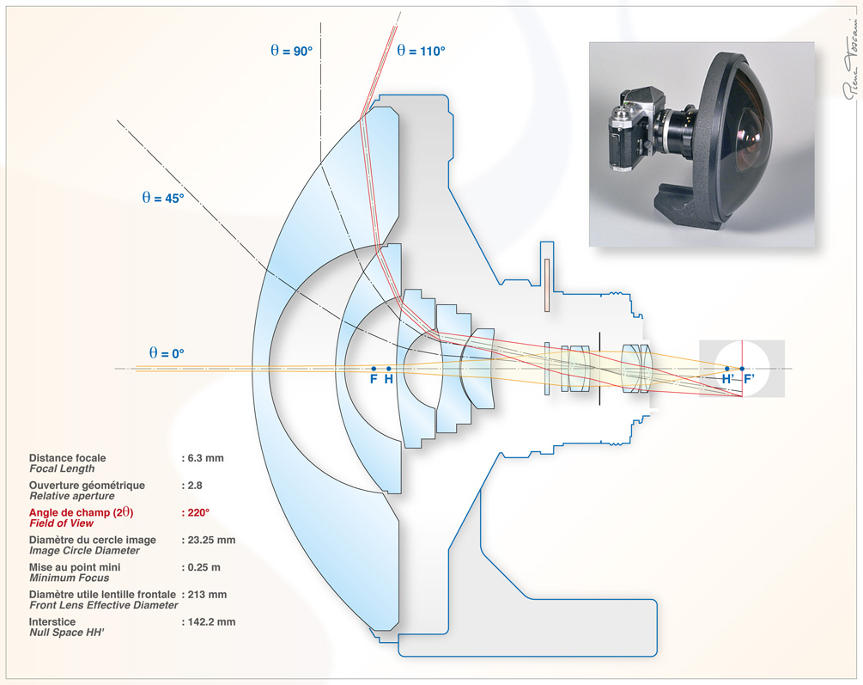

Compact, wide field-of-view optics: an unmet need
Fisheye-Nikkor 6 mm f/2.8
Wide field-of-view optics are vital for imaging, sensing, and display
Conventional wide-angle optical systems are bulky and complicated

Slide 22
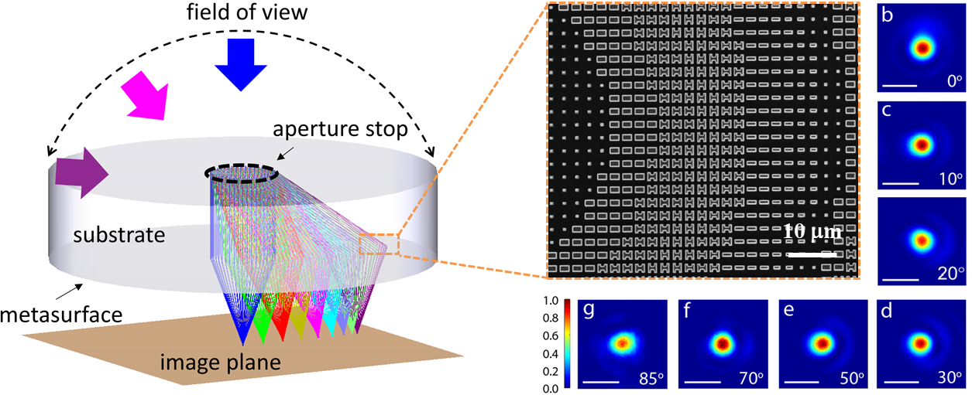
A single-element, flat fisheye metalens
Ultra-wide FOV: unprecedented near-180° FOV
High resolution: diffraction-limited performance across the entire FOV
Compact, light-weight, and low-cost optics compatible with standard silicon foundry manufacturing
Nano Lett. 20, 7429-7437 (2020)

Slide 23
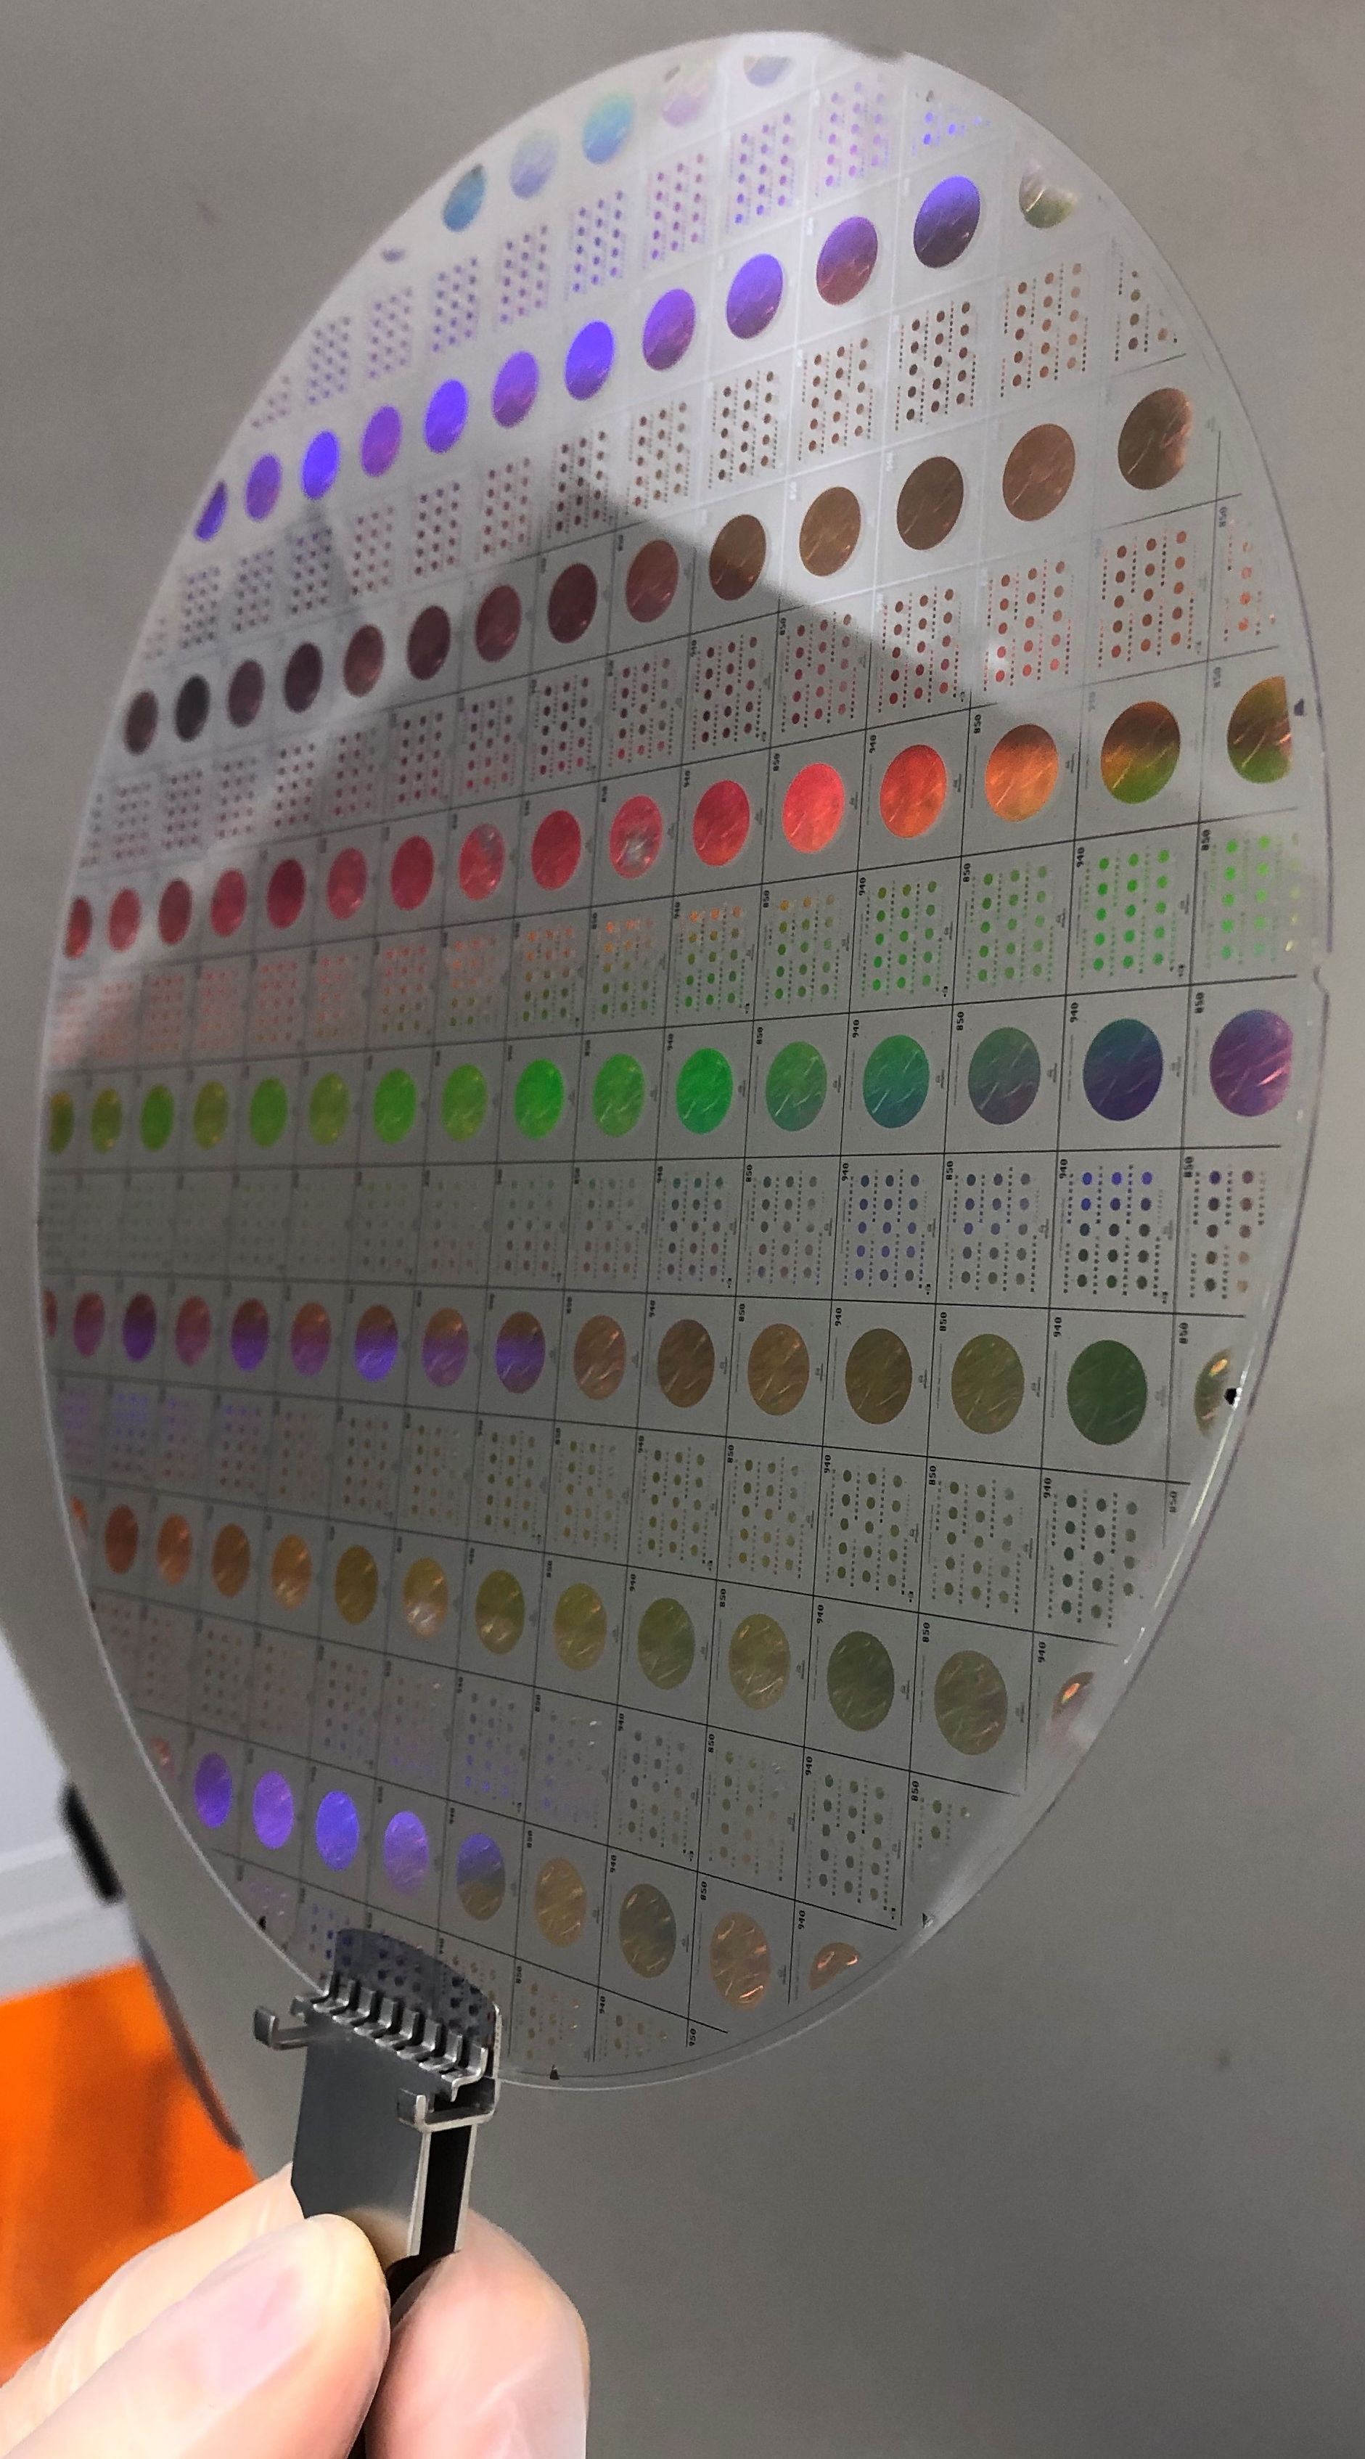
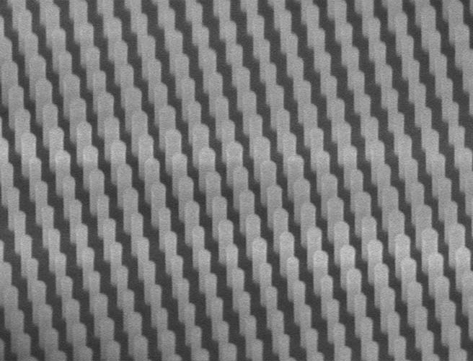
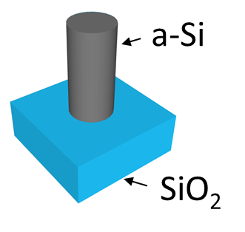

Foundry fabricated fisheye metalens
Scalable manufacturing of wide-FOV metalenses on 200 mm glass wafers leveraging commercial foundry process
200 mm metalens wafer

Slide 24
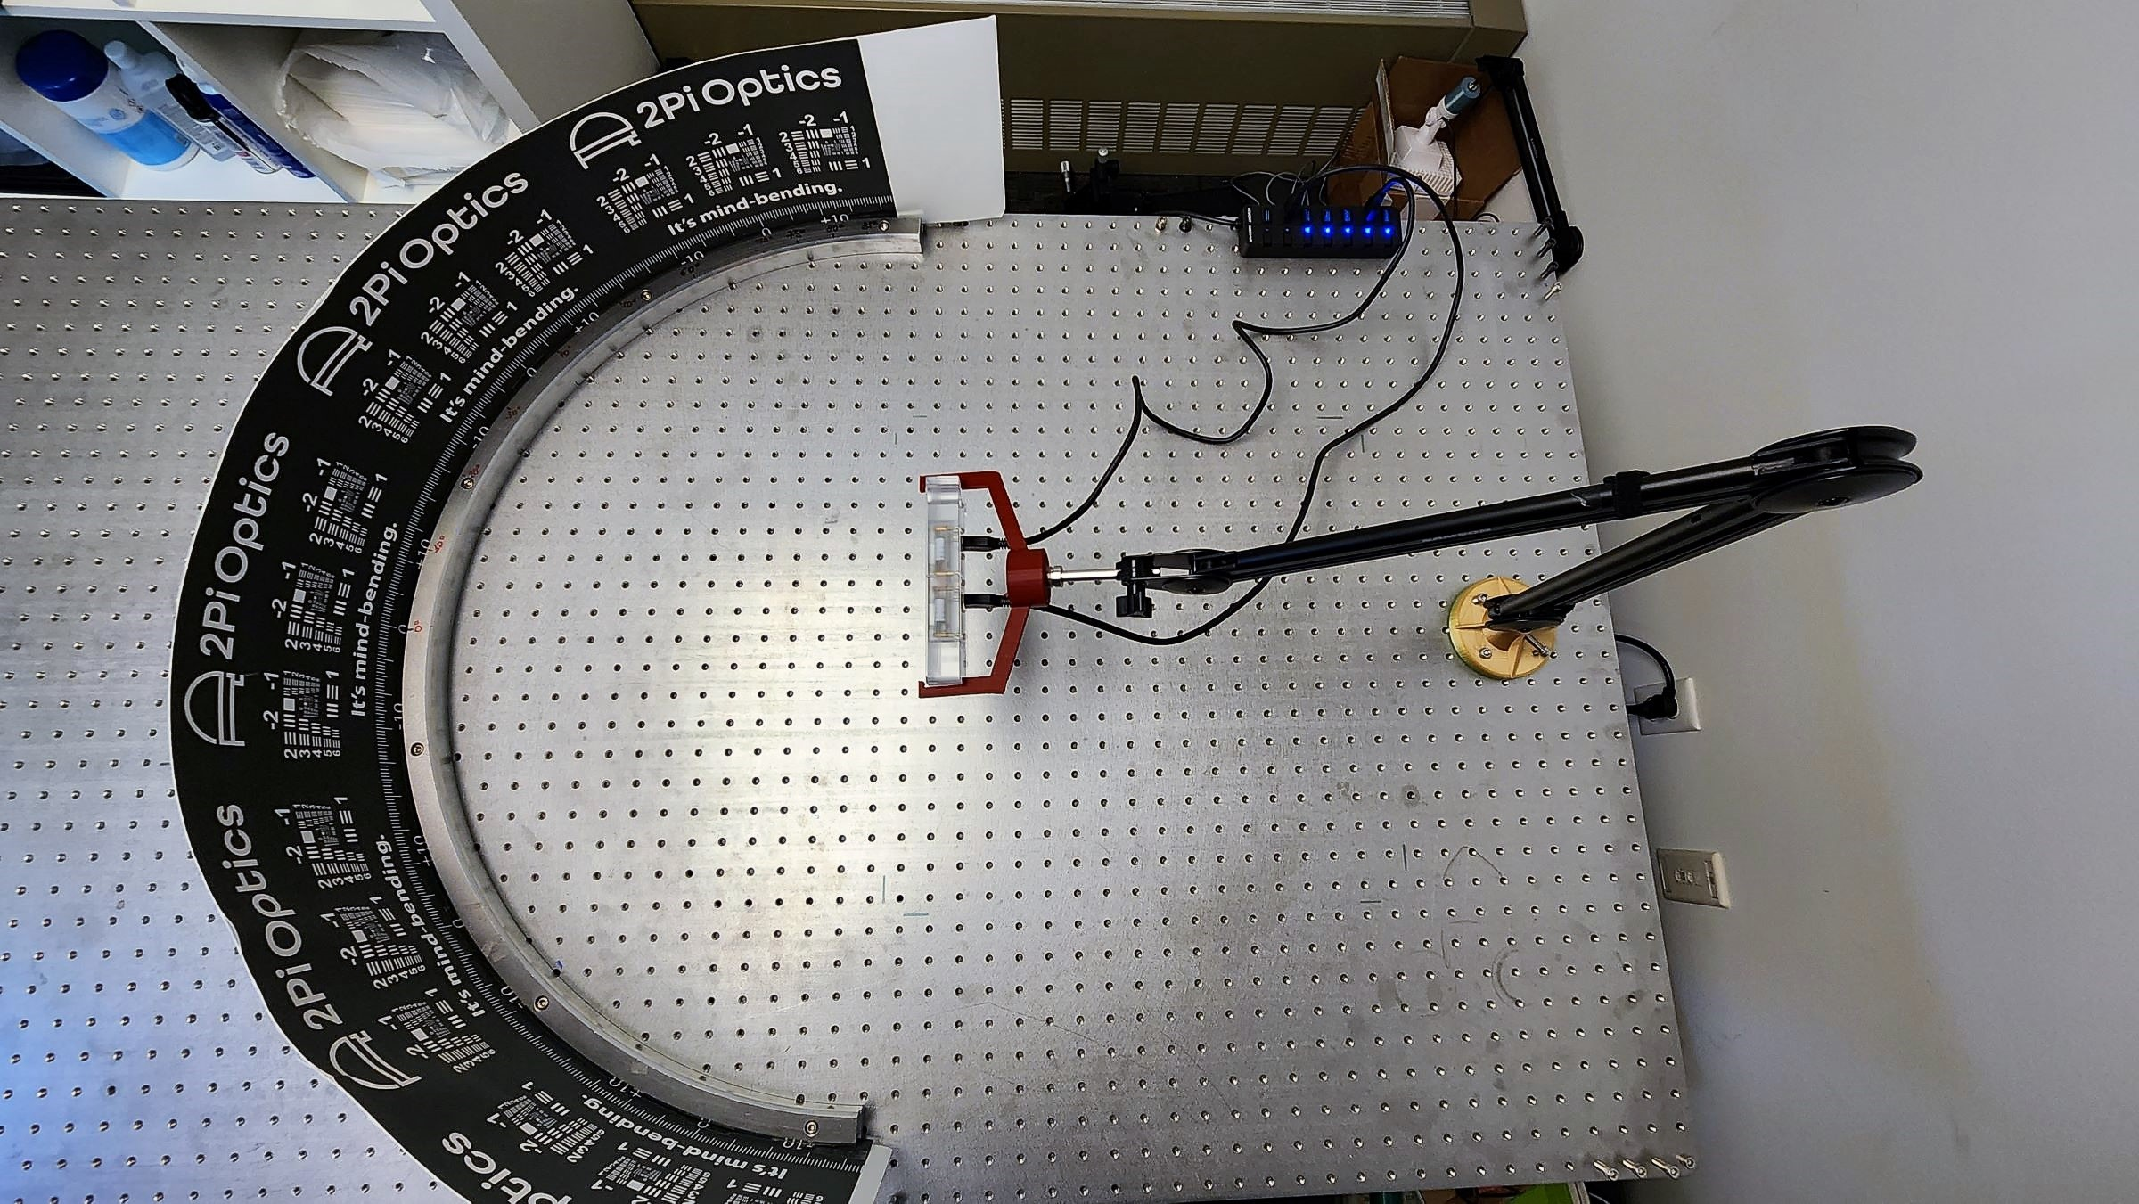
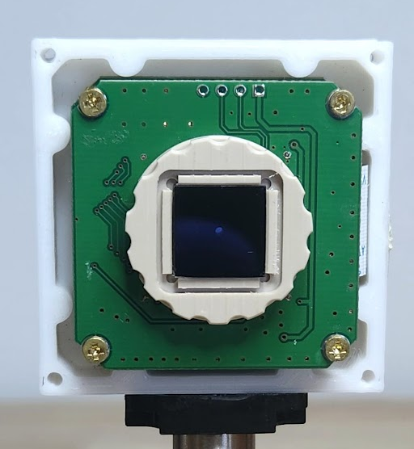
A fisheye meta-camera
Camera position
Circular 180° target
Metalens + image sensor assembly

Slide 25
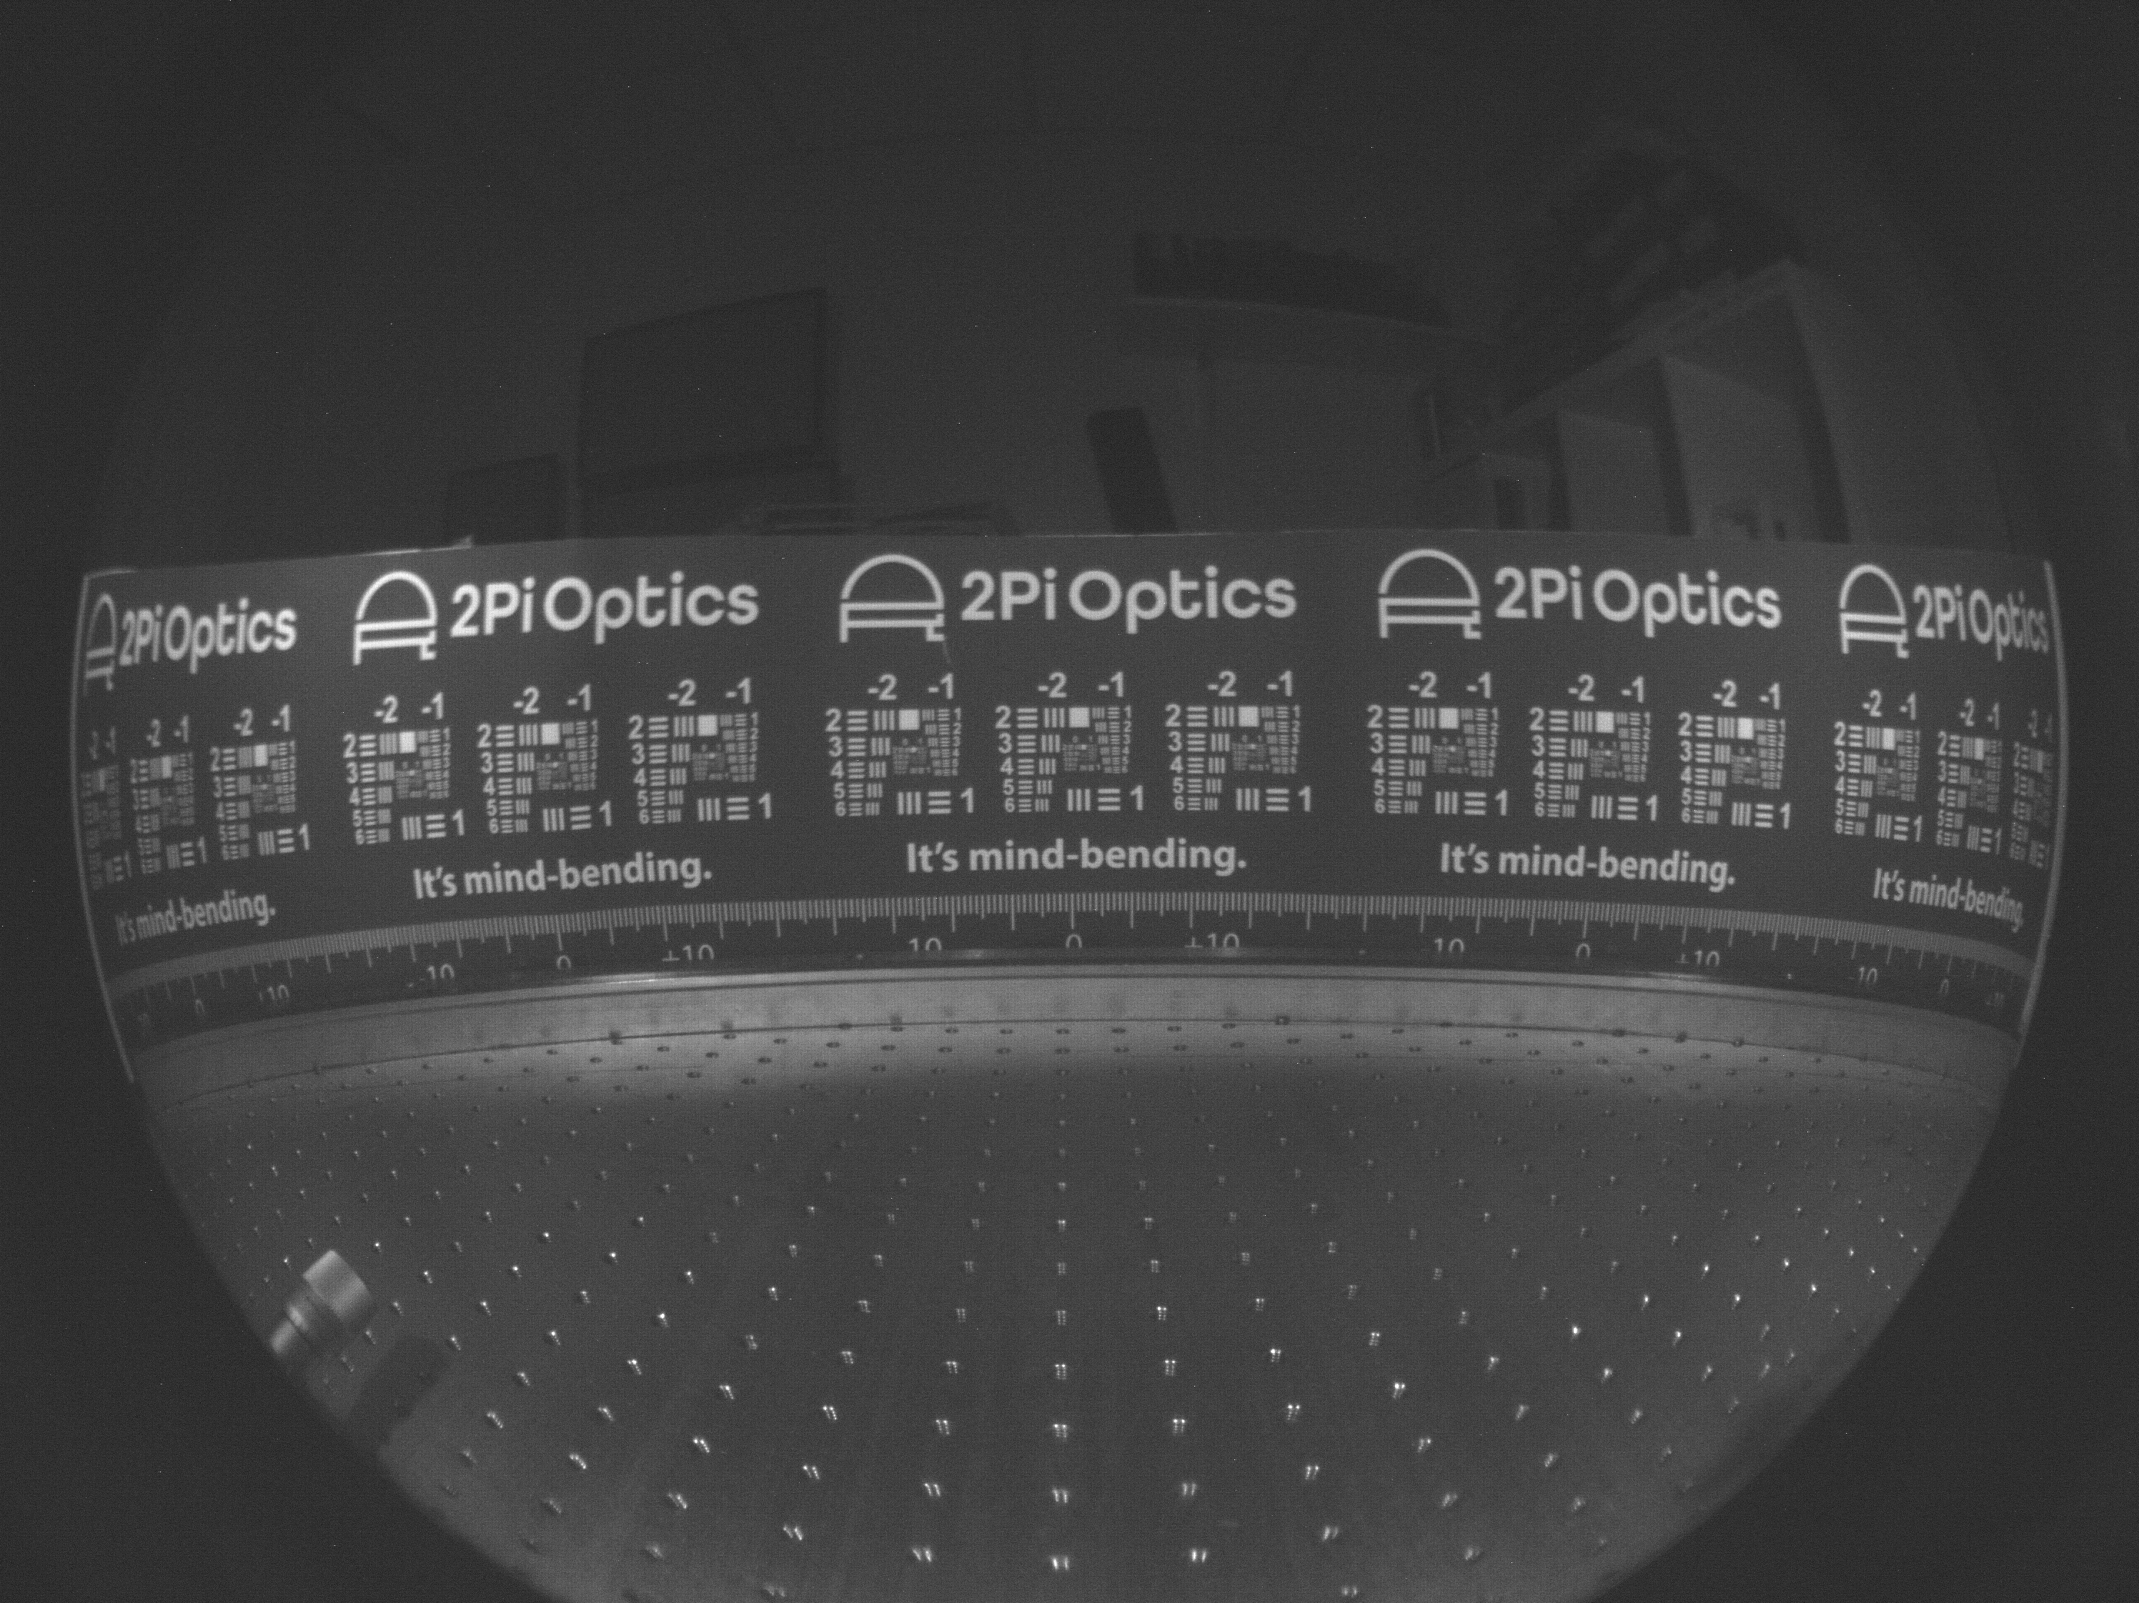
Diffraction-limited performance across 180° FOV

Slide 26



Applications
Sensing and tracking
Near-eye display
LiDAR
Flat optics
Medical imaging
Night vision

Slide 27
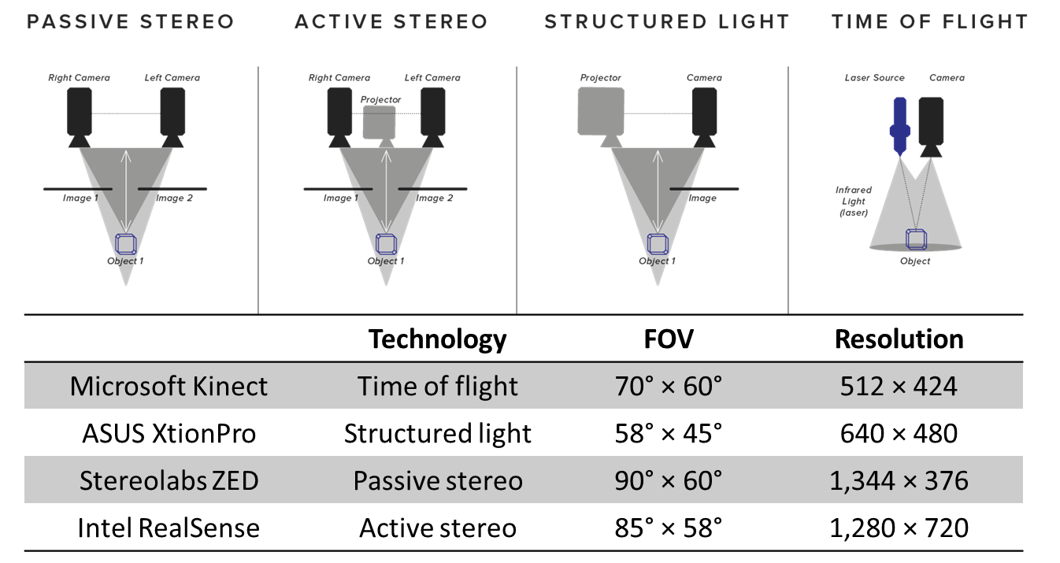
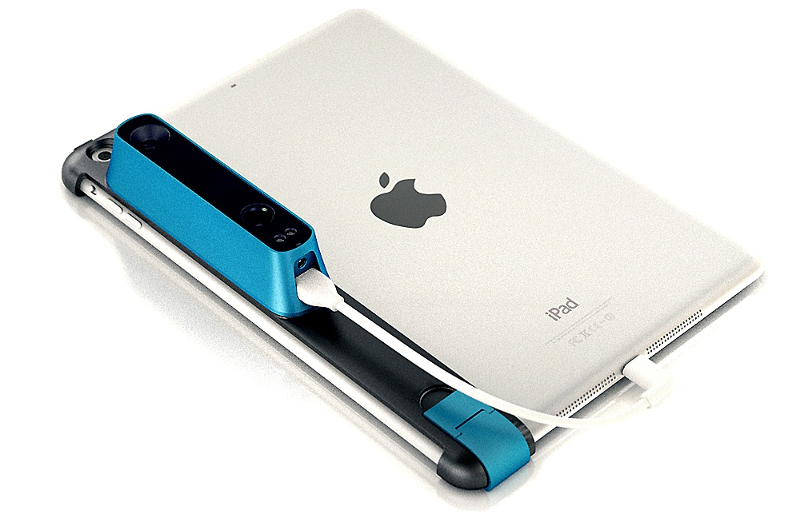
3-D optical sensing: state-of-the-art
Structured light 3-D scanner
Conventional 3-D sensor optics modules
FOV typically < 90°
Bulky
Poor resolution
Complex assembly

Slide 28
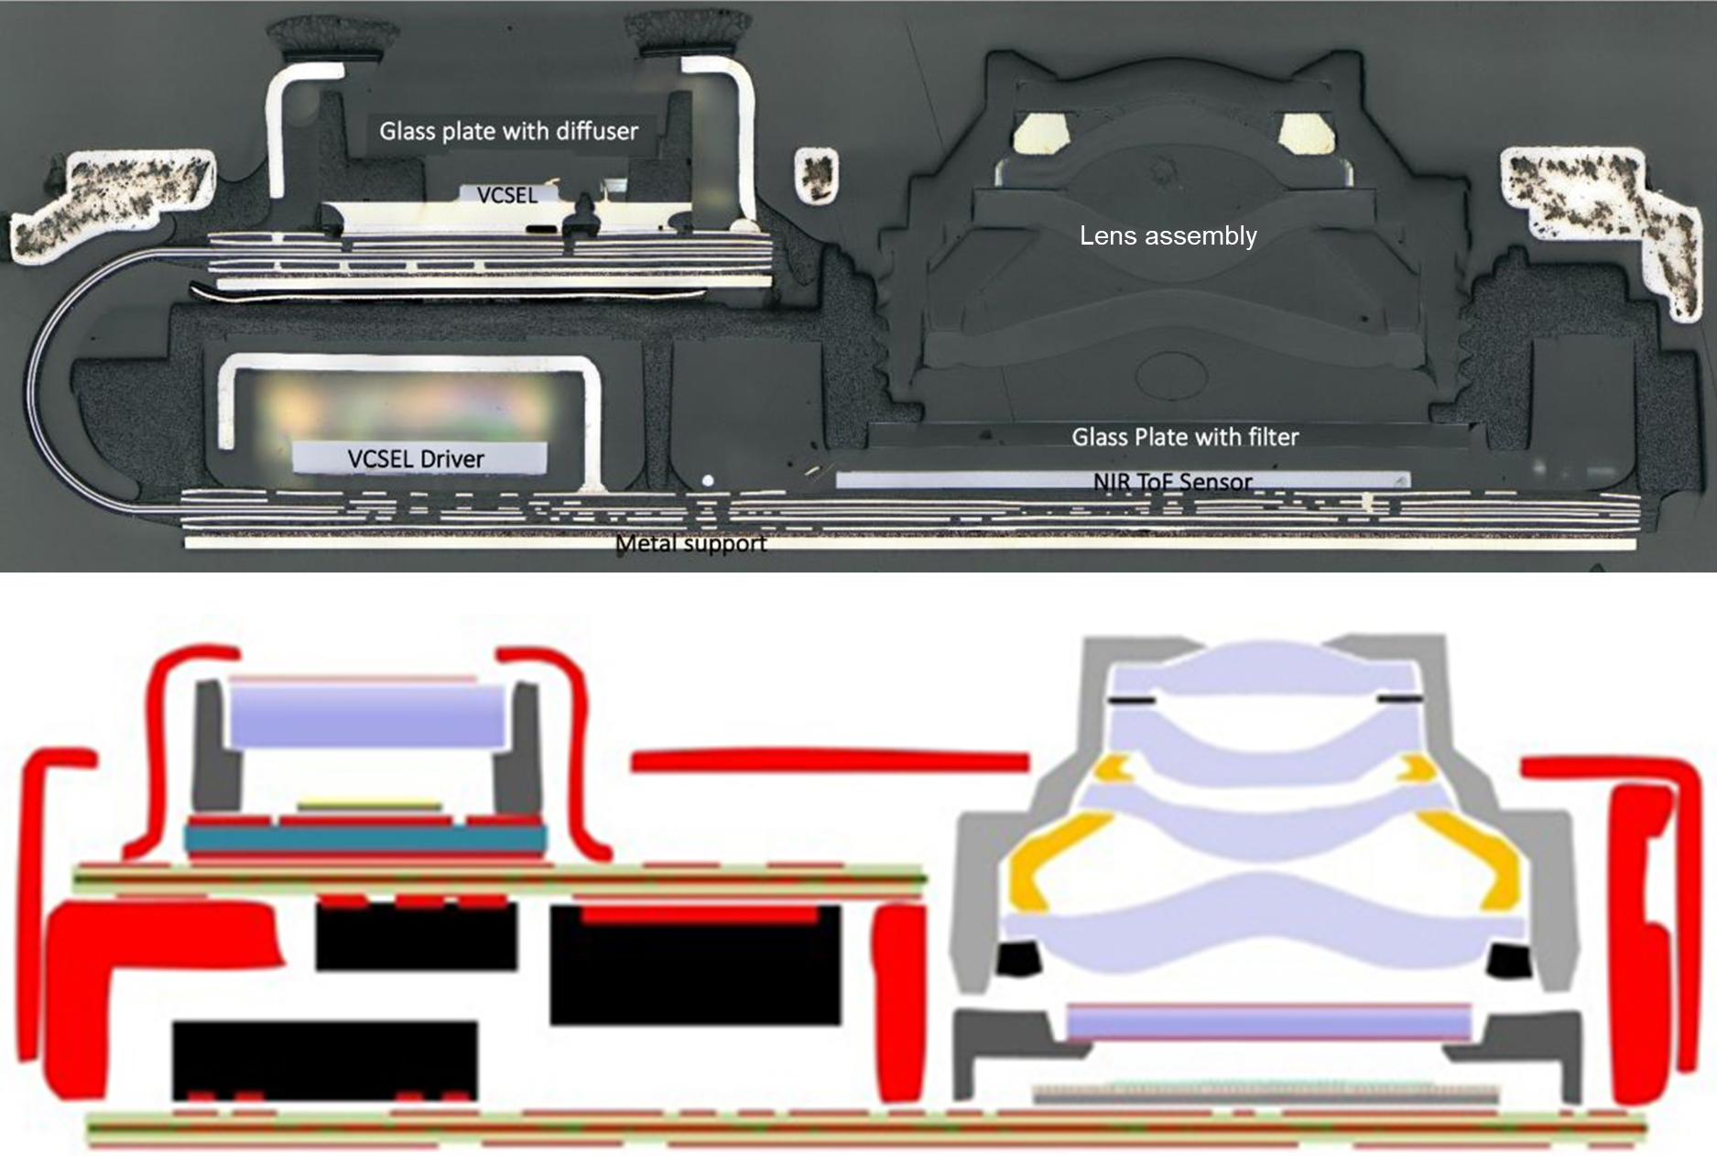
3-D optical sensing: state-of-the-art
Structured light 3-D scanner
Source: System Plus Consulting
Conventional 3-D sensor optics modules
Field-of-view typically < 90°
Bulky
Poor resolution
Complex assembly

Slide 29
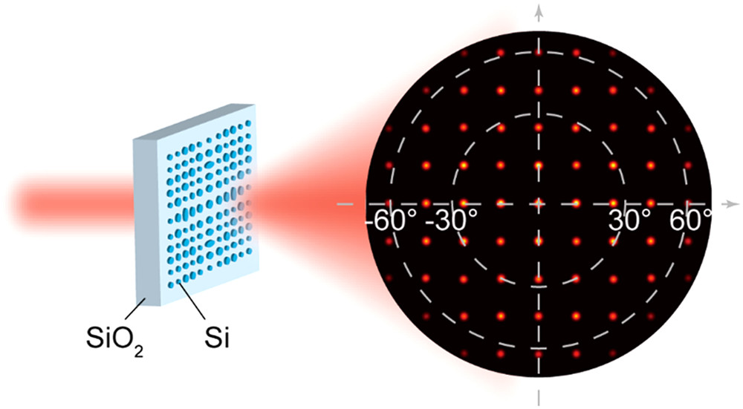
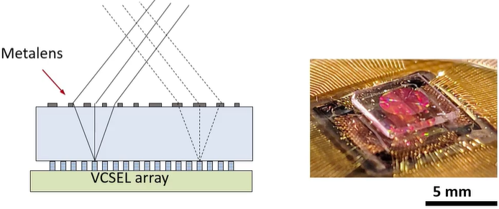
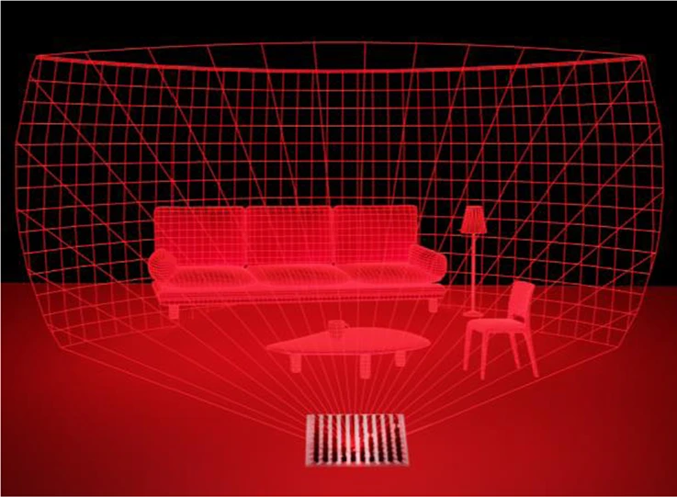
Metasurface projection optics
Nano Lett. 20, 6719 (2020)
SPIE Proc. PC12432, 0Q (2023)
Structured light
Beam steering
Projection display
Holography
High resolution, large field-of-view, high contrast
Nat. Commun. 20, 6719 (2023)

Slide 30
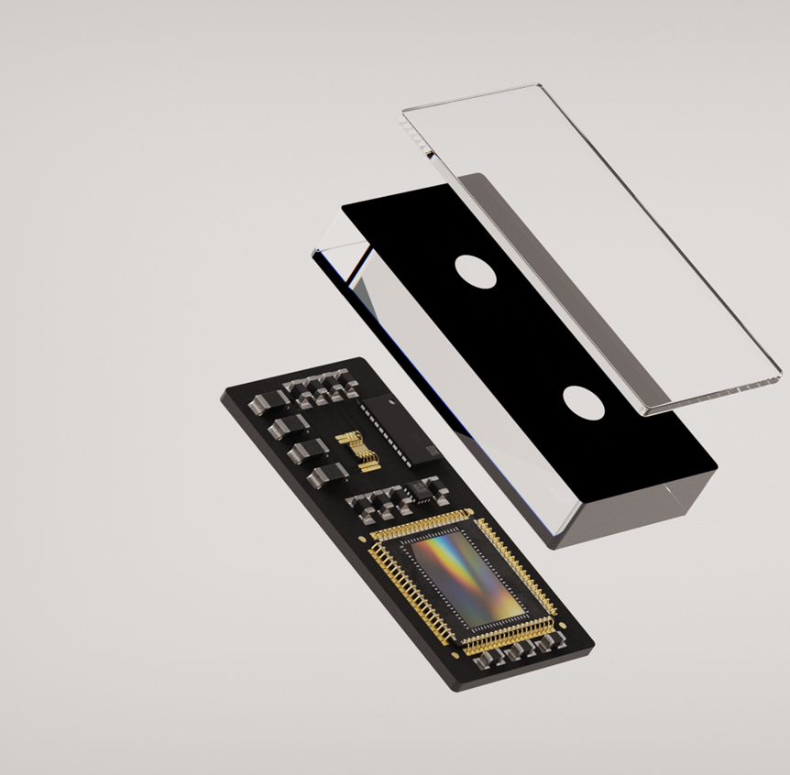
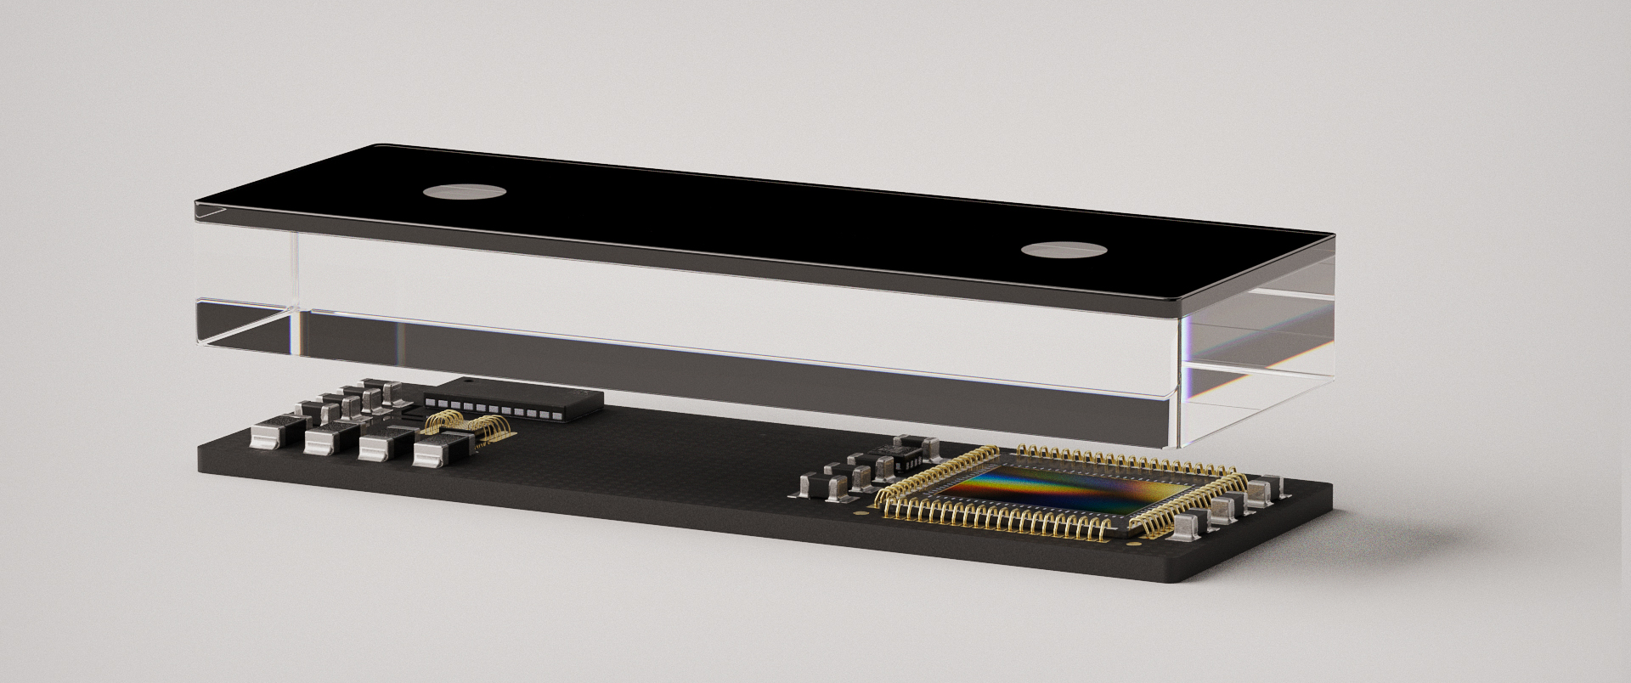
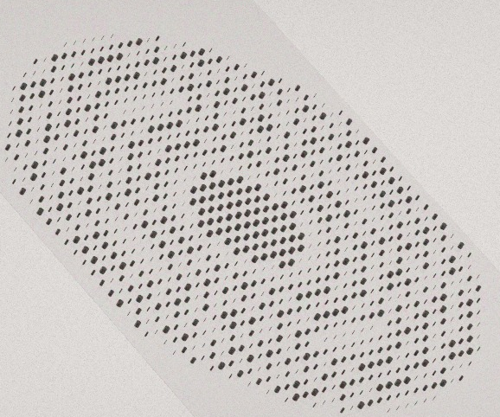
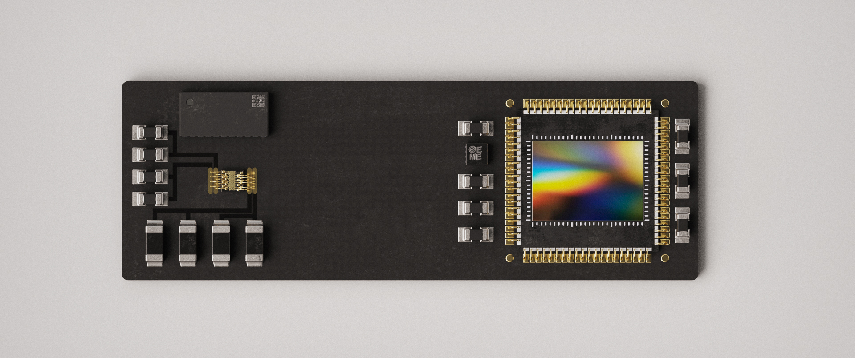
Metasurface-enabled 3-D sensor
An all-planar, high-performance 3-D sensor for integration with mobile devices, AR/VR modules, automobile systems, robotics, etc.

Slide 31
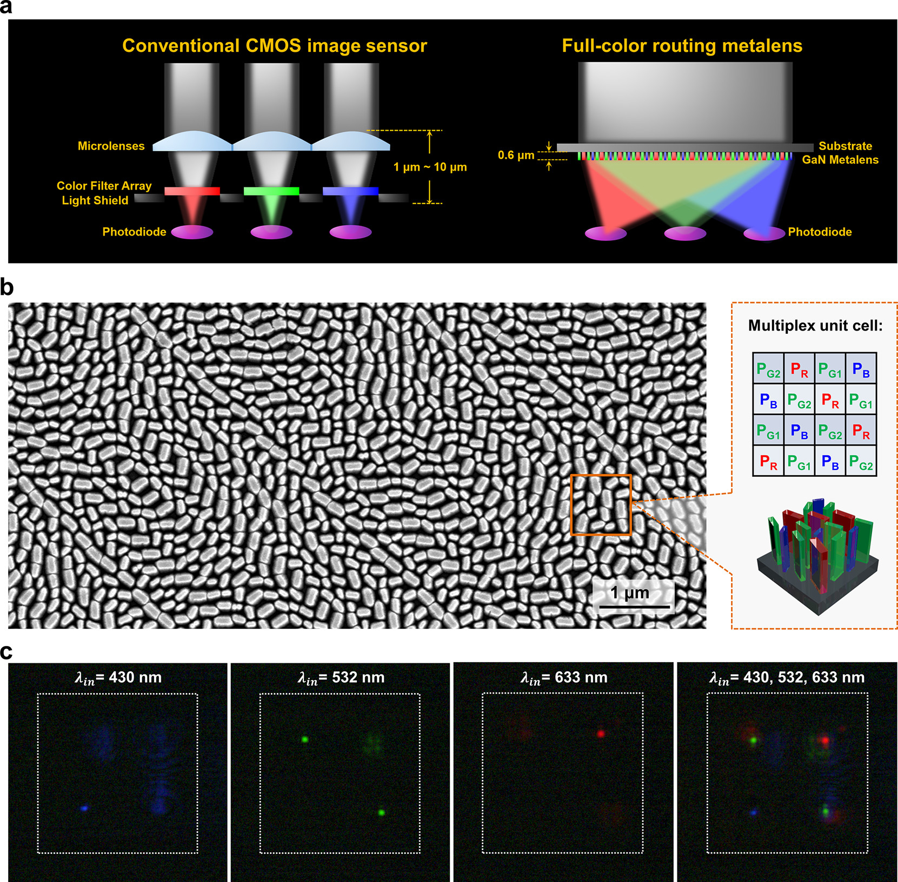
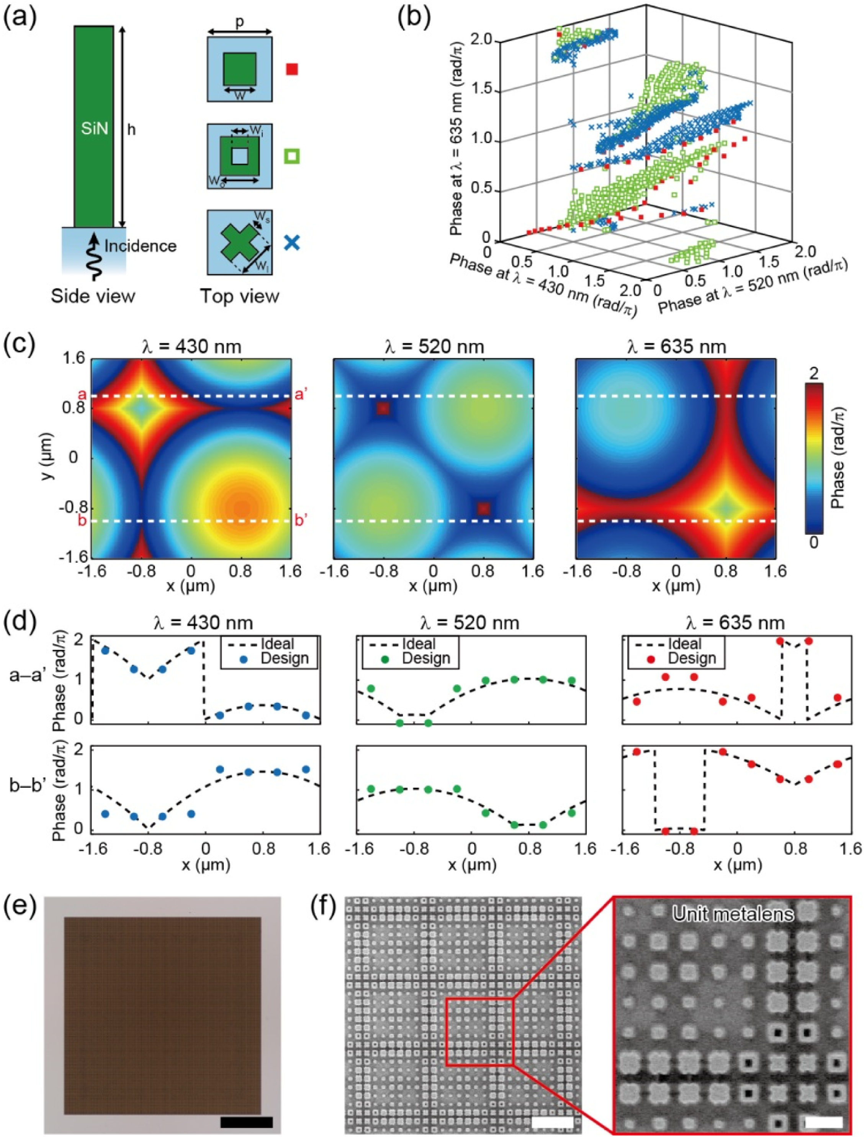
Metasurface color routers
Reduce photon loss due to filtering
Nano Lett. 17, 6345 (2017); Optica 8, 1596 (2021)

Slide 32
List of symbols
η – diffraction efficiency
Δϕ – average optical phase error

