Slide 1
MIT 3.156/3.46
Photonic Materials and Devices
3: Guided Wave Optics
Juejun (JJ) Hu
hujuejun@mit.edu

Slide 2

Guided wave optics vs. multi-layers
Light
Longitudinal variation of refractive indices
  Refractive indices vary along the light propagation direction
  Approach: transfer matrix method
  Devices: DBRs, ARCs
Transverse variation of refractive indices
  The index distribution is not a function of z (light propagation direction)
  Approach: guided wave optics
  Devices: fibers, planar waveguides
H
L
H
L
H
L
High-index substrate

Slide 3
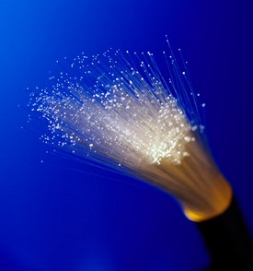
Why is guided wave optics important?
It is the very basis of numerous photonic devices
  Optical fibers, waveguides, traveling wave resonators, waveguide lasers, waveguide modulators…
Fiber optics
The masters of light
“If we were to unravel all of the glass fibers that wind around the globe, we would get a single thread over one billion kilometers long – which is enough to encircle the globe more than 25 000 times – and is increasing by thousands of kilometers every hour.”
-- 2009 Nobel Prize in Physics
Press Release

Slide 4
Waveguide geometries and terminologies
2-d optical confinement
1-d optical confinement
cladding
n_{low}
core
n_{low}
n_{low}
core
n_{high}
n_{high}
n_{high}
cladding
n_{low}
cladding
n_{low}
Slab waveguide
Channel/photonic wire
waveguide
Rib/ridge waveguide
cladding
core
Step-index fiber
Graded-index (GRIN) fiber

Slide 5
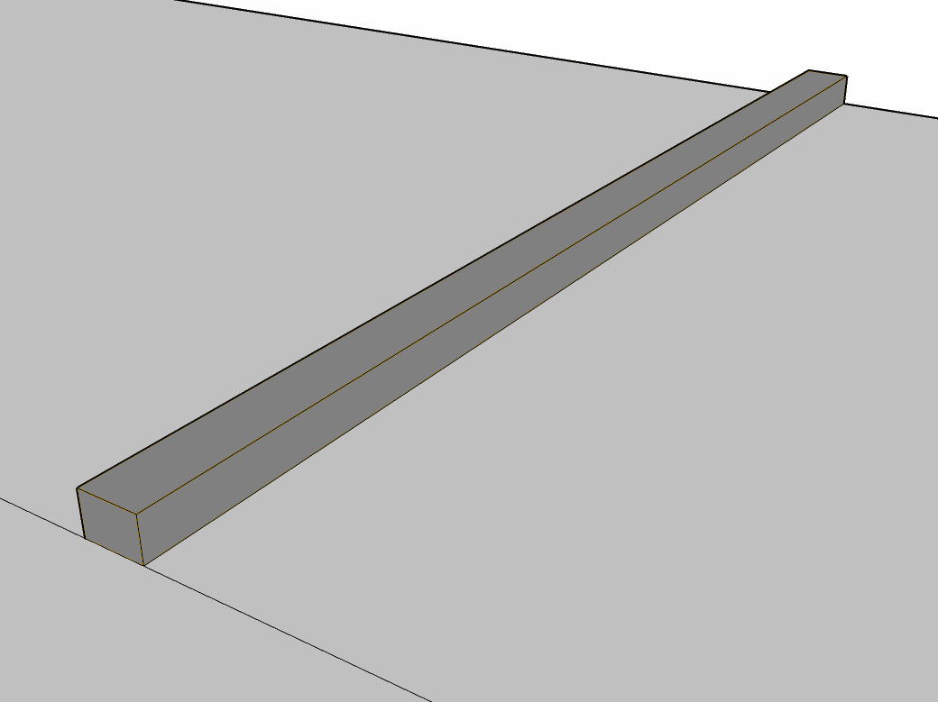


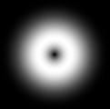
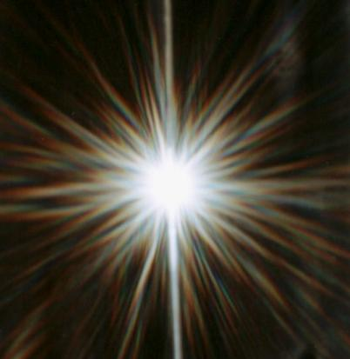

How does light propagate in a waveguide?
light
Question:
If we send light through a channel waveguide, what are we going to see at the waveguide output facet?
?
JJ knows the answer, but we don’t !
A
B
C
D
E

Slide 6
Modes
“When asked, many well-trained scientists and engineers will say that they understand what a mode is, but will be unable to define the idea of modes and will also be unable to remember where they learned the idea!”
Quantum Mechanics for Scientists and Engineers
David A. B. Miller

Slide 7
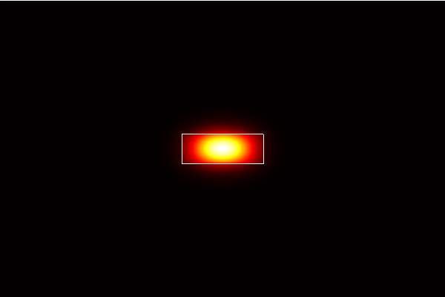
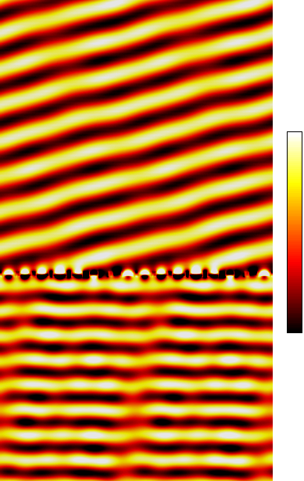
What is a waveguide mode?
A propagation mode of a waveguide at a given wavelength is a stable cross-sectional shape (complex amplitude of fields) in which the wave propagates
Waveguide modes at any given wavelength are completely determined by the cross-sectional geometry and refractive index profile of the waveguide
1
SiO₂
x
220 nm
Si
z
y
500 nm
0
Fundamental TE mode @ 1550 nm

Slide 8
What is a waveguide mode?
A propagation mode of a waveguide at a given wavelength is a stable cross-sectional shape (complex amplitude of fields) in which the wave propagates
Waveguide modes at any given wavelength are completely determined by the cross-sectional geometry and refractive index profile of the waveguide
SiO₂
Si
y
x
z

Slide 9
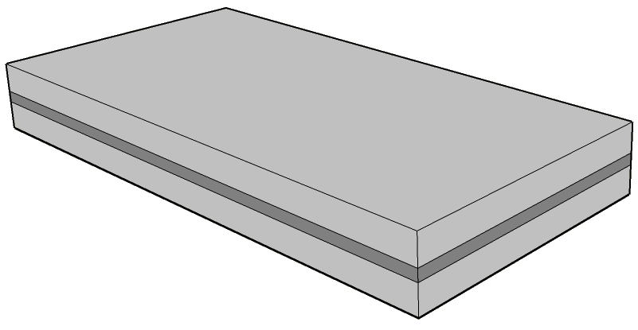

1-d optical confinement: slab waveguide
Wave equation:
with spatially non-uniform refractive index
x
y
z
TE: E-field parallel to substrate
Helmholtz equation:
z
k = nk₀ = nω/c₀
effective index
Propagation constant is related to the wavelength (spatial period) of light propagating in the waveguide
Propagation constant: β = n_{eff} k₀
Field boundary conditions

Slide 10
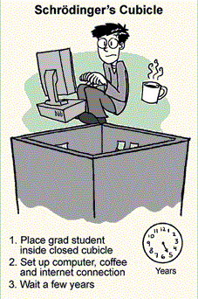

Quantum mechanics = Guided wave optics
?
“The equations for many different physical situations have exactly the same appearance… (therefore) it is actually quite possible for a physicist to retain a broad knowledge of the physical world rather than to become a specialist in some narrow area.”
-- R. P. Feynman
Guided wave optics
Quantum mechanics
"According to the experiment, grad students exist in a state of both productivity and unproductivity."
-- Ph.D. Comics

Slide 11
Quantum mechanics = Guided wave optics
?
“The equations for many different physical situations have exactly the same appearance… (therefore) it is actually quite possible for a physicist to retain a broad knowledge of the physical world rather than to become a specialist in some narrow area.”
-- R. P. Feynman
Quantum mechanics
1-d time-independent Schrödinger equation
ψ(x) : time-independent wave function (time cross-section)
-V(x) : potential energy landscape
-E : energy (eigenvalue)
Time-dependent wave function (energy eigenstate)
t : time evolution
Guided wave optics
Helmholtz equation in a slab waveguide
U(x) : cross-sectional optical mode profile (complex amplitude)
k₀²n(x)² : x-sectional index profile
β² : propagation constant
Electric field along z direction (waveguide mode)
z : wave propagation

Slide 12






Slab waveguide in a quantum mechanics lens
Helmholtz equation:
Schrödinger equation:
x
V
n_{clad}
?
V₀
n_{core}
E₃
n_{clad}
E₂
n
V_{well}
E₁
x
n_{clad}
n_{core}
Discretized propagation constant β values
Higher order mode with smaller β have more nodes (U = 0)
Larger waveguides with higher index contrast supports more modes
Guided modes: n_{clad} < n_{eff} < n_{core}
1-d potential well (particle in a well)
Discretized energy levels (states)
Wave functions with higher energy have more nodes (ψ = 0)
Deeper and wider potential wells gives more bounded states
Bounded states: V_{well} < E < V₀

Slide 13
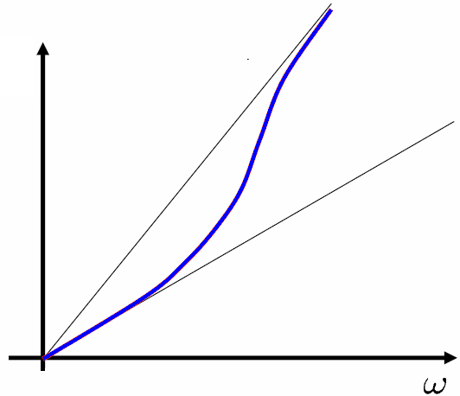
Waveguide dispersion
waveguide dispersion
short λ
high ω
long λ
low ω
β = n_{eff} k₀ = n_{eff} ω/c₀
n_{clad}
n_{core}ω/c₀
n_{core}
n_{clad}ω/c₀
n_{clad}
At long wavelength, effective index is small (QM analogy: reduced potential well depth)
At short wavelength, effective index is large

Slide 14
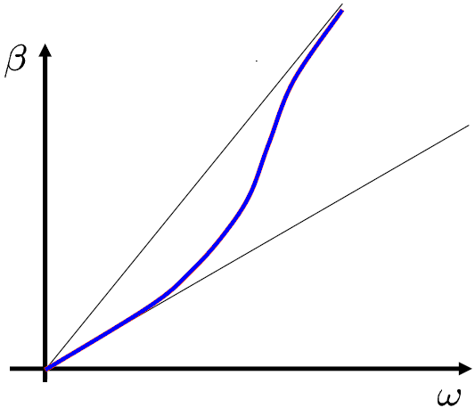
Group velocity in waveguides
Phase velocity v_{p}: traveling speed of any given phase of the wave
n_{core}ω/c₀
Low v_{g}
n_{clad}ω/c₀
Group velocity v_{g}: velocity of wave packets (information)
Group index
Effective index: spatial periodicity (phase)
  Waveguide effective index is always smaller than core index
Group index: information velocity (wave packet)
  In waveguides, group index can be greater than core index!

Slide 15
2-d confinement: effective index method (EIM)
Channel waveguide
Rib/ridge waveguide
Directly solving 2-d Helmholtz equation for U(x,y)
Deconvoluting the 2-d equation into two 1-d problems
  Separation of variables
  Solve for U’(x) & U”(y)
  U(x,y) ~ U’(x) U”(y)
Less accurate for high-index-contrast waveguide systems
n_{clad}
n_{clad}
n_{core}
n_{core}
n_{clad}
n_{clad}
n_{eff,core}
n_{clad}
n_{eff,clad}
n_{eff,core}
n_{eff,clad}
y
EIM mode solver:
http://www.computational-photonics.eu/eims.html
x
z

Slide 16
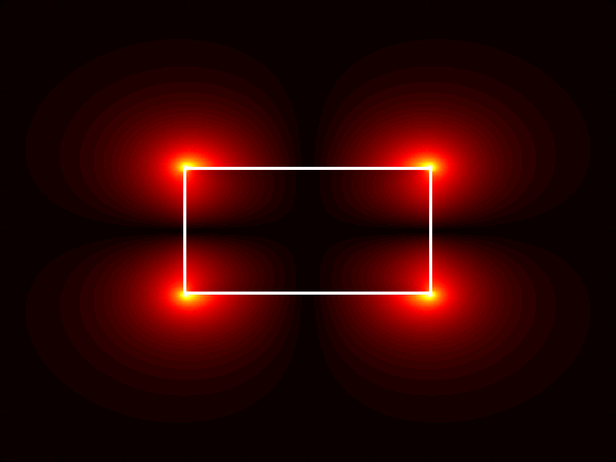
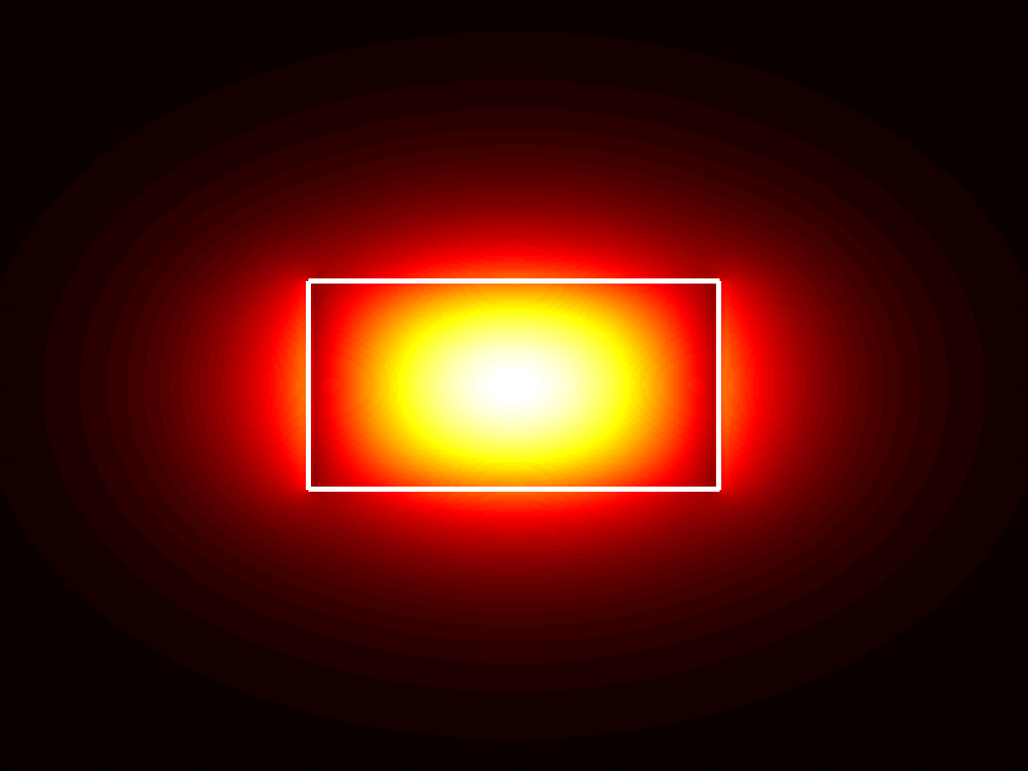
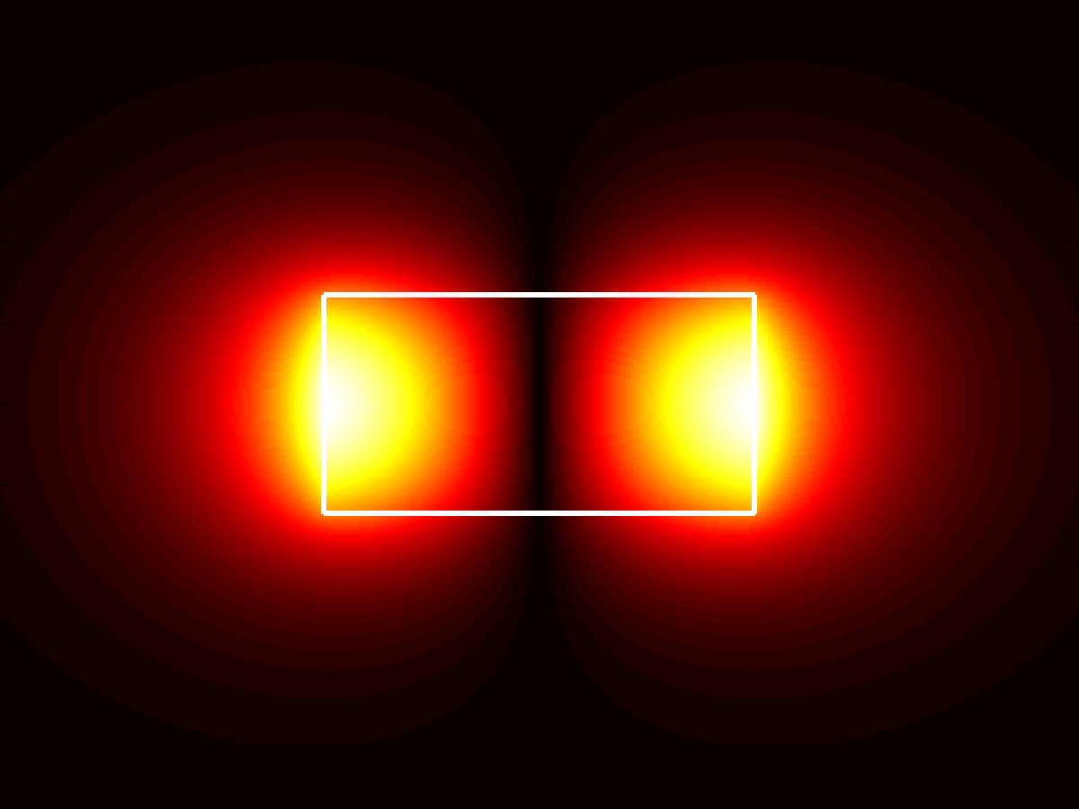
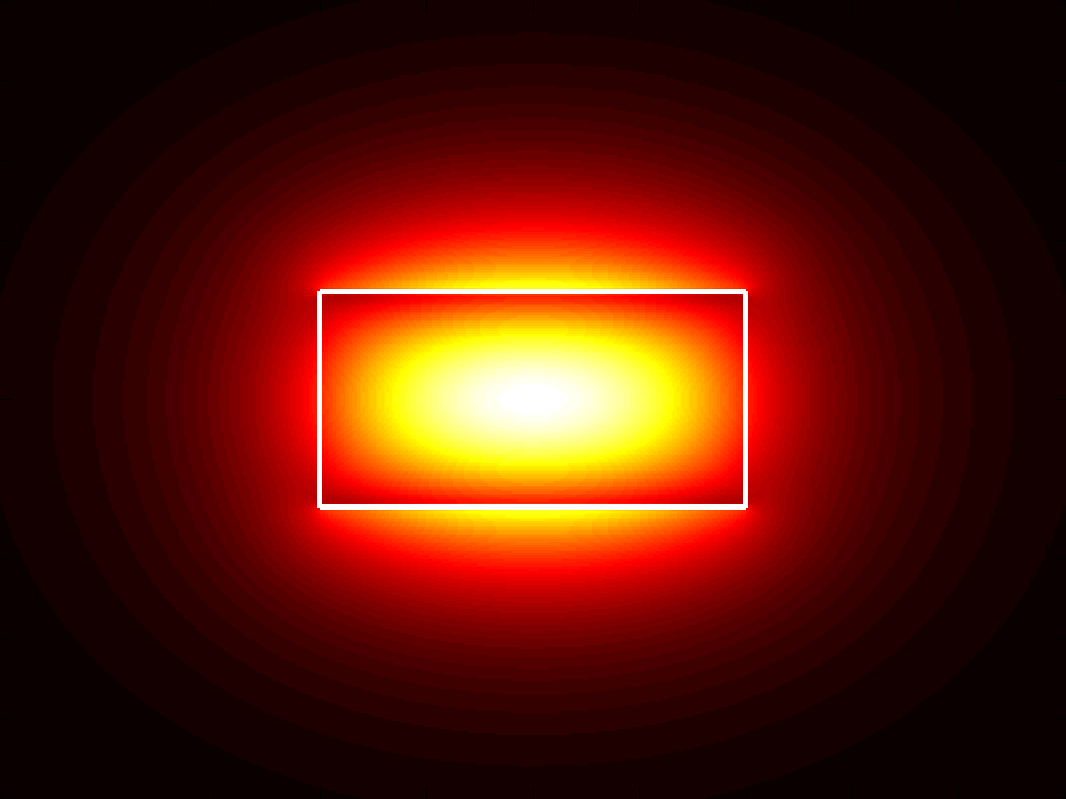
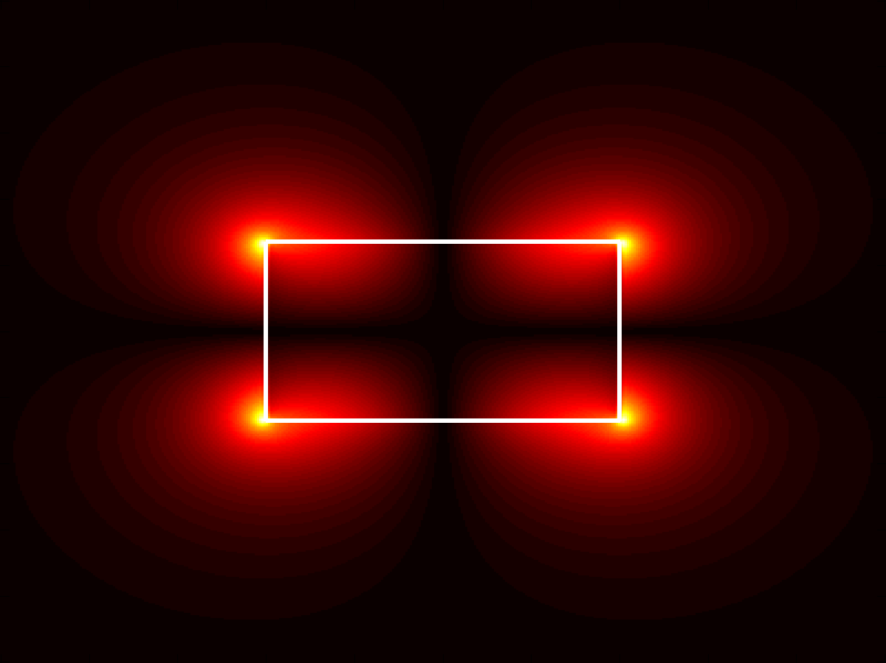
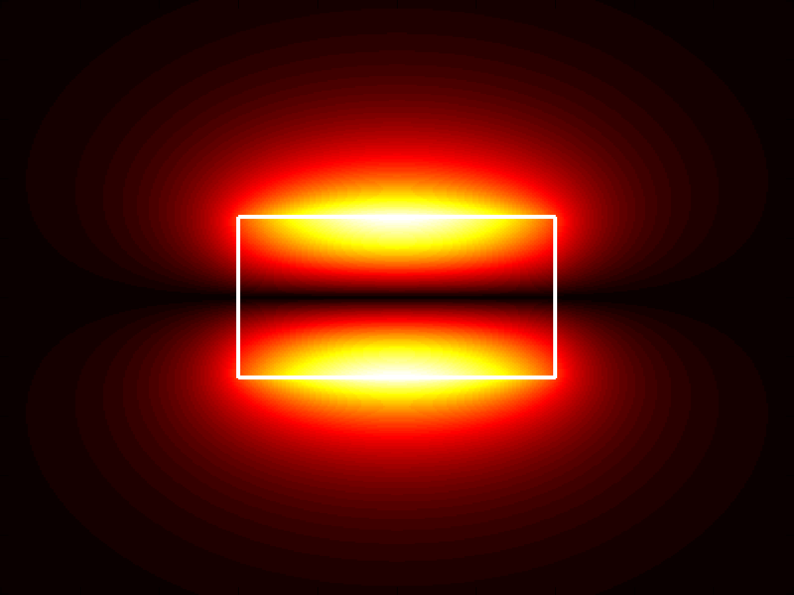
Guided modes in a channel waveguide
E_{x}
E_{y}
E_{z}
(Quasi-)TE
x
z
y
E_{x}
E_{y}
E_{z}
(Quasi-)TM
For channel waveguides, all six E/H field components are non-zero!

Slide 17
Guided modes in a channel waveguide
Each mode has different effective and group indices
Single-mode (only fundamental TE and TM modes are supported) waveguides are preferred in most applications
TE
TM
TE fundamental
TM fundamental
Fundamental
Fundamental
TM 2nd order
TE 2nd order
2nd order
2nd order
Notes:
Mode profiles at 1550 nm wavelength

Slide 18
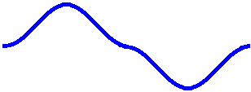



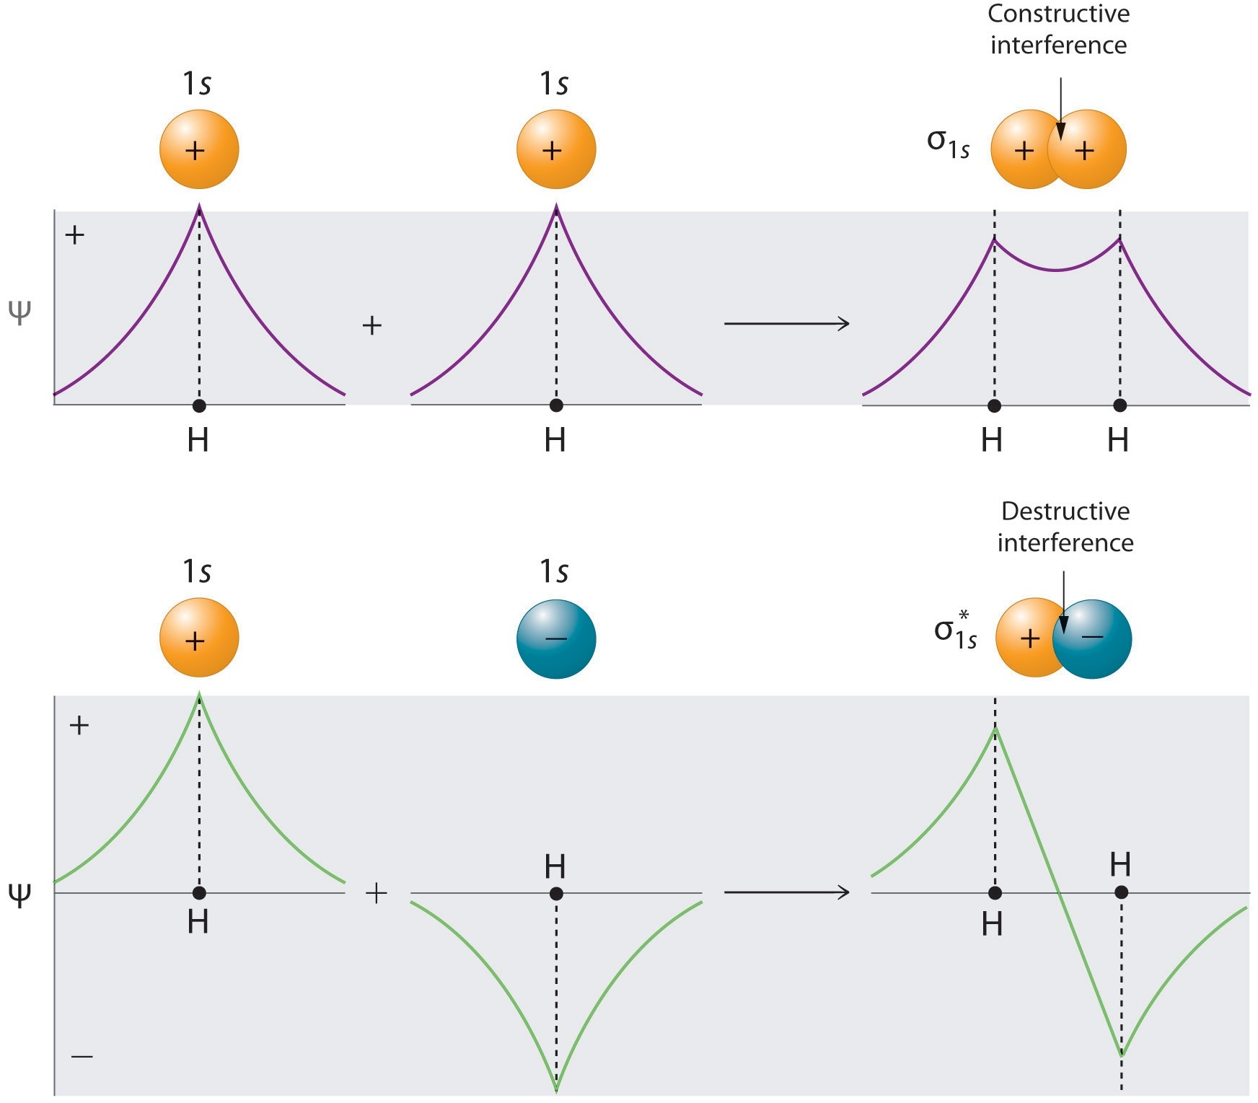
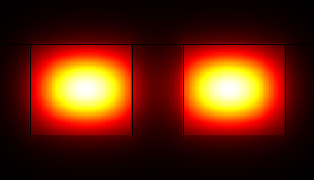
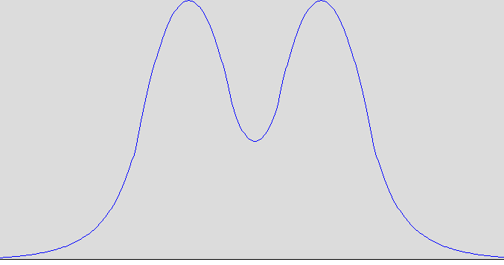
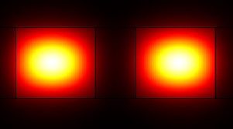
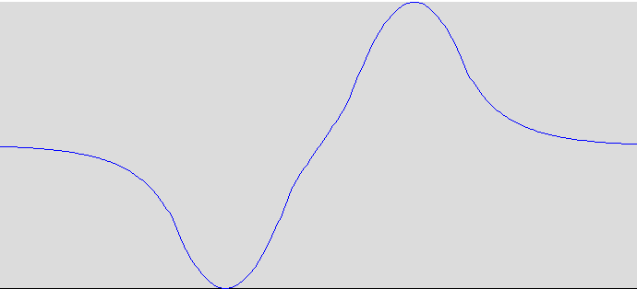
Coupled waveguides and supermodes
V
Anti-symmetric
x
WG 1
WG 2
Symmetric
z
y
Cladding
y
y
supermodes
Modal overlap!
n_{eff} + Δn
n_{eff} - Δn

Slide 19
Waveguide directional coupler
Output 1
Output 2
Field at input (z = 0)
Field at output z > 0
When
σ_{z}
Φ₊
Φ₋
σ₀
Input 1
Input 2

Slide 20
Waveguide directional coupler
Output 1
Output 2
Field at input (z = 0)
Field at output z > 0
When
σ_{z}
Φ₊
Φ₋
σ₀
Input 1
Input 2

Slide 21
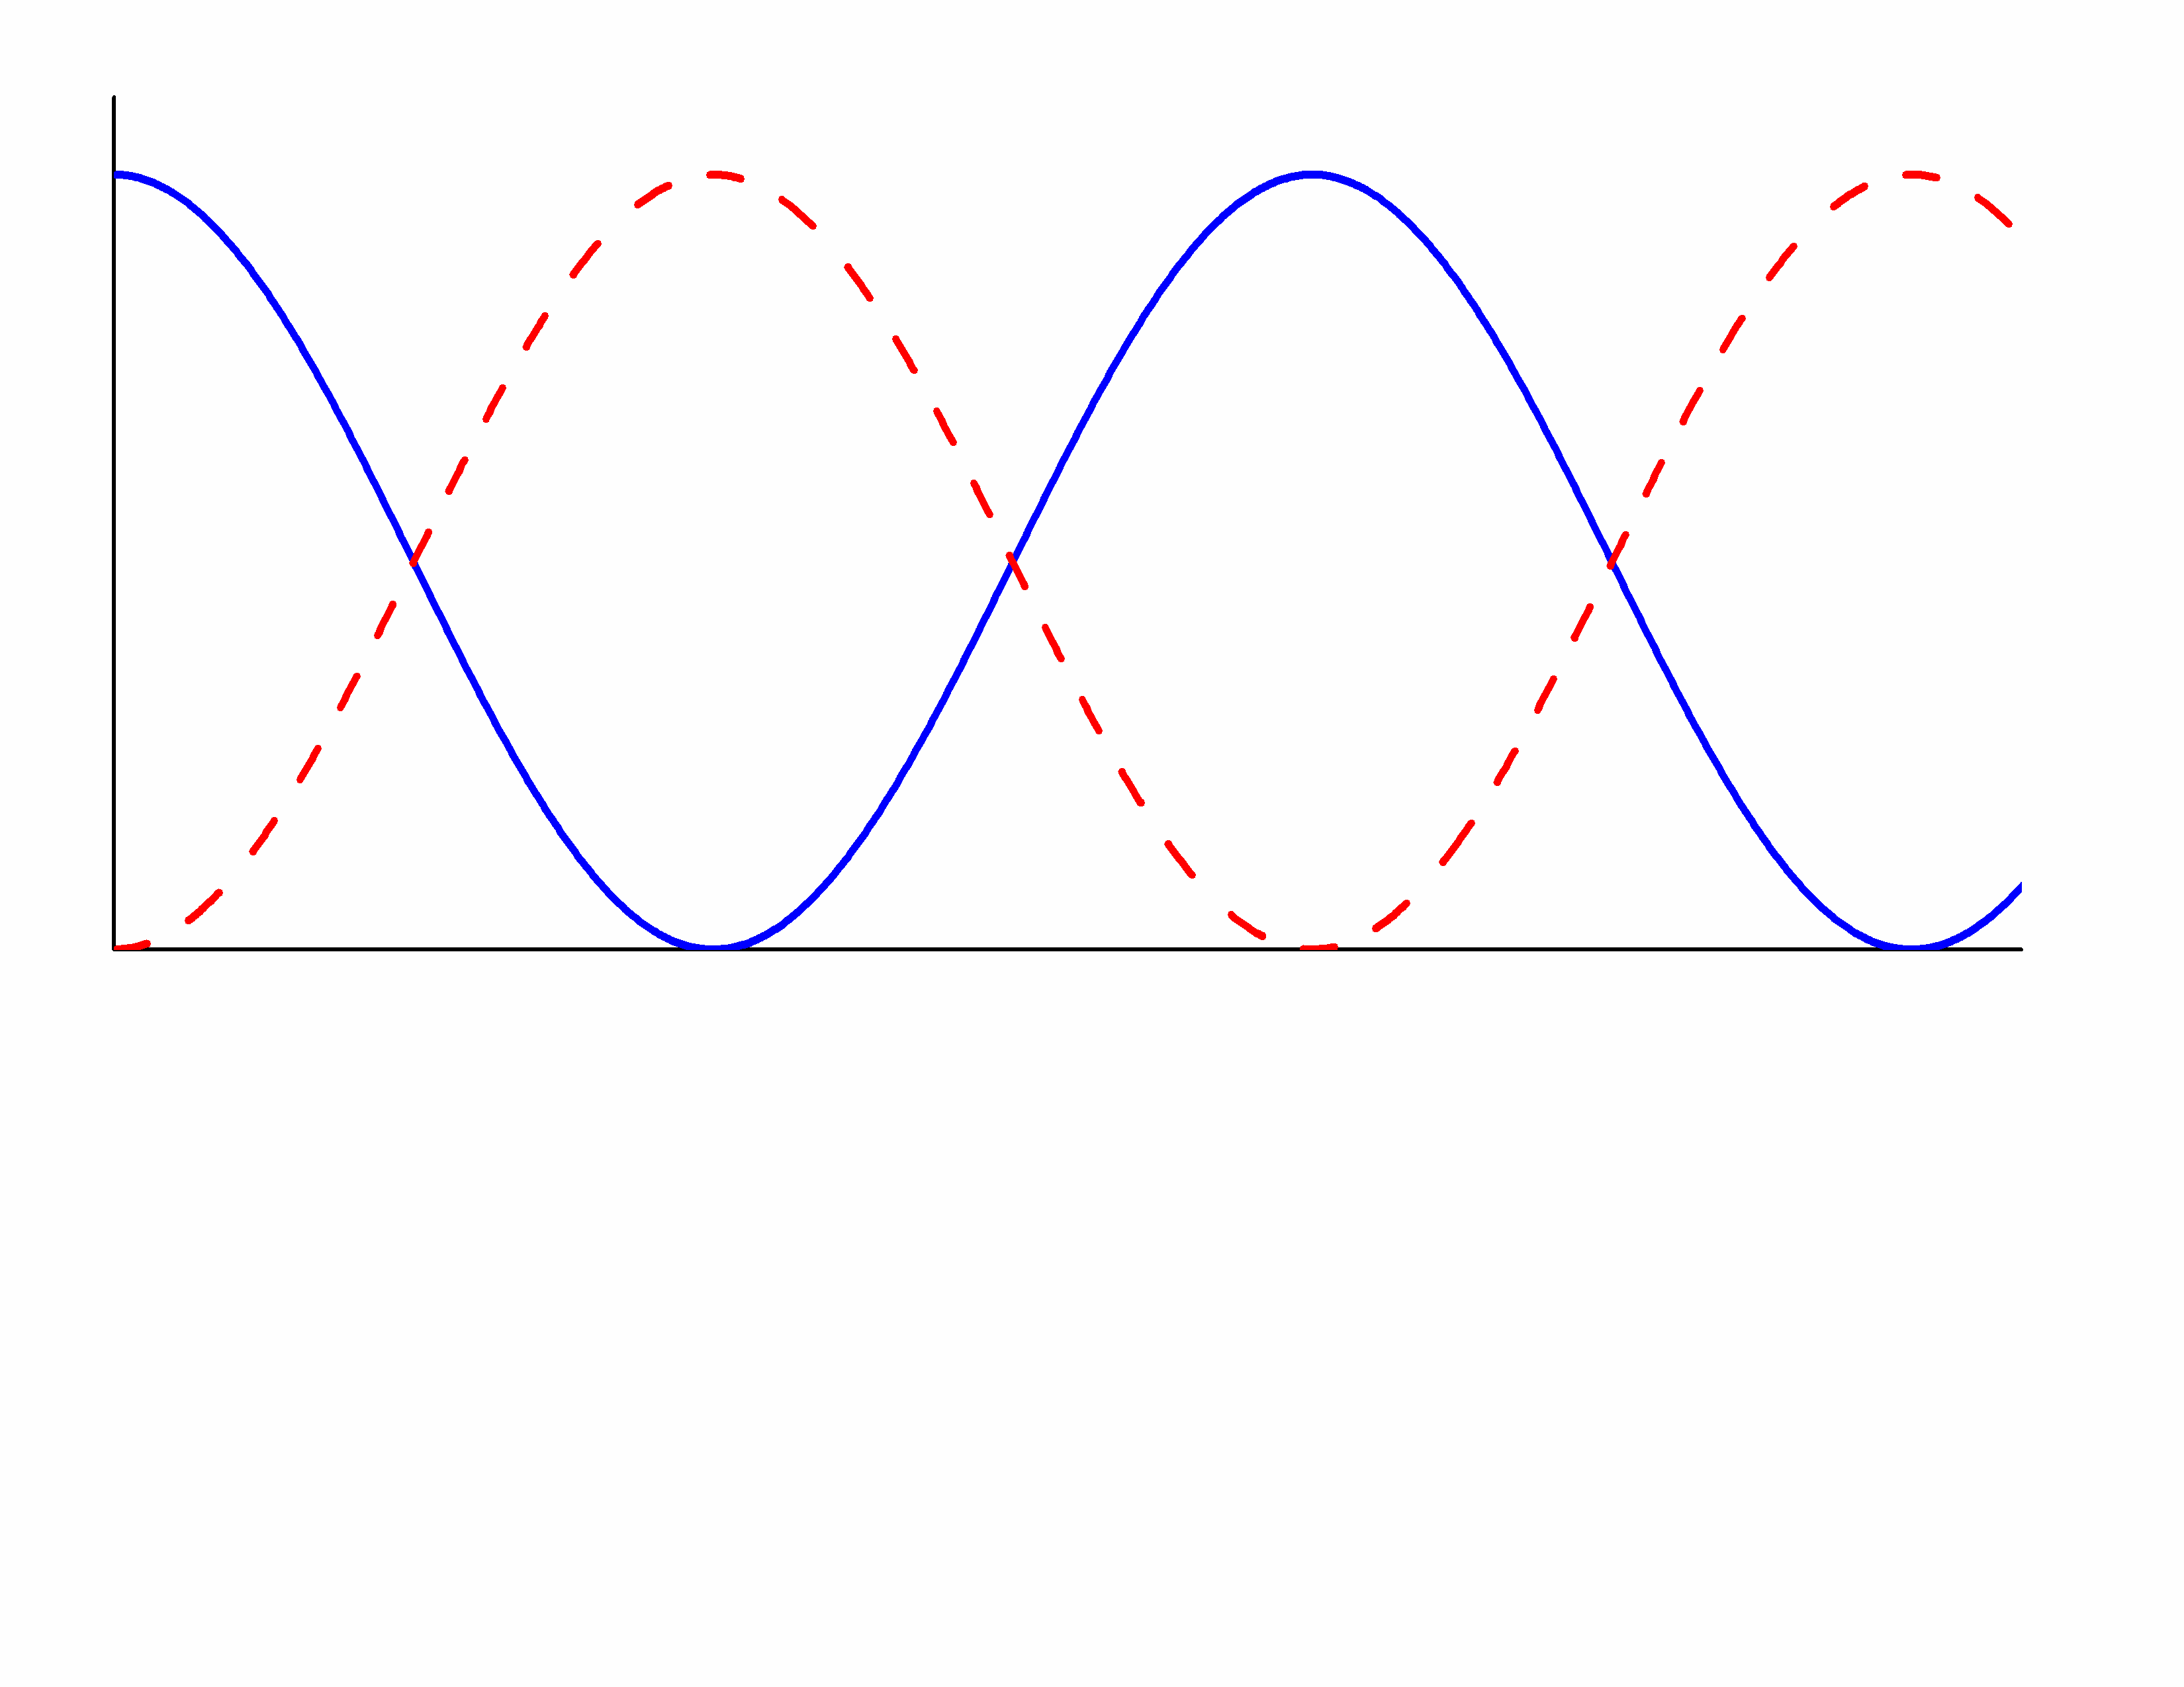
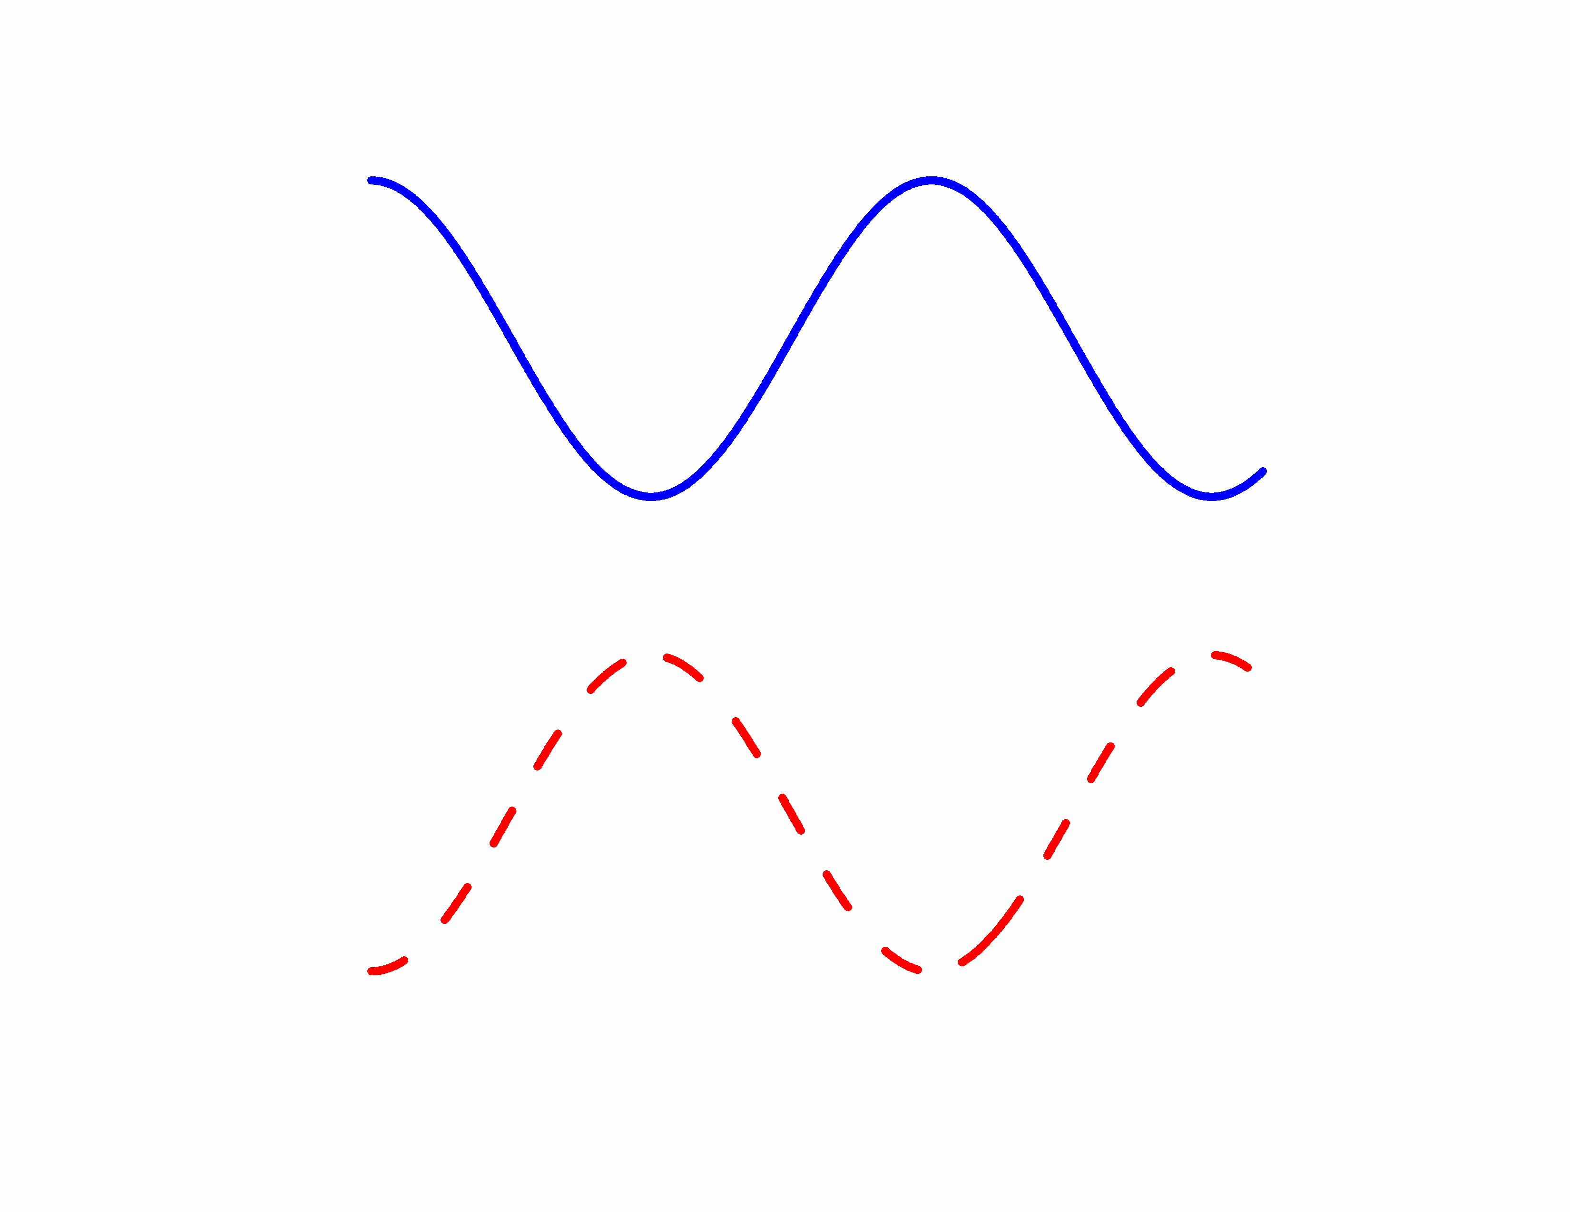
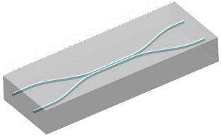
Waveguide directional coupler
Beating length
Symmetric coupler
Asymmetric waveguide directional coupler
Optical power
Optical power
Propagation distance
Propagation distance
3 dB direction coupler
WG 1
WG 2
Cladding

Slide 22
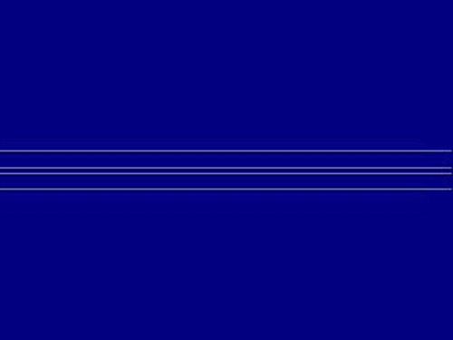

Beating in a directional coupler
Symmetric directional coupler
Asymmetric directional coupler

Slide 23
Optical loss in waveguides
Material attenuation
  Electronic absorption (band-to-band transition)
  Bond vibrational (phonon) absorption
  Impurity absorption
  Semiconductors: free carrier absorption (FCA)
  Glasses: Rayleigh scattering, Urbach band tail states
Roughness scattering
  Planar waveguides: line edge roughness due to imperfect lithography and pattern transfer
  Fibers: frozen-in surface capillary waves
Optical leakage (imperfect waveguiding)
  Bending loss
  Substrate leakage

Slide 24
Waveguide confinement factor
A waveguide consists of an absorptive core with an absorption coefficient α_{core} and an non-absorptive cladding. How do the mode profile evolve when it propagate along the guide?
core
cladding
E
Modal attenuation coefficient:
x
Propagation
Confinement factor:
E
Note that in general
?
J. Robinson, K. Preston, O. Painter, M. Lipson, "First-principle derivation of gain in high-index-contrast waveguides," Opt. Express 16, 16659 (2008).
x

Slide 25
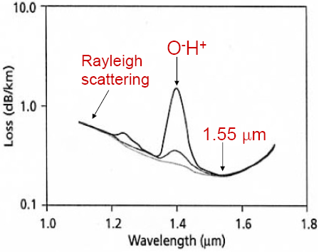
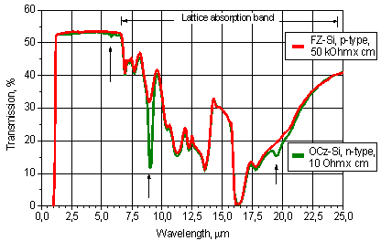
Absorption in silica (glass) and silicon (semiconductor)
Short wavelength edge: Rayleigh scattering (density fluctuation in glasses)
Long wavelength edge: Si-O bond phonon absorption
Other mechanisms: impurities, band tail states
Short wavelength edge: band-to-band transition
Long wavelength edge: Si-Si phonon absorption
Other mechanisms: FCA, oxygen impurities (the arrows below)

Slide 26
Roughness scattering
Origin of roughness:
  Planar waveguides: line edge roughness evolution in processing
    T. Barwicz and H. Smith, “Evolution of line-edge roughness during fabrication of high-index-contrast microphotonic devices,” J. Vac. Sci. Technol. B 21, 2892-2896 (2003).
  Fibers: frozen-in capillary waves due to energy equi-partition
    P. Roberts et al., “Ultimate low loss of hollow-core photonic crystal fibres,” Opt. Express 13, 236-244 (2005).
QM analogy: time-dependent perturbation
Modeling of scattering loss
  High-index-contrast waveguides suffer from high scattering loss
  F. Payne and J. Lacey, “A theoretical analysis of scattering loss from planar optical waveguides,” Opt. Quantum Electron. 26, 977 (1994).
  D. Kita, J. Michon, S. G. Johnson, and J. Hu, "Are slot and sub-wavelength grating waveguides better than strip waveguides for sensing?" Optica 5, 1046-1054 (2018).
where σ is the RMS roughness

Slide 27
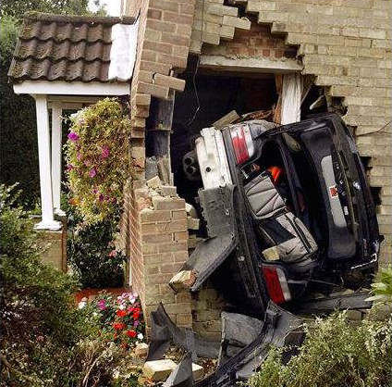

Optical leakage loss
n
x
Single-crystal
Silicon
n_{Si}
n_{SiO2}
Silicon oxide cladding
Silicon substrate
x
QM analogy
V
x
Tunneling!
Unfortunately quantum tunneling does not work for cars!

Slide 28
Waveguide bending loss
Radiative bending loss
  Guided modes in a bent waveguide are inherently lossy (leaky)
Junction loss
  Mismatch between modes of a straight and a bent waveguide sections
  Mitigation: use a bend design with smoothly changing curvature (e.g. Bezier curve, Euler spiral)
Radiative bending loss
Scattering loss at junctions
Example: Light Sci. Appl. 7, e17138 (2018)

Slide 29

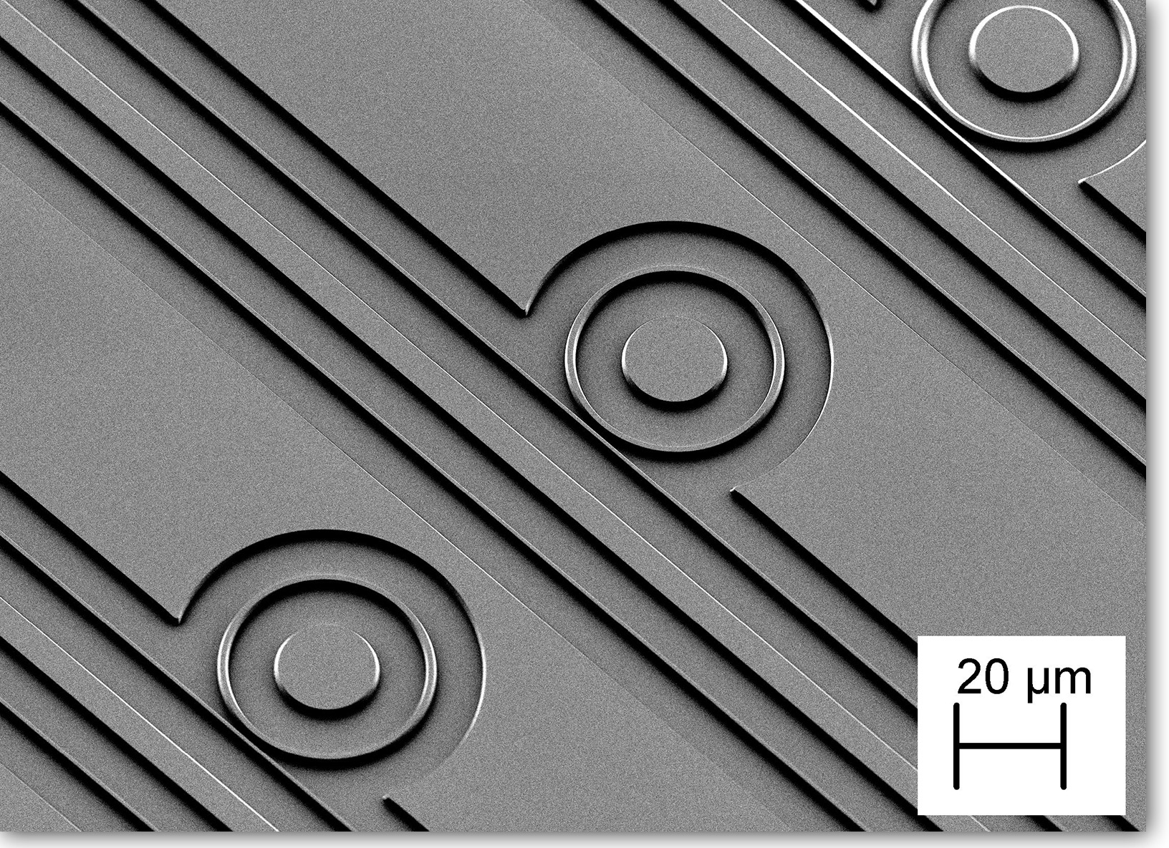
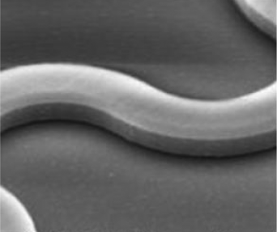
Waveguide bending loss
High index contrast (core-cladding index difference) enables small bending radius
5 mm
Doped silica (n ~ 1.5), bending radius ~ mm
50 μm
SiN_{x} (n ~ 2.0), bending radius ~ 20 μm
Si (n = 3.5), bending radius < 5 μm
Image from EPFL
1 μm
J. Lightwave Technol. 33, 3116 (2015)

Slide 30
Waveguide loss measurement
Cut-back
Camera imaging
Ring resonator
Fabry-Perot

Slide 31
Waveguide loss measurement
Cut-back
Camera imaging
Ring resonator
Fabry-Perot
Transmitted power (in dB)
Waveguide length

Slide 32
Waveguide loss measurement
Cut-back
Camera imaging
Ring resonator
Fabry-Perot
Transmitted power (in dB)
Waveguide length

Slide 33
Waveguide loss measurement
Cut-back
Camera imaging
Ring resonator
Fabry-Perot
Transmitted power (in dB)
Waveguide length

Slide 34
Waveguide loss measurement
Cut-back
Camera imaging
Ring resonator
Fabry-Perot
Transmitted power (in dB)
Intercept: coupling loss
Slope: propagation loss
Waveguide length

Slide 35
Waveguide loss measurement
Cut-back
Camera imaging
Ring resonator
Fabry-Perot
Sensitivity to facet quality
Waveguide “paperclips” for cutback measurement

Slide 36
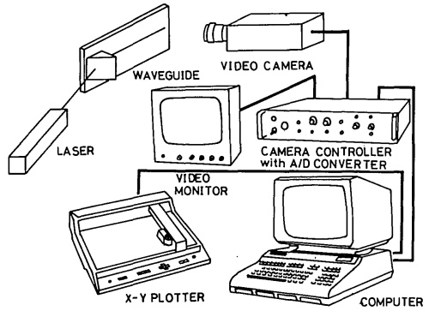
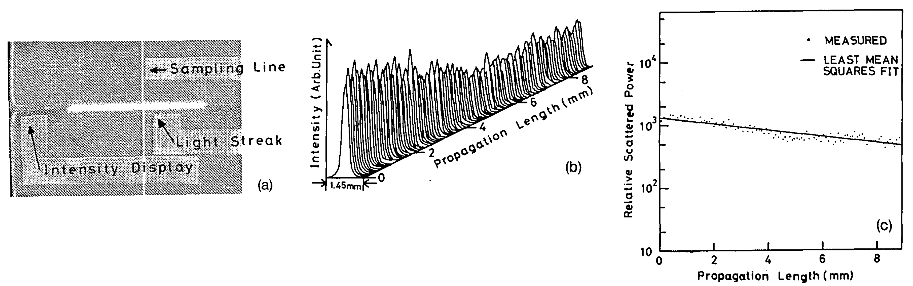
Waveguide loss measurement
Cut-back
Camera imaging
Ring resonator
Fabry-Perot
Appl. Opt. 22, 3892-3894 (1983)

Slide 37
Waveguide loss measurement
Cut-back
Camera imaging
Ring resonator
Fabry-Perot
Sensitivity to defects and surface quality
Appl. Opt. 22, 3892-3894 (1983)

Slide 38
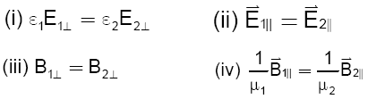
Boundary conditions
Guided wave optics
Quantum mechanics
Continuity of wave function
Continuity of the first order derivative of wave function
Polarization dependent!
Core
y
Cladding
x
Substrate
z
TE mode: E_{z} = 0 (slab), E_{x} >> E_{y} (channel)
TM mode: H_{z} = 0 (slab), E_{y} >> E_{x} (channel)

Slide 39
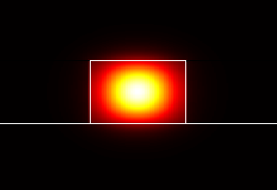
Boundary conditions
Guided wave optics
Polarization dependent!
TE mode profile
Core
y
Cladding
x
Substrate
z
TE mode: E_{z} = 0 (slab), E_{x} >> E_{y} (channel)
TM mode: H_{z} = 0 (slab), E_{y} >> E_{x} (channel)
Notes:
Unlike in slab waveguide modes, channel waveguide modes have all six non-vanishing field components

Slide 40
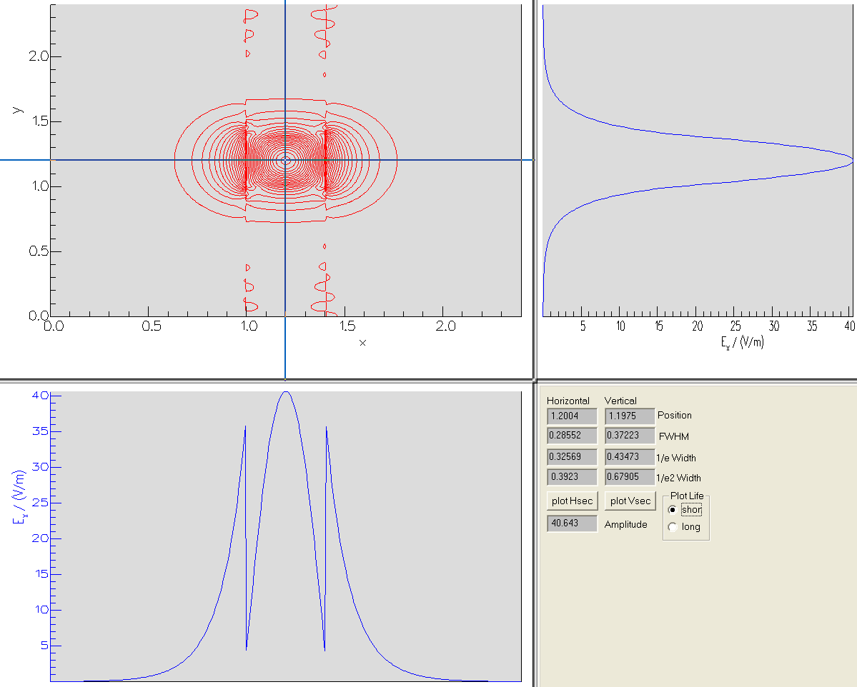
E_{x} amplitude of TE mode
y
y
x
z
x
Discontinuity of field due to boundary condition!

Slide 41
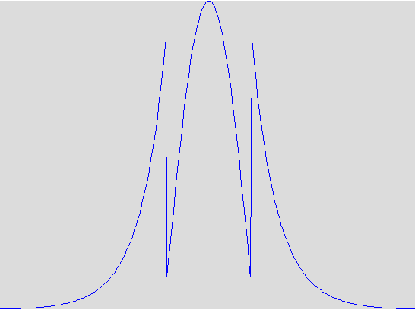
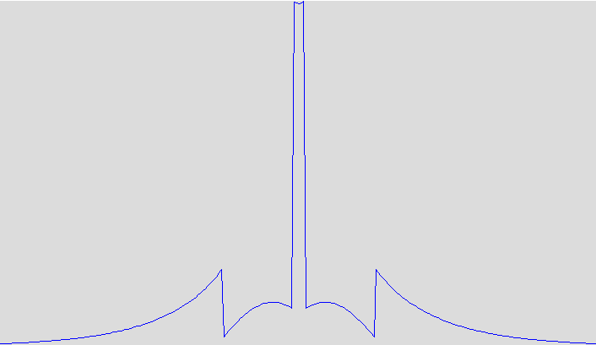
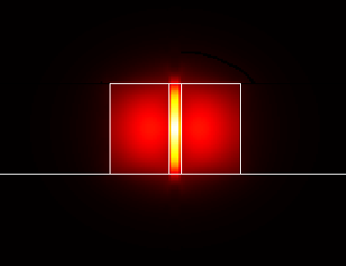
Slot waveguides
Field concentration in low index material
y
slot
Use low index material for:
Light emission
Light modulation
Plasmonic waveguiding
x
z
Cladding
Substrate
V. Almeida et al., “Guiding and confining light in void nanostructure,” Opt. Lett. 29, 1209-1211 (2004).
TE mode profile

Slide 42

Resources: VM-Lab Simulations
Waveguide mode 1: fields
Waveguide mode 2: waveguide geometry
Directional coupler

Slide 43
List of symbols
E – electric field or particle energy depending on context
n – refractive index
c₀ – speed of light in vacuum (2.99792458 × 10⁸ m/s)
t – time
β – propagation constant
ω – angular frequency
λ – wavelength of light
k₀ – wave number in free space
n_{eff} – waveguide effective index
V – potential energy

Slide 44
List of symbols
m – mass
ћ – reduced Planck constant (1.055 × 10⁻³⁴ J·s)
n_{core} / n_{clad} – refractive index of waveguide core / cladding
n_{g} – waveguide group index
v_{g} – group velocity
v_{p} – phase velocity
α_{core} / α_{wg} / α_{wg,s} – loss coefficient of core material / waveguide / waveguide due to scattering loss
Γ_{core} / Γ_{clad} – confinement factor in core / cladding
ε₀ – vacuum permittivity (8.854 × 10⁻¹² C/Vm)
H – magnetic field

